Slide 1
Isaiah 35:4-6
“Behold, your God will come . . . and save you.” Then the eyes of the blind shall be opened, and the ears of the deaf unstopped; then shall the lame man leap like a deer, and the tongue of the mute sing for joy. For waters break forth in the wilderness, and streams in the desert …”

Slide 2
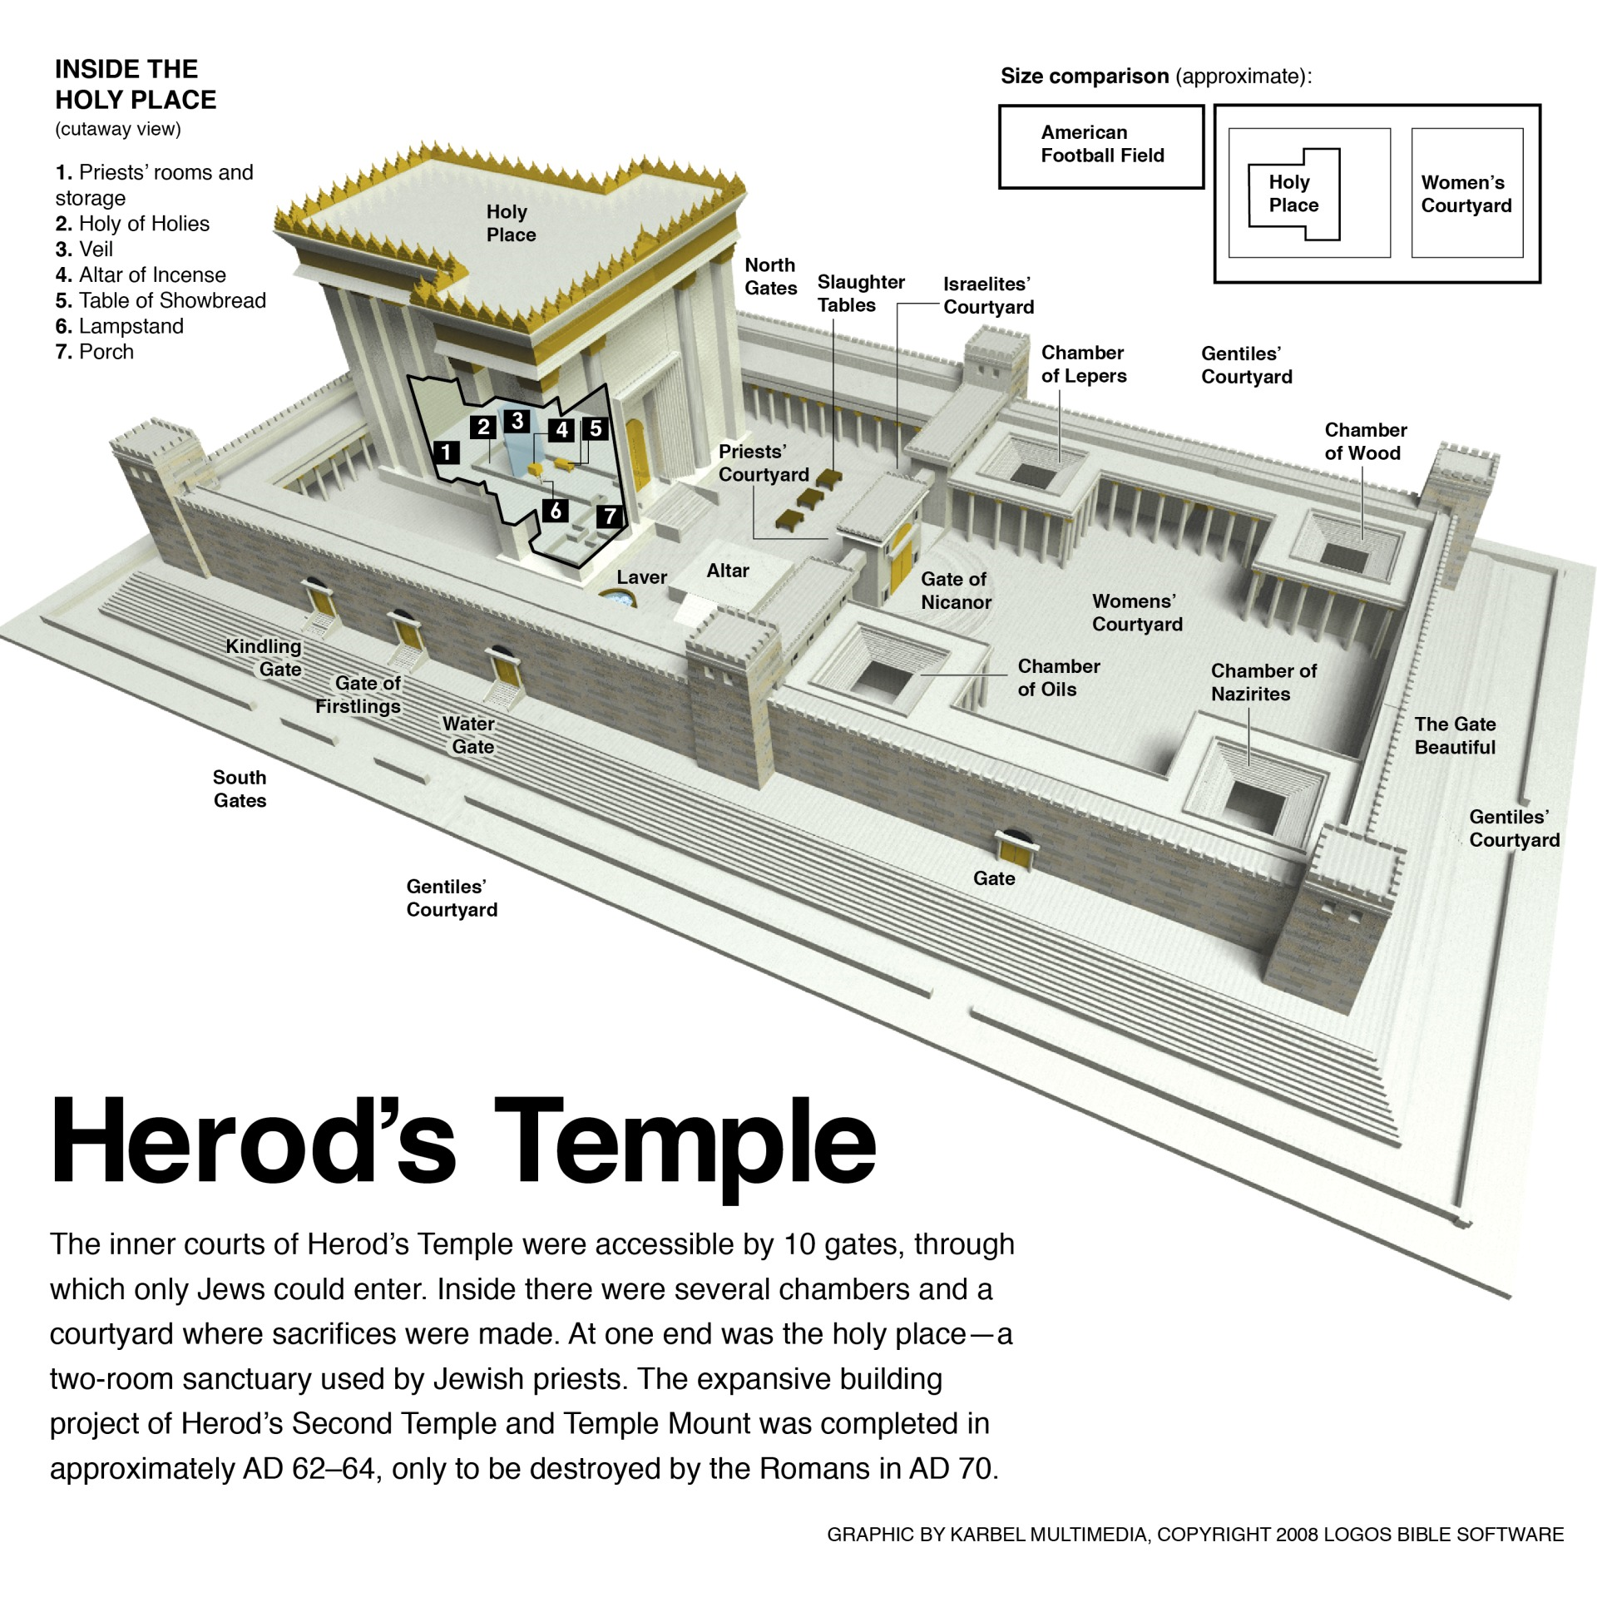

Slide 3
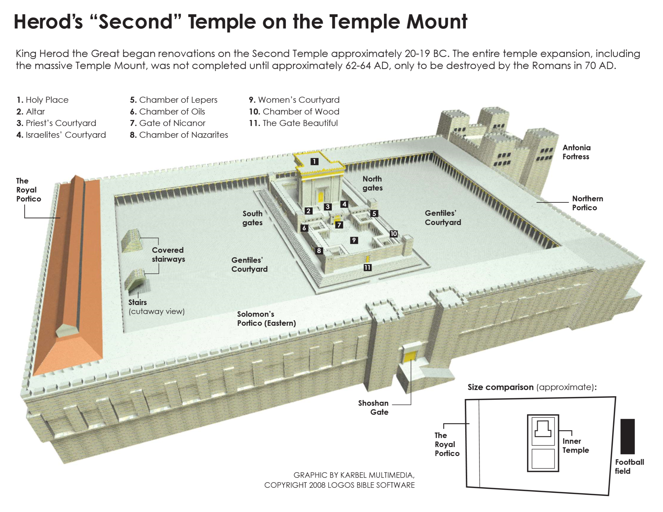

Slide 4
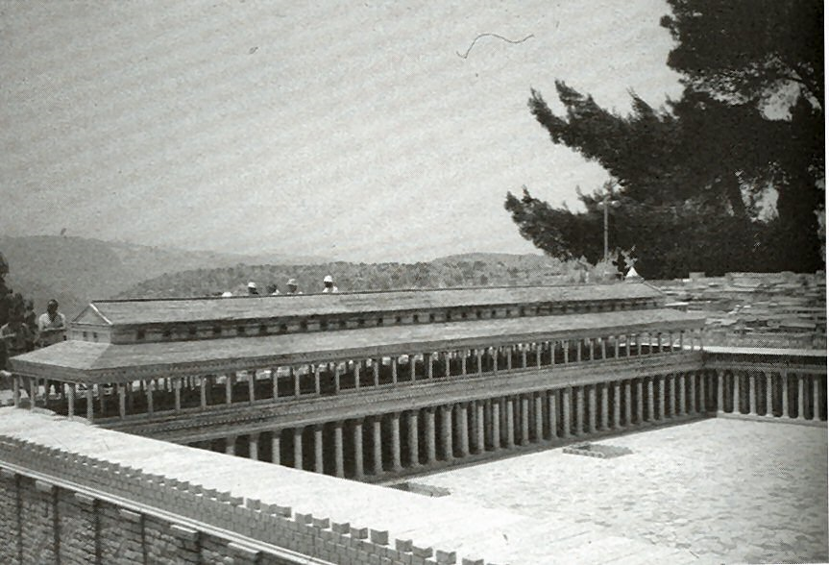

Slide 5
Isaiah 49:7
Thus says the Lord, the Redeemer of Israel and his Holy One, to one deeply despised, abhorred by the nation, the servant of rulers: “Kings shall see and arise; princes, and they shall prostrate themselves; because of the Lord, who is faithful, the Holy One of Israel, who has chosen you.”

Slide 6
Isaiah 53:11
Out of the anguish of his soul he shall see and be satisfied; by his knowledge shall the righteous one, my servant, make many to be accounted righteous, and he shall bear their iniquities.

Slide 7
Colossians 1:16-17
“For by him all things were created, in heaven and on earth, visible and invisible, whether thrones or dominions or rulers or authorities—all things were created through him and for him. And he is before all things, and in him all things hold together.”

Slide 8
1 John 5:11-12
“And this is the testimony, that God gave us eternal life, and this life is in his Son. Whoever has the Son has life; whoever does not have the Son of God does not have life.”

