Slide 1
When witnessing for Jesus amidst opposition:
1. Know that some will vehemently reject Jesus and take it out on you.

Slide 2
1. Know that some will vehemently reject Jesus and take it out on you
Acts 17:5 (ESV)
“But the Jews were jealous, and taking some wicked men of the rabble, they formed a mob, set the city in an uproar, and attacked the house of Jason, seeking to bring them out to the crowd.”
Attacked (Acts 17:5)= same word in Greek as “came upon” (Acts 4:1)

Slide 3
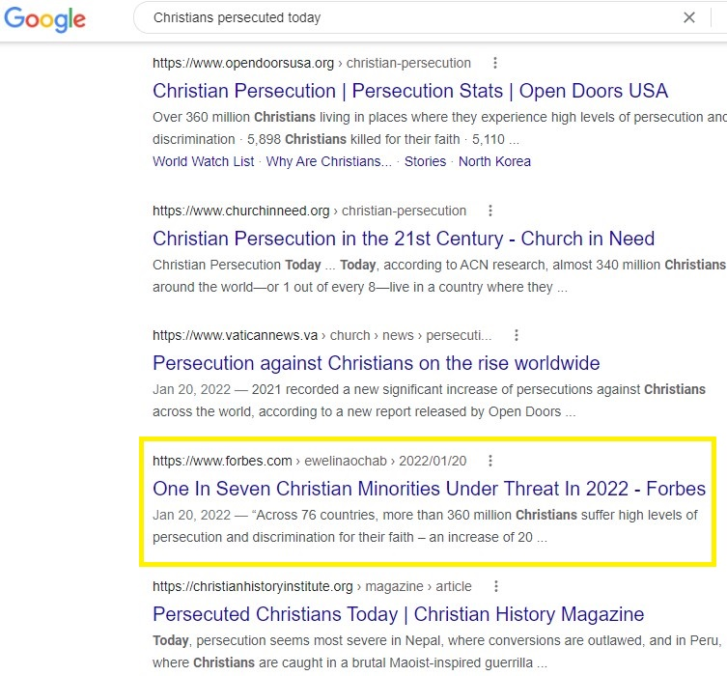

Slide 4
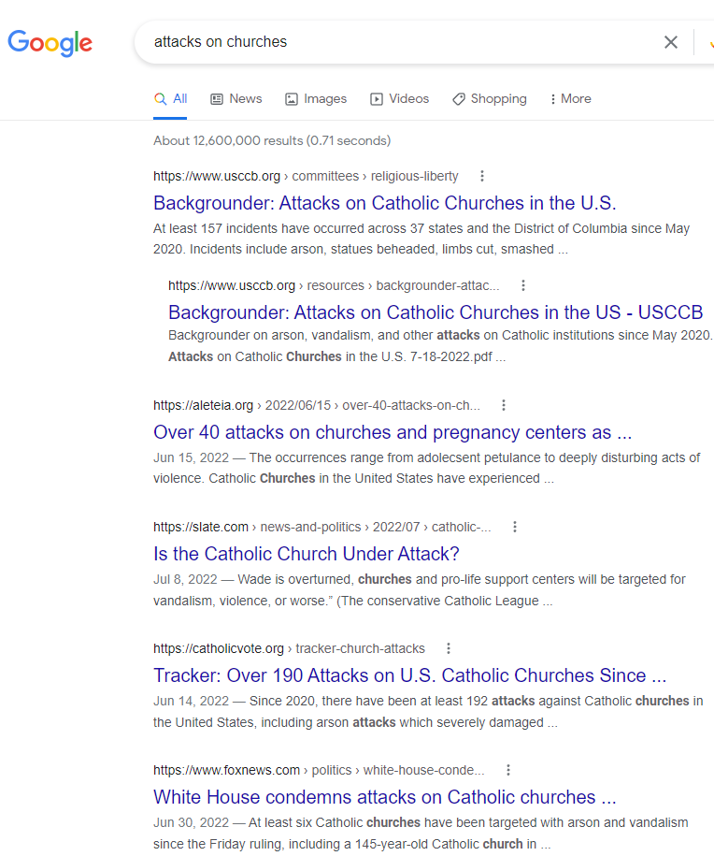

Slide 5
1. Know that some will vehemently reject Jesus and take it out on you
Luke 1:8-9 (ESV)
Verse 8: “Now while he was serving as priest before God when his division was on duty,
Verse 9: according to the custom of the priesthood, he was chosen by lot to enter the temple of the Lord and burn incense.”

Slide 6
1. Know that some will vehemently reject Jesus and take it out on you
“There came to him some Sadducees, those who deny that there is a resurrection” – Luke 20:27 (ESV)
For the Sadducees say that there is no resurrection, nor angel, nor spirit, but the Pharisees acknowledge them all. – Acts 23:8 (ESV)

Slide 7
1. Know that some will vehemently reject Jesus and take it out on you
John 15:20-23 (ESV)
“Remember the word that I said to you: ‘A servant is not greater than his master.’ If they persecuted me, they will also persecute you. If they kept my word, they will also keep yours. But all these things they will do to you on account of my name, because they do not know him who sent me. If I had not come and spoken to them, they would not have been guilty of sin, but now they have no excuse for their sin. Whoever hates me hates my Father also.”

Slide 8
When witnessing for Jesus amidst opposition:
Know that some will vehemently reject Jesus and take it out on you.
2. Know that others will accept Jesus and will be for you!

Slide 9
2. Know that others will accept Jesus and will be for you!
5000 total / 2000 “men” (aner) added!
“But some men joined him and believed, among whom also were Dionysius the Areopagite and a woman named Damaris and others with them.” – Acts 17:34 (ESV)

Slide 10
When witnessing for Jesus amidst opposition:
Know that some will vehemently reject Jesus and take it out on you.
2. Know that others will accept Jesus and will be for you!
3. Be ready to give a defense.

Slide 11
3. Be ready to give a defense
Sanhedrin
71 Members total
Numbers 11:16: Then the Lord said to Moses, “Gather for me seventy men of the elders of Israel, whom you know to be the elders of the people and officers over them, and bring them to the tent of meeting, and let them take their stand there with you.
1 High Priest, 24 priest, 24 elders, 22 scribes

Slide 12
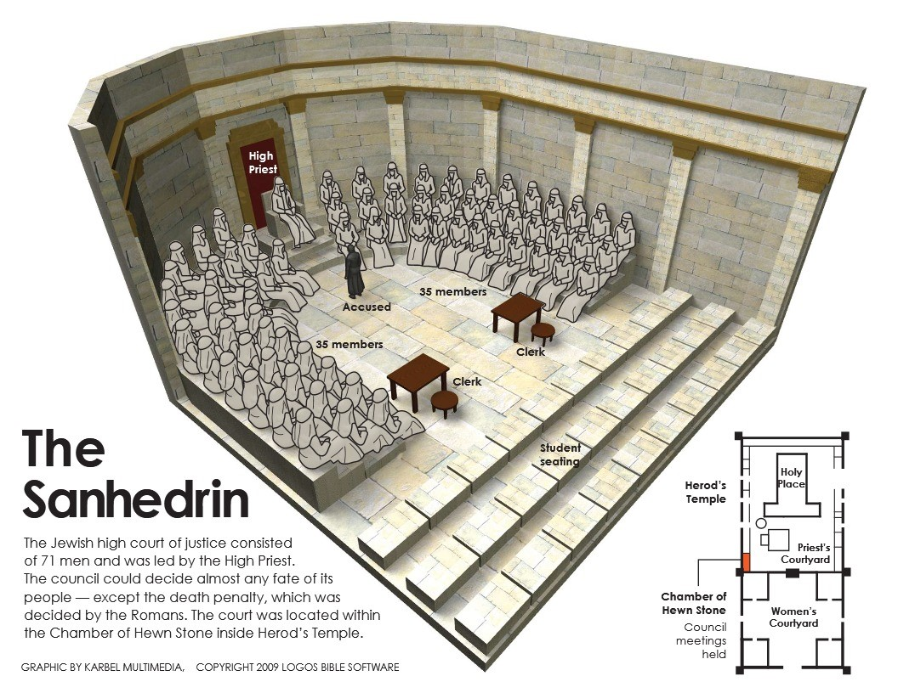
3. Be ready to give a defense

Slide 13

3. Be ready to give a defense

Slide 14
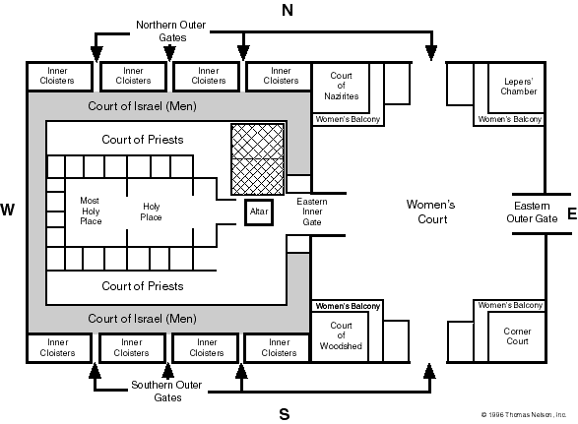
3. Be ready to give a defense

Slide 15
3. Be ready to give a defense

Slide 16
When witnessing for Jesus amidst opposition:
Know that some will vehemently reject Jesus and take it out on you.
2. Know that others will accept Jesus and will be for you!
3. Be ready to give a defense.
4. Be filled with the Holy Spirit.

Slide 17
Be filled with the Holy Spirit
“Now Peter was sitting outside in the courtyard. And a servant girl came up to him and said, “You also were with Jesus the Galilean.” But he denied it before them all, saying, “I do not know what you mean.” And when he went out to the entrance, another servant girl saw him, and she said to the bystanders, “This man was with Jesus of Nazareth.” And again he denied it with an oath: “I do not know the man.” After a little while the bystanders came up and said to Peter, “Certainly you too are one of them, for your accent betrays you.” Then he began to invoke a curse on himself and to swear, “I do not know the man.” And immediately the rooster crowed.” – Matthew 26:69-74 (ESV)

Slide 18
Be filled with the Holy Spirit
“Then Peter, filled with the Holy Spirit,”
Filled = aorist, passive, participle
Filled = was being filled
“Then Peter was being filled with the Holy Spirit”

Slide 19
Be filled with the Holy Spirit
Luke 12:11-12 (ESV)
11: “And when they bring you before the synagogues and the rulers and the authorities, do not be anxious about how you should defend yourself or what you should say,”
12: “for the Holy Spirit will teach you in that very hour what you ought to say.”

Slide 20
When witnessing for Jesus amidst opposition:
Know that some will vehemently reject Jesus and take it out on you.
2. Know that others will accept Jesus and will be for you!
3. Be ready to give a defense.
4. Be filled with the Holy Spirit
5. Be respectful.

Slide 21
When witnessing for Jesus amidst opposition:
Know that some will vehemently reject Jesus and take it out on you.
2. Know that others will accept Jesus and will be for you!
3. Be ready to give a defense.
4. Be filled with the Holy Spirit.
5. Be respectful.
6. Find common ground with God’s common grace. (Be gentle)

Slide 22
When witnessing for Jesus amidst opposition:
Know that some will vehemently reject Jesus and take it out on you.
2. Know that others will accept Jesus and will be for you!
3. Be ready to give a defense.
4. Be filled with the Holy Spirit.
5. Be respectful.
6. Find common ground with God’s common grace. (Be gentle)
7. Share the whole truth, even the “offensive” parts.

Slide 23
Share the whole truth, even the ‘offensive’ parts
Psalm 118:22 (ESV)
“The stone that the builders rejected, has become the cornerstone¹.”
¹ or, head of the corner

Slide 24
When witnessing for Jesus amidst opposition:
1. Know that some will vehemently reject Jesus and take it out on you.
2. Know that others will accept Jesus and will be for you!
3. Be ready to give a defense.
4. Be filled with the Holy Spirit.
5. Be respectful.
6. Find common ground with God’s common grace. (Be gentle)
7. Share the whole truth, even the “offensive” parts.

