Slide 2
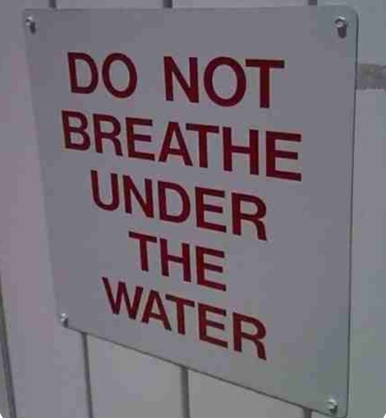
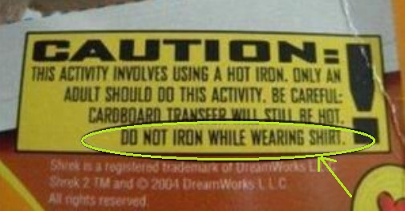

Slide 3
Matthew 14:24b-31 (ESV)
When evening came, he was there alone, but the boat by this time was a long way from the land, beaten by the waves, for the wind was against them. And in the fourth watch of the night he came to them, walking on the sea. But when the disciples saw him walking on the sea, they were terrified, and said, “It is a ghost!” and they cried out in fear. But immediately Jesus spoke to them, saying, “Take heart; it is I. Do not be afraid.” And Peter answered him, “Lord, if it is you, command me to come to you on the water.” He said, “Come.” So Peter got out of the boat and walked on the water and came to Jesus. But when he saw the wind, he was afraid, and beginning to sink he cried out, “Lord, save me.” Jesus immediately reached out his hand and took hold of him, saying to him, “O you of little faith, why did you doubt?”

Slide 4
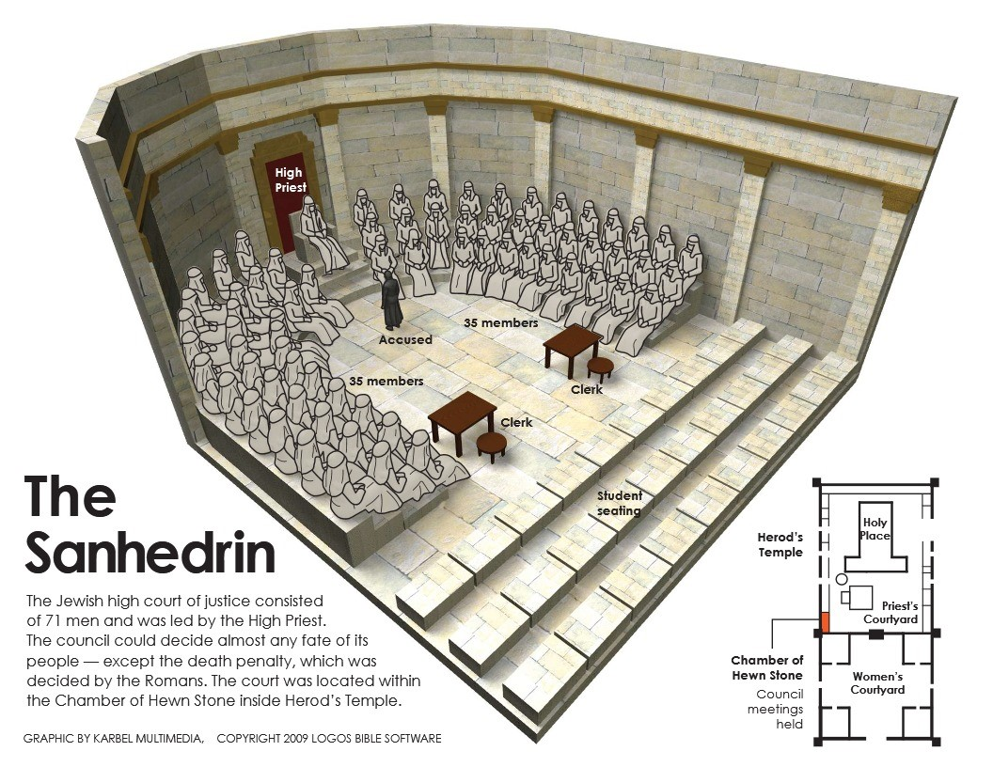
Three Reasons to continue courageously as you witness for Christ
1. Take courage because boldness does not come from you, but from Christ in you. (Acts 4:13)
a. The boldness of Peter and John = complete freedom and confidence to speak God’s word.

Slide 5
Three Reasons to continue courageously as you witness for Christ
1. Take courage because boldness does not come from you, but from Christ in you. (Acts 4:13)
a. The boldness of Peter and John = complete freedom and confidence in speaking God’s word
b. The boldness of Peter and John was not due to their ability or education. They were unlettered laymen.

Slide 6
Three Reasons to continue courageously as you witness for Christ
1. Take courage because boldness does not come from you, but from Christ in you. (Acts 4:13)
a. The boldness of Peter and John = complete freedom and confidence in speaking God’s word
b. The boldness of Peter and John was not due to their ability or education. They were unlettered laymen
c. You can be bold because you have the same words and the same Spirit!
“But you have been anointed by the Holy One, and you all have knowledge.” – 1 Jn 2:20 (ESV)
“But the anointing that you received from him abides in you ... and as his anointing teaches you … abide in him.” – 1 Jn 2:27 (ESV)

Slide 7
Three Reasons to continue courageously as you witness for Christ
1. Take courage because boldness does not come from you, but from Christ in you. (v.13)
2. Take courage because your oppressors only have empty threats in light of Jesus’s truth. (vv. 14-18)
a. Peter and John are boldly speaking but the powerful court is left speech-LESS. They had “nothing to say in opposition.”

Slide 8
Three Reasons to continue courageously as you witness for Christ
1. Take courage because boldness does not come from you, but from Christ in you. (v.13)
2. Take courage because your oppressors only have empty threats in light of Jesus’s truth. (vv. 14-18)
a. Peter and John are boldly speaking but the powerful court is left speech-LESS. They had “nothing to say in opposition.”
b. The court asks, “what shall we do with these men?,” but should have simply asked, “what shall we do?” (c.f. Acts 2:27)

Slide 9
Three Reasons to continue courageously as you witness for Christ
1. Take courage because boldness does not come from you, but from Christ in you. (v.13)
2. Take courage because your oppressors only have empty threats in light of Jesus’s truth. (vv. 14-18)
a. Peter and John are boldly speaking but the powerful court is left speech-LESS. They had “nothing to say in opposition.”
b. The court asks, “what shall we do with these men?,” but should have simply asked, “what shall we do?” (c.f. Acts 2:27)
c. Not once is it refuted that Christ was, in fact, raised from the dead. The tomb was empty!

Slide 10
Three Reasons to continue courageously as you witness for Christ
1. Take courage because boldness does not come from you, but from Christ in you. (v.13)
2. Take courage because your oppressors only have empty threats in light of Jesus’s truth. (vv. 14-18)
a. Peter and John are boldly speaking but the powerful court is left speech-LESS. They had “nothing to say in opposition.”
b. The court asks, “what shall we do with these men?,” but should have simply asked, “what shall we do?” (c.f. Acts 2:27)
c. Not once is it refuted that Christ was, in fact, raised from the dead. The tomb was empty!
d. Although the miracle left them speechless, it was the message they wanted silenced, but these 2 are inseparable.

Slide 11
Three Reasons to continue courageously as you witness for Christ
1. Take courage because boldness does not come from you, but from Christ in you. (v.13)
2. Take courage because your oppressors only have empty threats in light of Jesus’s truth. (vv. 14-18)
a. Peter and John are boldly speaking but the powerful court is left speech-LESS. They had “nothing to say in opposition.”
b. The court asks, “what shall we do with these men?,” but should have simply asked, “what shall we do?” (c.f. Acts 2:27)
c. Not once is it refuted that Christ was, in fact, raised from the dead. The tomb was empty!
d. Although the miracle left them speechless, it was the message they wanted silenced, but these 2 are inseparable.
e. They cannot refute the truth, so they resort to threats. (warn = “to prohibit under threat.”)

Slide 12
Three Reasons to continue courageously as you witness for Christ
1. Take courage because boldness does not come from you, but from Christ in you. (v.13)
2. Take courage because your oppressors only have empty threats in light of Jesus’s truth. (vv. 14-18)
a. Peter and John are boldly speaking but the powerful court is left speech-LESS. They had “nothing to say in opposition.”
b. The court asks, “what shall we do with these men?,” but should have simply asked, “what shall we do?” (c.f. Acts 2:27)
c. Not once is it refuted that Christ was, in fact, raised from the dead. The tomb was empty!
d. Although the miracle left them speechless, it was the message they wanted silenced, but these 2 are inseparable.
e. They cannot refute the truth, so they resort to threats. (warn = “to prohibit under threat.”)
f. The threats were real but empty considering the truth about Jesus.
“Why do the nations rage and the peoples plot in vain? The kings of the earth set themselves, and the rulers take counsel together, against the Lord and against his Anointed … He who sits in the heavens laughs; the Lord holds them in derision. Then he will speak to them in his wrath, and terrify them in his fury, saying, ‘As for me, I have set my King on Zion, my holy hill.’”
– Ps 2:1-6 (ESV)

Slide 13
Three Reasons to continue courageously as you witness for Christ
1. Take courage because boldness does not come from you, but from Christ in you. (v.13)
2. Take courage because your oppressors only have empty threats in light of Jesus’s truth. (vv. 14-18)
“But before all this they will lay their hands on you and persecute you, delivering you up to the synagogues and prisons, and you will be brought before kings and governors for my name’s sake. This will be your opportunity to bear witness. Settle it therefore in your minds not to meditate beforehand how to answer, for I will give you a mouth and wisdom, which none of your adversaries will be able to withstand or contradict. You will be delivered up even by parents and brothers and relatives and friends, and some of you they will put to death. You will be hated by all for my name’s sake. But not a hair of your head will perish. By your endurance you will gain your lives.” – Luke 21:12-19 (ESV)
“do not fear those who kill the body but cannot kill the soul. Rather fear him who can destroy both soul and body in hell.”
– Matthew 10:28

Slide 14
Three Reasons to continue courageously as you witness for Christ
1. Take courage because boldness does not come from you, but from Christ in you. (v.13)
2. Take courage because your oppressors only have empty threats in light of Jesus’s truth. (vv. 14-18)
“So we are always of good courage. We know that while we are at home in the body we are away from the Lord, for we walk by faith, not by sight. Yes, we are of good courage, and we would rather be away from the body and at home with the Lord.” – 2 Corinthians 5:6-8 (ESV)

Slide 15
Three Reasons to continue courageously as you witness for Christ
1. Take courage because boldness does not come from you, but from Christ in you. (v.13)
2. Take courage because your oppressors only have empty threats in light of Jesus’s truth. (vv. 14-18)
3. Take courage because you serve God, who is for you, and not man, who is against you. (vv.19-22)
“But Peter and the apostles answered, “We must obey God rather than men.” – Acts 5:29 (ESV)

Slide 16
Three Reasons to continue courageously as you witness for Christ
1. Take courage because boldness does not come from you, but from Christ in you. (v.13)
2. Take courage because your oppressors only have empty threats in light of Jesus’s truth. (vv. 14-18)
3. Take courage because you serve God, who is for you, and not man, who is against you. (vv.19-22)
“The Lord brings the counsel of the nations to nothing; he frustrates the plans of the peoples. The counsel of the Lord stands forever, the plans of his heart to all generations. Blessed is the nation whose God is the Lord, the people whom he has chosen as his heritage! The Lord looks down from heaven; he sees all the children of man; from where he sits enthroned he looks out on all the inhabitants of the earth, he who fashions the hearts of them all and observes all their deeds.” – Psalm 33:10-15 (ESV)
“The eye of the Lord is on those who fear him, on those who hope in his steadfast love.” – Psalm 33:18 (ESV)

Slide 17
Three Reasons to continue courageously as you witness for Christ
1. Take courage because boldness does not come from you, but from Christ in you. (v.13)
2. Take courage because your oppressors only have empty threats in light of Jesus’s truth. (vv. 14-18)
3. Take courage because you serve God, who is for you, and not man, who is against you. (vv.19-22)
God or Man?
“Let every person be subject to the governing authorities. For there is no authority except from God, and those that exist have been instituted by God. Therefore whoever resists the authorities resists what God has appointed, and those who resist will incur judgment.” – Romans 13:1 (ESV)
“I urge that supplications, prayers, intercessions, and thanksgivings be made for all people, for kings and all who are in high positions, that we may lead a peaceful and quiet life, godly and dignified in every way.” – 1 Timothy 2:1-2 (ESV)

Slide 18
Three Reasons to continue courageously as you witness for Christ
1. Take courage because boldness does not come from you, but from Christ in you. (v.13)
2. Take courage because your oppressors only have empty threats in light of Jesus’s truth. (vv. 14-18)
3. Take courage because you serve God, who is for you, and not man, who is against you. (vv.19-22)
God or Man?
“Let every person be subject to the governing authorities. For there is no authority except from God, and those that exist have been instituted by God. Therefore whoever resists the authorities resists what God has appointed, and those who resist will incur judgment.” – Romans 13:1 (ESV)
“I urge that supplications, prayers, intercessions, and thanksgivings be made for all people, for kings and all who are in high positions, that we may lead a peaceful and quiet life, godly and dignified in every way.” – 1 Timothy 2:1-2 (ESV)

