Slide 1
Acts 4:31 – Acts 5:11
Holy God
Holy People

Slide 2
1. God fills the church with His Spirit
a. The Spirit fills the church with inseparable unity. (v.32)
“I therefore, a prisoner for the Lord, urge you to walk in a manner worthy of the calling to which you have been called, with all humility and gentleness, with patience, bearing with one another with all humility and gentleness, with patience, bearing with one another in love, eager to maintain the unity of the Spirit in the bond of peace.
in the bond of peace.” – Ephesians 4:1-3 (ESV)

Slide 3
1. God fills the church with His Spirit
a. The Spirit fills the church with inseparable unity. (v.32)
b. The Spirit fills the church with strong testimony. (v.33a)

Slide 4
1. God fills the church with His Spirit
a. The Spirit fills the church with inseparable unity. (v.32)
b. The Spirit fills the church with strong testimony. (v.33a)
c. The Spirit fills the church with super grace. (v.33b)
megas charis (μέγας χάρις) = MEGA Grace

Slide 5
1. God fills the church with His Spirit
a. The Spirit fills the church with inseparable unity. (v.32)
b. The Spirit fills the church with strong testimony. (v.33a)
c. The Spirit fills the church with super grace. (v.33b)
d. The Spirit fills the church with sacrificial love. (v.34-35)
“complete my joy by being of the same mind, having the same love, being in full accord and of one mind. Do nothing from selfish ambition or conceit, but in humility count others more significant than yourselves.” – Philippians 2:2-3 (ESV)

Slide 6
1. God fills the church with His Spirit
a. The Spirit fills the church with inseparable unity. (v.32)
b. The Spirit fills the church with strong testimony. (v.33a)
c. The Spirit fills the church with super grace. (v.33b)
d. The Spirit fills the church with sacrificial love. (v.34-35)
e. The Spirit fills the church with spiritual gifts. (vv.36-37)

Slide 7
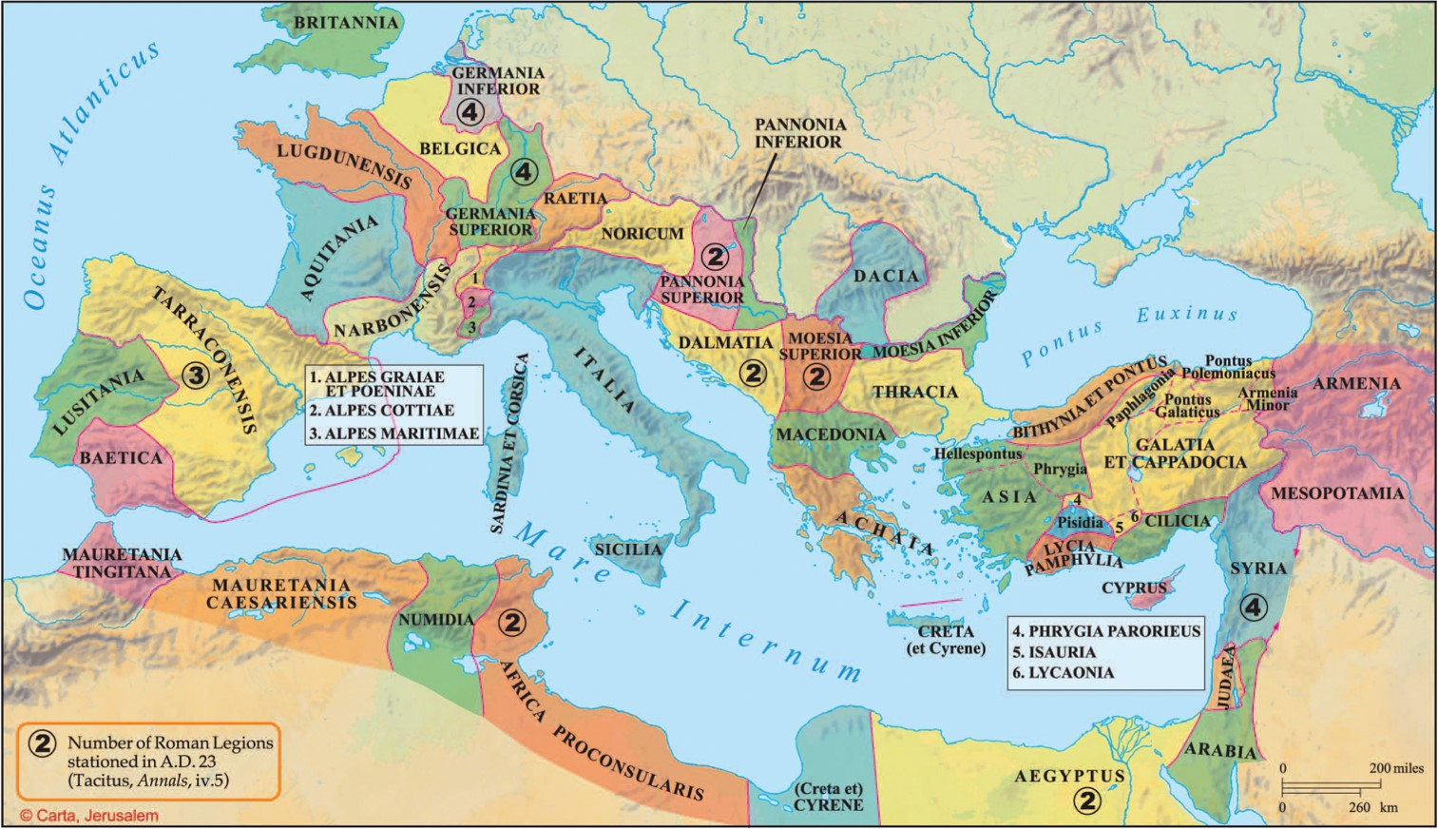
1. God fills the church with His Spirit

Slide 8
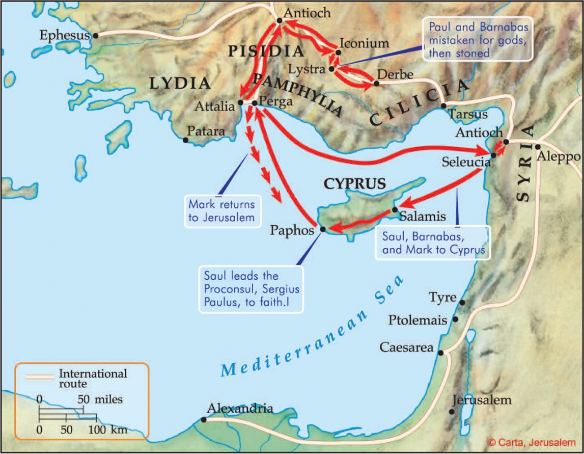
1. God fills the church with His Spirit

Slide 9
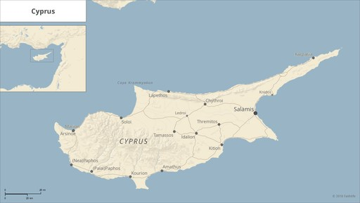
1. God fills the church with His Spirit

Slide 10
1. God fills the church with His Spirit

Slide 11
1. God fills the church with His Spirit
a. The Spirit fills the church with inseparable unity. (v.32)
b. The Spirit fills the church with strong testimony. (v.33a)
c. The Spirit fills the church with super grace. (v.33b)
d. The Spirit fills the church with sacrificial love. (v.34-35)
e. The Spirit fills the church with spiritual gifts. (vv.36-37)
“but rather go to the lost sheep of the house of Israel. “And as you go, preach, saying, ‘The kingdom of heaven is at hand.’ “Heal the sick, raise the dead, cleanse the lepers, cast out demons. Freely you received, freely give.” – Matthew 10:6-8 (NASB95)

Slide 12
1. God fills the church with His Spirit
a. The Spirit fills the church with inseparable unity. (v.32)
b. The Spirit fills the church with strong testimony. (v.33a)
c. The Spirit fills the church with super grace. (v.33b)
d. The Spirit fills the church with sacrificial love. (v.34-35)
e. The Spirit fills the church with spiritual gifts. (vv.36-37)
Having gifts that differ according to the grace given to us, let us use them: if prophecy, in proportion to our faith; if service, in our serving; the one who teaches, in his teaching; the one who exhorts, in his exhortation; the one who contributes, in generosity; the one who leads, with zeal; the one who does acts of mercy, with cheerfulness. – Romans 12:6-8 (ESV)

Slide 13
1. God fills the church with His Spirit (Acts 4:31-36)
2. God fills the church with great fear (Acts 5:1-11)
Verse 5: When Ananias heard these words, he fell down and breathed his last. And great fear came upon all who heard of it.
Verse 11: And great fear came upon the whole church and upon all who heard of these things.

Slide 14
1. God fills the church with His Spirit (Acts 4:31-36)
2. God fills the church with great fear (Acts 5:1-11)
Verse 5: “When Ananias heard these words, he fell down and breathed his last. And great fear came upon all who heard of it.”
Verse 11: And great fear came upon the whole church and upon all who heard of these things.
Church = ekklesia (ἐκκλησία) = 1st use in Acts!
The normal word for the gathering of believers and the word we think of today.

Slide 15
1. God fills the church with His Spirit (Acts 4:31-36)
2. God fills the church with great fear (Acts 5:1-11)
a. Fear God, because God is jealous for His church and zealous to see her holy. (vv. 5, 11)
“As obedient children, do not be conformed to the passions of your former ignorance, but as he who called you is holy, you also be holy in all your conduct, since it is written, ‘You shall be holy, for I am holy.’”
– 1 Pet 1:14-16 (ESV)
“Do you not know that you (ya’ll) are God’s temple and that God’s Spirit dwells in you (ya’ll)?”
– 1 Corinthians 3:16 (ESV)

Slide 16
1. God fills the church with His Spirit (Acts 4:31-36)
2. God fills the church with great fear (Acts 5:1-11)
a. Fear God, because God is jealous for His church and zealous to see her holy. (vv. 5, 11)
“What causes quarrels and what causes fights among you? Is it not this, that your passions are at war within you? You desire and do not have, so you murder. You covet and cannot obtain, so you fight and quarrel. You do not have, because you do not ask. You ask and do not receive, because you ask wrongly, to spend it on your passions. You adulterous people! Do you not know that friendship with the world is enmity with God? Therefore whoever wishes to be a friend of the world makes himself an enemy of God. Or do you suppose it is to no purpose that the Scripture says, ‘He yearns jealously over the spirit that he has made to dwell in us’?” – James 4:1-5 (ESV)
“For I feel a divine jealousy for you, since I betrothed you to one husband, to present you as a pure virgin to Christ.” – 2 Corinthians 11:2

Slide 17
1. God fills the church with His Spirit (Acts 4:31-36)
2. God fills the church with great fear (Acts 5:1-11)
a. Fear God, because God is jealous for His church and zealous to see her holy. (vv. 5, 11)
“And great fear came upon the whole church and upon all who heard of these things.” (Acts 5:11)

Slide 18
1. God fills the church with His Spirit (Acts 4:31-36)
2. God fills the church with great fear (Acts 5:1-11)
a. Fear God, because God is jealous for His church and zealous to see her holy. (vv. 5, 11)
“They went out from us, but they were not of us; for if they had been of us, they would have continued with us. But they went out, that it might become plain that they all are not of us. But you have been anointed by the Holy One, and you all have knowledge.” – 1 John 2:19-20a (ESV)

Slide 19
1. God fills the church with His Spirit (Acts 4:31-36)
2. God fills the church with great fear (Acts 5:1-11)
a. Fear God, because God is jealous for His church and zealous to see her holy. (vv. 5, 11)
b. Fear God, because nothing is hidden from His sight (vv. 3, 4b, 9)
“And Peter took him aside and began to rebuke him, saying, ‘Far be it from you, Lord! This shall never happen to you.’ But he turned and said to Peter, ‘Get behind me, Satan! You are a hindrance to me. For you are not setting your mind on the things of God, but on the things of man.’” – Matthew 16:22-23

Slide 20
1. God fills the church with His Spirit (Acts 4:31-36)
2. God fills the church with great fear (Acts 5:1-11)
a. Fear God, because God is jealous for His church and zealous to see her holy. (vv. 5, 11)
b. Fear God, because nothing is hidden from His sight (vv. 3, 4b, 9)
“Be sober-minded; be watchful. Your adversary the devil prowls around like a roaring lion, seeking someone to devour.” – 1 Peter 5:8 (ESV)
You are of your father the devil, and your will is to do your father’s desires. He was a murderer from the beginning, and does not stand in the truth, because there is no truth in him. When he lies, he speaks out of his own character, for he is a liar and the father of lies. – John 8:44 (ESV)

Slide 21
1. God fills the church with His Spirit (Acts 4:31-36)
2. God fills the church with great fear (Acts 5:1-11)
a. Fear God, because God is jealous for His church and zealous to see her holy. (vv. 5, 11)
b. Fear God, because nothing is hidden from His sight (vv. 3, 4b, 9)
c. Fear God, because there are personal consequences for sin (vv. 5, 10)
“When you are assembled in the name of the Lord Jesus and my spirit is present, with the power of our Lord Jesus, you are to deliver this man to Satan for the destruction of the flesh, so that his spirit may be saved in the day of the Lord.” – 1 Corinthians 5:4-5 (ESV)

Slide 22
1. God fills the church with His Spirit (Acts 4:31-36)
2. God fills the church with great fear (Acts 5:1-11)
a. Fear God, because God is jealous for His church and zealous to see her holy. (vv. 5, 11)
b. Fear God, because nothing is hidden from His sight (vv. 3, 4b, 9)
c. Fear God, because there are personal consequences for sin (vv. 5, 10)
“Whoever, therefore, eats the bread or drinks the cup of the Lord in an unworthy manner will be guilty concerning the body and blood of the Lord. Let a person examine himself, then, and so eat of the bread and drink of the cup.” – 1 Corinthians 11:27-28 (ESV)
“For anyone who eats and drinks without discerning the body eats and drinks judgment on himself. That is why many of you are weak and ill, and some have died.” – 1 Corinthians 11:29-30 (ESV)

Slide 23
1. God fills the church with His Spirit (Acts 4:31-36)
2. God fills the church with great fear (Acts 5:1-11)
a. Fear God, because God is jealous for His church and zealous to see her holy. (vv. 5, 11)
b. Fear God, because nothing is hidden from His sight (vv. 3, 4b, 9)
c. Fear God, because there are personal consequences for sin (vv. 5, 10)
d. Fear God, because your sin may have consequences beyond yourself. (vv. 2a, 8-10)

Slide 24
1. God fills the church with His Spirit (Acts 4:31-36)
2. God fills the church with great fear (Acts 5:1-11)

