Slide 1
Acts 5:12 – Acts 5:26
Trusting God
Witnessing in a Hostile World

Slide 2
A Hostile World
“And you were dead in the trespasses and sins in which you once walked, following the course of this world, following the prince of the power of the air, the spirit that is now at work in the sons of disobedience -”– Ephesians 2:1-2 (ESV)
“We know that we are from God, and the whole world lies in the power of the evil one.” – 1 John 5:19 (ESV)
“Do not be surprised, brothers, that the world hates you.” – 1 John 3:13 (ESV)
“If you were of the world, the world would love you as its own; but because you are not of the world, but I chose you out of the world, therefore the world hates you.” – John 15:19 (ESV)

Slide 3
A Hostile World
“And you were dead in the trespasses and sins in which you once walked, following the course of this world, following the prince of the power of the air, the spirit that is now at work in the sons of disobedience - But God, being rich in mercy, because of the great love with which he loved us, even when we were dead in our trespasses, made us alive together with Christ—by grace you have been saved— and raised us up with him and seated us with him in the heavenly places in Christ Jesus, so that in the coming ages he might show the immeasurable riches of his grace in kindness toward us in Christ Jesus. ” – Ephesians 2:1-2, 5-7 (ESV)
“he who was born of God protects him, and the evil one does not touch him. We know that we are from God, and the whole world lies in the power of the evil one.” – 1 John 5:18b-19 (ESV)
“Do not be surprised, brothers, that the world hates you. We know that we have passed out of death into life”– 1 John 3:19-20 (ESV)

Slide 4
Trust God while witnessing in a hostile world because:
1. God will build His church.
a. In Acts, God continues to establish his church with proof of his approval through signs and wonder.
“Which is easier, to say to the paralytic, ‘Your sins are forgiven,’ or to say, ‘Rise, take up your bed and walk’? But that you may know that the Son of Man has authority on earth to forgive sins—he said to the paralytic— ‘I say to you, rise, pick up your bed, and go home.’ And he rose and immediately picked up his bed and went out before them all, so that they were all amazed”– Mark 2:9-12a (ESV)

Slide 5
Trust God while witnessing in a hostile world because:
1. God will build His church.
a. In Acts, God continues to establish his church with proof of his approval through signs and wonder.
b. Today, there is no longer a need for apostles who perform miracles nor prophets who reveal God’s truth in the new
covenant. The church and God’s word are both established.
“So then you are no longer strangers and aliens, but you are fellow citizens with the saints and members of the household of God, built on the foundation of the apostles and prophets, Christ Jesus himself being the cornerstone, in whom the whole structure, being joined together, grows into a holy temple in the Lord. In him you also are being built together into a dwelling place for God by the Spirit.”
- Ephesians 2:19-22 (ESV)

Slide 6
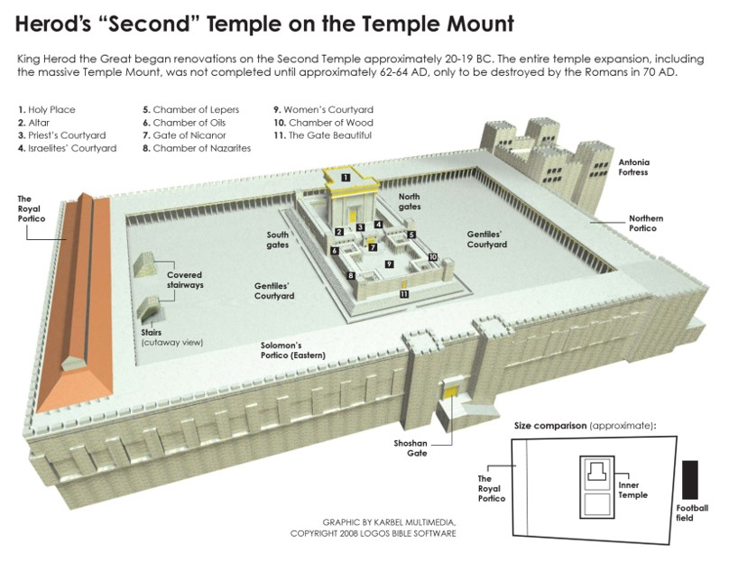
Solomon’s Portico (Porch or Colonnade)

Slide 7
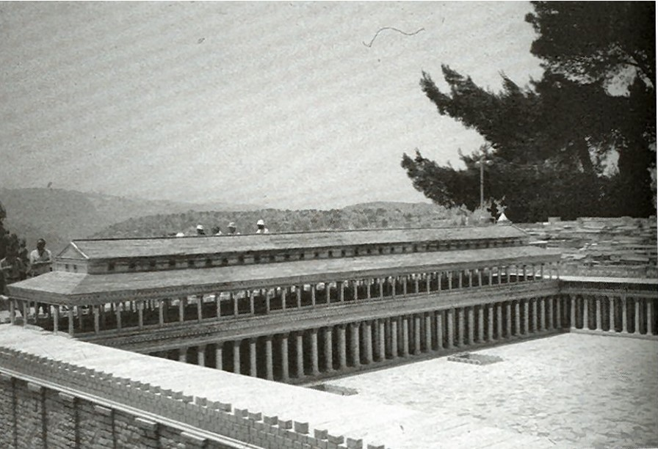
Solomon’s Portico (Porch or Colonnade)

Slide 8
Solomon’s Portico (Porch or Colonnade)

Slide 9
Who is the “all” and the “none of the rest?” in verses 12-14?
¹² “Now many signs and wonders were regularly done among the people by the hands of the apostles. And the church of believers was all together in Solomon’s portico. ¹³ None of the rest, that is, unbelievers, dared to join them, but these unbelieving people held them, the church, in high esteem. ¹⁴ And more than ever believers from these unbelieving people were added to the Lord, multitudes of both men and women.”

Slide 10
Who is the “all” and the “none of the rest?” in verses 12-14?
¹² “Now many signs and wonders were regularly done among the people by the hands of the apostles. And the church of believers was all together in Solomon’s portico. ¹³ None of the rest, that is, unbelievers, dared to join them, but these unbelieving people held them, the church, in high esteem. ¹⁴ And more than ever believers from these unbelieving people were added to the Lord, multitudes of both men and women.”
¹² “Now many signs and wonders were regularly done among the people by the hands of the apostles. And the apostles were all together in Solomon’s portico. ¹³ None of the rest of the church dared to join them, but the unbelieving people held them, the church, in high esteem. ¹⁴ And more than ever believers from these unbelieving people were added to the Lord, multitudes of both men and women.”

Slide 11
Trust God while witnessing in a hostile world because:
1. God will build His church.
2. God always has an unfailing plan, even if you can’t see it.
“For the Sadducees say that there is no resurrection, nor angel, nor spirit, but the Pharisees acknowledge them all.” – Acts 23:8 (ESV)

Slide 12
Trust God while witnessing in a hostile world because:
1. God will build His church.
2. God always has an unfailing plan, even if you can’t see it.
3. God rules over all authorities.

Slide 13
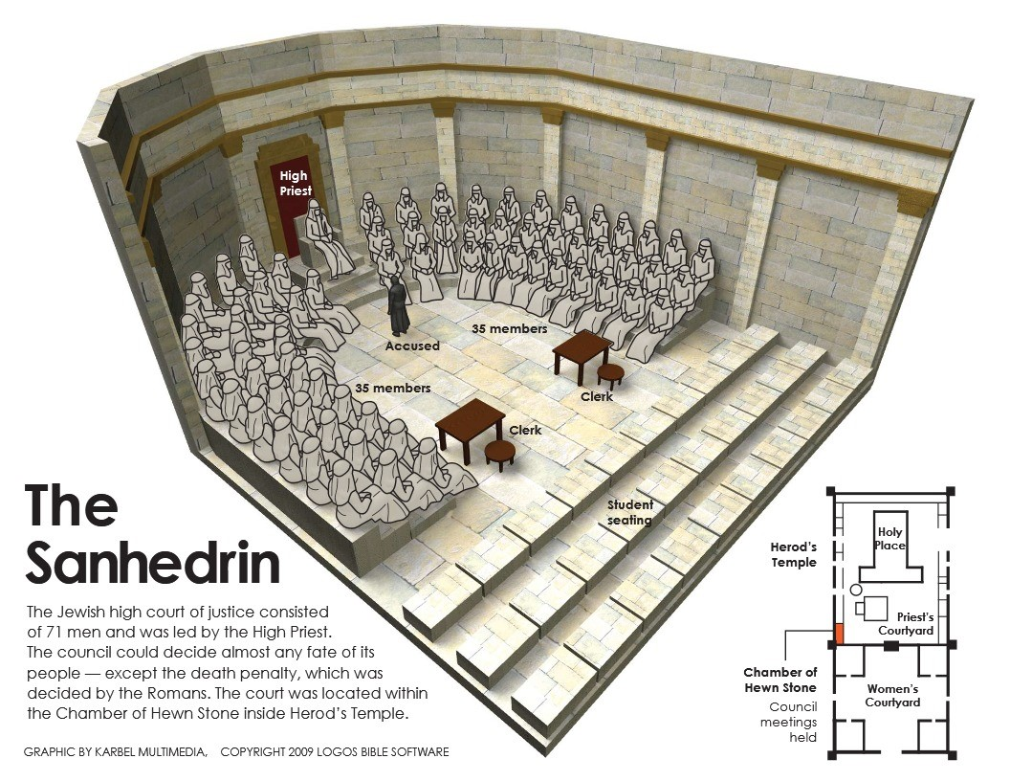
Sanhedrin Courtroom

Slide 14
Trust God while witnessing in a hostile world because:
1. God will build His church.
2. God always has an unfailing plan, even if you can’t see it.
3. God rules over all authorities.
“In their case the god of this world has blinded the minds of the unbelievers, to keep them from seeing the light of the gospel of the glory of Christ, who is the image of God.” – 2 Corinthians 4:4 (ESV)

Slide 15
Trust God while witnessing in a hostile world because:
1. God will build His church.
2. God always has an unfailing plan, even if you can’t see it.
3. God rules over all authorities.
“Let every person be subject to the governing authorities. For there is no authority except from God, and those that exist have been instituted by God.” – Romans 13:1 (ESV)

