Slide 1
Acts 5:26 – Acts 5:42
Trusting God
Witnessing in a Hostile World
Part 2

Slide 2
Psalm 10 (ESV)
Verse 1: “Why, O Lord, do you stand far away? Why do you hide yourself in times of trouble?”
Verse 2: “In the pride of his face the wicked does not seek him; all his thoughts are, ‘There is no God.’ His ways prosper at all times”
Verses 13: Why does the wicked renounce God and say in his heart, “You will not call to account”?
Verse 14: But you do see, for you note mischief and vexation, that you may take it into your hands; to you the helpless commits himself; you have been the helper of the fatherless.
Verse 15: “The Lord is king forever and ever”
Verses 16-17a: “O Lord, you hear the desire of the afflicted; you will strengthen their heart; you will incline your ear to do justice to the fatherless and the oppressed, so that man who is of the earth may strike terror no more.”

Slide 3
As you witness, prove your trust by:
1. Submitting to the authorities. (vv. 26-27a)
“Force” (ESV) = bia (Greek) = “violence”
“Some in the crowd were shouting one thing, some another. And as he could not learn the facts because of the uproar, he ordered him to be brought into the barracks. And when he came to the steps, he was actually carried by the soldiers because of the violence of the crowd, for the mob of the people followed, crying out, “Away with him! – Acts 21:34-36 (ESV)

Slide 4
As you witness, prove your trust by:
1. Submitting to the authorities. (vv. 26-27a)
“For there is no authority except from God, and those that exist have been instituted by God.” – Rom 13:1b (ESV)

Slide 5
As you witness, prove your trust by:
1. Submitting to the authorities. (vv. 26-27a)
“Let every person be subject to the governing authorities. For there is no authority except from God, and those that exist have been instituted by God.” – Rom 13:1 (ESV)

Slide 6
As you witness, prove your trust by:
1. Submitting to the authorities. (vv. 26-27a)
“Let every person be subject to the governing authorities. For there is no authority except from God, and those that exist have been instituted by God. Therefore, whoever resists the authorities resists what God has appointed, and those who resist will incur judgment.” – Rom 13:1-2 (ESV)

Slide 7
As you witness, prove your trust by:
1. Submitting to the authorities. (vv. 26-27a)
“Be subject for the Lord’s sake to every human institution, whether it be to the emperor as supreme, or to governors as sent by him to punish those who do evil and to praise those who do good.” – 1 Pet 2:13-14a (ESV)

Slide 8
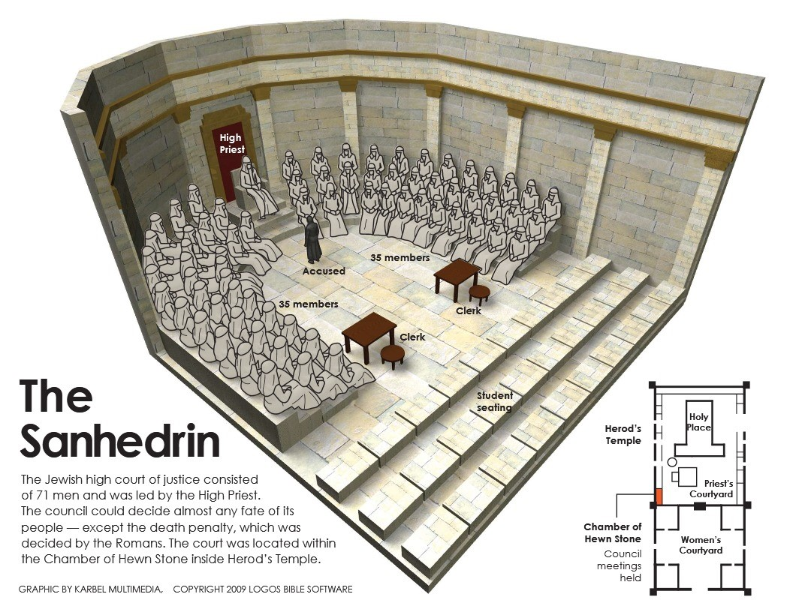
As you witness, prove your trust by:
2. Obeying God rather than man. (vv. 27b-29)
“So when Pilate saw that he was gaining nothing, but rather that a riot was beginning, he took water and washed his hands before the crowd, saying, ‘I am innocent of this man’s blood; see to it yourselves.’ And all the people answered, ‘His blood be on us and on our children!’” – Matthew 27:24-25 (ESV)

Slide 9
As you witness, prove your trust by:
3. Continuing to share His Gospel, no matter what. (vv. 30-32)
Therefore, as the Holy Spirit says, “Today, if you hear his voice, do not harden your hearts as in the rebellion
- Hebrews 3:7-8, 15; 4:7; Psalm 95:7-8 (ESV)
“if you confess with your mouth that Jesus is Lord and believe in your heart that God raised him from the dead, you will be saved. For with the heart one believes and is justified, and with the mouth one confesses and is saved.” – Romans 10:9-10 (ESV)

Slide 10
As you witness, prove your trust by:
4. Waiting on God for the outcome. (vv. 33-39)
“Enraged” (ESV) = diaprio = “cut or sawn in two/half”
“I am a Jew, born in Tarsus in Cilicia, but brought up in this city, educated at the feet of Gamaliel according to the strict manner of the law of our fathers, being zealous for God as all of you are this day.” – Acts 22:3 (ESV)
“though I myself have reason for confidence in the flesh also. If anyone else thinks he has reason for confidence in the flesh, I have more: circumcised on the eighth day, of the people of Israel, of the tribe of Benjamin, a Hebrew of Hebrews; as to the law, a Pharisee; as to zeal, a persecutor of the church; as to righteousness under the law, blameless.” – Philippians 3:4-6 (ESV)

Slide 11
As you witness, prove your trust by:
5. Rejoicing to share in Jesus’s suffering (vv. 40-41)
“then if the guilty man deserves to be beaten, the judge shall cause him to lie down and be beaten in his presence with a number of stripes in proportion to his offense. Forty stripes may be given him, but not more, lest, if one should go on to beat him with more stripes than these, your brother be degraded in your sight. – Deuteronomy 25:2-3 (ESV)
“Count it all joy, my brothers, when you meet trials of various kinds, for you know that the testing of your faith produces steadfastness. And let steadfastness have its full effect, that you may be perfect and complete, lacking in nothing.” – James 1:2-4 (ESV)

Slide 12
As you witness, prove your trust by:
6. Not Ceasing to share the Gospel (v. 42)

Slide 13
As you witness, prove your trust by:
1. Submitting to the authorities.
2. Obeying God rather than man.
3. Continuing to share His Gospel, no matter what.
4. Waiting on God for the outcome.
5. Rejoicing to share in Jesus’s suffering.
6. Not Ceasing to share the Gospel.

