Slide 1
Acts 6:3-13
Stephen: A Witness under god’s control

Slide 2
Acts 5:3 (ESV)
But Peter said, “Ananias, why has Satan filled your heart to lie to the Holy Spirit and to keep back for yourself part of the proceeds of the land?”
To be “full of” is to
be “controlled” by.
Acts 5:17 (ESV)
But the high priest rose up, and all who were with him (that is, the party of the Sadducees), and filled with jealousy they arrested the apostles and put them in the public prison.

Slide 3
1 Corinthians 4:16 (ESV)
“I urge you, then, be imitators of me”
1 Corinthians 11:1 (ESV)
“Be imitators of me, as I am of Christ”
2. Like Stephen, be under
god’s control.
1 Thessalonians 1:6; 2 Thess 3:7 (ESV)
“Be imitators of us / You ought to imitate us”
Hebrews 6:12 (ESV)
“imitate those who through faith and patience inherit the promises”
Hebrews 6:12 (ESV)
“Remember your leaders … consider their way of life, and imitate their faith”

Slide 4
1 Timothy 3:1 (ESV)
The saying is trustworthy: If anyone aspires to the office of overseer, he desires a noble task.
Stephen was controlled by a good reputation. (v.3)
2 Corinthians 5:20 (ESV)
Therefore, we are ambassadors for Christ, God making his appeal through us.

Slide 5
Ephesians 5:18 (ESV)
And do not get drunk with wine, for that is debauchery, but be filled with the Spirit,
Ephesians 5:19-21 (ESV)
addressing one another in psalms and hymns and spiritual songs, singing and making melody to the Lord with your heart, giving thanks always and for everything to God the Father in the name of our Lord Jesus Christ, submitting to one another out of reverence for Christ.
b. Stephen was controlled by the Holy Spirit. (vv. 3, 5, 10; 7:55)

Slide 6
James 1:5 (ESV)
“If any of you lacks wisdom, let him ask God, who gives generously to all without reproach, and it will be given him.”
c. Stephen was controlled by wisdom. (vv. 3, 10)
Ephesians 5:15-18 (ESV)
“Look carefully then how you walk, not as unwise but as wise, making the best use of the time, because the days are evil. Therefore do not be foolish, but understand what the will of the Lord is. And do not get drunk with wine, for that is debauchery, but be filled with the Spirit”

Slide 7
James 1:5 (ESV)
“If any of you lacks wisdom, let him ask God, who gives generously to all without reproach, and it will be given him;
But let him ask in faith, with no doubting”
d. Stephen was controlled by
faith. (vv. 3, 10)

Slide 8
Ephesians 2:8-9 (ESV)
“For by grace you have been saved through faith. And this is not your own doing; it is the gift of God, not a result of works, so that no one may boast.”
e. Stephen was controlled by
grace. (vv. 8; 7:59-60)

Slide 9
Acts 1:8 (ESV)
“But you will receive power when the Holy Spirit has come upon you, and you will be my witnesses in Jerusalem and in all Judea and Samaria, and to the end of the earth.”
f. Stephen was controlled by
power. (v. 8)
Galatians 5:22-23 (ESV)
“But the fruit of the Spirit is love, joy, peace, patience, kindness, goodness, faithfulness, gentleness, self-control”
1 Corinthians 12:6b-7 (ESV)
“it is the same God who empowers them all in everyone. To each is given the manifestation of the Spirit for the common good.”

Slide 10
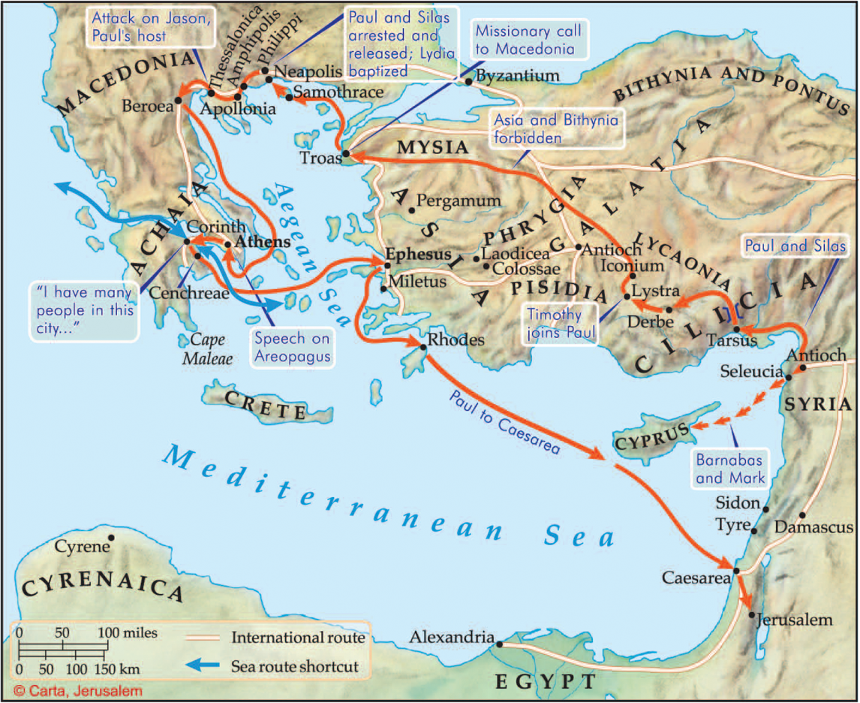
g. Stephen was controlled by
courage. (v. 9-13)

Slide 11
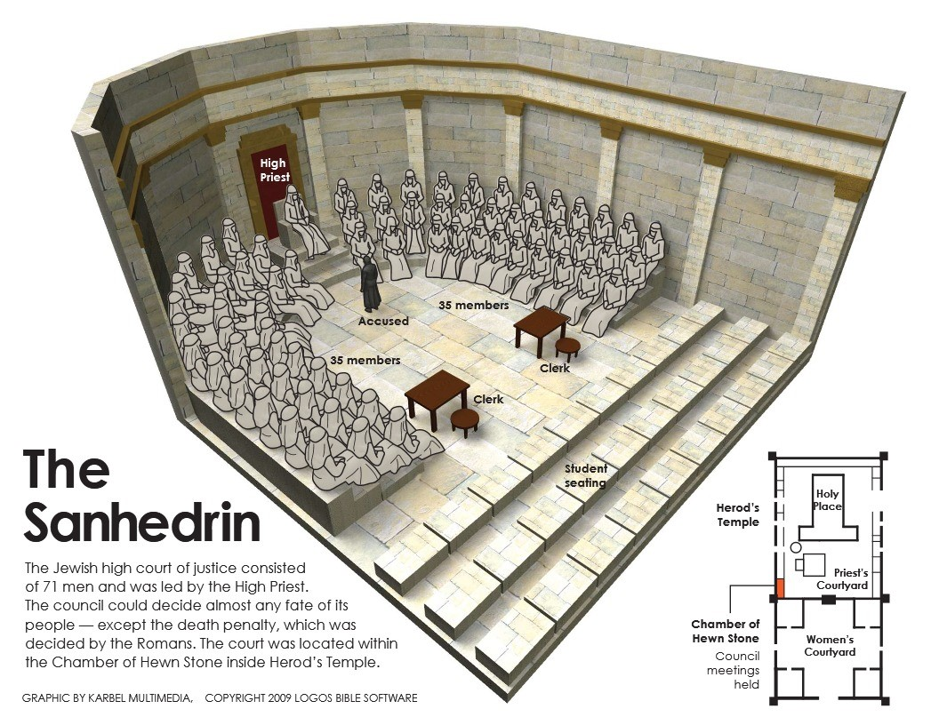
g. Stephen was controlled by
courage. (v. 9-13)

Slide 12
BE FILLED with
1. A good reputation
2. The Holy Spirit.
3. Wisdom.
4. Faith.
5. Grace.
6. Power.
7. Courage
What about you?

