Slide 1
Acts 6:8-7:19
Stephen Defense: How God redeems
(part 1)

Slide 2
Stephen is accused of blaspheming against
a) Moses and God.
The Accusation.

Slide 3
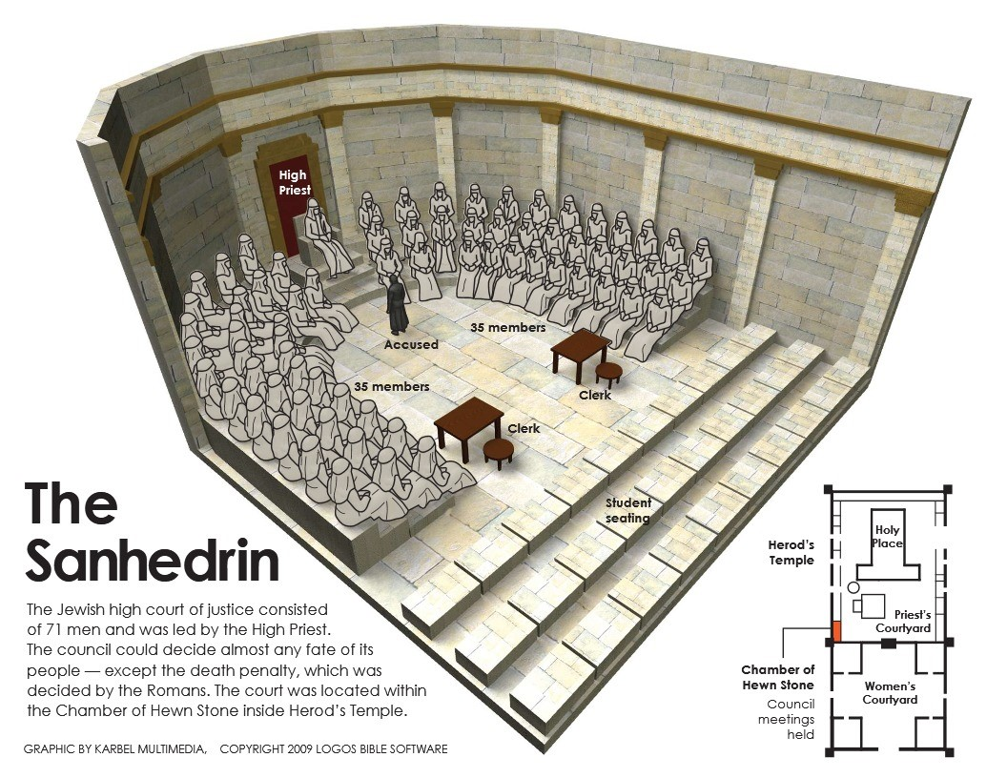

Slide 4
Stephen is accused of blaspheming against
a) Moses and God.
b) a place, the temple.
c) certain practices, the Law.
The Accusation.
John 2:19 (ESV)
Jesus answered them, “Destroy this temple, and in three days I will raise it up…”
John 2:21 (ESV)
… but he was speaking about the temple of his body.

Slide 5
Stephen is accused of blaspheming against
a) Moses and God.
b) a place, the temple.
c) certain practices, the Law.
The Accusation.
Matthew 5:17-19 (ESV)
“Do not think that I have come to abolish the Law or the Prophets; I have not come to abolish them but to fulfill them. For truly, I say to you, until heaven and earth pass away, not an iota, not a dot, will pass from the Law until all is accomplished.”

Slide 6
Literally, face like an angel
Exodus 34:29-30 (ESV)
“When Moses came down from Mount Sinai, with the two tablets of the testimony in his hand as he came down from the mountain, Moses did not know that the skin of his face shone because he had been talking with God. Aaron and all the people of Israel saw Moses, and behold, the skin of his face shone, and they were afraid to come near him.”
The ADVOCATE.

Slide 7
Stephen argues that God’s redemptive plan has never been about:
a) A place, but God’s promises.
The APOLOGY (p.1)
Psalm 29 (ESV)
“Ascribe to the Lord, O heavenly beings, ascribe to the Lord glory and strength …the glory due his name; worship the Lord in the splendor of holiness. The voice of the Lord is over the waters; the God of glory thunders … The voice of the Lord is powerful … full of majesty… and in his temple all cry, “Glory!”

Slide 8
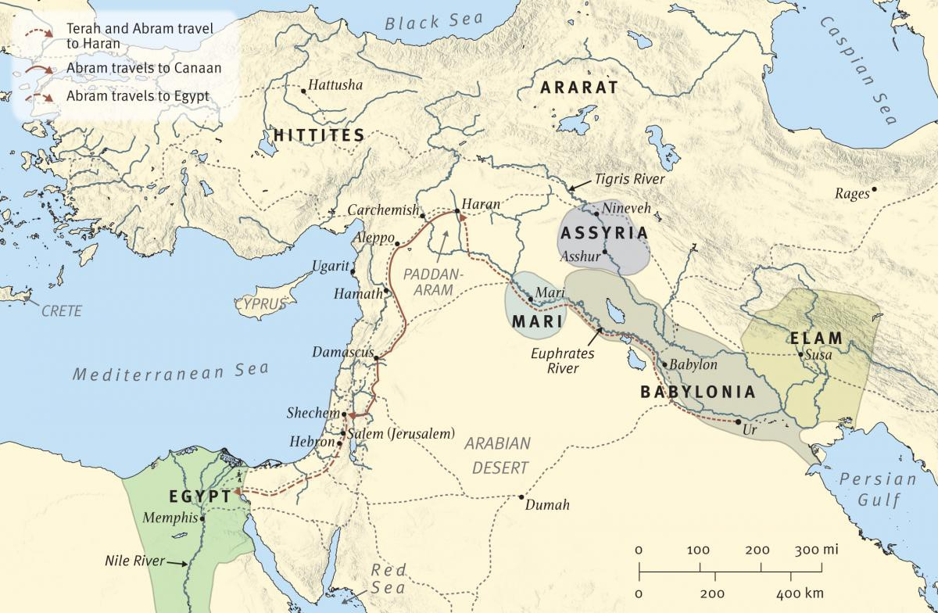

Slide 9
Stephen argues that God’s redemptive plan has never been about:
A place, but God’s promises.
Certain practices but a certain person.
The APOLOGY (p.1)
Genesis 17:3-11 (ESV). Then Abram fell on his face. And God said to him, “Behold, my covenant is with you, and you shall be the father of a multitude of nations. No longer shall your name be called Abram, but your name shall be Abraham, for I have made you the father of a multitude of nations … I will establish my covenant between me and you and your offspring after you throughout their generations for an everlasting covenant, to be God to you and to your offspring after you … This is my covenant, which you shall keep, between me and you and your offspring after you: Every male among you shall be circumcised…
Genesis 15:6 (ESV). “And he believed the Lord, and he counted it to him as righteousness.”

Slide 11
It’s all about GOD!
Not a place, but God’s promises.
Not certain practices but God’s person (redeemer).
The APOLOGY (p.1)

