Slide 1
Acts 7:35-53
Stephen’s Apology (p.3): Rejecting God

Slide 2
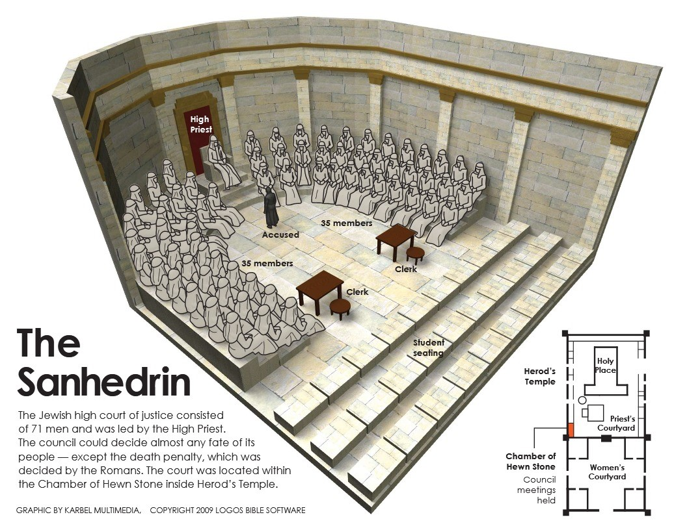
review
Stephen is accused of blaspheming against
(1) Moses and (2) God (Acts 6:11)
(3) The Temple and (4) the Law (Acts 6:13)
Stephen demonstrates God’s redemption is not about
1) certain places but God’s certain promises
2) certain practices but God’s chosen people.

Slide 3
Numbers 14:11(ESV)
“How long will they not believe in me, in spite of all the signs that I have done among them?”
1. To reject God is to reject His chosen
redeemer.

Slide 4
Exodus 24:3 (ESV)
Moses came and told the people all the words of the LORD and all the rules. And all the people answered with one voice and said, “All the words that the LORD has spoken we will do.”
2. To reject God is to reject His living
words.
Exodus 24:16-17 (ESV)
Then Moses went up on the mountain, and the cloud covered the mountain. The glory of the LORD dwelt on Mount Sinai … the appearance of the glory of the LORD was like a devouring fire on the top of the mountain in the sight of the people of Israel.

Slide 5
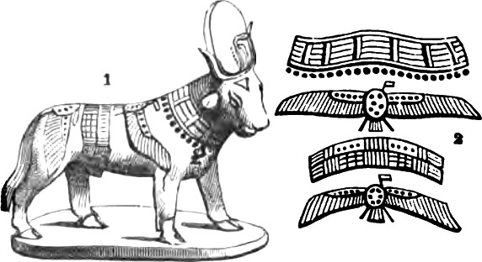
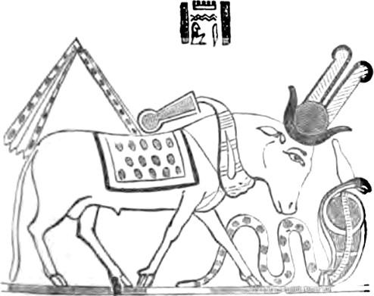
3. To reject God is to turn from His path
to your own idols.
Apis Mnevis

Slide 6
3. To reject God is to turn from His path
to your own idols.
Apis Mnevis
Exodus 20:3 (ESV)
“You shall have no other gods before me.”

Slide 7
Psalm 115:4-9a (ESV)
Their idols are silver and gold, the work of human hands. They have mouths, but do not speak; eyes, but do not see. They have ears, but do not hear; noses, but do not smell. They have hands, but do not feel; feet, but do not walk; and they do not make a sound in their throat. Those who make them become like them; so do all who trust in them. O Israel, trust in the LORD! He is their help and their shield.
3. To reject God is to turn from His path
to your own idols.

Slide 8
Jeremiah 10:3-8 (ESV)
for the customs of the peoples are vanity …Their idols are like scarecrows in a cucumber field, and they cannot speak; they have to be carried, for they cannot walk. Do not be afraid of them, for they cannot do evil, neither is it in them to do good.” There is none like you, O LORD; you are great, and your name is great in might … the instruction of idols is but wood!
3. To reject God is to turn from His path
to your own idols.

Slide 9
Romans 1:24-25 (ESV)
Therefore God gave them up in the lusts of their hearts to impurity, to the dishonoring of their bodies among themselves, because they exchanged the truth about God for a lie and worshiped and served the creature rather than the Creator, who is blessed forever! Amen.
God gave them up: See also: Romans 1:26 and 28.
3. To reject God is to turn from His path
to your own idols.

Slide 10
2 Samuel 7:2 (ESV)
the king said to Nathan the prophet, “See now, I dwell in a house of cedar, but the ark of God dwells in a tent.”
4. To reject God is to choose dead religion
over the living God.
2 Samuel 7:11b (ESV)
Moreover, the LORD declares to you that the LORD will make you a house.
1 Kings 8:27 (ESV)
“But will God indeed dwell on the earth? Behold, heaven and the highest heaven cannot contain you; how much less this house that I have built!

Slide 11
Exodus 32:9 (ESV)
And the LORD said to Moses, “I have seen this people, and behold, it is a stiff-necked people…
1. Don’t reject God by
being as stubborn as a mule.
Stiff-necked:
“Hard in the neck; Obstinate; Completely Unyielding; Not Willing to be taught or understood”

Slide 12
Proverbs 14:12 (ESV)
There is a way that seems right to a man, but its end is the way(s) to death.
1. Don’t reject God by
being as stubborn as a mule.
John 14:6 (ESV)
Jesus said to him, “I am the way, and the truth, and the life. No one comes to the Father except through me.”

Slide 13
1 John 2:15 (ESV)
Do not love the world or the things in the world. If anyone loves the world, the love of the Father is not in him.
2. Don’t reject God by
living in idolatry like the world.
Revelation 21:8 (ESV)
But as for the cowardly, the faithless, the detestable, as for murderers, the sexually immoral, sorcerers, idolaters, and all liars, their portion will be in the lake that burns with fire and sulfur, which is the second death.”

Slide 14
“Congregation” (vs. 38)
ἐκκλησία (ekklesia) = church or congregation
1 Peter 2:4-5 (ESV)
As you come to him (Jesus Christ), a living stone rejected by men but in the sight of God chosen and precious, you yourselves like living stones are being built up as a spiritual house, to be a holy priesthood, to offer spiritual sacrifices acceptable to God through Jesus Christ.
3. Don’t reject God by putting
dead tradition over the living Person.
1 Corinthians 3:16 (ESV)
Do you not know that you (plural) are God’s temple and that God’s Spirit dwells in you (plural) ?

Slide 15
Matthew 23:37 (ESV)
“O Jerusalem, Jerusalem, the city that kills the prophets and stones those who are sent to it! How often would I have gathered your children together as a hen gathers her brood under her wings, and you were not willing!”
4. Don’t reject God by rejecting
His Redeemer, Jesus Christ.
Acts 13:37-39 (ESV)
but he (Jesus Christ) whom God raised up did not see corruption. Let it be known to you therefore, brothers, that through this man forgiveness of sins is proclaimed to you, and by him everyone who believes is freed from everything from which you could not be freed by the law of Moses.

Slide 16
2 Timothy 2:15
Be diligent to present yourself to God as one approved, a worker who has no need to be ashamed, rightly handling the word of truth.
5. Don’t reject God by rejecting
His living words.

