Slide 1
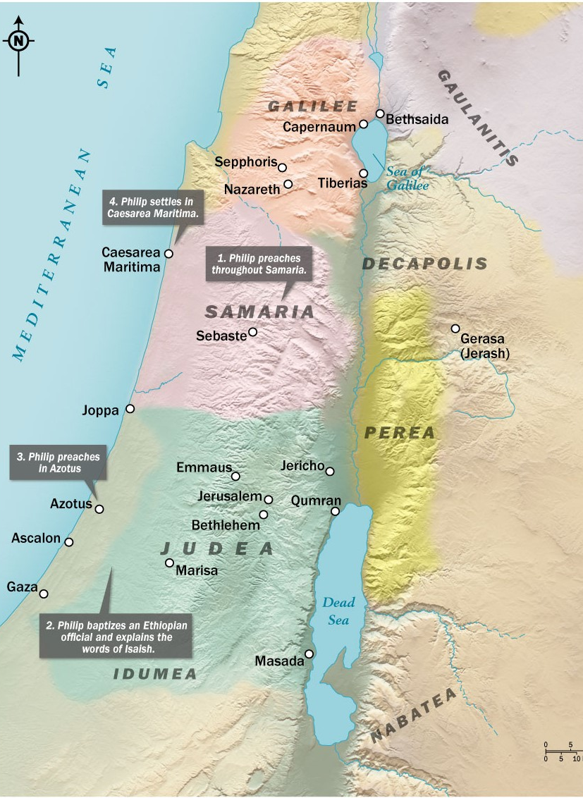
A Scattered Church: God’s Providence in Persecution
Acts 8:1-8

Slide 2
James 1:2 (ESV)
‘Count it all joy, my brothers, when you meet trials of various kinds’
Romans 5:3-4 (ESV)
… we rejoice in our sufferings, knowing that suffering produces endurance, and endurance produces character, and character produces hope…
Hebrews 12:2 (ESV)
looking to Jesus, the founder and perfecter of our faith, who for the joy that was set before him endured the cross, despising the shame, and is seated at the right hand of the throne of God.

Slide 3
John 15:20b (ESV)
… If they persecuted me, they will also persecute you …
John 16:33b (ESV)
In the world you will have tribulation. But take heart; I have overcome the world.
John 17:14 (ESV)
I have given them your word, and the world has hated them because they are not of the world, just as I am not of the world.

Slide 4
The Jerusalem church is scattered by the providence of God’s will.
Acts 1:8 (ESV)
But you will receive power when the Holy Spirit has come upon you, and you will be my witnesses in Jerusalem and in all Judea and Samaria, and to the end of the earth.”

Slide 5
The Jerusalem church is scattered by the providence of God’s will.
Acts 2:5-6 (ESV)
Now there were dwelling in Jerusalem Jews, devout men from every nation under heaven. And at this sound the multitude came together, and they were bewildered, because each one was hearing them speak in his own language.

Slide 6
The Jerusalem church is scattered by the providence of God’s will.
Galatians 1:13-14 (ESV)
For you have heard of my former life in Judaism, how I persecuted the church of God violently and tried to destroy it. And I was advancing in Judaism beyond many of my own age among my people, so extremely zealous was I for the traditions of my fathers.
Psalm 80:13 (ESV)
The boar from the forest ravages it, and all that move in the field feed on it.

Slide 7
The Jerusalem church is scattered by the providence of God’s will.
Acts 26:9-10 (ESV)
I myself was convinced that I ought to do many things in opposing the name of Jesus of Nazareth. And I did so in Jerusalem. I not only locked up many of the saints in prison after receiving authority from the chief priests, but when they were put to death I cast my vote against them. And I punished them often in all the synagogues and tried to make them blaspheme, and in raging fury against them I persecuted them even to foreign cities.
Acts 22:4 (ESV)
I persecuted this Way to the death, binding and delivering to prison both men and women,
Acts 9:1 (ESV)
But Saul, still breathing threats and murder against the disciples of the Lord, went to the high priest

Slide 8
The Jerusalem church is scattered by the providence of God’s will.
John 12:24 (ESV)
Truly, truly, I say to you, unless a grain of wheat falls into the earth and dies, it remains alone; but if it dies, it bears much fruit.

Slide 9
The scattering of the church leads to the preaching of God’s word.
“But go zealously on, good presidents, you will stand higher with the people if you sacrifice the Christians at their wish, kill us, torture us, condemn us, grind us to dust; your injustice is the proof that we are innocent ... The oftener we are mown down by you, the more in number we grow; the blood of Christians is seed”
– Tertullian, The Apology

Slide 10
The scattering of the church leads to the proclamation of God’s Chosen One.
John 4:9 (ESV)
The Samaritan woman said to him, “How is it that you, a Jew, ask for a drink from me, a woman of Samaria?” (For Jews have no dealings with Samaritans.)
John 4:20 (ESV)
Our fathers worshiped on this mountain, but you say that in Jerusalem is the place where people ought to worship.”
John 4:21 (ESV)
Jesus said to her, “Woman, believe me, the hour is coming when neither on this mountain nor in Jerusalem will you worship the Father.

Slide 11
The scattering of the church leads to the proclamation of God’s Chosen One.
John 4:25-26 (ESV)
The woman said to him, “I know that Messiah is coming (he who is called Christ). When he comes, he will tell us all things.” Jesus said to her, “I who speak to you am he.”
John 4:20 (ESV)
They said to the woman, “It is no longer because of what you said that we believe, for we have heard for ourselves, and we know that this is indeed the Savior of the world.”

Slide 12
The proclamation is accompanied by the planting of God’s wonder.
Ephesians 6:10-12 (ESV)
Finally, be strong in the Lord and in the strength of his might. Put on the whole armor of God, that you may be able to stand against the schemes of the devil. For we do not wrestle against flesh and blood, but against the rulers, against the authorities, against the cosmic powers over this present darkness, against the spiritual forces of evil in the heavenly places.
Ephesians 6:17-18 (ESV)
and take the helmet of salvation, and the sword of the Spirit, which is the word of God, praying at all times in the Spirit, with all prayer and supplication. To that end, keep alert with all perseverance, making supplication for all the saints

Slide 13
The proclamation is accompanied by the planting of God’s wonder.
Luke 9:52-54 (ESV)
And he sent messengers ahead of him, who went and entered a village of the Samaritans, to make preparations for him. But the people did not receive him, because his face was set toward Jerusalem. And when his disciples James and John saw it, they said, “Lord, do you want us to tell fire to come down from heaven and consume them?”
Matthew 5:44 (ESV)
But I say to you, love your enemies and pray for those who persecute you,

