Slide 1
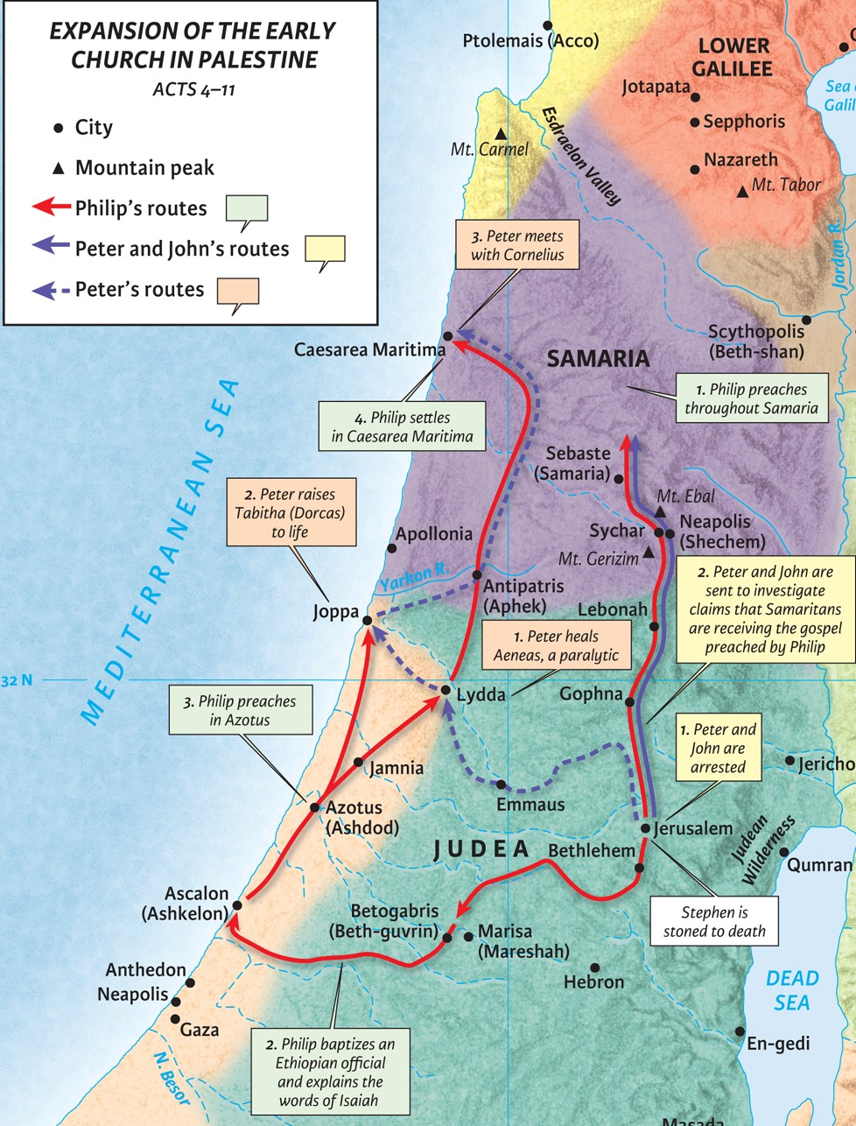
Philip and the Eunuch:
Three Steps to Conversion
Acts 8:26-40

Slide 2
1. There must be a proper preparation.
a. God prepares the messenger
Luke 16:10 (ESV)
“He who is faithful in a very little thing is faithful also in much; and he who is unrighteous in a very little thing is unrighteous also in much.
Acts 6:2-5 (ESV)
Therefore, brothers, pick out from among you seven men of good repute, full of the Spirit and of wisdom, whom we will appoint to this duty (v.2: serving tables) … and they chose Stephen, a man full of faith and of the Holy Spirit, and Philip …

Slide 3
1. There must be a proper preparation.
b. God prepares the listener

Slide 4
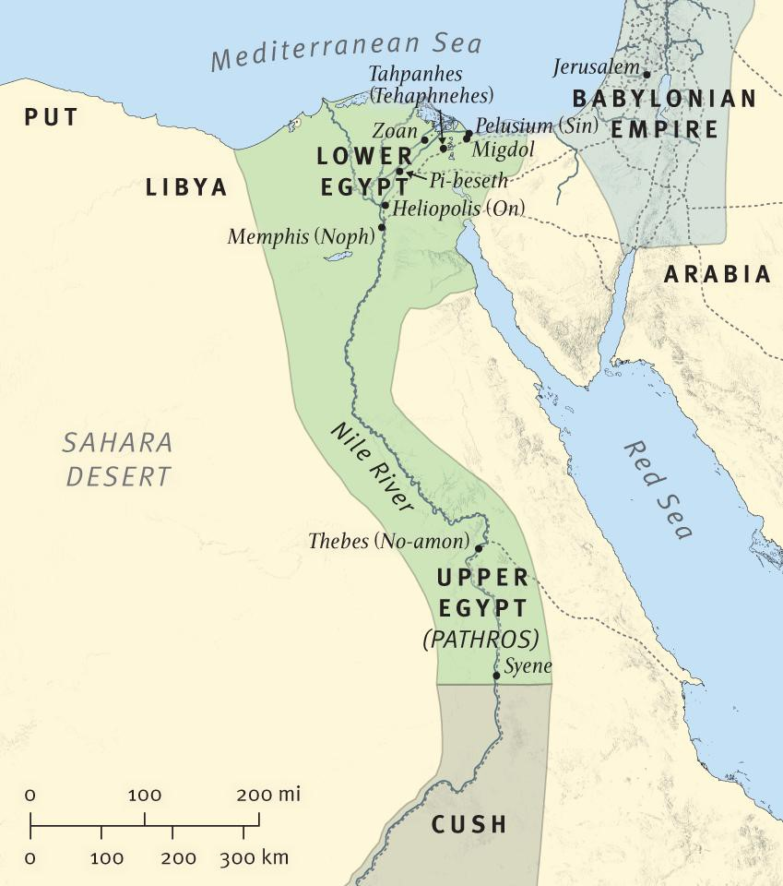
1. There must be a proper preparation.
b. God prepares the listener

Slide 5
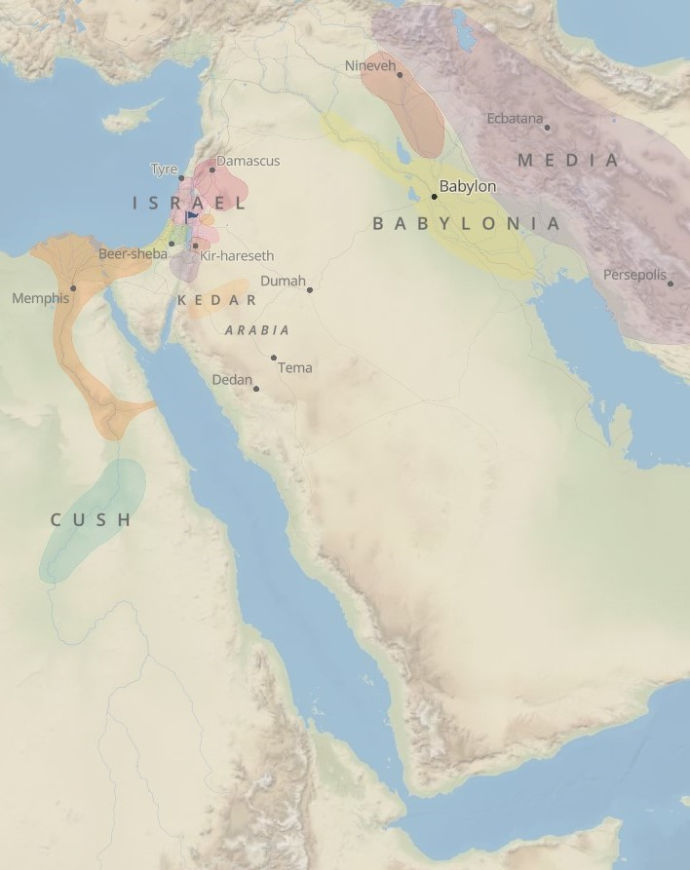
1. There must be a proper preparation.
b. God prepares the listener

Slide 6
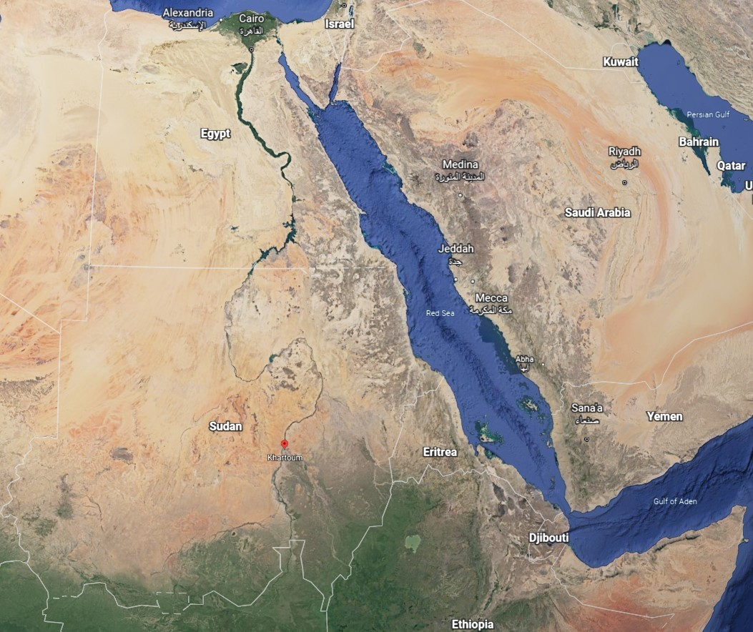
1. There must be a proper preparation.
b. God prepares the listener

Slide 7
1. There must be a proper preparation.
b. God prepares the listener
Romans 1:19-20 (ESV)
For what can be known about God is plain to them, because God has shown it to them. For his invisible attributes, namely, his eternal power and divine nature, have been clearly perceived, ever since the creation of the world, in the things that have been made. So they are without excuse.

Slide 8
2. There must be a proper preparation.
c. God prepares the opportunity.

Slide 9
2. There must be a proper presentation.
a. It must be centered on God’s word.
“A religion that is not based on understanding will soon come to an end. An emotional religion – one that is nothing but emotion – will be a temoprary and transient religion. The Bible was meant to be understood, and it benefits us in proportion as we get at the meaning of it. The mere words of Scripture passing over the ears or before the eyes can do us little good.” – Charles Spurgeon
Romans 10:14-15a (ESV)
How then will they call on him in whom they have not believed? And how are they to believe in him of whom they have never heard? And how are they to hear without someone preaching? And how are they to preach unless they are sent? As it is written, “How beautiful are the feet of those who preach the good news!”

Slide 10
2. There must be a proper presentation.
a. It must be centered on God’s word.
2 Timothy 2:15 (ESV)
Do your best to present yourself to God as one approved, a worker who has no need to be ashamed, rightly handling the word of truth.

Slide 11
2. There must be a proper presentation.
b. It must be centered on Jesus Christ.
Hebrews 10:1-5 (ESV)
For since the law has but a shadow of the good things to come instead of the true form of these realities, it can never, by the same sacrifices that are continually offered every year, make perfect those who draw near. Otherwise, would they not have ceased to be offered, since the worshipers, having once been cleansed, would no longer have any consciousness of sins? But in these sacrifices there is a reminder of sins every year. For it is impossible for the blood of bulls and goats to take away sins. Consequently, when Christ came into the world, he said, “Sacrifices and offerings you have not desired, but a body have you prepared for me;

Slide 12
3. There must be a proper response.
a. A response of faith in Jesus Christ.
Acts 8:37 (NASB95)
(not in oldest and best mss.)
[And Philip said, “If you believe with all your heart, you may.” And he answered and said, “I believe that Jesus Christ is the Son of God.”]

Slide 13
3. There must be a proper response.
b. A response of joy to God.
Isaiah 56:1-5 (ESV)
Thus says the LORD: “Keep justice, and do righteousness, for soon my salvation will come, and my righteousness be revealed. Blessed is the man who does this, and the son of man who holds it fast, who keeps the Sabbath, not profaning it, and keeps his hand from doing any evil.” Let not the foreigner who has joined himself to the LORD say, “The LORD will surely separate me from his people”; and let not the eunuch say, “Behold, I am a dry tree.” For thus says the LORD: “To the eunuchs who keep my Sabbaths, who choose the things that please me and hold fast my covenant, I will give in my house and within my walls a monument and a name better than sons and daughters; I will give them an everlasting name that shall not be cut off. “

Slide 14
3. There must be a proper response.
c. These responses cause God’s Gospel to spread!

