Slide 1
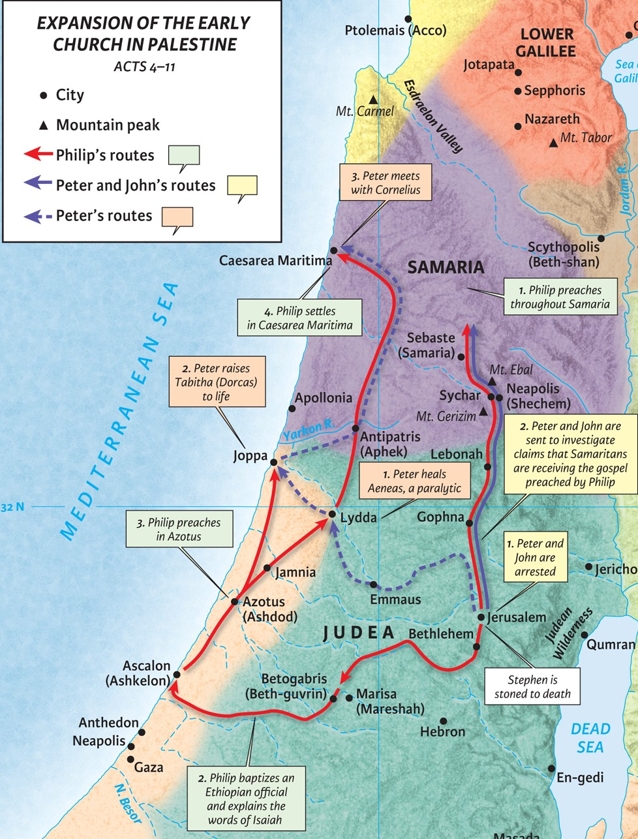
Sowing Seed in Samaria: What to Expect When Evangelizing
Acts 8:4-25

Slide 2
1. When evangelizing, expect your prejudices will be challenged.
“Preaching” = (Gr.) euangelizo = (En.) “evangelize”

Slide 3
1. When evangelizing, expect your prejudices will be challenged.
John 17:14(ESV)
The Samaritan woman said to him, “How is it that you, a Jew, ask for a drink from me, a woman of Samaria?” (For Jews have no dealings with Samaritans.)
Luke 9:52-54(ESV)
And he sent messengers ahead of him, who went and entered a village of the Samaritans, to make preparations for him. But the people did not receive him, because his face was set toward Jerusalem. And when his disciples James and John saw it, they said, “Lord, do you want us to tell fire to come down from heaven and consume them?”

Slide 4
1. When evangelizing, expect your prejudices will be challenged.
Acts 6:3-5a(ESV)
Therefore, brothers, pick out from among you seven men of good repute, full of the Spirit and of wisdom, whom we will appoint to this duty. But we will devote ourselves to prayer and to the ministry of the word.” And what they said pleased the whole gathering, and they chose Stephen, a man full of faith and of the Holy Spirit, and Philip…
Acts 1:8(ESV)
But you will receive power when the Holy Spirit has come upon you, and you will be my witnesses in Jerusalem and in all Judea and Samaria, and to the end of the earth.”

Slide 5
1. When evangelizing, expect your prejudices will be challenged.
Ephesians 3:4-6(ESV)
When you read this, you can perceive my insight into the mystery of Christ, which was not made known to the sons of men in other generations as it has now been revealed to his holy apostles and prophets by the Spirit. This mystery is that the Gentiles are fellow heirs, members of the same body, and partakers of the promise in Christ Jesus through the gospel.

Slide 6
2. When evangelizing, expect there will be spiritual warfare.
Exodus 7:20-22(ESV)
Moses and Aaron did as the Lord commanded. In the sight of Pharaoh and in the sight of his servants he lifted up the staff and struck the water in the Nile, and all the water in the Nile turned into blood … But the magicians of Egypt did the same by their secret arts.
Exodus 8:6-7(ESV)
So Aaron stretched out his hand over the waters of Egypt, and the frogs came up and covered the land of Egypt. But the magicians did the same by their secret arts and made frogs come up on the land of Egypt.

Slide 7
2. When evangelizing, expect there will be spiritual warfare.
Acts 16:16(ESV)
As we were going to the place of prayer, we were met by a slave girl who had a spirit of divination and brought her owners much gain by fortune-telling.

Slide 8
2. When evangelizing, expect there will be spiritual warfare.
Ephesians 2:1-2(ESV)
And you were dead in the trespasses and sins in which you once walked, following the course of this world, following the prince of the power of the air, the spirit that is now at work in the sons of disobedience—

Slide 9
2. When evangelizing, expect there will be spiritual warfare.
Ephesians 6:11-12(ESV)
Put on the whole armor of God, that you may be able to stand against the schemes of the devil. For we do not wrestle against flesh and blood, but against the rulers, against the authorities, against the cosmic powers over this present darkness, against the spiritual forces of evil in the heavenly places.
Ephesians 6:18-19(ESV)
praying at all times in the Spirit, with all prayer and supplication. To that end, keep alert with all perseverance, making supplication for all the saints, and also for me, that words may be given to me in opening my mouth boldly to proclaim the mystery of the gospel

Slide 10
3. When evangelizing, expect some will believe.
James 2:19b(ESV)
Even the demons believe—and shudder!
John 2:23-25(ESV)
Now when he was in Jerusalem at the Passover Feast, many believed in his name when they saw the signs that he was doing. But Jesus on his part did not entrust himself to them, because he knew all people and needed no one to bear witness about man, for he himself knew what was in man.

Slide 11
3. When evangelizing, expect some will believe.
Ephesians 3:4-6(ESV)
When you read this, you can perceive my insight into the mystery of Christ, which was not made known to the sons of men in other generations as it has now been revealed to his holy apostles and prophets by the Spirit. This mystery is that the Gentiles are fellow heirs, members of the same body, and partakers of the promise in Christ Jesus through the gospel.

Slide 12
3. When evangelizing, expect some will believe.
Romans 8:9b(ESV)
‘Anyone who does not have the Spirit of Christ does not belong to him.’
Ephesians 1:13(ESV)
In him you also, when you heard the word of truth, the gospel of your salvation, and believed in him, were sealed with the promised Holy Spirit, who is the guarantee of our inheritance until we acquire possession of it, to the praise of his glory.
Sealed = Ownership, Untakeable/unbreakable possession. King’s seal on an envelope.
Guarantee = Financial down payment to ensure a completed transaction

Slide 13
3. When evangelizing, expect some will believe.
Ephesians 2:19-20(ESV)
You are no longer strangers and aliens, but you are fellow citizens with the saints and members of the household of God, built on the foundation of the apostles and prophets, Christ Jesus himself being the cornerstone,
1 Corinthians 12:13(ESV)
For in one Spirit we were all baptized into one body—Jews or Greeks, slaves or free—and all were made to drink of one Spirit.
Acts 10:44-47(ESV)
While Peter was still saying these things, the Holy Spirit fell on all who heard the word. And the believers from among the circumcised who had come with Peter were amazed, because the gift of the Holy Spirit was poured out even on the Gentiles. For they were hearing them speaking in tongues and extolling God. Then Peter declared, “Can anyone withhold water for baptizing these people, who have received the Holy Spirit just as we have?”

Slide 14
4. When evangelizing, expect rejection from others.
Matter (ESV) = (Gr.) logos = “word” (John 1:1)
1 Corinthians 6:9a(ESV)
Or do you not know that the unrighteous will not inherit the kingdom of God?
1 John 3:4-6(ESV)
Everyone who makes a practice of sinning also practices lawlessness; sin is lawlessness … no one who keeps on sinning has either seen him or known him.
Hebrews 12:15(ESV)
See to it that no one fails to obtain the grace of God; that no “root of bitterness” springs up and causes trouble…

Slide 15
5. When evangelizing, expect God desires you to continue His mission.

