Slide 1
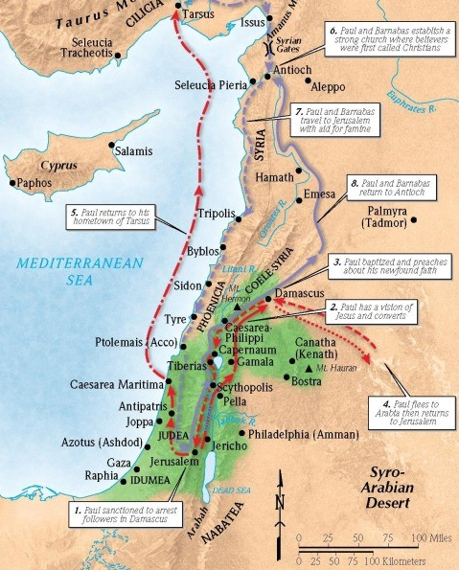
Saul and Ananias:
Ready Vessels Chosen by God
Acts 9:10-19

Slide 2
1 Timothy 2:3-4 (ESV)
This is good, and it is pleasing in the sight of God our Savior, who desires all people to be saved and to come to the knowledge of the truth.

Slide 3
1. Have a good reputation
Colossians 1:16-17 (ESV)
For by him all things were created, in heaven and on earth, visible and invisible, whether thrones or dominions or rulers or authorities—all things were created through him and for him. And he is before all things, and in him all things hold together.

Slide 4
1. Have a good reputation
Acts 22:11-13 (ESV)
And since I could not see because of the brightness of that light, I was led by the hand by those who were with me, and came into Damascus. “And one Ananias, a devout man according to the law, well spoken of by all the Jews who lived there, came to me, and standing by me said to me, ‘Brother Saul, receive your sight.’ And at that very hour I received my sight and saw him.

Slide 5
2. Hear God speak
After these things God tested Abraham and said to him, “Abraham!” And he said, “Here I am.” (Gen 22:1)
When the LORD saw that he turned aside to see, God called to him out of the bush, “Moses, Moses!” And he said, “Here I am.” (Exod 3:4)
Then the Lord called Samuel, and he said, “Here I am!” (1 Sam 3:4)
And I heard the voice of the Lord saying, “Whom shall I send, and who will go for us?” Then I said, “Here I am! Send me.” (Isa 6:8)

Slide 6
3. Pray
1 Thessalonians 5:16-18 (ESV)
Rejoice always, pray without ceasing, give thanks in all circumstances; for this is the will of God in Christ Jesus for you.

Slide 7
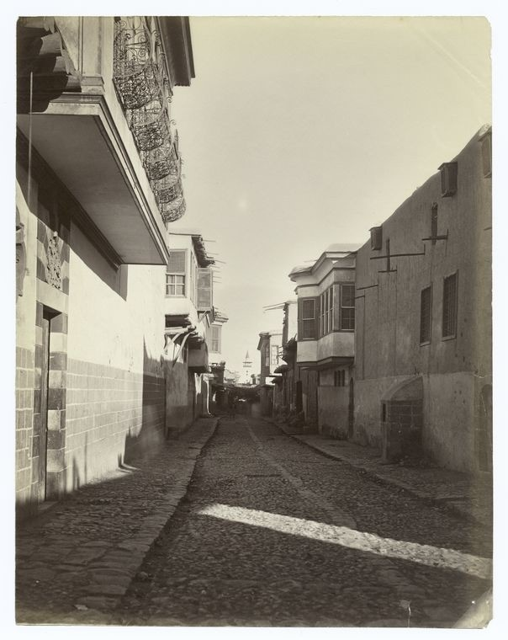
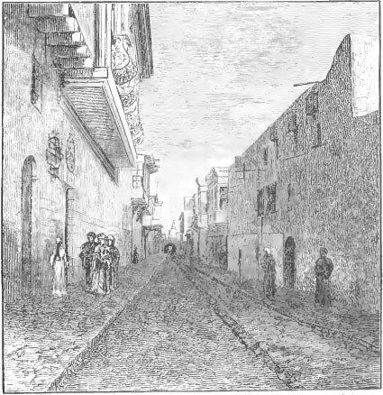

Slide 8
4. Count and pay the cost
1 Corinthians 15:8-9 (ESV)
Last of all, as to one untimely born, he appeared also to me. For I am the least of the apostles, unworthy to be called an apostle, because I persecuted the church of God.

Slide 9
4. Count and pay the cost
Romans 9:1-4 (ESV)
I am speaking the truth in Christ—I am not lying; my conscience bears me witness in the Holy Spirit— that I have great sorrow and unceasing anguish in my heart. For I could wish that I myself were accursed and cut off from Christ for the sake of my brothers, my kinsmen according to the flesh. They are Israelites, and to them belong the adoption, the glory, the covenants, the giving of the law, the worship, and the promises.

Slide 10
4. Count and pay the cost
Acts 26:15-18 (ESV)
And I said, ‘Who are you, Lord?’ And the Lord said, ‘I am Jesus whom you are persecuting. But rise and stand upon your feet, for I have appeared to you for this purpose, to appoint you as a servant and witness to the things in which you have seen me and to those in which I will appear to you, delivering you from your people and from the Gentiles—to whom I am sending you to open their eyes, so that they may turn from darkness to light and from the power of Satan to God, that they may receive forgiveness of sins and a place among those who are sanctified by faith in me.’

Slide 11
4. Count and pay the cost
Philippians (ESV)
1:21 – “For to me to live is Christ, and to die is gain.”
3:8 – “Indeed, I count everything as loss because of the surpassing worth of knowing Christ Jesus my Lord. For his sake I have suffered the loss of all things and count them as rubbish, in order that I may gain Christ”
2:17-18 – “Even if I am to be poured out as a drink offering upon the sacrificial offering of your faith, I am glad and rejoice with you all. Likewise, you also should be glad and rejoice with me.”

Slide 12
5. Wholeheartedly go where and when God calls you to.

Slide 13
6. Trust God for the work ahead

