Slide 1
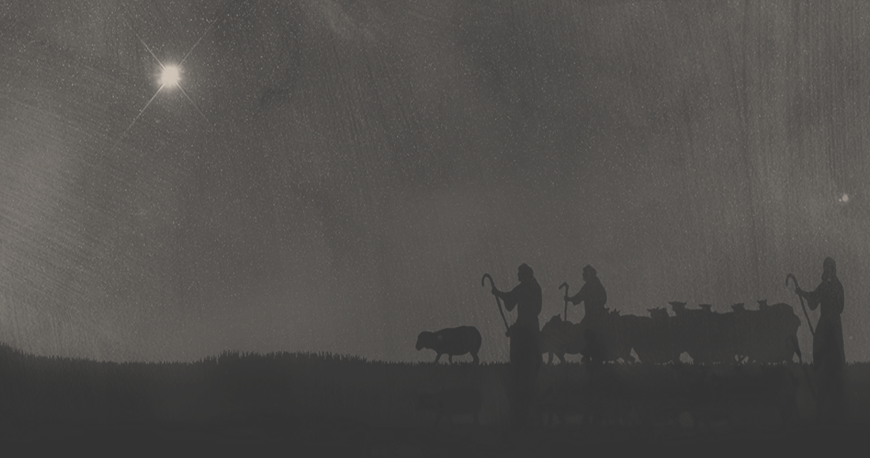
Glory to God! The Savior Is Born
Luke 2:12-20

Slide 2
#1. Comes in humility to the humble.
a. The good news comes to the humble.

Slide 3
#1. Comes in humility to the humble.
b. The good news comes by the humbled Savior.

Slide 4
Philippians 2:5-8 (ESV)
Have this mind among yourselves, which is yours in Christ Jesus, who, though he was in the form of God, did not count equality with God a thing to be grasped, but emptied himself, by taking the form of a servant, being born in the likeness of men.
And being found in human form, he humbled himself by becoming obedient to the point of death, even death on a cross.
Galatians 3:13 (ESV)
Christ redeemed us from the curse of the law by becoming a curse for us—for it is written, “Cursed is everyone who is hanged on a tree”—

Slide 5
Philippians 2:5-11 (ESV)
Have this mind among yourselves, which is yours in Christ Jesus, who, though he was in the form of God, did not count equality with God a thing to be grasped, but emptied himself, by taking the form of a servant, being born in the likeness of men.
And being found in human form, he humbled himself by becoming obedient to the point of death, even death on a cross.
Therefore God has highly exalted him and bestowed on him the name that is above every name, so that at the name of Jesus every knee should bow, in heaven and on earth and under the earth, and every tongue confess that Jesus Christ is Lord, to the glory of God the Father.
Galatians 3:13 (ESV)
Christ redeemed us from the curse of the law by becoming a curse for us—for it is written, “Cursed is everyone who is hanged on a tree”—

Slide 6
#2. Is the Good News of peace.
Revelation 5:11-12 (ESV)
Then I looked, and I heard around the throne and the living creatures and the elders the voice of many angels, numbering myriads of myriads and thousands of thousands, saying with a loud voice, “Worthy is the Lamb who was slain, to receive power and wealth and wisdom and might and honor and glory and blessing!”

Slide 7
#2. Is the Good News of peace.
Matthew 26:53-54 (ESV)
Do you think that I cannot appeal to my Father, and he will at once send me more than twelve legions of angels? But how then should the Scriptures be fulfilled, that it must be so?”
Luke 2:14 (NIV)
“Glory to God in the highest heaven, and on earth peace to those on whom his favor rests.”

Slide 8
#2. Is the Good News of peace.
Romans 5:1 (ESV)
… since we have been justified by faith, we have peace with God through our Lord Jesus Christ.
Philippians 4:7 (ESV)
And the peace of God, which surpasses all understanding, will guard your hearts and your minds in Christ Jesus.
Galatians 5:22-23 (ESV)
But the fruit of the Spirit is love, joy, peace, patience, kindness, goodness, faithfulness, gentleness, self-control; against such things there is no law.

Slide 9
#3. Is worth seeking and proclaiming.
“this thing” = “this word” or “this reality”
“that has happened” = “has happened and is still happening” (perfect participle)
“which the Lord has made known” = The angel’s delivered GOD’S word, GOD’S Revelation
The Shepherd’s Believed!

Slide 10
#4. Is a gift that can be responded to.
“wondered” = “astonishment” or “amazement” (positive or negative sense)
“treasured up” = sense of “preserving, protecting, defending”
“pondering” = “placing things together for comparison”

Slide 11
#5. Transforms hearts and lives.
Romans 12:2 (ESV)
Do not be conformed to this world, but be transformed by the renewal of your mind, that by testing you may discern what is the will of God, what is good and acceptable and perfect.

