Slide 1
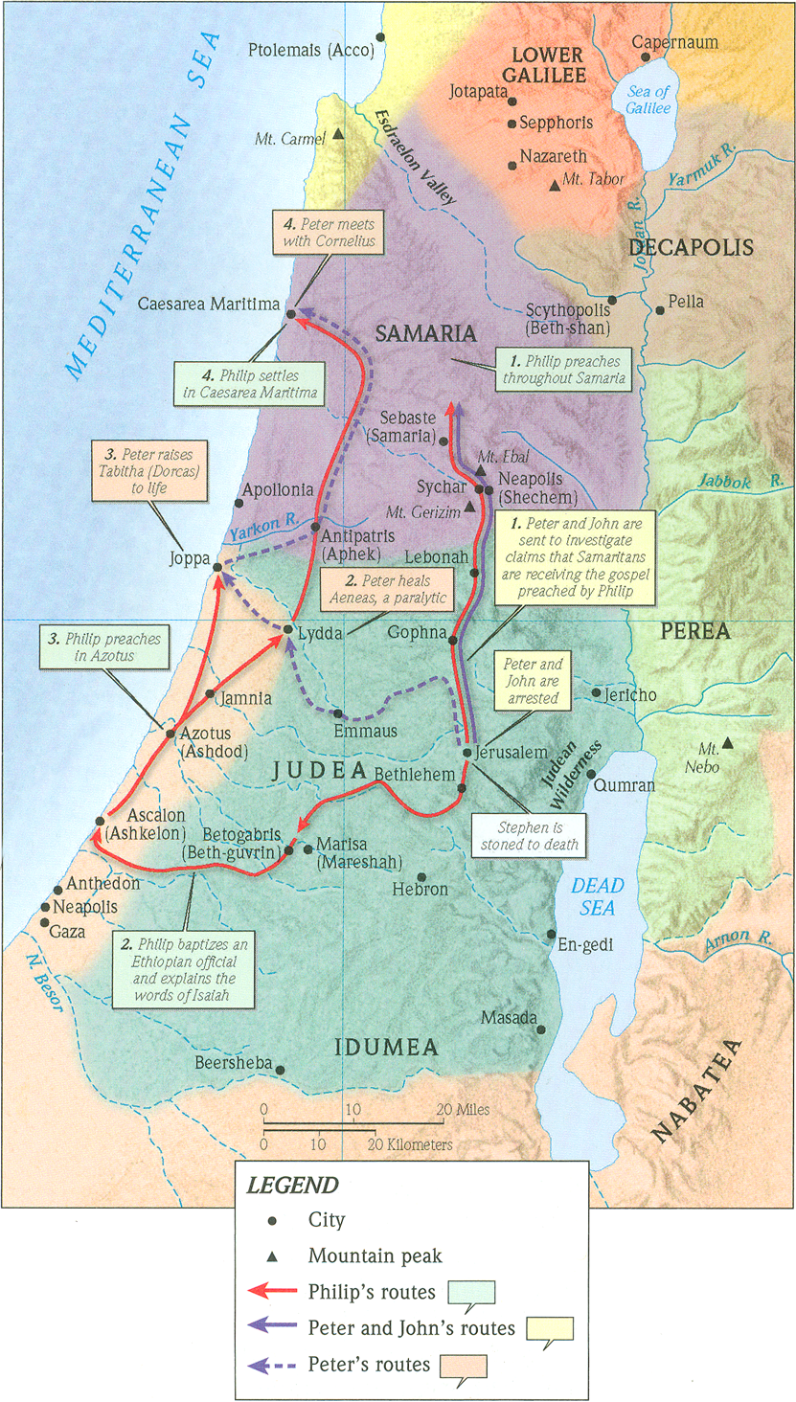
One Gospel, One People, Many Nations (p.1)
Acts 9:43-10:8

Slide 2
Acts 1:8b (ESV)
“…and you will be my witnesses in Jerusalem and in all Judea and Samaria, and to the end of the earth.”
Acts 4:12 (ESV)
“And there is salvation in no one else, for there is no other name under heaven given among men by which we must be saved.”

Slide 3
1. God has already began preparing Peter by breaking down his social barriers
Jonah 1:3 (ESV)
But Jonah rose to flee to Tarshish from the presence of the LORD. He went down to Joppa and found a ship going to Tarshish. So he paid the fare and went down into it, to go with them to Tarshish, away from the presence of the LORD.

Slide 4
A. God has already began preparing Peter by breaking down his social barriers
From the Babylonion Talmud
(Jewish Law and Commentary)
“If a tanner married without mentioning his trade, his wife is permitted to get a divorce”
“The law of levirate marriage might be set aside if the brother-in-law of the childless widow is a tanner”
“A tanner’s yard must be at least fifty cubits from any town”

Slide 5
A. God has already began preparing Peter by breaking down his social barriers
APPLICATION
God prepares you for what is to come by entrusting you first with the little things and gives you more as you are faithful in those things.
Luke 16:10-12 (ESV)
“One who is faithful in a very little is also faithful in much, and one who is dishonest in a very little is also dishonest in much. If then you have not been faithful in the unrighteous wealth, who will entrust to you the true riches? And if you have not been faithful in that which is another’s, who will give you that which is your own?”

Slide 6
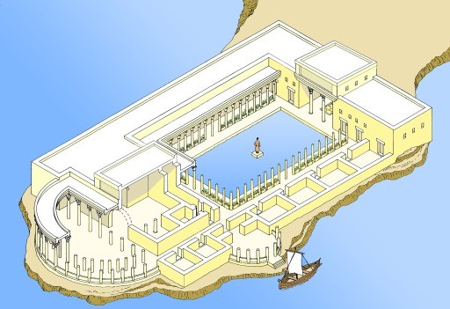
B. God prepares the Gentile, Cornelius, for Gospel reception.

Slide 7
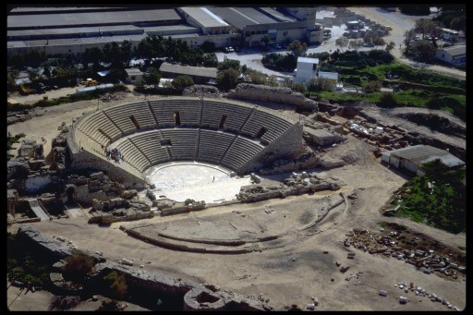
B. God prepares the Gentile, Cornelius, for Gospel reception.

Slide 8
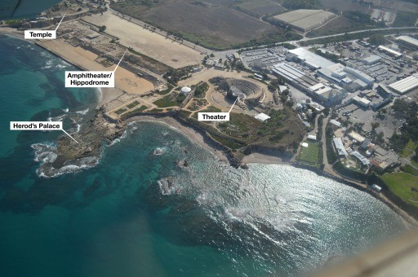
B. God prepares the Gentile, Cornelius, for Gospel reception.

Slide 9
B. God prepares the Gentile, Cornelius, for Gospel reception.
APPLICATION #1
You can be confident that Scripture is grounded in real history.

Slide 10
B. God prepares the Gentile, Cornelius, for Gospel reception.
APPLICATION #2
Salvation does not depend on your good works, but belief and trust in Jesus and his Gospel message.

Slide 11
B. God prepares the Gentile, Cornelius, for Gospel reception.
APPLICATION #3
Only God knows the heart and his grace knows no prejudice.

Slide 12
B. God prepares the Gentile, Cornelius, for Gospel reception.
APPLICATION #4
God can reach the most remote location and will reach those who are truly seeking Him.
James 4:8a (ESV)
Draw near to God, and he will draw near to you. Cleanse your hands, you sinners…

Slide 13
B. God prepares the Gentile, Cornelius, for Gospel reception.
APPLICATION #5
God’s normal plan is to use people to deliver the message of salvation to other people.

Slide 14
B. God prepares the Gentile, Cornelius, for Gospel reception.
APPLICATION #6
Stepping out in faith-filled obedience is evidence of a true heart response to God.

