Slide 1
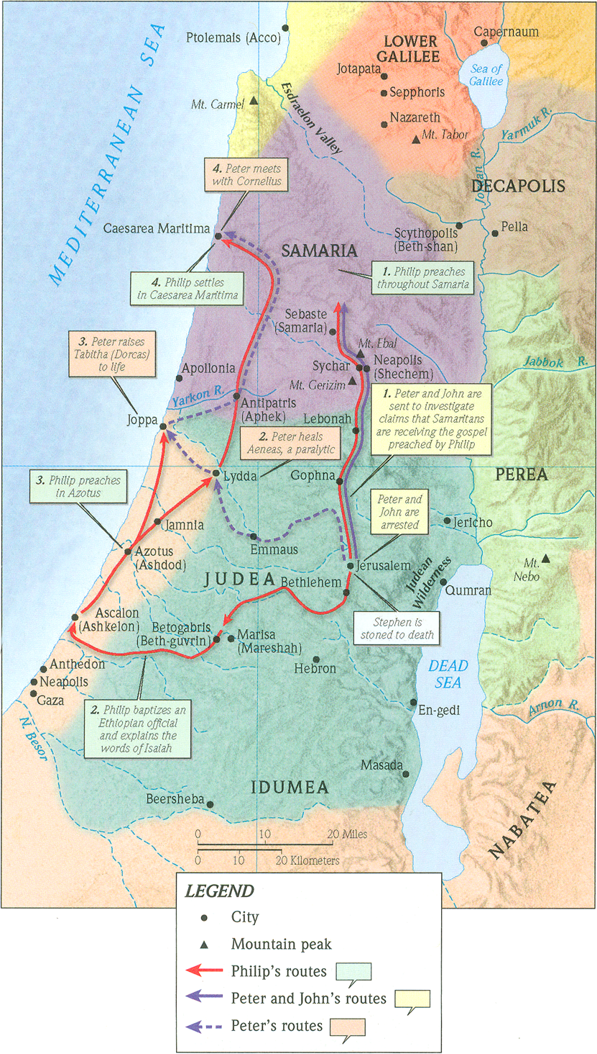
One Gospel, One People, Many Nations (p.3)
Acts 10:34-48
“Be my witnesses in Jerusalem and in all Judea and Samaria, and to the ends of the earth” – Acts 1:8 (ESV)

Slide 2
Matthew 28:19-20 (ESV)
Go therefore and make disciples of all nations, baptizing them in the name of the Father and of the Son and of the Holy Spirit, teaching them to observe all that I have commanded you. And behold, I am with you always, to the end of the age.”
“nations” (ESV) = “ethnos” (Greek)
“ethnic, ethnicities”

Slide 3
1. God shows no partiality in offering it.
Deuteronomy 10:17-19 (ESV)
For the Lord your God is God of gods and Lord of lords, the great, the mighty, and the awesome God, who is not partial and takes no bribe. He executes justice for the fatherless and the widow, and loves the sojourner, giving him food and clothing. Love the sojourner, therefore, for you were sojourners in the land of Egypt.

Slide 4
1. God shows no partiality in offering it.
Acts 11:14 (ESV)
he will declare to you a message by which you will be saved, you and all your household.’

Slide 5
2. It brings peace with God.
Romans 2:11-12 (ESV)
For God shows no partiality. For all who have sinned without the law will also perish without the law, and all who have sinned under the law will be judged by the law.
Romans 3:23 (ESV)
for all have sinned and fall short of the glory of God,
Romans 6:23 (ESV)
For the wages of sin is death….

Slide 6
2. It brings peace with God.
Romans 5:1 (ESV)
Therefore, since we have been justified by faith, we have peace with God through our Lord Jesus Christ.
Romans 5:6 (ESV)
while we were still weak, at the right time Christ died for the ungodly.
Romans 5:8 (ESV)
but God shows his love for us in that while we were still sinners, Christ died for us.
Romans 5:10 (ESV)
For if while we were enemies we were reconciled to God by the death of his Son, much more, now that we are reconciled, shall we be saved by his life.

Slide 7
2. It brings peace with God.
a. God added humanity to Himself and lived a perfect life.
Acts 8:40 (ESV)
But Philip found himself at Azotus, and as he passed through he preached the gospel to all the towns until he came to Caesarea.
Acts 21:8 (ESV)
On the next day we departed and came to Caesarea, and we entered the house of Philip the evangelist, who was one of the seven, and stayed with him.
Acts 9:30 (ESV)
And when the brothers learned this, they brought him (Saul/Paul) down to Caesarea and sent him off to Tarsus.

Slide 8
2. It brings peace with God.
a. God added humanity to Himself and lived a perfect life.
Matthew 3:14-17 (ESV)
John would have prevented him, saying, “I need to be baptized by you, and do you come to me?” But Jesus answered him, “Let it be so now, for thus it is fitting for us to fulfill all righteousness.” Then he consented. And when Jesus was baptized, immediately he went up from the water, and behold, the heavens were opened to him, and he saw the Spirit of God descending like a dove and coming to rest on him; and behold, a voice from heaven said, “This is my beloved Son, with whom I am well pleased.”

Slide 9
2. It brings peace with God.
b. Jesus was cruelly killed but triumphantly rose from the dead.
Deuteronomy 21:22-23 (ESV)
“And if a man has committed a crime punishable by death and he is put to death, and you hang him on a tree, his body shall not remain all night on the tree, but you shall bury him the same day, for a hanged man is cursed by God. You shall not defile your land that the LORD your God is giving you for an inheritance.
Galatians 3:13-14 (ESV)
Christ redeemed us from the curse of the law by becoming a curse for us—for it is written, “Cursed is everyone who is hanged on a tree”— so that in Christ Jesus the blessing of Abraham might come to the Gentiles, so that we might receive the promised Spirit through faith.

Slide 10
2. It brings peace with God.
b. Jesus was cruelly killed but triumphantly rose from the dead.
1 Corinthians 15:6 (ESV)
Then he appeared to more than five hundred brothers at one time, most of whom are still alive, though some have fallen asleep.

Slide 11
2. It brings peace with God.
b. Jesus is Lord of all.
John 5:22 (ESV)
For the Father judges no one, but has given all judgment to the Son,

Slide 12
3. Salvation is not about what you can do but Who you believe in.
Genesis 3:15 (ESV)
I will put enmity between you and the woman, and between your offspring and her offspring; he shall bruise your head, and you shall bruise his heel.”

Slide 13
4. Believing in Jesus means your sins are forgiven.
2 Corinthians 5:21 (ESV)
For our sake he made him to be sin who knew no sin, so that in him we might become the righteousness of God.

Slide 14
4. Believing in Jesus means your sins are forgiven.
Psalm 103:12 (ESV)
as far as the east is from the west, so far does he remove our transgressions from us.
Isaiah 1:18 (ESV)
“…though your sins are like scarlet, they shall be as white as snow; though they are red like crimson, they shall become like wool.”
Isaiah 53:11 (ESV)
Out of the anguish of his soul he shall see and be satisfied; by his knowledge shall the righteous one, my servant, make many to be accounted righteous, and he shall bear their iniquities.
Ezekiel 36:25-26 (ESV)
I will sprinkle clean water on you, and you shall be clean from all your uncleannesses, and from all your idols I will cleanse you.

Slide 15
5. Believing in Jesus means you are given a new Spirit.

Slide 16
6. Believing in Jesus means you are given a new family.
1 Corinthians 12:13 (ESV)
For in one Spirit we were all baptized into one body—Jews or Greeks, slaves or free—and all were made to drink of one Spirit.

