Slide 1
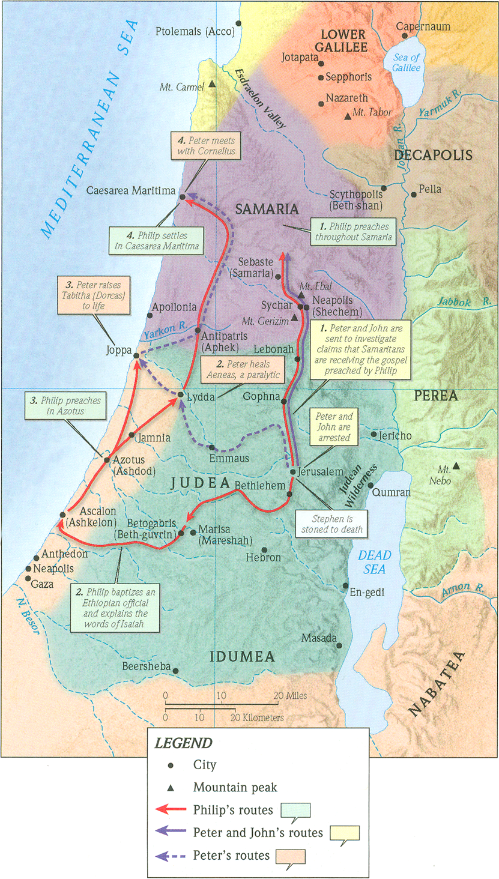
One Gospel, One People, Many Nations (p.1)
Acts 9:43-10:8
“Be my witnesses in Jerusalem and in all Judea and Samaria, and to the ends of the earth” – Acts 1:8 (ESV)

Slide 2
Genesis 12:1-3 (ESV)
Now the Lord said to Abram, “Go from your country and your kindred and your father’s house to the land that I will show you. And I will make of you a great nation, and I will bless you and make your name great, so that you will be a blessing. I will bless those who bless you, and him who dishonors you I will curse, and in you all the families of the earth shall be blessed.”

Slide 3
Ephesians 3:4-6 (ESV)
When you read this, you can perceive my insight into the mystery of Christ, which was not made known to the sons of men in other generations as it has now been revealed to his holy apostles and prophets by the Spirit. This mystery is that the Gentiles are fellow heirs, members of the same body, and partakers of the promise in Christ Jesus through the gospel.

Slide 4
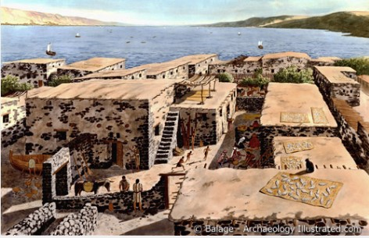
A. God prepares Peter an unwanted meal

Slide 5
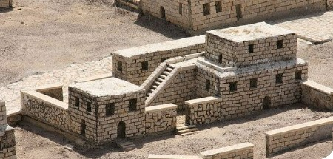
A. God prepares Peter an unwanted meal.

Slide 6
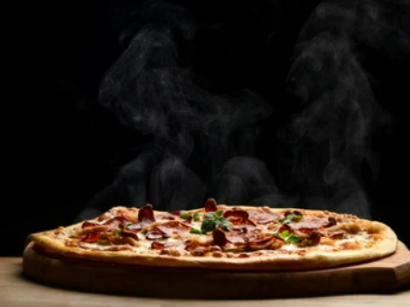
A. God prepares Peter an unwanted meal.
1. Be devoted to prayer.

Slide 7
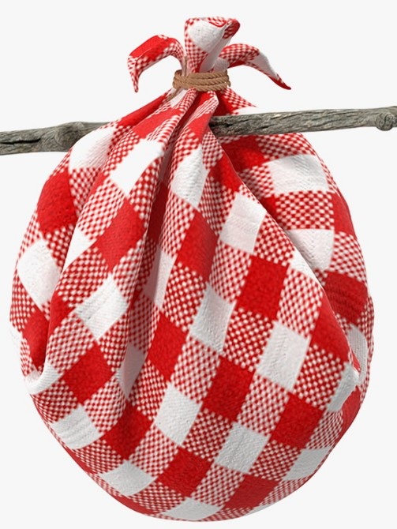
A. God prepares Peter an unwanted meal.
2. God’s timing isn’t always convenient for me, but it’s always perfect.

Slide 8
A. God prepares Peter an unwanted meal.
2. God’s timing isn’t always convenient for me, but it’s always perfect.
Galatians 2:11-12 (ESV)
But when Cephas (Peter) came to Antioch, I opposed him to his face, because he stood condemned. For before certain men came from James, he was eating with the Gentiles…

Slide 9
A. God prepares Peter an unwanted meal.
3. If it’s a choice between tradition and God’s word, choose God’s word. Every time.
Colossians 2:16-17 (ESV)
Therefore let no one pass judgment on you in questions of food and drink, or with regard to a festival or a new moon or a Sabbath. These are a shadow of the things to come, but the substance belongs to Christ.
Ephesians 5:19 (ESV)
addressing one another in psalms and hymns and spiritual songs, singing and making melody to the Lord with your heart,

Slide 10
A. God prepares Peter an unwanted meal.
3. If it’s a choice between tradition and God’s word, choose God’s word. Every time.
1 Timothy 4:1-5 (ESV)
Now the Spirit expressly says that in later times some will depart from the faith by devoting themselves to deceitful spirits and teachings of demons, through the insincerity of liars whose consciences are seared, who forbid marriage and require abstinence from foods that God created to be received with thanksgiving by those who believe and know the truth. For everything created by God is good, and nothing is to be rejected if it is received with thanksgiving, for it is made holy by the word of God and prayer.

Slide 11
A. God prepares Peter an unwanted meal.
4. If it’s a choice between the voice in your head and God’s word, choose God’s word. Every time.

Slide 12
B. God prepares Peter for unwanted company
5. When God tells you to go, do so without hesitation and without discrimination.
Jonah 1:3 (ESV)
But Jonah rose to flee to Tarshish from the presence of the LORD. He went down to Joppa and found a ship going to Tarshish. So he paid the fare and went down into it, to go with them to Tarshish, away from the presence of the LORD.

Slide 13
B. God prepares Peter for unwanted company
6. Don’t neglect to show hospitality to strangers.
Hebrews 13:2 (ESV)
Do not neglect to show hospitality to strangers, for thereby some have entertained angels unawares.

Slide 14
C. God prepares an unexpected meeting of former enemies
7. You can trust the authority of God’s word.

Slide 15
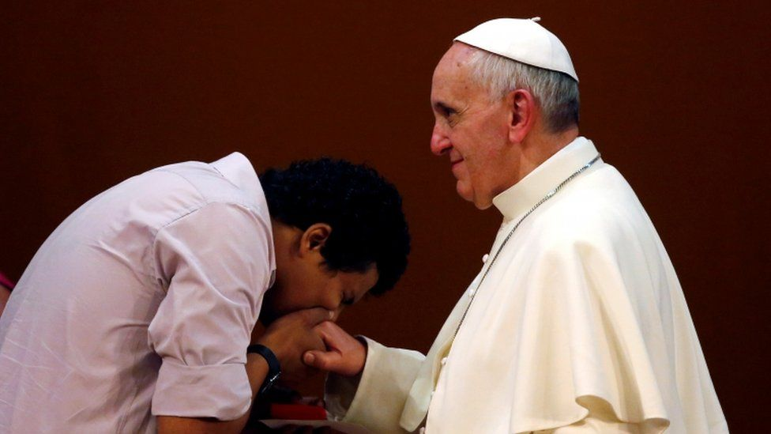
C. God prepares an unexpected meeting of former enemies
7. Only God is worthy of our worship.

