Slide 1
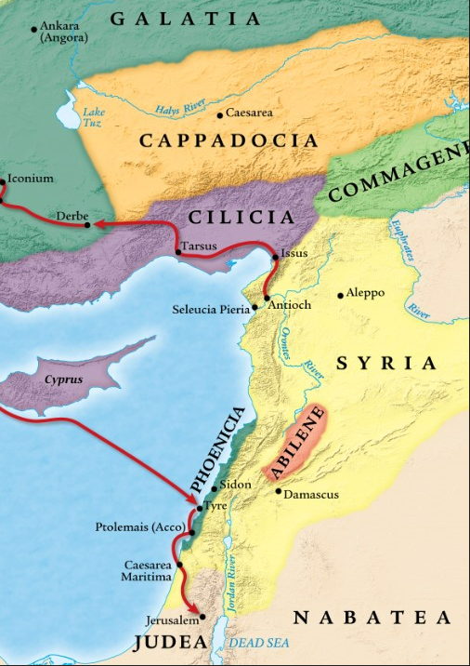
One Gospel, One People, Many Nations (p.4)
Acts 11:1-30
“Be my witnesses in Jerusalem and in all Judea and Samaria, and to the ends of the earth” – Acts 1:8 (ESV)

Slide 2
1. The criticism from Jerusalem.
Application #1
Ask the Lord to keep you from having a spirit of criticism.
Galatians 5:22-23 (ESV)
But the fruit of the Spirit is
love,
joy,
peace,
patience,
kindness,
goodness,
faithfulness,
gentleness,
self-control;
(criticism)

Slide 3
1. The criticism from Jerusalem.
Application #1
Ask the Lord to keep you from having a spirit of criticism.
Matthew 7:5 (ESV)
You hypocrite, first take the log out of your own eye, and then you will see clearly to take the speck out of your brother’s eye.
Matthew 18:15-17a (ESV)
If your brother sins against you, go and tell him his fault, between you and him alone. If he listens to you, you have gained your brother. But if he does not listen, take one or two others along with you, that every charge may be established by the evidence of two or three witnesses. If he refuses to listen to them, tell it to the church.
Galatians 6:1 (ESV)
Brothers, if anyone is caught in any transgression, you who are spiritual should restore him in a spirit of gentleness. Keep watch on yourself, lest you too be tempted.

Slide 4
2. Peter’s response to the critics.
Application #2
Respond to criticism by God’s Spirit and through His Word.

Slide 5
2. Peter’s response to the critics.
Application #3
Jesus is head of the church and what he has spoken has the final authority in all things
Ephesians 1:20-23 (ESV)
which He brought about in Christ, when He raised Him from the dead and seated Him at His right hand in the heavenly places, far above all rule and authority and power and dominion, and every name that is named, not only in this age but also in the one to come. And He put all things in subjection under His feet, and gave Him as head over all things to the church, which is His body, the fullness of Him who fills all in all.

Slide 6
2. Peter’s response to the critics.
“Same” gift = ‘isos’ = English prefix “iso-” (isosceles triangle)
Job 40:1-2 (ESV)
Then the Lord said to Job, “Will the faultfinder contend with the Almighty? Let him who reproves God answer it.”

Slide 7
3. The critic’s response back to Peter.
Application #4
Glorify God no matter the circumstances
1 Corinthians 10:31 (ESV)
Whether, then, you eat or drink or whatever you do, do all to the glory of God.

Slide 8
3. The critic’s response back to Peter.
Application #5
True belief comes with repentance.

Slide 9
4. God is doing the same work of salvation to Gentiles in Antioch.
Acts 2:8-11 (ESV)
“And how is it that we each hear them in our own language to which we were born? “Parthians and Medes and Elamites, and residents of Mesopotamia, Judea and Cappadocia, Pontus and Asia, Phrygia and Pamphylia, Egypt and the districts of Libya around Cyrene, and visitors from Rome, both Jews and proselytes, Cretans and Arabs—we hear them in our own tongues speaking of the mighty deeds of God.”

Slide 10
4. God is doing the same work of salvation to Gentiles in Antioch.
Application #6
Christians are to be in the world but not of it.
John 17:15-16 (ESV)
“I do not ask You to take them out of the world, but to keep them from the evil one. “They are not of the world, even as I am not of the world.”

Slide 11
4. God is doing the same work of salvation to Gentiles in Antioch.
Application #7
We go in humility trusting God to work.

Slide 12
5. The Jew & Gentile churches experience unity.
Application #8
We are all growing in God’s truth and grace, and as one body.

Slide 13
5. The Jew & Gentile churches experience unity.
“Look for” = Search diligently; search up and down, all over, until found
Luke 2:43-46 (ESV)
And when the feast was ended, as they were returning, the boy Jesus stayed behind in Jerusalem. His parents did not know it, but supposing him to be in the group they went a day’s journey, but then they began to search for him among their relatives and acquaintances, and when they did not find him, they returned to Jerusalem, searching for him. After three days they found him in the temple, sitting among the teachers, listening to them and asking them questions.

Slide 14
5. The Jew & Gentile churches experience unity.
Philippians 2:1-5 (ESV)
So if there is any encouragement in Christ, any comfort from love, any participation in the Spirit, any affection and sympathy, complete my joy by being of the same mind, having the same love, being in full accord and of one mind. Do nothing from selfish ambition or conceit, but in humility count others more significant than yourselves. Let each of you look not only to his own interests, but also to the interests of others. Have this mind among yourselves, which is yours in Christ Jesus,

