Slide 1
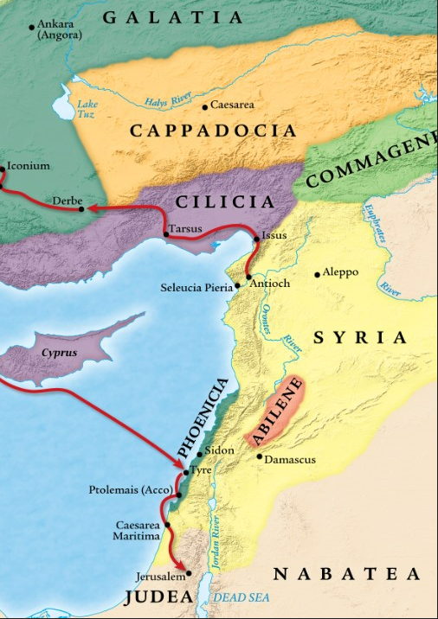
When it Doesn’t Seem Like God Is in Control, p.2
Acts 12:1-25
“Be my witnesses in Jerusalem and in all Judea and Samaria, and to the ends of the earth” – Acts 1:8 (ESV)

Slide 2
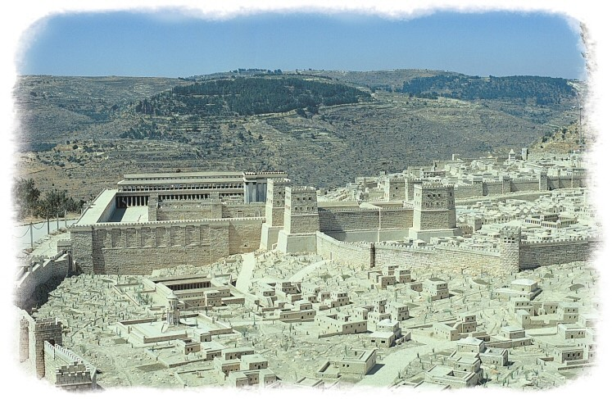

Slide 4
3. God IS unquestionably in control.
a. God rescues Peter from a hopeless situation.
Luke 22:44 (ESV)
And he withdrew from them about a stone’s throw, and knelt down and prayed, saying, “Father, if you are willing, remove this cup from me. Nevertheless, not my will, but yours, be done.” And there appeared to him an angel from heaven, strengthening him. And being in agony he prayed more earnestly; and his sweat became like great drops of blood falling down to the ground.

Slide 5
3. God IS unquestionably in control.
a. God rescues Peter from a hopeless situation.
Application #1
Always pray, especially when trials come, and you may feel like doing anything but.

Slide 6
3. God IS unquestionably in control.
a. God rescues Peter from a hopeless situation.
Philippians 4:6-7 (ESV)
do not be anxious about anything, but in everything by prayer and supplication with thanksgiving let your requests be made known to God. And the peace of God, which surpasses all understanding, will guard your hearts and your minds in Christ Jesus.
John 21:1-19 (ESV)
He said to him the third time, “Simon, son of John, do you love me?” Peter was grieved because he said to him the third time, “Do you love me?” and he said to him, “Lord, you know everything; you know that I love you.” Jesus said to him, “Feed my sheep. Truly, truly, I say to you, when you were young, you used to dress yourself and walk wherever you wanted, but when you are old, you will stretch out your hands, and another will dress you and carry you where you do not want to go.” (This he said to show by what kind of death he was to glorify God.) And after saying this he said to him, “Follow me.”
1 Peter 6:6-7 (ESV)
Humble yourselves, therefore, under the mighty hand of God so that at the proper time he may exalt you, casting all your anxieties on him, because he cares for you.

Slide 7
3. God IS unquestionably in control.
a. God rescues Peter from a hopeless situation.
Verse 10: “of its own accord”
Greek: automatos
English: automatic

Slide 8
3. God IS unquestionably in control.
a. God rescues Peter from a hopeless situation.
Application #2
God will deliver you in His perfect timing according to His perfect will.

Slide 9
3. God IS unquestionably in control.
b. God reassures the church and tenderly answers prayer.
Colossians 4:10 (ESV)
Aristarchus my fellow prisoner greets you, and Mark the cousin of Barnabas…

Slide 10
3. God IS unquestionably in control.
b. God reassures the church and tenderly answers prayer.
Verse 15: “You are out of your mind.”
Greek: mainomai
English: mania (maniac)

Slide 11
3. God IS unquestionably in control.
b. God reassures the church and tenderly answers prayer.
Hebrews 1:14 (ESV)
Are they (angels) not all ministering spirits sent out to serve for the sake of those who are to inherit salvation?
Revelation 5:11 (ESV)
Then I looked, and I heard around the throne and the living creatures and the elders the voice of many angels, numbering myriads of myriads and thousands of thousands
Matthew 18:10 (ESV)
“See that you do not despise one of these little ones. For I tell you that in heaven their angels always see the face of my Father who is in heaven.

Slide 12
3. God IS unquestionably in control.
b. God reassures the church and tenderly answers prayer.
Application #3
Recognize and acknowledge God’s faithfulness in answered prayer.
1 John 5:14-15 (ESV)
And this is the confidence that we have toward him, that if we ask anything according to his will he hears us. And if we know that he hears us in whatever we ask, we know that we have the requests that we have asked of him.

Slide 13
3. God IS unquestionably in control.
c. God executes judgment on the enemy.
Application #4
God is sovereign, but man is still responsible.

Slide 14
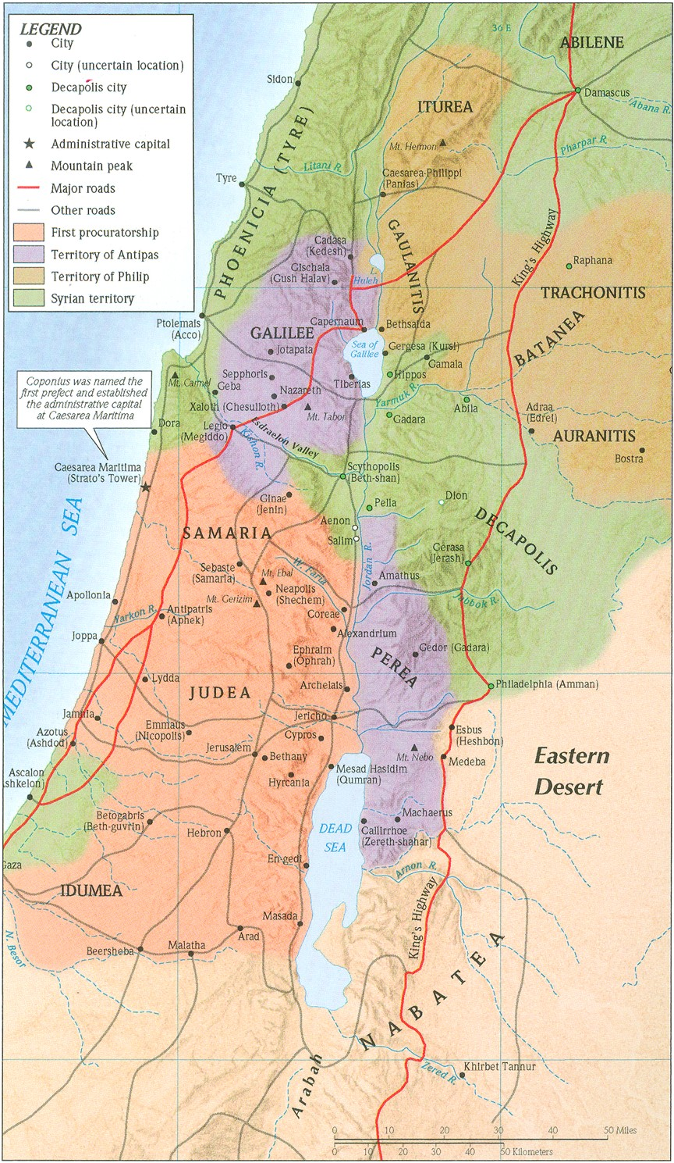

Slide 15
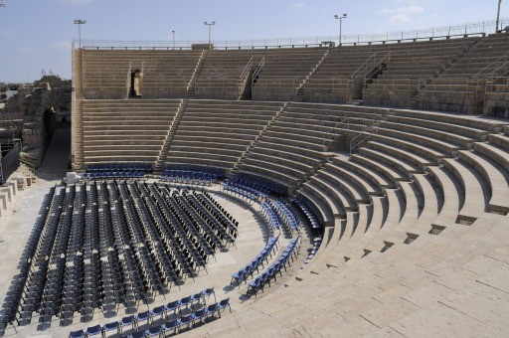
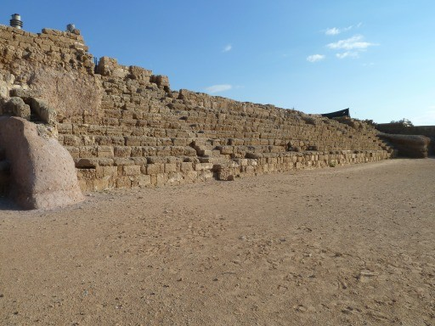
3. God IS unquestionably in control.
c. God executes judgment on the enemy.
Excerpt from Josephus, The Antiquities XIX
On the second day of which shows he put on a garment made wholly of silver, and of a contexture truly wonderful, and came into the theatre early in the morning; at which time the silver of his garment being illuminated by the fresh reflection of the sun’s rays upon it, shone out after a surprising manner, and was so resplendent as to spread a horror over those that looked intently upon him;

Slide 16
3. God IS unquestionably in control.
c. God executes judgment on the enemy.
Acts 10:25-26 (ESV)
When Peter entered, Cornelius met him and fell down at his feet and worshiped him. But Peter lifted him up, saying, “Stand up; I too am a man.”
Acts 14:11-15 (ESV)
And when the crowds saw what Paul had done, they lifted up their voices, saying in Lycaonian, “The gods have come down to us in the likeness of men!” Barnabas they called Zeus, and Paul, Hermes, because he was the chief speaker. And the priest of Zeus, whose temple was at the entrance to the city, brought oxen and garlands to the gates and wanted to offer sacrifice with the crowds. But when the apostles Barnabas and Paul heard of it, they tore their garments and rushed out into the crowd, crying out, “Men, why are you doing these things? We also are men, of like nature with you, and we bring you good news, that you should turn from these vain things to a living God, who made the heaven and the earth and the sea and all that is in them.

Slide 17
3. God IS unquestionably in control.
c. God executes judgment on the enemy.
Application #5
Don’t fight against God; instead give Him the glory.

Slide 18
Communion

