Slide 1
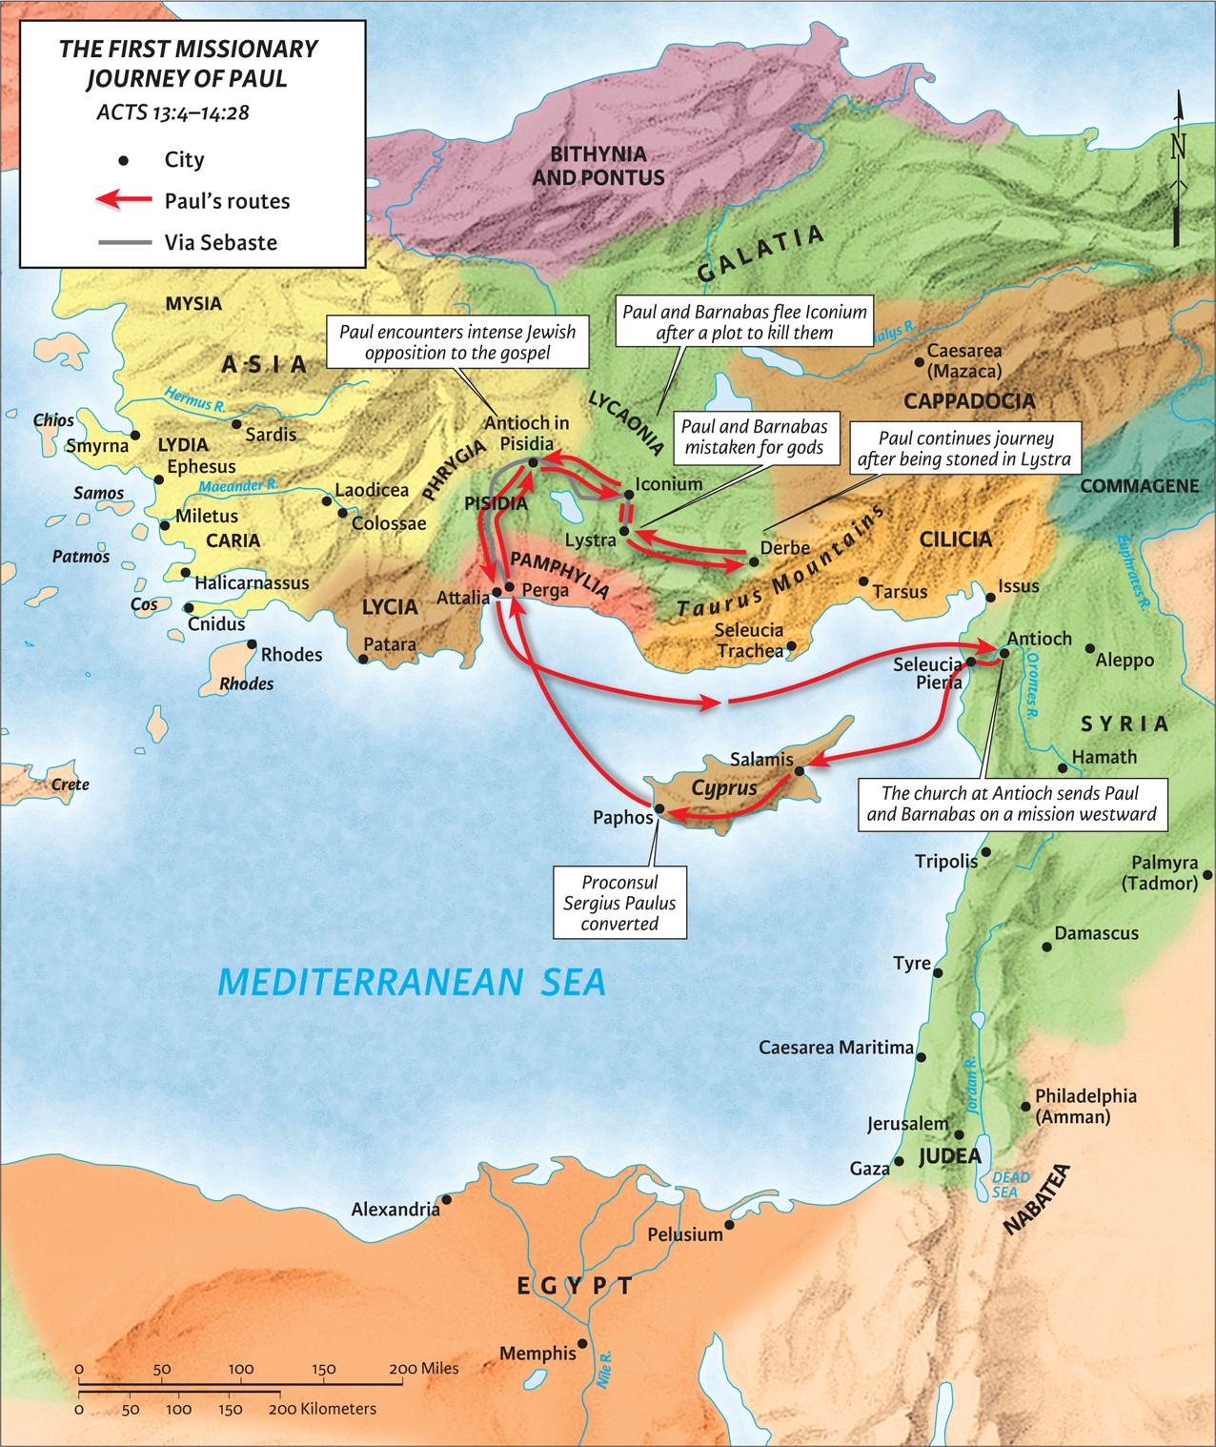
The Spirit Sends,
Satan Opposes
part 1
Acts 13:1-14
“Be my witnesses in Jerusalem and in all Judea and Samaria, and to the ends of the earth”
– Acts 1:8 (ESV)

Slide 2
Prophets and Teachers:
Ephesians 2:19-20 (ESV)
So then you are no longer strangers and aliens, but you are fellow citizens with the saints and members of the household of God, built on the foundation of the apostles and prophets, Christ Jesus himself being the cornerstone,
1 Timothy 3:2 (ESV)
Therefore an overseer must be above reproach, the husband of one wife, sober-minded, self-controlled, respectable, hospitable, able to teach,

Slide 3
1. Devote yourself to the word of God.
1 Timothy 4:6-8 (ESV)
If you put these things before the brothers, you will be a good servant of Christ Jesus, being trained in the words of the faith and of the good doctrine that you have followed. Have nothing to do with irreverent, silly myths. Rather train yourself for godliness; for while bodily training is of some value, godliness is of value in every way, as it holds promise for the present life and also for the life to come.

Slide 4
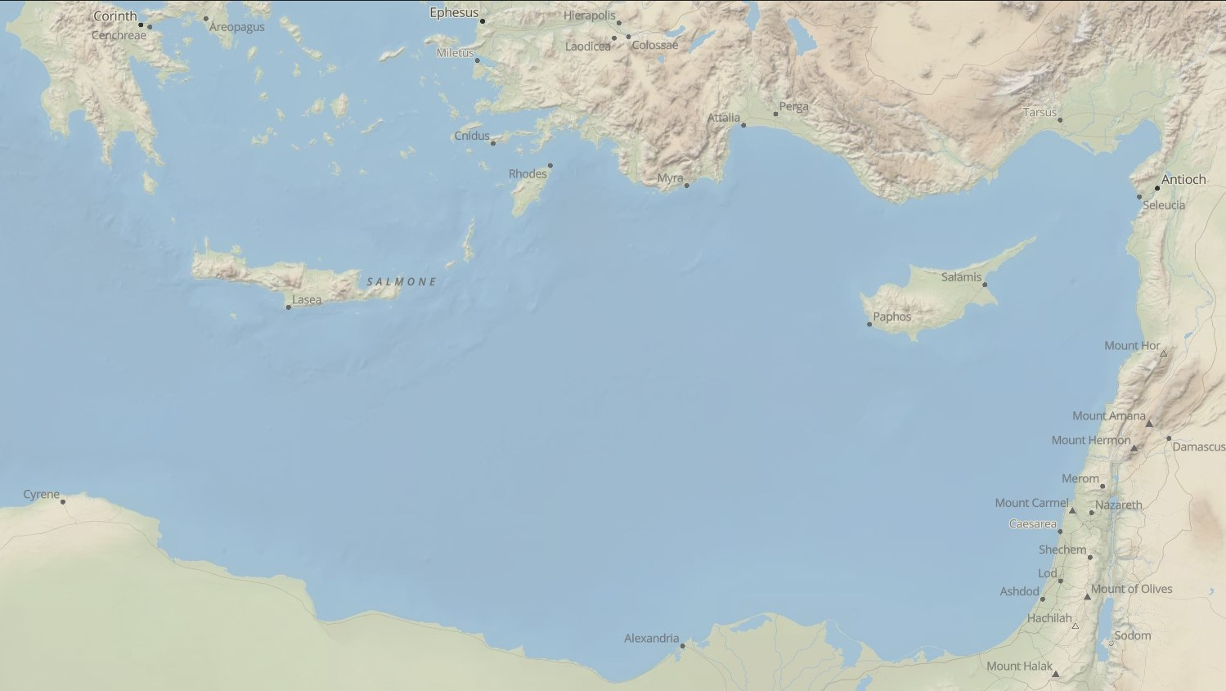


2. Devote yourself to one another.
But there were some of them, men of Cyprus and Cyrene, who on coming to Antioch spoke to the Hellenists also, preaching the Lord Jesus. - Acts 11:20 (ESV)

Slide 5
2. Devote yourself to the one another.
Luke 8:1-3 (ESV)
Soon afterward he went on through cities and villages, proclaiming and bringing the good news of the kingdom of God. And the twelve were with him, and also some women who had been healed of evil spirits and infirmities: Mary, called Magdalene, from whom seven demons had gone out, and Joanna, the wife of Chuza, Herod’s household manager, and Susanna, and many others, who provided for them out of their means.

Slide 6
2. Devote yourself to the one another.
John 13:34-35 (ESV)
A new commandment I give to you, that you love one another: just as I have loved you, you also are to love one another. By this all people will know that you are my disciples, if you have love for one another.”

Slide 7
3. Devote yourself to God and not self.
Proverbs 16:9 (ESV)
The heart of man plans his way, but the LORD establishes his steps.

Slide 8
3. Devote yourself to God and not self.
a) Through worship
Exodus 28:35 (ESV)
And it shall be on Aaron when he ministers, and its sound shall be heard when he goes into the Holy Place before the LORD, and when he comes out, so that he does not die.
Psalm 51:16-17 (ESV)
For you will not delight in sacrifice, or I would give it; you will not be pleased with a burnt offering. The sacrifices of God are a broken spirit; a broken and contrite heart, O God, you will not despise.

Slide 9
3. Devote yourself to God and not self.
a) Through worship
Romans 12:1-2 (ESV)
I appeal to you therefore, brothers, by the mercies of God, to present your bodies as a living sacrifice, holy and acceptable to God, which is your spiritual worship. Do not be conformed to this world, but be transformed by the renewal of your mind, that by testing you may discern what is the will of God, what is good and acceptable and perfect.
Colossians 3:23 (ESV)
Whatever you do, work heartily, as for the Lord and not for men,

Slide 10
3. Devote yourself to God and not self.
a) Through worship
b) Through fasting
Definition
Fasting is a “believer’s voluntary abstinence from food for spiritual purposes.” – Don Whitney, Spiritual Disciplines for Christian Life
Matthew 4:2-3a (ESV)
And after fasting forty days and forty nights, he was hungry. And the tempter came…

Slide 11
3. Devote yourself to God and not self.
a) Through worship
b) Through fasting
Definition
Fasting is a “believer’s voluntary abstinence from food for spiritual purposes.” – Don Whitney, Spiritual Disciplines for Christian Life
Matthew 6:16-18 (ESV)
“And when you fast, do not look gloomy like the hypocrites, for they disfigure their faces that their fasting may be seen by others. Truly, I say to you, they have received their reward. But when you fast, anoint your head and wash your face, that your fasting may not be seen by others but by your Father who is in secret. And your Father who sees in secret will reward you.

Slide 12
3. Devote yourself to God and not self.
a) Through worship
b) Through fasting
Definition
Fasting is a “believer’s voluntary abstinence from food for spiritual purposes.” – Don Whitney, Spiritual Disciplines for Christian Life
Matthew 6:16-18 (ESV)
“And when you fast, do not look gloomy like the hypocrites, for they disfigure their faces that their fasting may be seen by others. Truly, I say to you, they have received their reward. But when you fast, anoint your head and wash your face, that your fasting may not be seen by others but by your Father who is in secret. And your Father who sees in secret will reward you.

Slide 13
3. Devote yourself to God and not self.
a) Through worship
b) Through fasting
Purpose
To turn your attention to worshipful obedience to God when tough choices and circumstances arise.

Slide 14
3. Devote yourself to God and not self.
a) Through worship
b) Through fasting
Required?
It is not commanded but is expected.
Matthew 6:16-18 (ESV)
“And when you fast, do not look gloomy like the hypocrites, for they disfigure their faces that their fasting may be seen by others. Truly, I say to you, they have received their reward. But when you fast, anoint your head and wash your face, that your fasting may not be seen by others but by your Father who is in secret. And your Father who sees in secret will reward you.

Slide 15
3. Devote yourself to God and not self.
a) Through worship
b) Through fasting
Required?
It is not commanded but is expected.
Luke 5:34 (ESV)
And they said to him, “The disciples of John fast often and offer prayers, and so do the disciples of the Pharisees, but yours eat and drink.” And Jesus said to them, “Can you make wedding guests fast while the bridegroom is with them? The days will come when the bridegroom is taken away from them, and then they will fast in those days.”

Slide 16
4. Devote yourself actively to His will now (don’t be idle).

Slide 17
5. Devote yourself to prayer.
1 Corinthians 3:11-16 (ESV)
For no one can lay a foundation other than that which is laid, which is Jesus Christ. Now if anyone builds on the foundation with gold, silver, precious stones, wood, hay, straw— each one’s work will become manifest, for the Day will disclose it, because it will be revealed by fire, and the fire will test what sort of work each one has done. If the work that anyone has built on the foundation survives, he will receive a reward. If anyone’s work is burned up, he will suffer loss, though he himself will be saved, but only as through fire. Do you not know that you are God’s temple and that God’s Spirit dwells in you?
1 Thessalonians 5:17 (ESV)
Pray without ceasing,

Slide 18
You are called by God if you are a Christian. Fulfill that call by devoting yourself to:
God’s Word
One Another
God and not self
Actively to His will now (don’t be idle)
Prayer.

