Slide 1
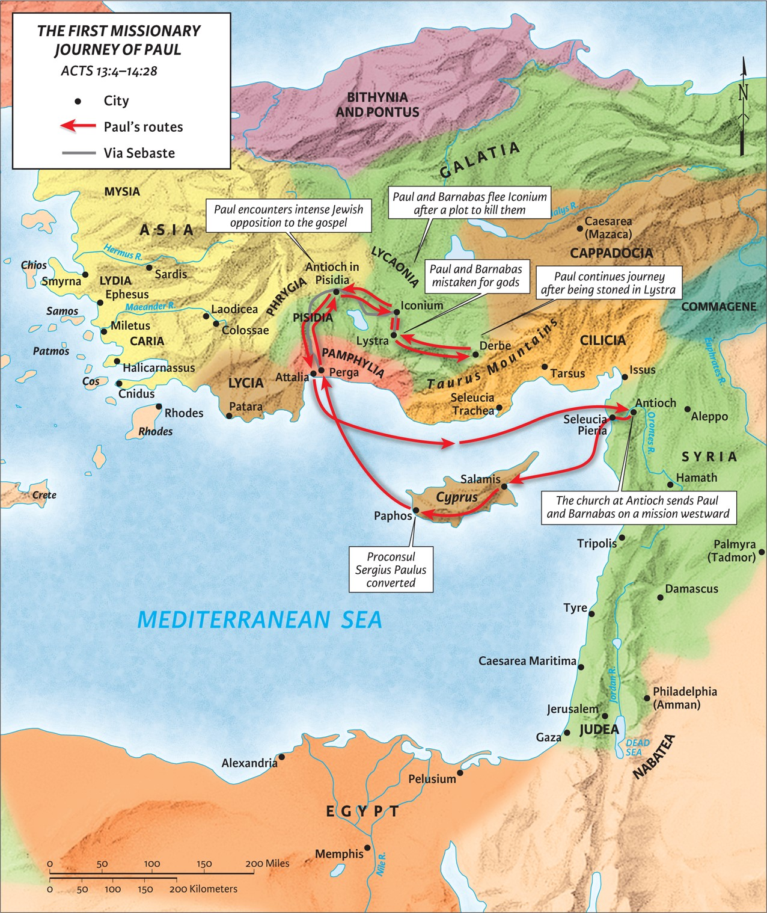
The Spirit Sends,
Satan Opposes
part 2
Acts 13:1-14
“Be my witnesses in Jerusalem and in all Judea and Samaria, and to the ends of the earth”
– Acts 1:8 (ESV)

Slide 2
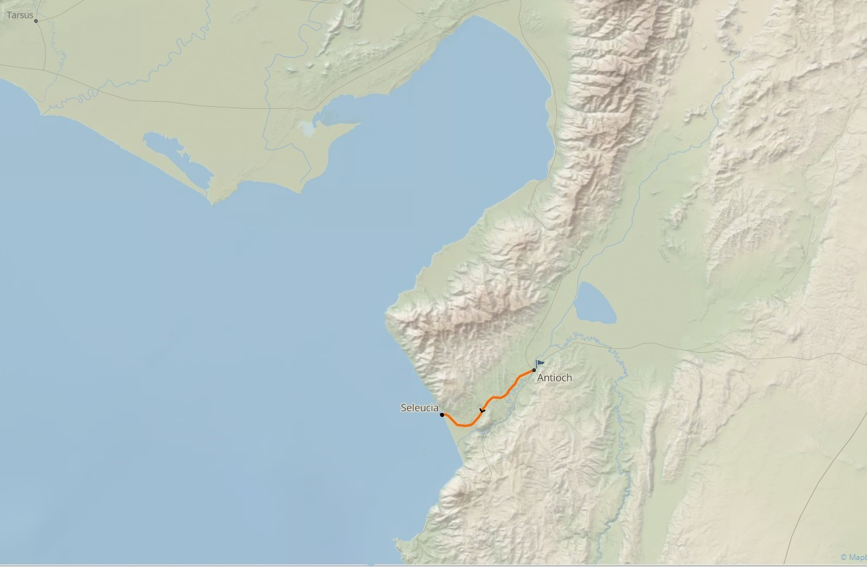

Slide 3
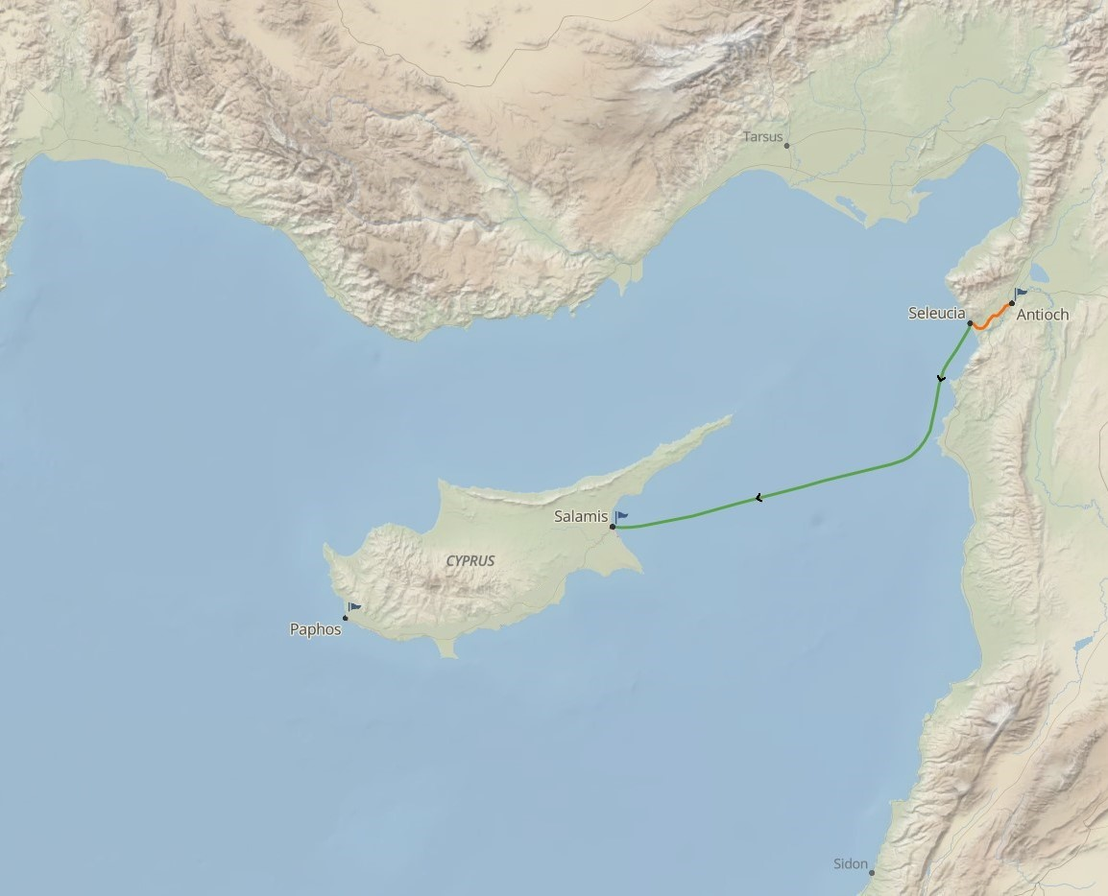
Acts 4:36 (ESV)
“Thus Joseph, who was also called by the apostles Barnabas (which means son of encouragement), a Levite, a native of Cyprus…”

Slide 4
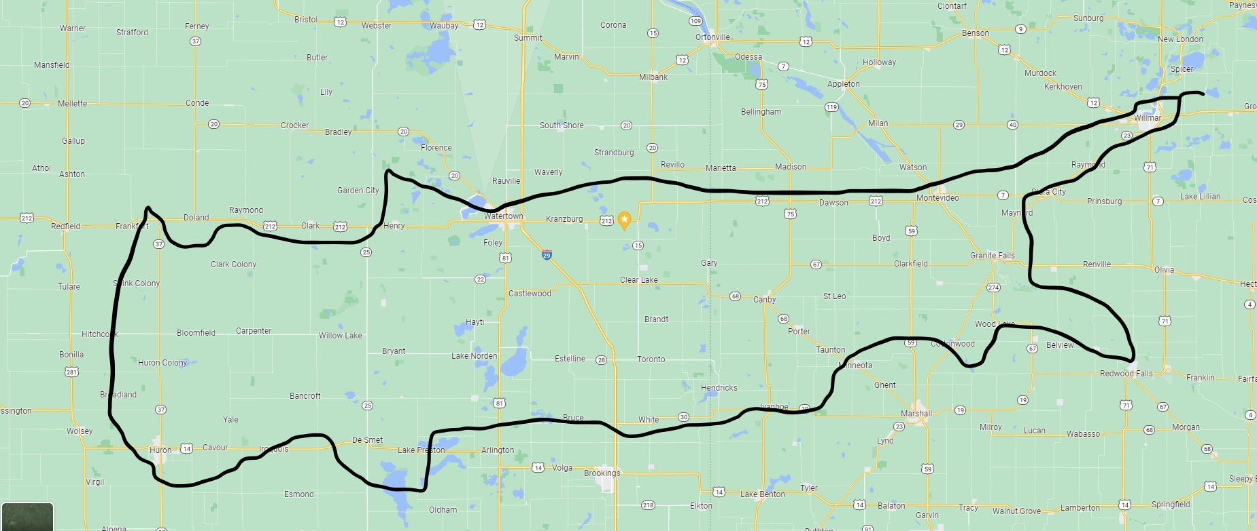

Slide 6
Acts 17:1-2 (ESV)
Now when they had passed through Amphipolis and Apollonia, they came to Thessalonica, where there was a synagogue of the Jews. And Paul went in, as was his custom, and on three Sabbath days he reasoned with them from the Scriptures,
Romans 1:15-16 (ESV)
So I am eager to preach the gospel to you also who are in Rome. For I am not ashamed of the gospel, for it is the power of God for salvation to everyone who believes, to the Jew first and also to the Greek.

Slide 7
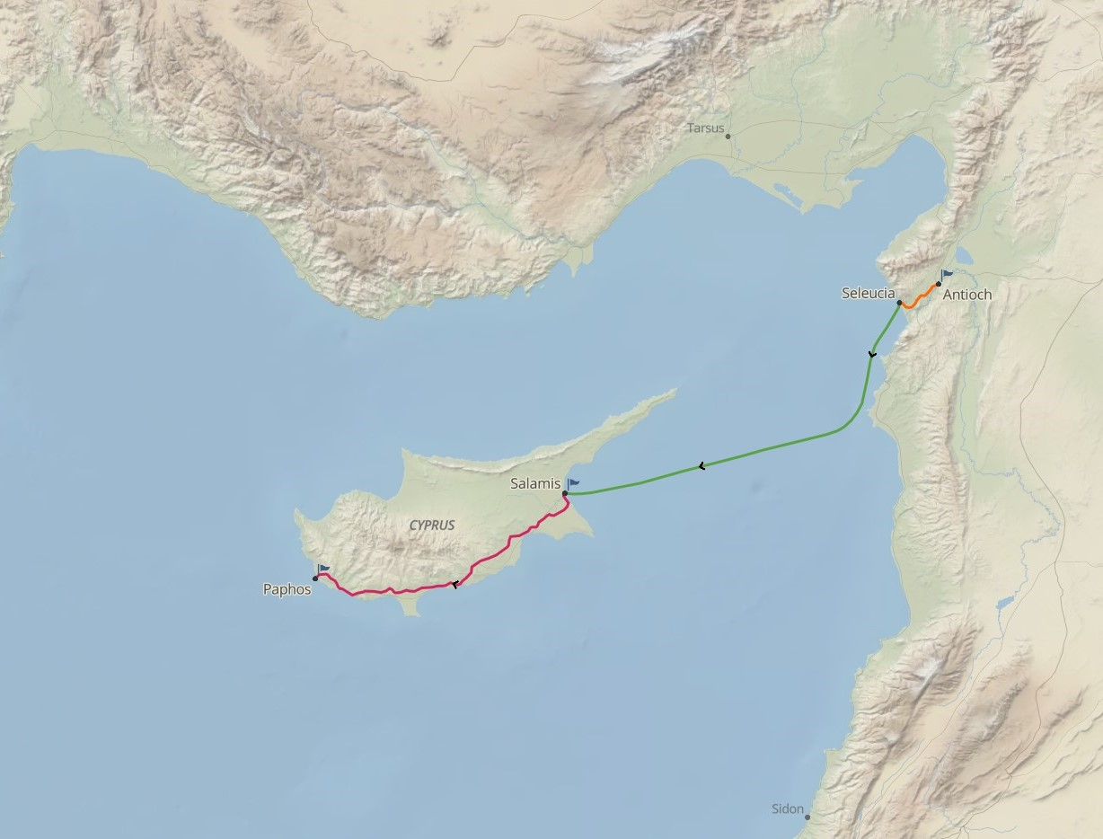
Satan opposes from the outside

Slide 8
Satan opposes from the outside
Matthew 7:15 (ESV)
“Beware of false prophets, who come to you in sheep’s clothing but inwardly are ravenous wolves.
2 Peter 2:1-3a (ESV)
But false prophets also arose among the people, just as there will be false teachers among you, who will secretly bring in destructive heresies, even denying the Master who bought them, bringing upon themselves swift destruction. And many will follow their sensuality, and because of them the way of truth will be blasphemed. And in their greed they will exploit you with false words..
2 Corinthians 11:13-14 (ESV)
For such men are false apostles, deceitful workmen, disguising themselves as apostles of Christ. And no wonder, for even Satan disguises himself as an angel of light.
1 Timothy 4:1 (ESV)
Now the Spirit expressly says that in later times some will depart from the faith by devoting themselves to deceitful spirits and teachings of demons…

Slide 9
Satan opposes from the outside
1 Corinthians 9:20-23 (ESV)
To the Jews I became as a Jew, in order to win Jews. To those under the law I became as one under the law (though not being myself under the law) that I might win those under the law. To those outside the law I became as one outside the law (not being outside the law of God but under the law of Christ) that I might win those outside the law. To the weak I became weak, that I might win the weak. I have become all things to all people, that by all means I might save some. I do it all for the sake of the gospel, that I may share with them in its blessings.

Slide 10
Satan opposes from the outside
John 8:44 (ESV)
You are of your father the devil, and your will is to do your father’s desires. He was a murderer from the beginning, and does not stand in the truth, because there is no truth in him. When he lies, he speaks out of his own character, for he is a liar and the father of lies.

Slide 11
Satan opposes from the outside
Proberbs 10:9 (ESV)
“Whoever walks in integrity walks securely, but he who makes his ways crooked will be found out.”

Slide 12
Satan opposes from the inside
Acts 9:27: But Barnabas took him (Saul)…..
Acts 11:25: Barnabas went …. to look for Saul.
Acts 11:30: sending it to the elders by the hand of Barnabas and Saul
Acts 12:25: Barnabas and Saul returned to Jerusalem…
Acts 13:2: prophets and teachers, Barnabas …. and Saul
Acts 13:7: …summoned Barnabas and Saul...

Slide 13
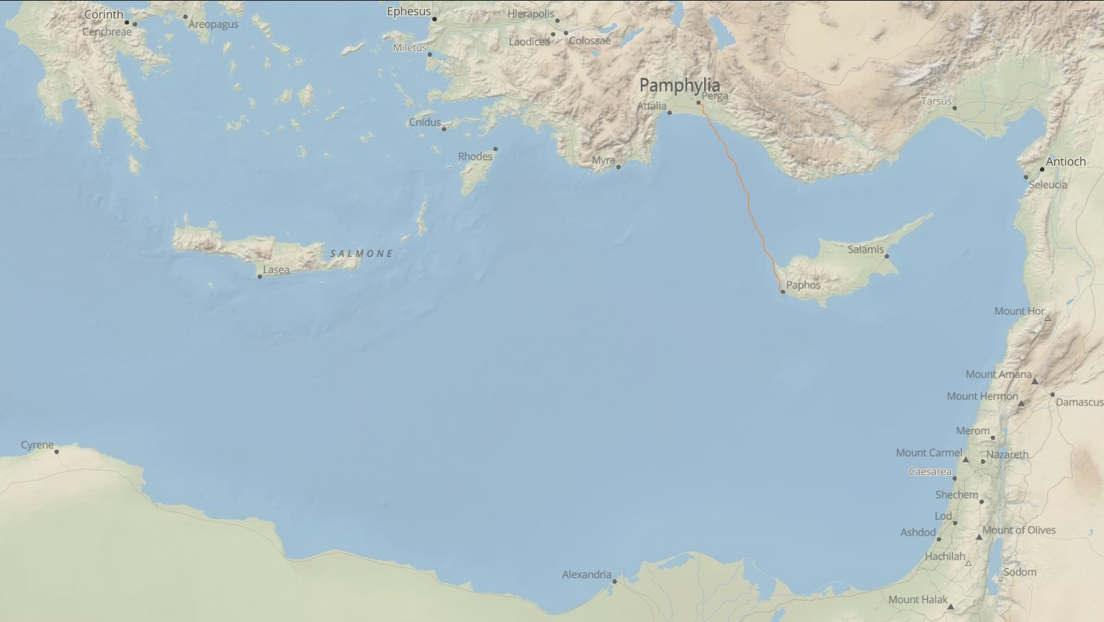
Satan opposes from the inside

Slide 14
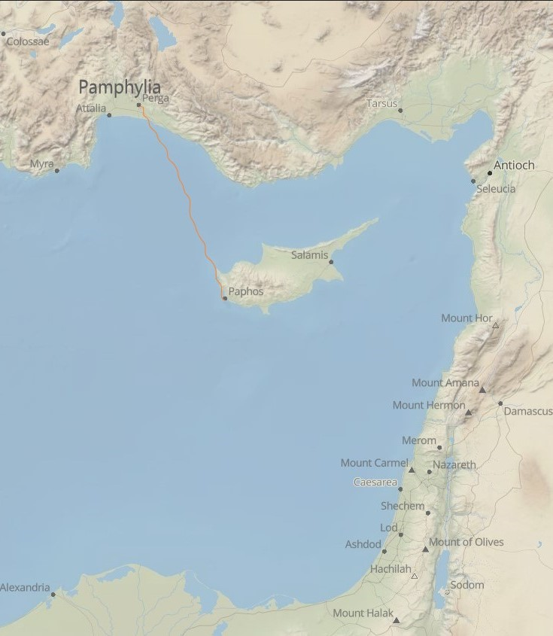
Satan opposes from the inside
Acts 15:36-40a (ESV)
And after some days Paul said to Barnabas, “Let us return and visit the brothers in every city where we proclaimed the word of the Lord, and see how they are.” Now Barnabas wanted to take with them John called Mark. But Paul thought best not to take with them one who had withdrawn from them in Pamphylia and had not gone with them to the work. And there arose a sharp disagreement, so that they separated from each other. Barnabas took Mark with him and sailed away to Cyprus, but Paul chose Silas and departed…

Slide 15
Satan opposes from the inside
James 4:1-7 (ESV)
What causes quarrels and what causes fights among you? Is it not this, that your passions are at war within you? You desire and do not have, so you murder. You covet and cannot obtain, so you fight and quarrel. You do not have, because you do not ask. You ask and do not receive, because you ask wrongly, to spend it on your passions. You adulterous people! Do you not know that friendship with the world is enmity with God? Therefore whoever wishes to be a friend of the world makes himself an enemy of God. Or do you suppose it is to no purpose that the Scripture says, “He yearns jealously over the spirit that he has made to dwell in us”? But he gives more grace. Therefore it says, “God opposes the proud but gives grace to the humble.” Submit yourselves therefore to God. Resist the devil, and he will flee from you.

Slide 16
Satan opposes from the inside

Slide 17
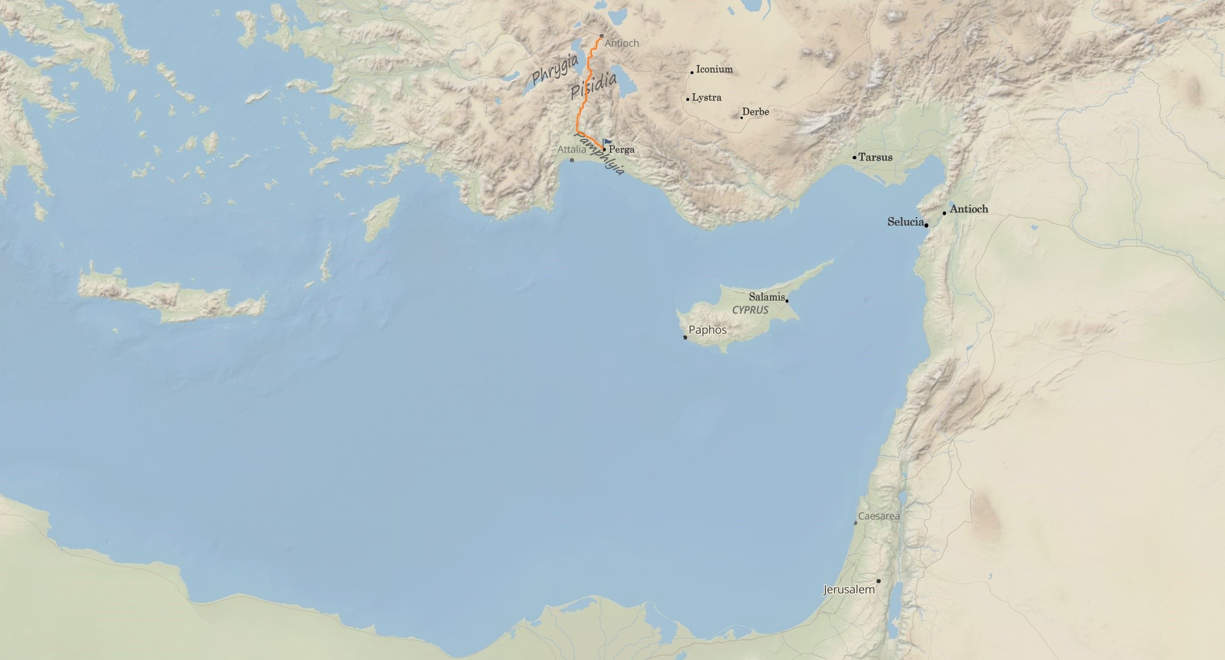
Satan opposes from the inside
X

Slide 18
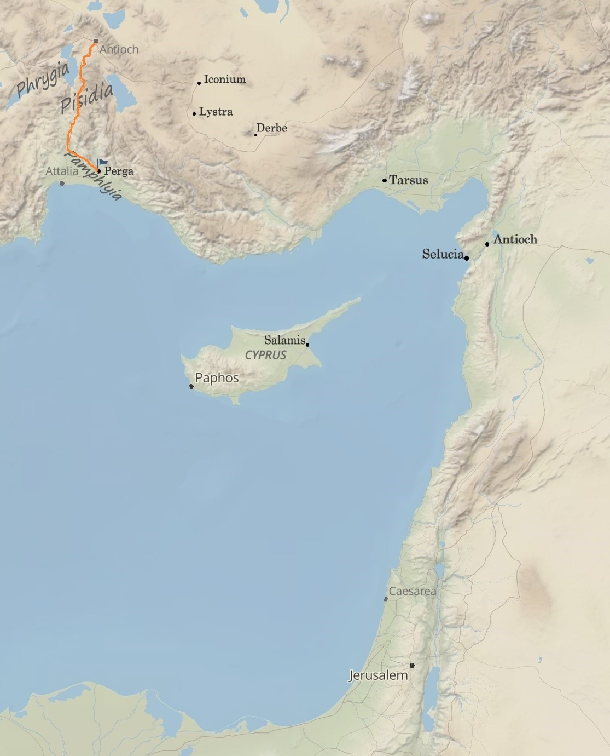
Satan opposes from the inside
2 Corinthians 11:23-28 (ESV)
Are they servants of Christ? I am a better one—I am talking like a madman—with far greater labors, far more imprisonments, with countless beatings, and often near death. Five times I received at the hands of the Jews the forty lashes less one. Three times I was beaten with rods. Once I was stoned. Three times I was shipwrecked; a night and a day I was adrift at sea; on frequent journeys, in danger from rivers, danger from robbers, danger from my own people, danger from Gentiles, danger in the city, danger in the wilderness, danger at sea, danger from false brothers; in toil and hardship, through many a sleepless night, in hunger and thirst, often without food, in cold and exposure. And, apart from other things, there is the daily pressure on me of my anxiety for all the churches.

Slide 19
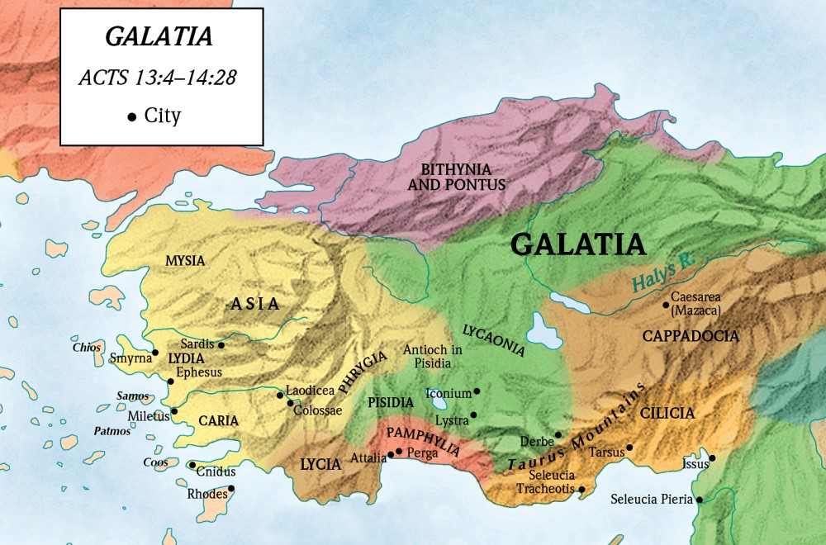
Satan opposes from the inside

Slide 20
Satan opposes from the inside
Galatians 4:12-14 (ESV)
Brothers, I entreat you, become as I am, for I also have become as you are. You did me no wrong. You know it was because of a bodily ailment that I preached the gospel to you at first, and though my condition was a trial to you, you did not scorn or despise me, but received me as an angel of God, as Christ Jesus.

Slide 21
Hebrews 2:17-18 (ESV)
Therefore he had to be made like his brothers in every respect, so that he might become a merciful and faithful high priest in the service of God, to make propitiation for the sins of the people. For because he himself has suffered when tempted, he is able to help those who are being tempted.
Hebrews 4:15 (ESV)
For we do not have a high priest who is unable to sympathize with our weaknesses, but one who in every respect has been tempted as we are, yet without sin.

Slide 22
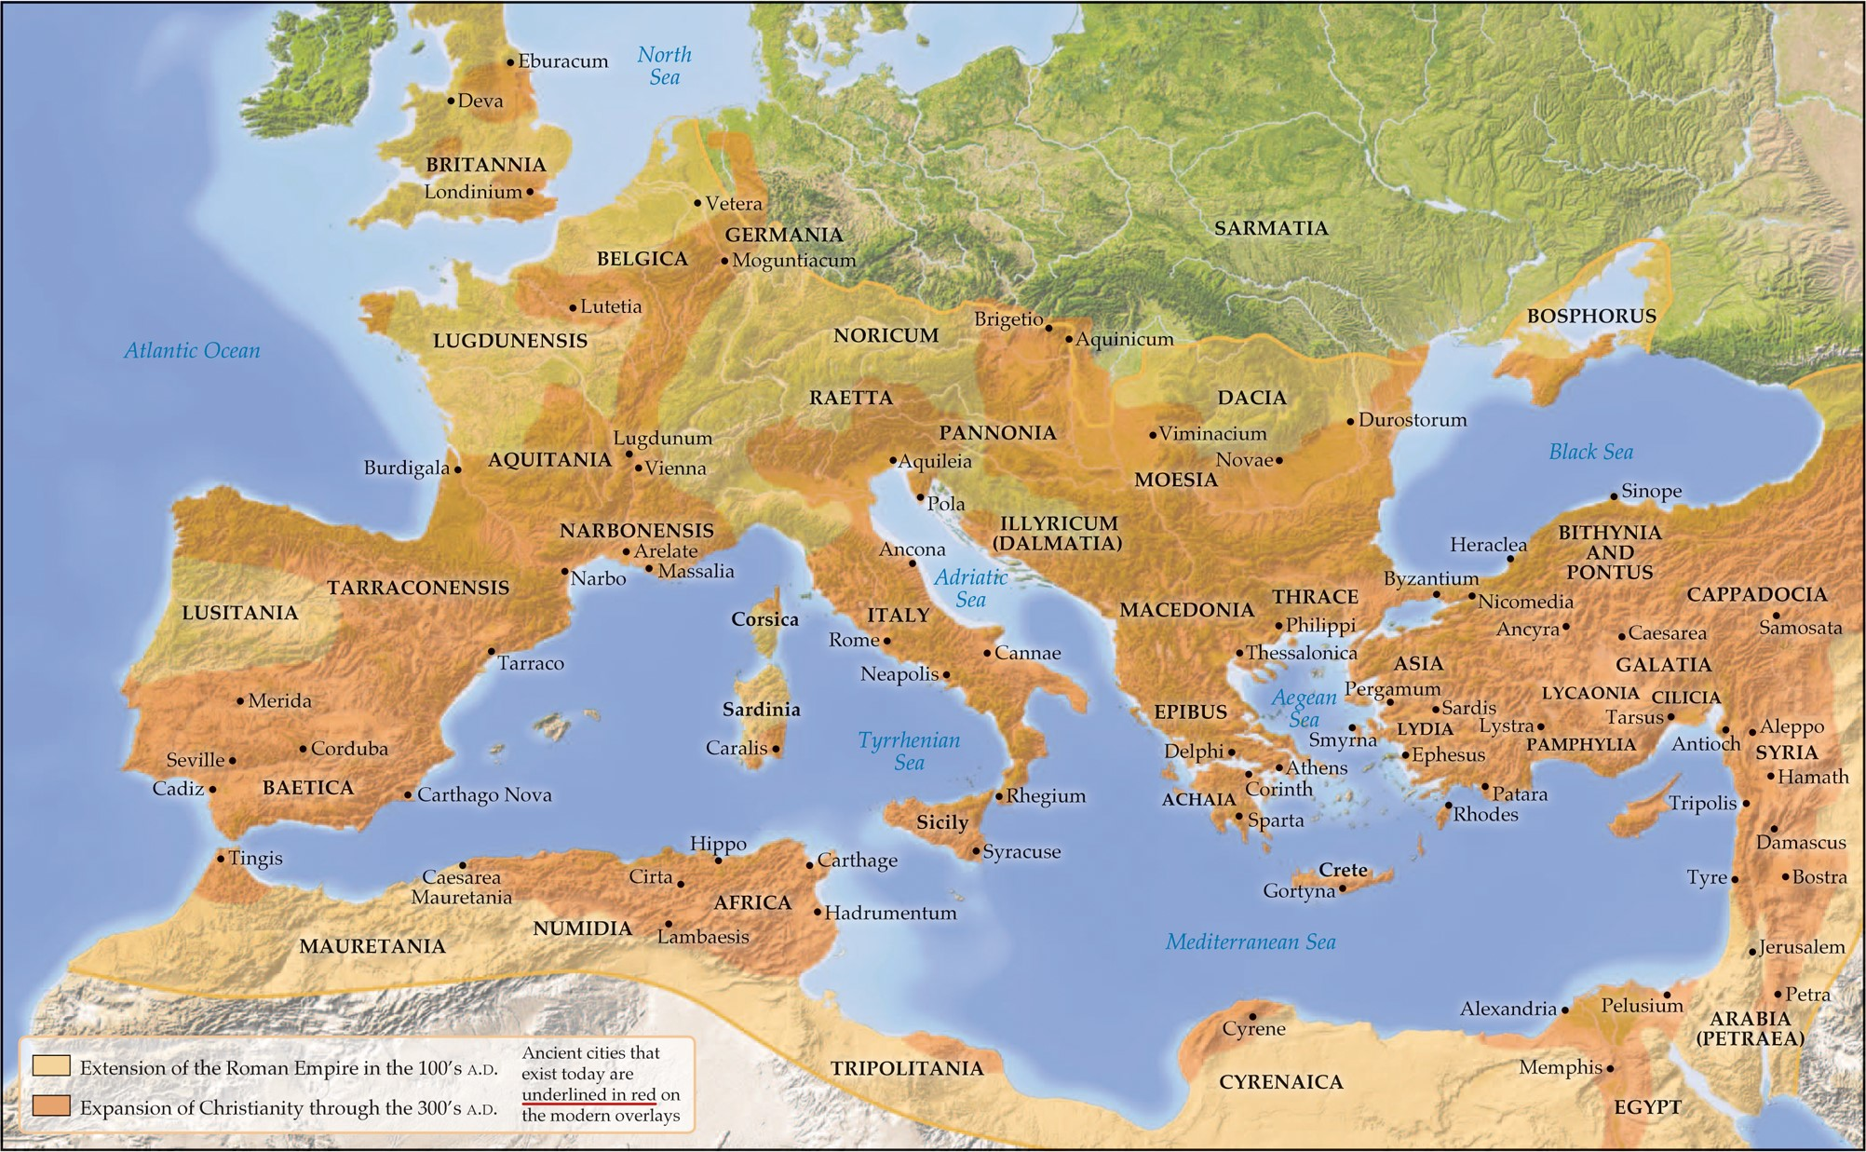
The Spirit sends, Satan Opposes
1 John 4:4 (KJV)
“Ye are of God, little children, and have overcome them: because greater is he that is in you, than he that is in the world.”

Slide 23
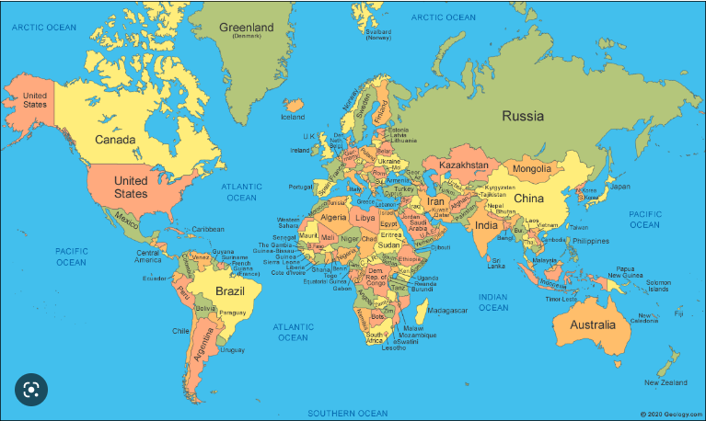
The Spirit sends, Satan Opposes
1 John 4:4 (KJV)
“Ye are of God, little children, and have overcome them: because greater is he that is in you, than he that is in the world.”

