Slide 1
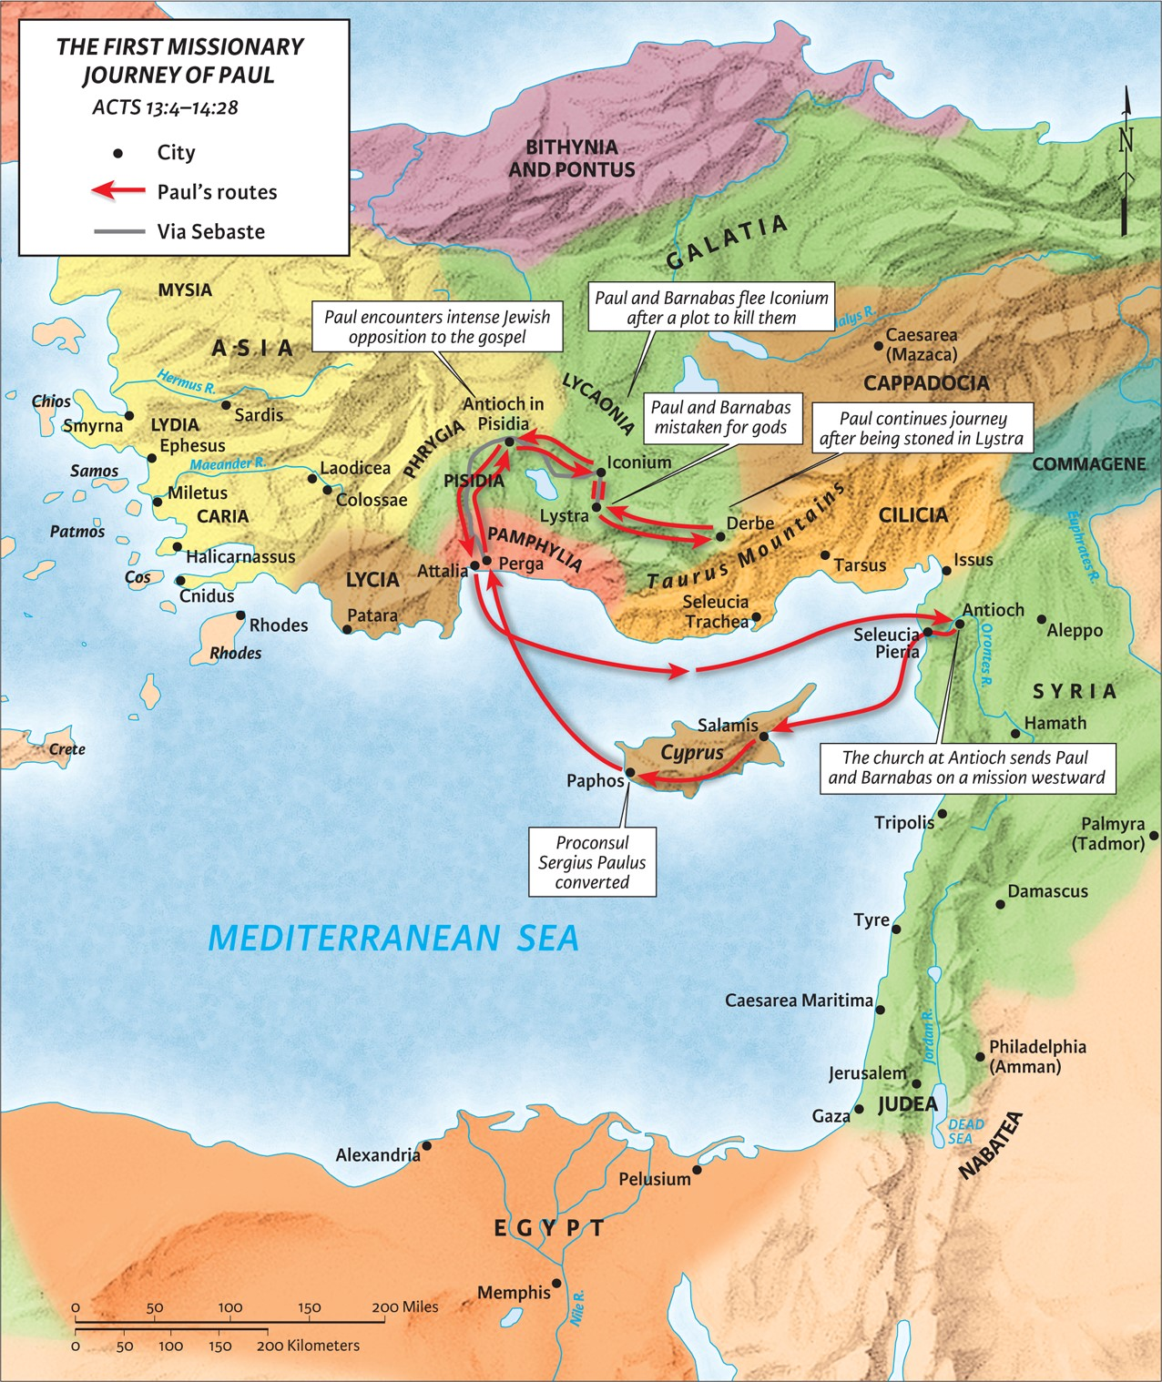
The Promised King Has Come and His Name Is Jesus
Acts 13:14-23
X
“Be my witnesses in Jerusalem and in all Judea and Samaria, and to the ends of the earth”
– Acts 1:8 (ESV)

Slide 2
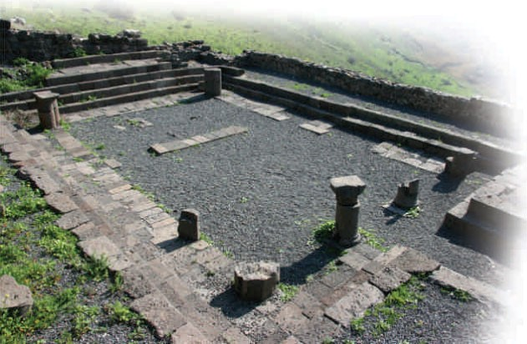
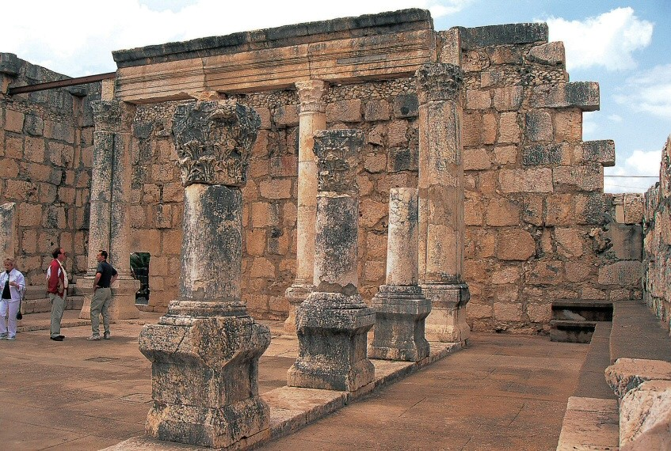
3rd Century Synagogue Remains in Capernaum
1st Century Synagogue Remains in Gamla

Slide 3
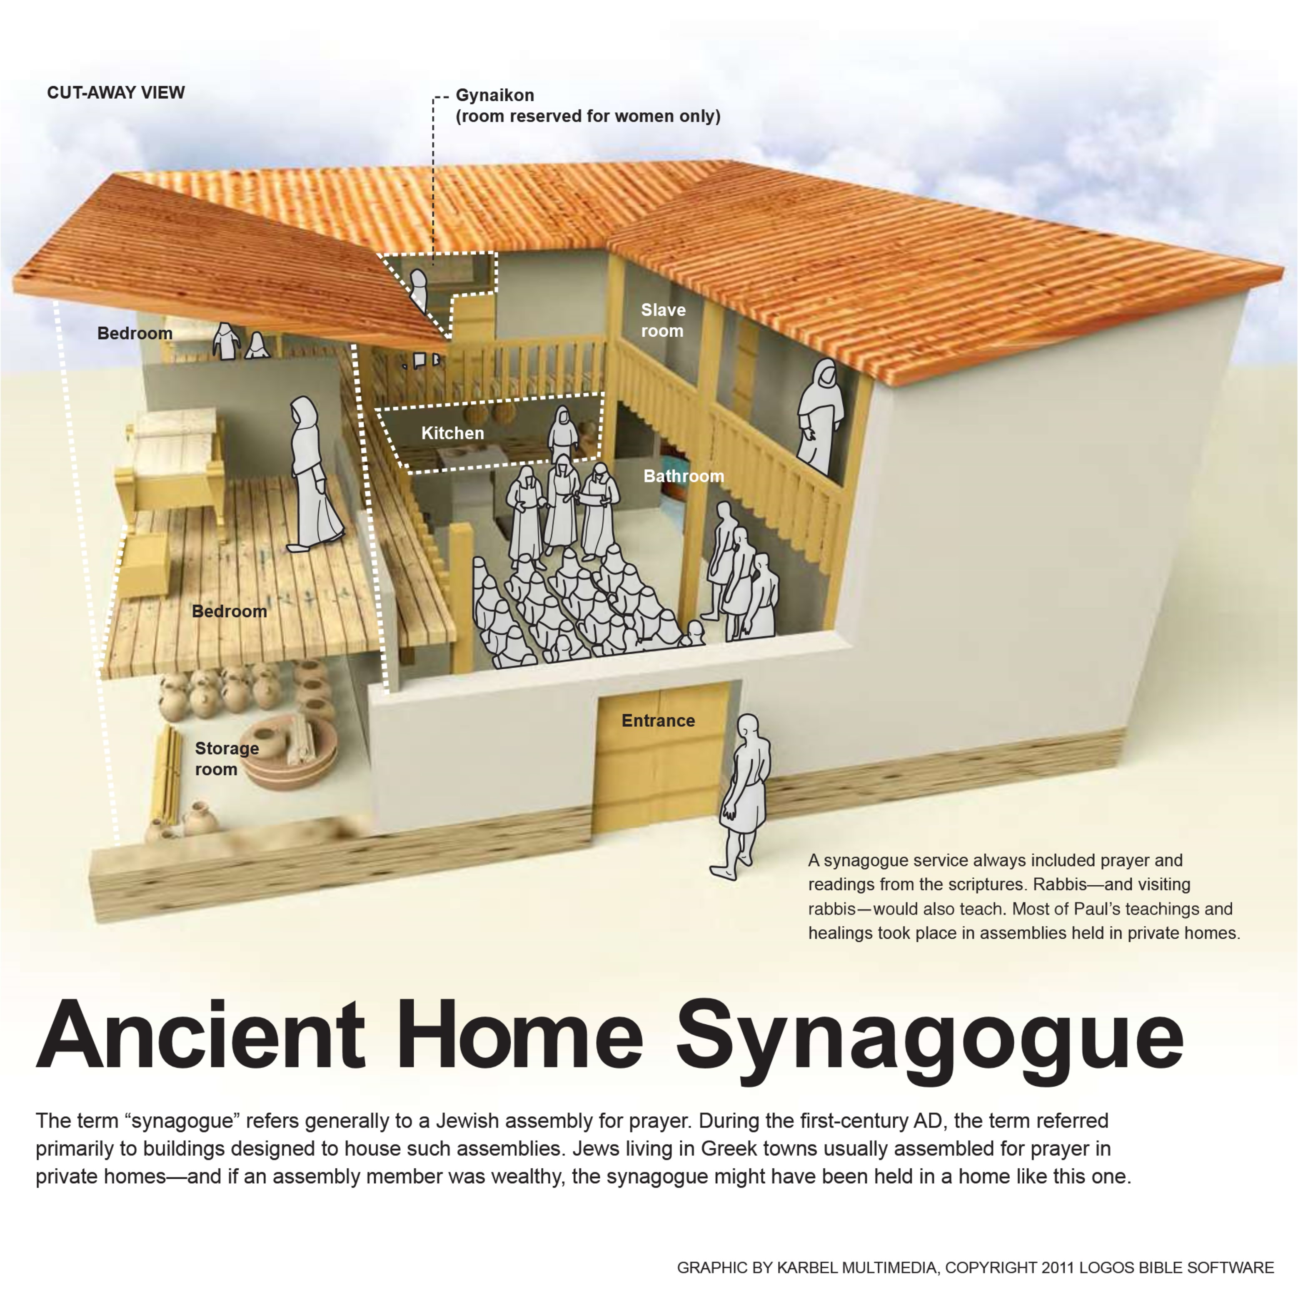

Slide 4
Luke 4:16-21 (ESV)
And he came to Nazareth, where he had been brought up. And as was his custom, he went to the synagogue on the Sabbath day, and he stood up to read. And the scroll of the prophet Isaiah was given to him. He unrolled the scroll and found the place where it was written, “The Spirit of the Lord is upon me, because he has anointed me to proclaim good news to the poor. He has sent me to proclaim liberty to the captives and recovering of sight to the blind, to set at liberty those who are oppressed, to proclaim the year of the Lord’s favor.” And he rolled up the scroll and gave it back to the attendant and sat down. And the eyes of all in the synagogue were fixed on him. And he began to say to them, “Today this Scripture has been fulfilled in your hearing.”

Slide 5
Acts 10:1-2 (ESV)
At Caesarea there was a man named Cornelius, a centurion of what was known as the Italian Cohort, a devout man who feared God with all his household, gave alms generously to the people, and prayed continually to God.
Acts 10:22 (ESV)
And they said, “Cornelius, a centurion, an upright and God-fearing man, who is well spoken of by the whole Jewish nation, was directed by a holy angel to send for you to come to his house and to hear what you have to say.”

Slide 6
1. God gave Israel a special relationship with Him.
1 Corinthians 1:27-29 (ESV)
But God chose what is foolish in the world to shame the wise; God chose what is weak in the world to shame the strong; God chose what is low and despised in the world, even things that are not, to bring to nothing things that are, so that no human being might boast in the presence of God.
Ephesians 1:3-4 (ESV)
Blessed be the God and Father of our Lord Jesus Christ, who has blessed us in Christ with every spiritual blessing in the heavenly places, even as he chose us in him before the foundation of the world, that we should be holy and blameless before him.
2 Thessalonians 2:13-15 (ESV)
But we ought always to give thanks to God for you, brothers beloved by the Lord, because God chose you as the firstfruits to be saved, through sanctification by the Spirit and belief in the truth. To this he called you through our gospel, so that you may obtain the glory of our Lord Jesus Christ. So then, brothers, stand firm and hold to the traditions that you were taught by us, either by our spoken word or by our letter.

Slide 7
2. God gave Israel strength in their captivity.
Exodus 1:7 (ESV)
But the people of Israel were fruitful and increased greatly; they multiplied and grew exceedingly strong, so that the land was filled with them.
Exodus 1:12 (ESV)
But the more they were oppressed, the more they multiplied and the more they spread abroad. And the Egyptians were in dread of the people of Israel.

Slide 8
3. God gave Israel freedom from captivity.
Deuteronomy 26:8 (ESV)
And the LORD brought us out of Egypt with a mighty hand and an outstretched arm, with great deeds of terror, with signs and wonders. And he brought us into this place and gave us this land, a land flowing with milk and honey.
Colossians 1:13-14 (ESV)
He has delivered us from the domain of darkness and transferred us to the kingdom of his beloved Son, in whom we have redemption, the forgiveness of sins.

Slide 9
4. God gave Israel mercy in the wilderness.
Hebrews 4:14-16 (ESV)
Since then we have a great high priest who has passed through the heavens, Jesus, the Son of God, let us hold fast our confession. For we do not have a high priest who is unable to sympathize with our weaknesses, but one who in every respect has been tempted as we are, yet without sin. Let us then with confidence draw near to the throne of grace, that we may receive mercy and find grace to help in time of need.

Slide 10
5. God gave Israel land as an inheritance.
Deuteronomy 7:1 (ESV)
“When the LORD your God brings you into the land that you are entering to take possession of it, and clears away many nations before you, the Hittites, the Girgashites, the Amorites, the Canaanites, the Perizzites, the Hivites, and the Jebusites, seven nations more numerous and mightier than you,
Joshua 14:1-2 (ESV)
These are the inheritances that the people of Israel received in the land of Canaan, which Eleazar the priest and Joshua the son of Nun and the heads of the fathers’ houses of the tribes of the people of Israel gave them to inherit. Their inheritance was by lot, just as the LORD had commanded by the hand of Moses for the nine and one-half tribes.

Slide 11
5. God gave Israel land as an inheritance.
Philippians 2:8-11 (ESV)
And being found in human form, he humbled himself by becoming obedient to the point of death, even death on a cross. Therefore God has highly exalted him and bestowed on him the name that is above every name, so that at the name of Jesus every knee should bow, in heaven and on earth and under the earth, and every tongue confess that Jesus Christ is Lord, to the glory of God the Father.
Hebrews 9:15 (ESV)
Therefore he is the mediator of a new covenant, so that those who are called may receive the promised eternal inheritance…
Ephesians 1:13-14 (ESV)
In him you also, when you heard the word of truth, the gospel of your salvation, and believed in him, were sealed with the promised Holy Spirit, who is the guarantee of our inheritance until we acquire possession of it, to the praise of his glory.

Slide 12
6. God gave Israel judges and prophets in their rebellion.
Genesis 15:13 (ESV)
Then the Lord said to Abram, “Know for certain that your offspring will be sojourners in a land that is not theirs and will be servants there, and they will be afflicted for four hundred years.
+
Numbers 14:34 (ESV)
According to the number of the days in which you spied out the land, forty days, a year for each day, you shall bear your iniquity forty years, and you shall know my displeasure.’
+
Numbers 14:34 (ESV)
And now, behold, the LORD has kept me alive, just as he said, these forty-five years since the time that the LORD spoke this word to Moses, while Israel walked in the wilderness. And now, behold, I am this day eighty-five years old.
=
“about 450 years”

Slide 13
6. God gave Israel judges and prophets in their rebellion.
Judges 3:9 (ESV)
But when the people of Israel cried out to the LORD, the LORD raised up a deliverer for the people of Israel, who saved them, Othniel the son of Kenaz, Caleb’s younger brother.
Judges 3:10 (ESV)
Then the people of Israel cried out to the LORD, and the LORD raised up for them a deliverer, Ehud, the son of Gera, the Benjaminite, a left-handed man. The people of Israel sent tribute by him to Eglon the king of Moab.

Slide 14
7. God gave Israel their choice king.
Romans 11:1 (ESV)
I ask, then, has God rejected his people? By no means! For I myself am an Israelite, a descendant of Abraham, a member of the tribe of Benjamin.
Philippians 3:4-5 (ESV)
If anyone else thinks he has reason for confidence in the flesh, I have more: circumcised on the eighth day, of the people of Israel, of the tribe of Benjamin, a Hebrew of Hebrews; as to the law, a Pharisee;

Slide 15
8. God gave Israel His choice king.
1 Samuel 15:26 (ESV)
And Samuel said to Saul, “I will not return with you. For you have rejected the word of the LORD, and the LORD has rejected you from being king over Israel.”

Slide 16
9. God gave Israel the long-promised King and His name is Jesus!
2 Samuel 7:12-13 (ESV)
When your days are fulfilled and you lie down with your fathers, I will raise up your offspring after you, who shall come from your body, and I will establish his kingdom. He shall build a house for my name, and I will establish the throne of his kingdom forever.
Isaiah 11:10 (ESV)
They shall not hurt or destroy in all my holy mountain; for the earth shall be full of the knowledge of the LORD as the waters cover the sea. In that day the root of Jesse, who shall stand as a signal for the peoples—of him shall the nations inquire, and his resting place shall be glorious.
Jeremiah 23:5 (ESV)
“Behold, the days are coming, declares the LORD, when I will raise up for David a righteous Branch, and he shall reign as king and deal wisely, and shall execute justice and righteousness in the land.

Slide 17
9. God gave Israel the long-promised King and His name is Jesus!
Isaiah 52-53 (ESV)
52:13-14. Behold, my servant shall act wisely; he shall be high and lifted up, and shall be exalted. As many were astonished at you— his appearance was so marred, beyond human semblance, and his form beyond that of the children of mankind—
52:15: Kings shall shut their mouths because of him
53:3-5: He was despised and rejected by men, a man of sorrows and acquainted with grief; and as one from whom men hide their faces he was despised, and we esteemed him not. Surely he has borne our griefs and carried our sorrows; yet we esteemed him stricken, smitten by God, and afflicted. But he was pierced for our transgressions; he was crushed for our iniquities; upon him was the chastisement that brought us peace, and with his wounds we are healed.

Slide 18
Communion

