Slide 1
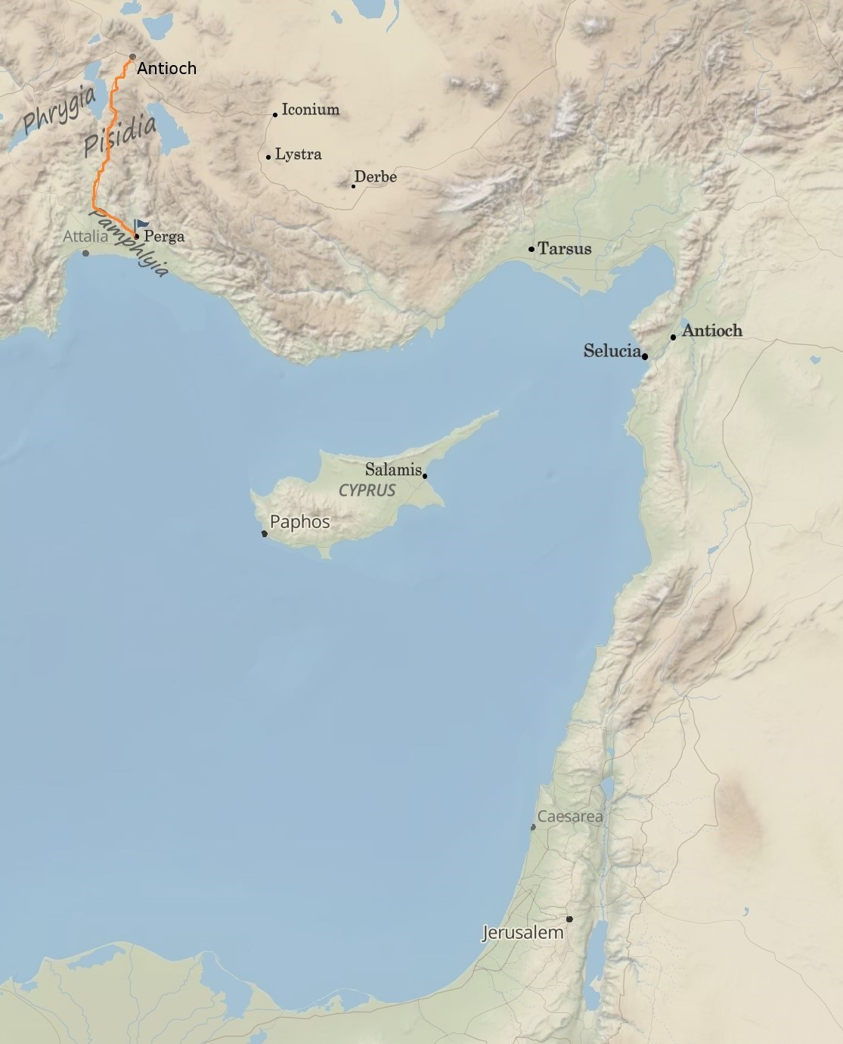
“But God Raised Him
From the Dead”
Acts 13:24-41
“Be my witnesses in Jerusalem and in all Judea and Samaria, and to the ends of the earth”
– Acts 1:8 (ESV)

Slide 2
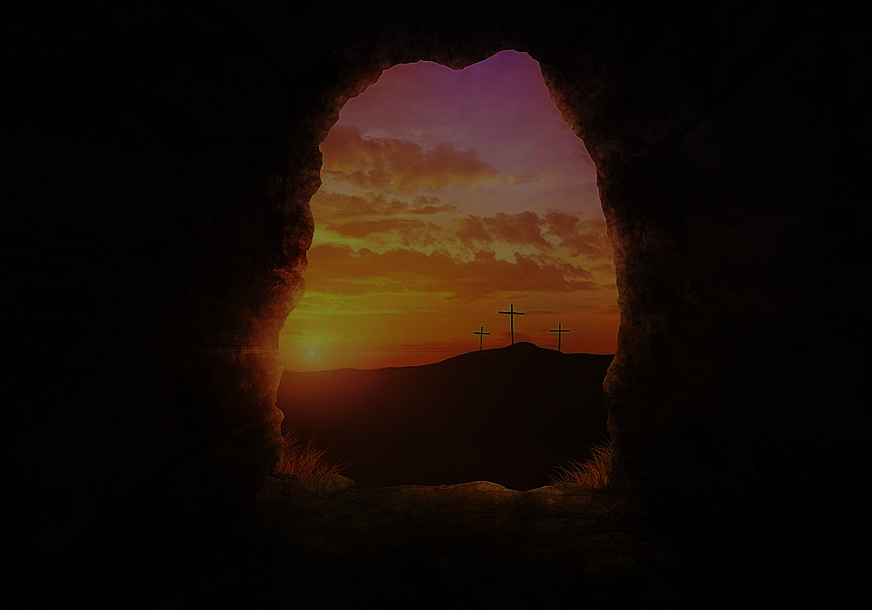
1 Corinthians 15:14 (ESV)
And if Christ has not been raised, then our preaching is in vain and your faith is in vain.
1 Corinthians 15:17 (ESV)
And if Christ has not been raised, your faith is futile and you are still in your sins.

Slide 3
Six Resurrection Truths:
1. Before He was raised, he had to be “the one who is coming.”
Malachi 3:1 (ESV)
“Behold, I send my messenger, and he will prepare the way before me. And the Lord whom you seek will suddenly come to his temple; and the messenger of the covenant in whom you delight, behold, he is coming, says the LORD of hosts.”
Isaiah 40:3 (ESV)
A voice cries: “In the wilderness prepare the way of the LORD; make straight in the desert a highway for our God.
Matthew 11:7-10 (ESV)
As they went away, Jesus began to speak to the crowds concerning John: “What did you go out into the wilderness to see? A reed shaken by the wind? What then did you go out to see? A man dressed in soft clothing? Behold, those who wear soft clothing are in kings’ houses. What then did you go out to see? A prophet? Yes, I tell you, and more than a prophet. This is he of whom it is written, “ ‘Behold, I send my messenger before your face, who will prepare your way before you.’
John 1:29 (ESV)
These things took place in Bethany across the Jordan, where John was baptizing. The next day he saw Jesus coming toward him, and said, “Behold, the Lamb of God, who takes away the sin of the world!

Slide 4
Six Resurrection Truths:
2. Before He was raised, he had to die.
a. He died innocent.
Mark 14:56-59 (ESV)
For many bore false witness against him, but their testimony did not agree. And some stood up and bore false witness against him, saying, “We heard him say, ‘I will destroy this temple that is made with hands, and in three days I will build another, not made with hands.’ ” Yet even about this their testimony did not agree.
Luke 23:1-2 (ESV)
Then the whole company of them arose and brought him before Pilate. And they began to accuse him, saying, “We found this man misleading our nation and forbidding us to give tribute to Caesar, and saying that he himself is Christ, a king.”
Verse 4: Then Pilate said to the chief priests and the crowds, “I find no guilt in this man.”
1 Peter 2:22 (ESV)
He committed no sin, neither was deceit found in his mouth. When he was reviled, he did not revile in return; when he suffered, he did not threaten, but continued entrusting himself to him who judges justly.

Slide 5
Six Resurrection Truths:
2. Before He was raised, he had to die.”
b. He died fulfilling prophecy.
Psalm 22:18 (ESV)
they divide my garments among them, and for my clothing they cast lots.
Mark 15:24 (ESV)
And they crucified him and divided his garments among them, casting lots for them, to decide what each should take.
Luke 24:38-39 (ESV)
And he said to them, “Why are you troubled, and why do doubts arise in your hearts? See my hands and my feet, that it is I myself. Touch me, and see. For a spirit does not have flesh and bones as you see that I have.”
Psalm 22:16 (ESV)
For dogs encompass me; a company of evildoers encircles me; they have pierced my hands and feet—

Slide 6
Six Resurrection Truths:
2. Before He was raised, he had to die.”
b. He died fulfilling prophecy.
Zechariah 12:10 (ESV)
…when they look on me, on him whom they have pierced, they shall mourn for him, as one mourns for an only child, and weep bitterly over him, as one weeps over a firstborn.
John 19:34, 37 (ESV)
But one of the soldiers pierced his side with a spear, and at once there came out blood and water … another Scripture says, “They will look on him whom they have pierced.”
Exodus 12:46 (ESV)
It shall be eaten in one house; you shall not take any of the flesh outside the house, and you shall not break any of its bones.
John 19:33, 36 (ESV)
But when they came to Jesus and saw that he was already dead, they did not break his legs … For these things took place that the Scripture might be fulfilled: “Not one of his bones will be broken.”
Psalm 34:19-20 (ESV)
Many are the afflictions of the righteous, but the LORD delivers him out of them all. He keeps all his bones; not one of them is broken.

Slide 7
Six Resurrection Truths:
2. Before He was raised, he had to die.”
c. He was buried.
Galatians 3:13 (ESV)
Christ redeemed us from the curse of the law by becoming a curse for us—for it is written, “Cursed is everyone who is hanged on a tree”—
John 19:38-40 (ESV)
After these things Joseph of Arimathea, who was a disciple of Jesus, but secretly for fear of the Jews, asked Pilate that he might take away the body of Jesus, and Pilate gave him permission. So he came and took away his body. Nicodemus also, who earlier had come to Jesus by night, came bringing a mixture of myrrh and aloes, about seventy-five pounds in weight. So they took the body of Jesus and bound it in linen cloths with the spices, as is the burial custom of the Jews.

Slide 8
Six Resurrection Truths:
3. He is risen!”
1 Corinthians 15:19 (ESV)
If in Christ we have hope in this life only, we are of all people most to be pitied.
1 Corinthians 15:20-21 (ESV)
But in fact Christ has been raised from the dead, the firstfruits of those who have fallen asleep. For as by a man came death, by a man has come also the resurrection of the dead.

Slide 9
Six Resurrection Truths:
4. After He was raised, he had many witnesses.”
a. He had many human witnesses.
1 Corinthians 15:5-8 (ESV)
and that he appeared to Cephas, then to the twelve. Then he appeared to more than five hundred brothers at one time, most of whom are still alive, though some have fallen asleep. Then he appeared to James, then to all the apostles. Last of all, as to one untimely born, he appeared also to me.

Slide 10
Six Resurrection Truths:
4. After He was raised, he had many witnesses.”
b. He had the Scripture’s witness.
John 5:39 (ESV)
You search the Scriptures because you think that in them you have eternal life; and it is they that bear witness about me,
Colossians 1:18 (ESV)
And he is the head of the body, the church. He is the beginning, the firstborn from the dead, that in everything he might be preeminent.
Hebrews 10:11-12 (ESV)
And every priest stands daily at his service, offering repeatedly the same sacrifices, which can never take away sins. But when Christ had offered for all time a single sacrifice for sins, he sat down at the right hand of God,

Slide 11
Six Resurrection Truths:
4. After He was raised, he had many witnesses.”
b. He had the Scripture’s witness.
Isaiah 55:3 (ESV)
Incline your ear, and come to me; hear, that your soul may live; and I will make with you an everlasting covenant, my steadfast, sure love for David.
2 Samuel 7:12, 16 (ESV)
When your days are fulfilled and you lie down with your fathers, I will raise up your offspring after you, who shall come from your body, and I will establish his kingdom … And your house and your kingdom shall be made sure forever before me. Your throne shall be established forever.’ ”

Slide 12
Six Resurrection Truths:
4. After He was raised, he had many witnesses.”
b. He had the Scripture’s witness.
Acts 2:27-29 (ESV)
For you will not abandon my soul to Hades, or let your Holy One see corruption. You have made known to me the paths of life; you will make me full of gladness with your presence.’ “Brothers, I may say to you with confidence about the patriarch David that he both died and was buried, and his tomb is with us to this day.
Romans 1:1-4 (ESV)
Paul, a servant of Christ Jesus, called to be an apostle, set apart for the gospel of God, which he promised beforehand through his prophets in the holy Scriptures, concerning his Son, who was descended from David according to the flesh and was declared to be the Son of God in power according to the Spirit of holiness by his resurrection from the dead, Jesus Christ our Lord,
2 Timothy 2:8 (ESV)
Remember Jesus Christ, risen from the dead, the offspring of David, as preached in my gospel,

Slide 13
Six Resurrection Truths:
5. Now that He is raised, justification from sin has been made available.
a. It’s available to those who repent from their sin.

Slide 14
Six Resurrection Truths:
5. Now that He is raised, justification from sin has been made available.
b. It’s available to those who believe in Jesus Christ, and Him alone.
Romans 5:1 (ESV)
Therefore, since we have been justified by faith, we have peace with God through our Lord Jesus Christ.
Romans 5:9 (ESV)
Since, therefore, we have now been justified by his blood, much more shall we be saved by him from the wrath of God.
Romans 8:28-29 (ESV)
For those whom he foreknew he also predestined to be conformed to the image of his Son, in order that he might be the firstborn among many brothers. And those whom he predestined he also called, and those whom he called he also justified, and those whom he justified he also glorified.
Verse 33: Who shall bring any charge against God’s elect? It is God who justifies.

Slide 15
Six Resurrection Truths:
6. Now that He is raised, those who don’t believe should heed God’s warning.”
a. Don’t trust in your own works.
Romans 3:28 (ESV)
For we hold that one is justified by faith apart from works of the law.
Galatians 2:16 (ESV)
yet we know that a person is not justified by works of the law but through faith in Jesus Christ, so we also have believed in Christ Jesus, in order to be justified by faith in Christ and not by works of the law, because by works of the law no one will be justified.
Galatians 3:11 (ESV)
Now it is evident that no one is justified before God by the law, for “The righteous shall live by faith.”

Slide 16
Six Resurrection Truths:
6. Now that He is raised, those who don’t believe should heed God’s warning.”
b. Don’t scoff at God’s work.

Slide 17
He is
Risen!

