Slide 1
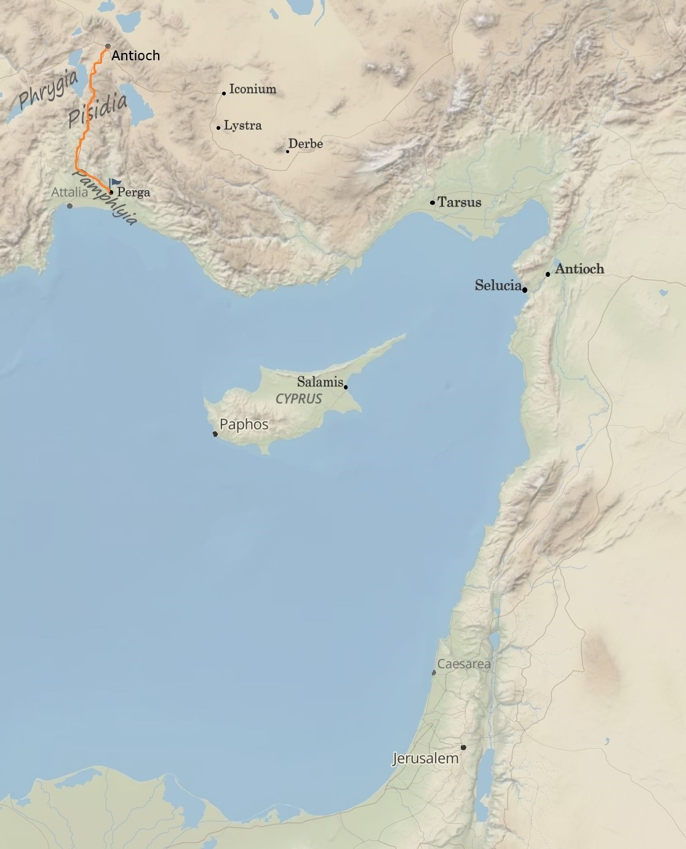
When Light Reaches into Darkness
Acts 13:42-52
“Be my witnesses in Jerusalem and in all Judea and Samaria, and to the ends of the earth”
– Acts 1:8 (ESV)

Slide 2
Romans 9:1-5 (ESV)
I am speaking the truth in Christ—I am not lying; my conscience bears me witness in the Holy Spirit— that I have great sorrow and unceasing anguish in my heart. For I could wish that I myself were accursed and cut off from Christ for the sake of my brothers, my kinsmen according to the flesh. They are Israelites, and to them belong the adoption, the glory, the covenants, the giving of the law, the worship, and the promises. To them belong the patriarchs, and from their race, according to the flesh, is the Christ, who is God over all, blessed forever. Amen.
Acts 26:22-23 (ESV)
To this day I have had the help that comes from God, and so I stand here testifying both to small and great, saying nothing but what the prophets and Moses said would come to pass: that the Christ must suffer and that, by being the first to rise from the dead, he would proclaim light both to our people and to the Gentiles.”

Slide 3
1. Expect that there WILL be a response and be ready to urge some to continue in God’s grace.
“converts to Judaism” = Gr.: proselytos = “proselytes”
John 8:30-31 (ESV)
As he was saying these things, many believed in him. So Jesus said to the Jews who had believed him, “If you abide in my word, you are truly my disciples,
1 John 2:24 (ESV)
Let what you heard from the beginning abide in you. If what you heard from the beginning abides in you, then you too will abide in the Son and in the Father.
1 John 2:19 (ESV)
They went out from us, but they were not of us; for if they had been of us, they would have continued with us. But they went out, that it might become plain that they all are not of us.
Colossians 1:21-23 (ESV)
And you, who once were alienated and hostile in mind, doing evil deeds, he has now reconciled in his body of flesh by his death, in order to present you holy and blameless and above reproach before him, if indeed you continue in the faith, stable and steadfast, not shifting from the hope of the gospel that you heard, which has been proclaimed in all creation under heaven, and of which I, Paul, became a minister.

Slide 4
1. Expect that there WILL be a response and be ready to urge some to continue in God’s grace.
Acts 11:22-23 (ESV)
The report of this came to the ears of the church in Jerusalem, and they sent Barnabas to Antioch. When he came and saw the grace of God, he was glad, and he exhorted them all to remain faithful to the Lord with steadfast purpose,

Slide 5
2. Expect that some will reject God.
Matthew 23:15 (ESV)
Woe to you, scribes and Pharisees, hypocrites! For you travel across sea and land to make a single proselyte, and when he becomes a proselyte, you make him twice as much a child of hell as yourselves.
“jealous” = Gr: zelos = “zealous (or jealous)”
Philippians 3:4-7 (ESV)
If anyone else thinks he has reason for confidence in the flesh, I have more: circumcised on the eighth day, of the people of Israel, of the tribe of Benjamin, a Hebrew of Hebrews; as to the law, a Pharisee; as to zeal, a persecutor of the church; as to righteousness under the law, blameless. But whatever gain I had, I counted as loss for the sake of Christ.
Romans 10:2 (ESV)
For I bear them witness that they have a zeal for God, but not according to knowledge.

Slide 6
2. Expect that some will reject God.
“reviling” = Gr: blasphemountes = “blaspheme”
1 Corinthians 10:30 (ESV)
If I partake with thankfulness, why am I denounced (blasphemountes) because of that for which I give thanks?
Luke 10:16 (ESV)
“The one who hears you hears me, and the one who rejects you rejects me, and the one who rejects me rejects him who sent me.”

Slide 7
2. Expect that some will reject God.
John 3:16 (ESV)
For God so loved the world, that he gave his only Son, that whoever believes in him should not perish but have eternal life.
John 3:18 (ESV)
Whoever believes in him is not condemned, but whoever does not believe is condemned already, because he has not believed in the name of the only Son of God.

Slide 8
3. Expect that God will save others.
Matthew 23:15 (ESV): For many are called, but few are chosen.
Mark 13:20 (ESV): …But for the sake of the elect, whom he chose, he shortened the days.
John 15:16 (ESV): You did not choose me, but I chose you and appointed you that you should go…
Romans 11:6-7 (ESV): But if it is by grace, it is no longer on the basis of works; otherwise grace would no longer be grace. What then? Israel failed to obtain what it was seeking. The elect obtained it, but the rest were hardened,
Ephesians 3:4 (ESV): even as he chose us in him before the foundation of the world…
Colossians 3:12 (ESV): Put on then, as God’s chosen ones, holy and beloved, compassionate hearts…
2 Thessalonians 2:13 (ESV): …because God chose you as the firstfruits to be saved…

Slide 9
3. Expect that God will save others.
Matthew 23:15 (ESV): For many are called, but few are chosen.
Mark 13:20 (ESV): …But for the sake of the elect, whom he chose, he shortened the days.
John 15:16 (ESV): You did not choose me, but I chose you and appointed you that you should go…
Romans 11:6-7 (ESV): But if it is by grace, it is no longer on the basis of works; otherwise grace would no longer be grace. What then? Israel failed to obtain what it was seeking. The elect obtained it, but the rest were hardened,
Ephesians 3:4 (ESV): even as he chose us in him before the foundation of the world…
Colossians 3:12 (ESV): Put on then, as God’s chosen ones, holy and beloved, compassionate hearts…
2 Thessalonians 2:13 (ESV): …because God chose you as the firstfruits to be saved…

Slide 10
3. Expect that God will save others.
Matthew 23:15 (ESV): For many are called, but few are chosen.
Mark 13:20 (ESV): …But for the sake of the elect, whom he chose, he shortened the days.
John 15:16 (ESV): You did not choose me, but I chose you and appointed you that you should go…
Romans 11:6-7 (ESV): But if it is by grace, it is no longer on the basis of works; otherwise grace would no longer be grace. What then? Israel failed to obtain what it was seeking. The elect obtained it, but the rest were hardened,
Ephesians 3:4 (ESV): even as he chose us in him before the foundation of the world…
Colossians 3:12 (ESV): Put on then, as God’s chosen ones, holy and beloved, compassionate hearts…
2 Thessalonians 2:13 (ESV): …because God chose you as the firstfruits to be saved…

Slide 11
3. Expect that God will save others.
Matthew 23:15 (ESV): For many are called, but few are chosen.
Mark 13:20 (ESV): …But for the sake of the elect, whom he chose, he shortened the days.
John 15:16 (ESV): You did not choose me, but I chose you and appointed you that you should go…
Romans 11:6-7 (ESV): But if it is by grace, it is no longer on the basis of works; otherwise grace would no longer be grace. What then? Israel failed to obtain what it was seeking. The elect obtained it, but the rest were hardened,
Ephesians 3:4 (ESV): even as he chose us in him before the foundation of the world…
Colossians 3:12 (ESV): Put on then, as God’s chosen ones, holy and beloved, compassionate hearts…
2 Thessalonians 2:13 (ESV): …because God chose you as the firstfruits to be saved…

Slide 12
3. Expect that God will save others.
Luke 10:20 (ESV)
Nevertheless, do not rejoice in this, that the spirits are subject to you, but rejoice that your names are written in heaven.”
Revelation 13:8 (ESV)
…everyone whose name has not been written before the foundation of the world in the book of life of the Lamb who was slain.

Slide 13
4. Expect that persecution will come.
2 Timothy 3:11 (ESV)
my persecutions and sufferings that happened to me at Antioch, at Iconium, and at Lystra—which persecutions I endured; yet from them all the Lord rescued me.
Matthew 5:11-12 (ESV)
“Blessed are you when others revile you and persecute you and utter all kinds of evil against you falsely on my account. Rejoice and be glad, for your reward is great in heaven, for so they persecuted the prophets who were before you.
John 15:20 (ESV)
Remember the word that I said to you: ‘A servant is not greater than his master.’ If they persecuted me, they will also persecute you. If they kept my word, they will also keep yours.

Slide 14
5. Expect to keep sharing.
Matthew 10:14 (ESV)
And if anyone will not receive you or listen to your words, shake off the dust from your feet when you leave that house or town. Truly, I say to you, it will be more bearable on the day of judgment for the land of Sodom and Gomorrah than for that town.

Slide 15
6. Expect that it is all worth it.

