Slide 1
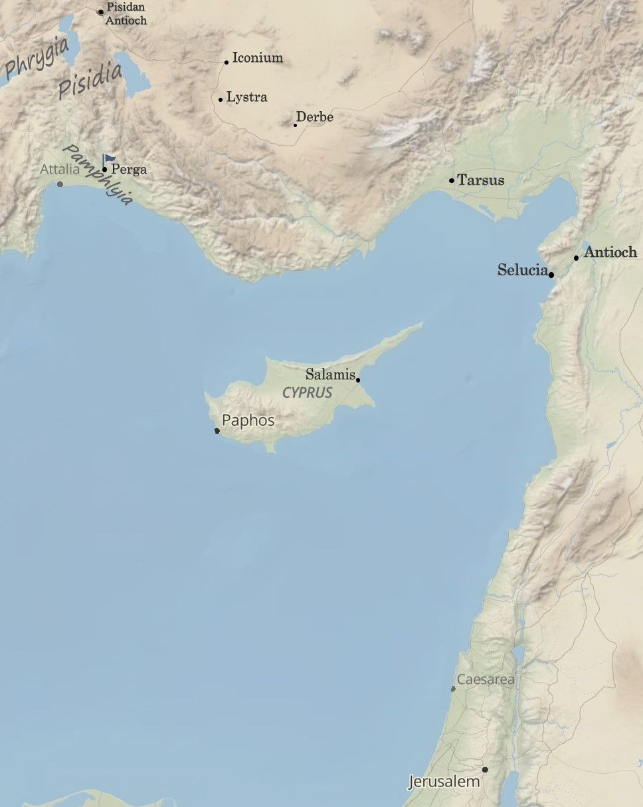
Paul and Barnabas to Iconium, Lystra, & Derbe:
“When God Sends”
Acts 14:1-21
“Be my witnesses in Jerusalem and in all Judea and Samaria, and to the ends of the earth”
– Acts 1:8 (ESV)

Slide 2



Acts 13:2-3 (ESV)
While they were worshiping the Lord and fasting, the Holy Spirit said, “Set apart for me Barnabas and Saul for the work to which I have called them.” Then after fasting and praying they laid their hands on them and sent them off.
Acts 13:51-52 (ESV)
But they shook off the dust from their feet against them and went to Iconium. And the disciples were filled with joy and with the Holy Spirit.

Slide 3

1. When God sends, be prepared to boldly speak a message that will divide.
Luke 12:51-53 (ESV)
Do you think that I have come to give peace on earth? No, I tell you, but rather division. For from now on in one house there will be five divided, three against two and two against three. They will be divided, father against son and son against father, mother against daughter and daughter against mother, mother-in-law against her daughter-in-law and daughter-in-law against mother-in-law.”

Slide 4
2. When God sends, be prepared to exercise wisdom.
Matthew 10:23a (ESV)
When they persecute you in one town, flee to the next…

Slide 5
3. When God sends, be prepared for those whom God has prepared.
Luke 17:11-19 (ESV)
On the way to Jerusalem, he was passing along between Samaria and Galilee. And as he entered a village, he was met by ten lepers, who stood at a distance and lifted up their voices, saying, “Jesus, Master, have mercy on us.” When he saw them, he said to them, “Go and show yourselves to the priests.” And as they went, they were cleansed. Then one of them, when he saw that he was healed, turned back, praising God with a loud voice; and he fell on his face at Jesus’ feet, giving him thanks. Now he was a Samaritan. Then Jesus answered, “Were not ten cleansed? Where are the nine? Was no one found to return and give praise to God except this foreigner?” And he said to him, “Rise and go your way; your faith has made you well.”

Slide 6
4. When God sends, be prepared for unexpected responses.
1 Corinthians 10:10 (ESV)
For they say, “His letters are weighty and strong, but his bodily presence is weak, and his speech of no account.”
Galatians 4:13 (ESV)
You know it was because of a bodily ailment that I preached the gospel to you at first,

Slide 7
5. When God sends, be prepared to give God all the glory.
Acts 12:22-23 (ESV)
And the people were shouting, “The voice of a god, and not of a man!” Immediately an angel of the Lord struck him down, because he did not give God the glory, and he was eaten by worms and breathed his last.

Slide 8
6. When God sends, be prepared to give a meaningful defense.
Romans 1:18-20 (ESV)
For the wrath of God is revealed from heaven against all ungodliness and unrighteousness of men, who by their unrighteousness suppress the truth. For what can be known about God is plain to them, because God has shown it to them. For his invisible attributes, namely, his eternal power and divine nature, have been clearly perceived, ever since the creation of the world, in the things that have been made. So they are without excuse.
1 Peter 3:15 (ESV)
but in your hearts honor Christ the Lord as holy, always being prepared to make a defense to anyone who asks you for a reason for the hope that is in you; yet do it with gentleness and respect,

Slide 9

7. When God sends, be prepared to persevere.
Galatians 6:17 (ESV)
From now on let no one cause me trouble, for I bear on my body the marks of Jesus.

