Slide 1
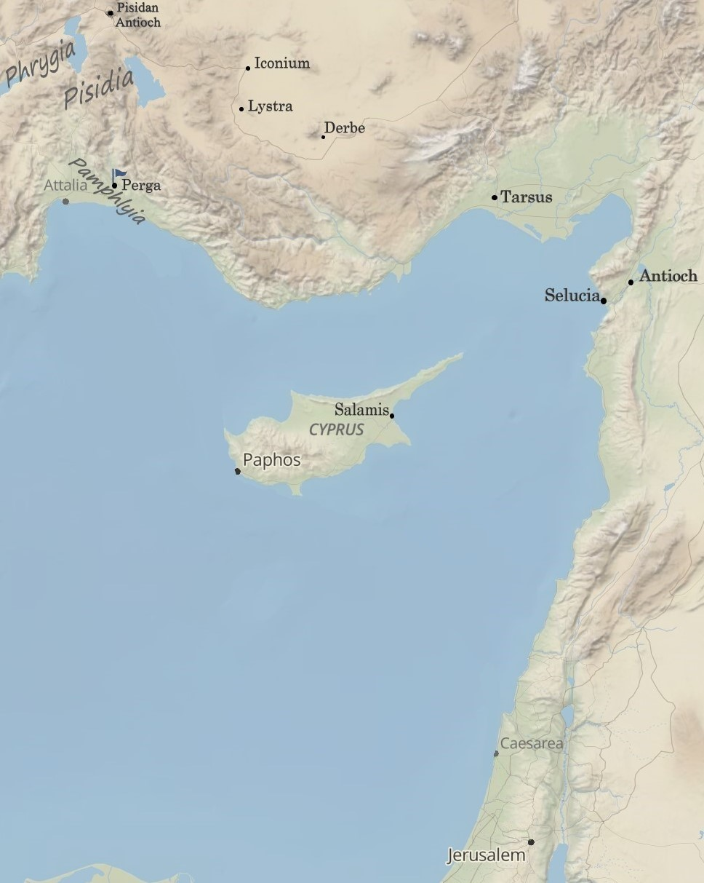
Completing the 1st Missionary Journey:
“Committed to Christ’s Calling”
Acts 14:21-28
“Be my witnesses in Jerusalem and in all Judea and Samaria, and to the ends of the earth”
– Acts 1:8 (ESV)

Slide 2
I. Strengthening the souls of other disciples.
2 Timothy 3:10-11 (ESV)
You, however, have followed my teaching, my conduct, my aim in life, my faith, my patience, my love, my steadfastness, my persecutions and sufferings that happened to me at Antioch, at Iconium, and at Lystra—which persecutions I endured; yet from them all the Lord rescued me.

Slide 3
I. Strengthening the souls of other disciples.
1. Through exhortation
1 Timothy 4:13 (ESV)
Until I come, devote yourself to the public reading of Scripture, to exhortation, to teaching.
2 Timothy 4:2 (ESV)
preach the word; be ready in season and out of season; reprove, rebuke, and exhort with complete patience and teaching.

Slide 4
I. Strengthening the souls of other disciples.
1. Through exhortation
a. To continue in the faith
Acts 11:23 (ESV)
When he came and saw the grace of God, he was glad, and he exhorted them all to remain faithful to the Lord with steadfast purpose,
Acts 13:43 (ESV)
And after the meeting of the synagogue broke up, many Jews and devout converts to Judaism followed Paul and Barnabas, who, as they spoke with them, urged them to continue in the grace of God.

Slide 5
I. Strengthening the souls of other disciples.
1. Through exhortation
a. To continue in the faith
John 8:31 (ESV)
So Jesus said to the Jews who had believed him, “If you abide in my word, you are truly my disciples,
John 15:1-10 (selected portions) (ESV)
“I am the true vine, and my Father is the vinedresser … Whoever abides in me and I in him, he it is that bears much fruit, for apart from me you can do nothing. If anyone does not abide in me he is thrown away like a branch and withers; and the branches are gathered, thrown into the fire, and burned … Abide in my love. If you keep my commandments, you will abide in my love, just as I have kept my Father’s commandments and abide in his love.

Slide 6
I. Strengthening the souls of other disciples.
1. Through exhortation
a. To continue in the faith
b. To expect hardship
2 Timothy 3:10-12 (ESV)
You, however, have followed my teaching, my conduct, my aim in life, my faith, my patience, my love, my steadfastness, my persecutions and sufferings that happened to me at Antioch, at Iconium, and at Lystra—which persecutions I endured; yet from them all the Lord rescued me.
Indeed, all who desire to live a godly life in Christ Jesus will be persecuted,

Slide 7
I. Strengthening the souls of other disciples.
1. Through exhortation
a. To continue in the faith
b. To expect hardship
c. To stay focused on the kingdom of God

Slide 8
I. Strengthening the souls of other disciples.
1. By entrusting them to the Lord through the care of a local church
a. Ensure the church exercises biblical authority and care
2 Corinthians 8:16-19 (ESV)
But thanks be to God, who put into the heart of Titus the same earnest care I have for you. For he not only accepted our appeal, but being himself very earnest he is going to you of his own accord. With him we are sending the brother who is famous among all the churches for his preaching of the gospel. And not only that, but he has been appointed by the churches to travel with us as we carry out this act of grace that is being ministered by us, for the glory of the Lord himself and to show our good will.

Slide 9
I. Strengthening the souls of other disciples.
1. By entrusting them to the Lord through the care of a local church
a. Ensure the church exercises biblical authority and care
Acts 6:3-6 (ESV)
Therefore, brothers, pick out from among you seven men of good repute, full of the Spirit and of wisdom, whom we will appoint to this duty. But we will devote ourselves to prayer and to the ministry of the word.” And what they said pleased the whole gathering, and they chose Stephen, a man full of faith and of the Holy Spirit, and Philip, and Prochorus, and Nicanor, and Timon, and Parmenas, and Nicolaus, a proselyte of Antioch. These they set before the apostles, and they prayed and laid their hands on them.

Slide 10
I. Strengthening the souls of other disciples.
1. By entrusting them to the Lord through the care of a local church
a. Ensure the church exercises biblical authority and care
b. And then entrust them to the Lord
i. Pray always for them.
ii. Keep in touch with them.

Slide 11
I. Continue to share the Gospel with non-believers.

Slide 12
I. Trust in God’s grace.

