Slide 1
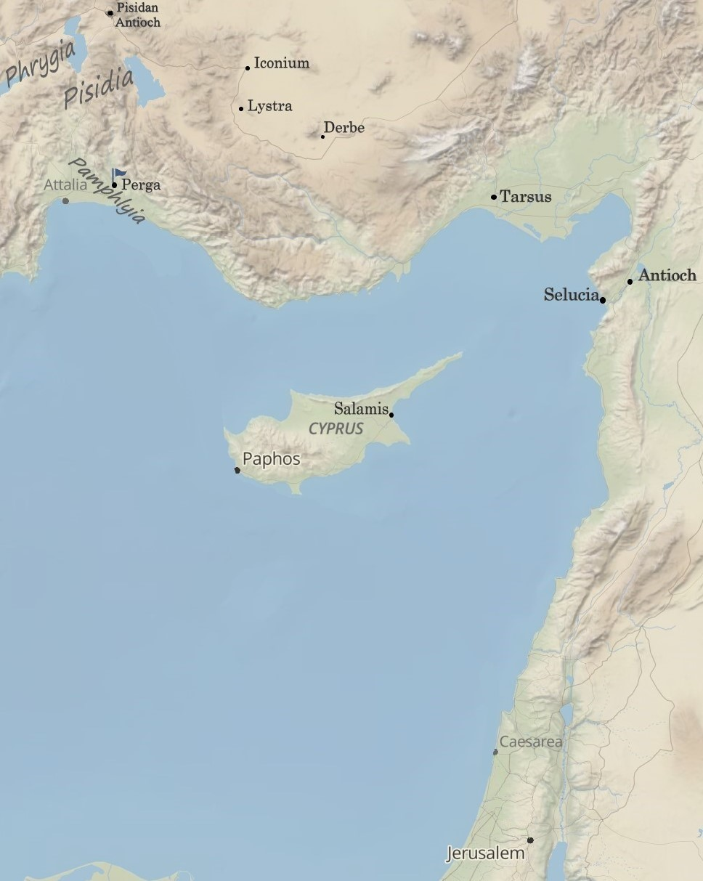
The Jerusalem Council:
“Unless You , You Cannot Be Saved”
Acts 15:1-11
“Be my witnesses in Jerusalem and in all Judea and Samaria, and to the ends of the earth”
– Acts 1:8 (ESV)

Slide 2
Ecclesiastes 3:1-10 (ESV)
For everything there is a season, and a time for every matter under heaven: a time to be born, and a time to die; a time to plant, and a time to pluck up what is planted; a time to kill, and a time to heal; a time to break down, and a time to build up; a time to weep, and a time to laugh; a time to mourn, and a time to dance; a time to cast away stones, and a time to gather stones together; a time to embrace, and a time to refrain from embracing; a time to seek, and a time to lose; a time to keep, and a time to cast away; a time to tear, and a time to sew; a time to keep silence, and a time to speak; a time to love, and a time to hate; a time for war, and a time for peace. What gain has the worker from his toil? I have seen the business that God has given to the children of man to be busy with.

Slide 3
Ecclesiastes 3:1-10 (ESV)
For everything there is a season, and a time for every matter under heaven: a time to be born, and a time to die; a time to plant, and a time to pluck up what is planted; a time to kill, and a time to heal; a time to break down, and a time to build up; a time to weep, and a time to laugh; a time to mourn, and a time to dance; a time to cast away stones, and a time to gather stones together; a time to embrace, and a time to refrain from embracing; a time to seek, and a time to lose; a time to keep, and a time to cast away; a time to tear, and a time to sew; a time to keep silence, and a time to speak; a time to love, and a time to hate; a time for war, and a time for peace. What gain has the worker from his toil? I have seen the business that God has given to the children of man to be busy with. He has made everything beautiful in its time. Also, he has put eternity into man’s heart….

Slide 4
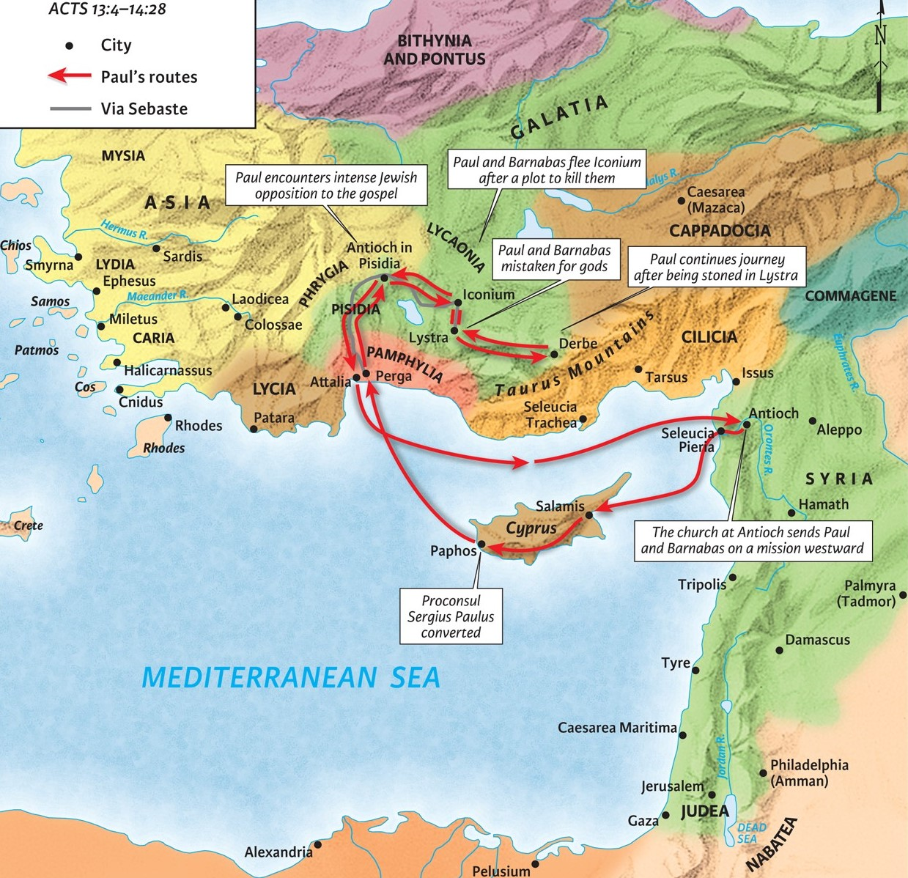
I. The Answer that Divides.
1. Unless you are circumcised according to the custom of Moses, you cannot be saved.

Slide 5
I. The Answer that Divides.
1. Unless you are circumcised according to the customs of Moses, you cannot be saved.
Acts 12:16-17 (ESV)
But Peter continued knocking, and when they opened, they saw him and were amazed. But motioning to them with his hand to be silent, he described to them how the Lord had brought him out of the prison. And he said, “Tell these things to James and to the brothers.” Then he departed and went to another place.

Slide 6
I. The Answer that Divides.
1. Unless you are circumcised according to the customs of Moses, you cannot be saved.
2. This is the wrong answer. Trusting any answer like this will earn you eternity in hell.
Galatians 1:6-9 (ESV)
I am astonished that you are so quickly deserting him who called you in the grace of Christ and are turning to a different gospel— not that there is another one, but there are some who trouble you and want to distort the gospel of Christ. But even if we or an angel from heaven should preach to you a gospel contrary to the one we preached to you, let him be accursed. As we have said before, so now I say again: If anyone is preaching to you a gospel contrary to the one you received, let him be accursed.

Slide 7
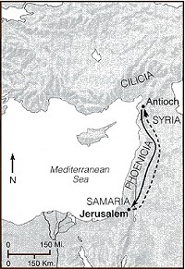
II. The Divisive Answer Rephrased and Debated.

Slide 8
II. The Divisive Answer Rephrased and Debated.
1. Unless you are circumcised and keep the law of Moses, you cannot be saved.
2. This, again, is the wrong answer and leads to hell.
Galatians 1:6-9 (ESV)
I am astonished that you are so quickly deserting him who called you in the grace of Christ and are turning to a different gospel— not that there is another one, but there are some who trouble you and want to distort the gospel of Christ. But even if we or an angel from heaven should preach to you a gospel contrary to the one we preached to you, let him be accursed. As we have said before, so now I say again: If anyone is preaching to you a gospel contrary to the one you received, let him be accursed.

Slide 9
III. The Answer God Decrees.
1. Unless it is by grace through faith in the Gospel of Jesus Christ, you cannot be saved.
2. Salvation comes by grace through faith in Jesus.
a. It is God’s choice.
b. God gives the Holy Spirit.
c. God is no respector of persons.
d. God’s cleanses hearts by faith.
e. God’s law cannot save anyone.
f. God saves by grace through Jesus Christ.

