Slide 1
The Jerusalem Council:
“Witnesses for Grace”
Acts 15:12-19
“Be my witnesses in Jerusalem and in all Judea and Samaria, and to the ends of the earth”
– Acts 1:8 (ESV)

Slide 2
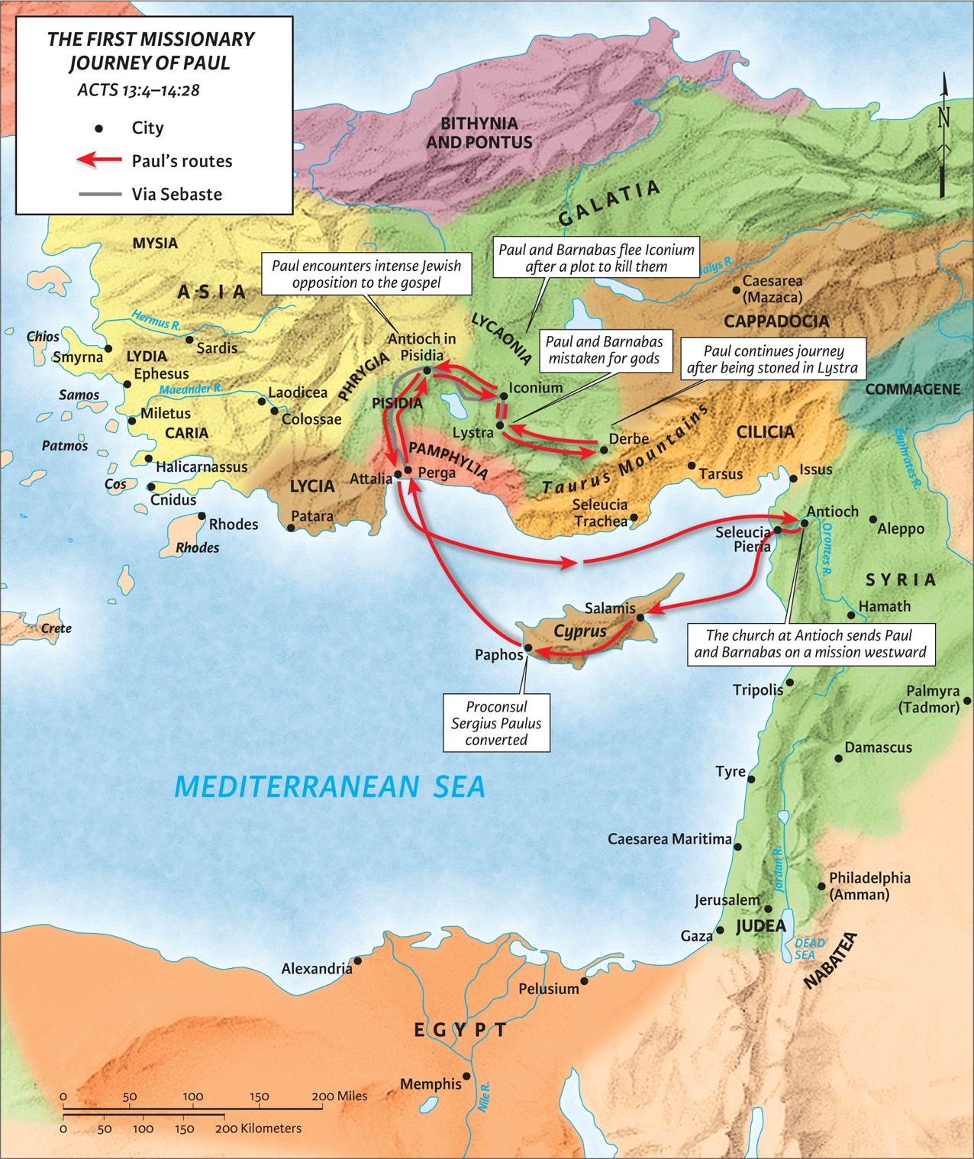
I. Salvation by grace alone is affirmed through God’s works.
1 Cor 1:22 (ESV)
‘For Jews demand signs and Greeks seek wisdom, but we preach Christ crucified, a stumbling block to Jews and folly to Gentiles,’

Slide 3
II. Salvation by grace alone is affirmed through God’s words.
A. When God ‘takes from the Gentiles a people for His name,’ it means that He saved them and made them His own.
Genesis 12:2-3 (ESV)
‘And I will make of you a great nation, and I will bless you and make your name great, so that you will be a blessing. I will bless those who bless you, and him who dishonors you I will curse, and in you all the families of the earth shall be blessed.’
Deuteronomy 7:6 (ESV)
‘For you are a people holy to the LORD your God. The LORD your God has chosen you to be a people for his treasured possession, out of all the peoples who are on the face of the earth.’

Slide 4
II. Salvation by grace alone is affirmed through God’s words.
B. The words of the prophets agree with this (letter A).
1. Notice that it is the prophets, plural. The message is repeated throughout the OT by them.
2. The prophets agree because their words are not their own interpretation but are God-breathed.
3. James does not say that the words of the prophets are fulfilled but that they agree.
2 Peter 1:19-21 (ESV)
And we have the prophetic word more fully confirmed, to which you will do well to pay attention as to a lamp shining in a dark place, until the day dawns and the morning star rises in your hearts, knowing this first of all, that no prophecy of Scripture comes from someone’s own interpretation. For no prophecy was ever produced by the will of man, but men spoke from God as they were carried along by the Holy Spirit.
2 Timothy 3:15-16 (ESV)
All Scripture is breathed out by God and profitable for teaching, for reproof, for correction, and for training in righteousness, that the man of God may be complete, equipped for every good work.

Slide 5
II. Salvation by grace alone is affirmed through God’s words.
C. This Amos 9:11-12 prophecy looks forward to the millennium.
1. The salvation of the Gentiles now and their inclusion into the church now, agrees with this future prophecy.
“Church” = Ecclesia = Ek (out from) + Kaleo (to call)

Slide 6
II. Salvation by grace alone is affirmed through God’s words.
C. This Amos 9:11-12 prophecy looks forward to the millennium.
1. The salvation of the Gentiles now and their inclusion into the church now, agrees with this future prophecy.
2. “After this,” Jesus returns in his second coming and restores Israel.
Amos 9:11 (ESV)
“In that day I will raise up the booth of David that is fallen and repair its breaches, and raise up its ruins and rebuild it as in the days of old…”

Slide 7
II. Salvation by grace alone is affirmed through God’s words.
C. This Amos 9:11-12 prophecy looks forward to the millennium.
1. The salvation of the Gentiles now and their inclusion into the church now, agrees with this future prophecy.
2. “After this,” Jesus returns in his second coming and restores Israel.
Zechariah 12:6-9 (ESV)
“On that day I will make the clans of Judah like a blazing pot in the midst of wood, like a flaming torch among sheaves. And they shall devour to the right and to the left all the surrounding peoples, while Jerusalem shall again be inhabited in its place, in Jerusalem. “And the LORD will give salvation to the tents of Judah first, that the glory of the house of David and the glory of the inhabitants of Jerusalem may not surpass that of Judah. On that day the LORD will protect the inhabitants of Jerusalem, so that the feeblest among them on that day shall be like David, and the house of David shall be like God, like the angel of the LORD, going before them. And on that day I will seek to destroy all the nations that come against Jerusalem.”
Jeremiah 23:5-6 (ESV)
“Behold, the days are coming, declares the LORD, when I will raise up for David a righteous Branch, and he shall reign as king and deal wisely, and shall execute justice and righteousness in the land. In his days Judah will be saved, and Israel will dwell securely. And this is the name by which he will be called: ‘The LORD is our righteousness.’

Slide 8
II. Salvation by grace alone is affirmed through God’s words.
C. This Amos 9:11-12 prophecy looks forward to the millennium.
1. The salvation of the Gentiles now and their inclusion into the church now, agrees with this future prophecy.
2. “After this,” Jesus returns in his second coming and restores Israel.
3. When Jesus returns at his second coming, it will be a literal return to a literal kingdom.
Acts 5:22 (ESV)
But when the officers came, they did not find them in the prison, so they returned and reported,

Slide 9
II. Salvation by grace alone is affirmed through God’s words.
C. This Amos 9:11-12 prophecy looks forward to the millennium.
1. The salvation of the Gentiles now and their inclusion into the church now, agrees with this future prophecy.
2. “After this,” Jesus returns in his second coming and restores Israel.
3. When Jesus returns at his second coming, it will be a literal return to a literal kingdom.
4. In the millennium, more Gentiles will be saved.
Isaiah 49:6 (ESV)
he says: “It is too light a thing that you should be my servant to raise up the tribes of Jacob and to bring back the preserved of Israel; I will make you as a light for the nations, that my salvation may reach to the end of the earth.”

Slide 10
II. Salvation by grace alone is affirmed through God’s words.
D. Conclusion: Since Gentiles are saved as Gentiles in the future millennium, with no requirements for becoming Jewish proselytes, it should not be expected to be different for Gentiles in this present age.
1. James’ judgment is, “I urge you to stop troubling them.”
2. James’ judgment is like Peter’s: “Stop putting an unnecessary yoke on the neck of these people.”
3. James’ judgment concludes that God will save Gentiles by his grace alone.
Judges 14:16-17 (ESV)
And Samson’s wife wept over him and said, “You only hate me; you do not love me. You have put a riddle to my people, and you have not told me what it is.” And he said to her, “Behold, I have not told my father nor my mother, and shall I tell you?” She wept before him the seven days that their feast lasted, and on the seventh day he told her, because she pressed him hard. Then she told the riddle to her people.

