Slide 1
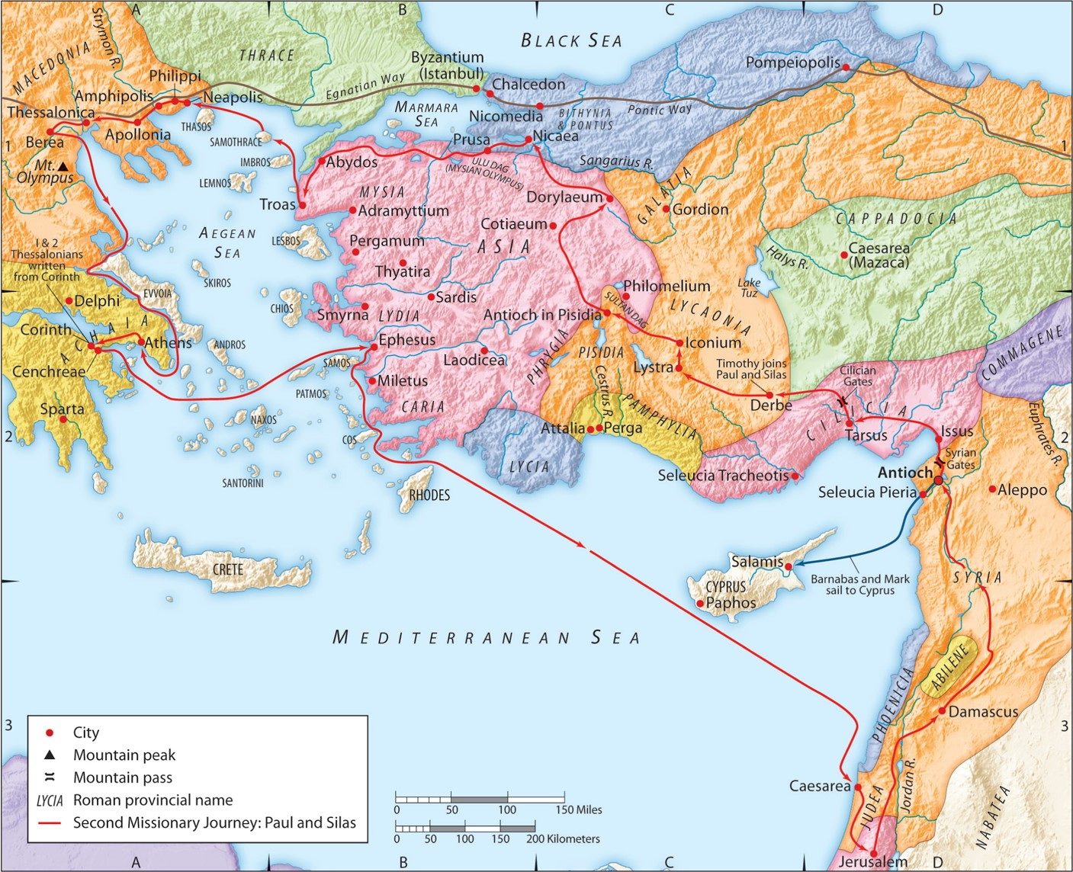
The Second Missionary Journey:
“Trusting God’s Guidance”
Acts 15:36 – Acts 16:5
“Be my witnesses in Jerusalem and in all Judea and Samaria, and to the ends of the earth”
– Acts 1:8 (ESV)

Slide 2
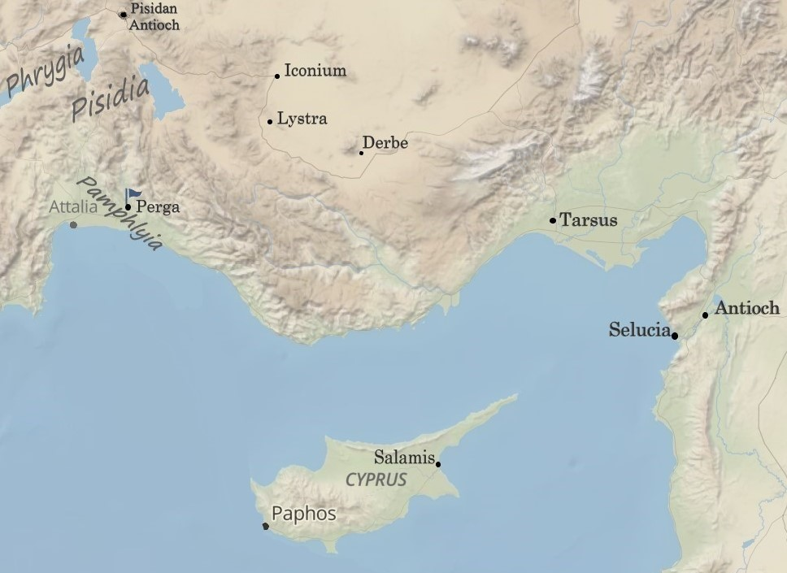
1. Trust God to guide you towards His Great Commission.

Slide 3
1. Trust God to guide you towards His Great Commission.
Exodus 4:31 (ESV)
And the people believed; and when they heard that the LORD had visited the people of Israel and that he had seen their affliction, they bowed their heads and worshiped.
Psalm 65:9 (ESV)
You visit the earth and water it; you greatly enrich it; the river of God is full of water; you provide their grain, for so you have prepared it.
Jeremiah 2:10-11 (ESV)
“For thus says the LORD: When seventy years are completed for Babylon, I will visit you, and I will fulfill to you my promise and bring you back to this place. For I know the plans I have for you, declares the LORD, plans for welfare and not for evil, to give you a future and a hope.

Slide 4
1. Trust God to guide you towards His Great Commission.
Matthew 25:34-40 (ESV)
Then the King will say to those on his right, ‘Come, you who are blessed by my Father, inherit the kingdom prepared for you from the foundation of the world. For I was hungry and you gave me food, I was thirsty and you gave me drink, I was a stranger and you welcomed me, I was naked and you clothed me, I was sick and you visited me, I was in prison and you came to me.’ Then the righteous will answer him, saying, ‘Lord, when did we see you hungry and feed you, or thirsty and give you drink? And when did we see you a stranger and welcome you, or naked and clothe you? And when did we see you sick or in prison and visit you?’ And the King will answer them, ‘Truly, I say to you, as you did it to one of the least of these my brothers, you did it to me.’

Slide 5
1. Trust God to guide you towards His Great Commission.
James 1:27 (ESV)
Religion that is pure and undefiled before God the Father is this: to visit orphans and widows in their affliction, and to keep oneself unstained from the world.

Slide 6
1. Trust God to guide you towards His Great Commission.
Matthew 28:19-20 (ESV)
Go therefore and make disciples of all nations, baptizing them in the name of the Father and of the Son and of the Holy Spirit, teaching them to observe all that I have commanded you. And behold, I am with you always, to the end of the age.”

Slide 7
1. Trust God to guide you towards His Great Commission.
Acts 13:2-3 (ESV)
While they were worshiping the Lord and fasting, the Holy Spirit said, “Set apart for me Barnabas and Saul for the work to which I have called them.” Then after fasting and praying they laid their hands on them and sent them off.

Slide 8
2. Trust God to guide you through conflict.
Colossians 4:10 (ESV)
Aristarchus my fellow prisoner greets you, and Mark the cousin of Barnabas (concerning whom you have received instructions—if he comes to you, welcome him),
Acts 12:12 (ESV)
When he (Peter) realized this, he went to the house of Mary, the mother of John whose other name was Mark, where many were gathered together and were praying.
Acts 13:5 (ESV)
When they arrived at Salamis, they proclaimed the word of God in the synagogues of the Jews. And they had John to assist them.
Acts 13:13 (ESV)
Now Paul and his companions set sail from Paphos and came to Perga in Pamphylia. And John left them and returned to Jerusalem,

Slide 9
2. Trust God to guide you through conflict.
“Withdrawn from” = Greek, “aphistemi” = English, “Apostacy”
Luke 13:27 (ESV)
But he will say, ‘I tell you, I do not know where you come from. Depart from (aphistemi) me, all you workers of evil!’
Luke 8:13 (ESV)
And the ones on the rock are those who, when they hear the word, receive it with joy. But these have no root; they believe for a while, and in time of testing fall away (aphistemi).
1 Timothy 4:1 (ESV)
Now the Spirit expressly says that in later times some will depart from (aphistemi) the faith by devoting themselves to deceitful spirits and teachings of demons,

Slide 10
2. Trust God to guide you through conflict.
Acts 4:36 -37 (ESV)
Thus Joseph, who was also called by the apostles Barnabas (which means son of encouragement), a Levite, a native of Cyprus, sold a field that belonged to him and brought the money and laid it at the apostles’ feet.
Acts 9:26-27 (ESV)
And when he (Saul/Paul) had come to Jerusalem, he attempted to join the disciples. And they were all afraid of him, for they did not believe that he was a disciple. But Barnabas took him and brought him to the apostles and declared to them how on the road he had seen the Lord, who spoke to him, and how at Damascus he had preached boldly in the name of Jesus.
Acts 11:21-22 (ESV)
And the hand of the Lord was with them, and a great number who believed turned to the Lord. The report of this came to the ears of the church in Jerusalem, and they sent Barnabas to Antioch.
Acts 11:24b-26 (ESV)
And a great many people were added to the Lord. So Barnabas went to Tarsus to look for Saul, and when he had found him, he brought him to Antioch. For a whole year they met with the church and taught a great many people. And in Antioch the disciples were first called Christians.

Slide 11
2. Trust God to guide you through conflict.
“Sharp Disagreement” = Greek, “paroxysmos” = English, “paroxysm”
Hebrews 10:24-25 (ESV)
And let us consider how to stir up (paroxysmos) one another to love and good works, not neglecting to meet together, as is the habit of some, but encouraging one another, and all the more as you see the Day drawing near.
Deuteronomy 29:28 (ESV)
and the LORD uprooted them from their land in anger and fury and great wrath (paroxymos) and cast them into another land, as they are this day.’
Jeremiah 32:37 (ESV)
Behold, I will gather them from all the countries to which I drove them in my anger and my wrath and in great indignation (paroxymos). I will bring them back to this place, and I will make them dwell in safety.

Slide 12
2. Trust God to guide you through conflict.
“Separated” = Greek, “apochorizo”
Revelation 6:12-14 (ESV)
When he opened the sixth seal, I looked, and behold, there was a great earthquake, and the sun became black as sackcloth, the full moon became like blood, and the stars of the sky fell to the earth as the fig tree sheds its winter fruit when shaken by a gale. The sky vanished (apochorizo) like a scroll that is being rolled up, and every mountain and island was removed from its place.

Slide 13
2. Trust God to guide you through conflict.
Hebrews 10:24 (ESV)
And let us consider how to stir up one another to love and good works,
James 4:1-3 (ESV)
What causes quarrels and what causes fights among you? Is it not this, that your passions are at war within you? You desire and do not have, so you murder. You covet and cannot obtain, so you fight and quarrel. You do not have, because you do not ask. You ask and do not receive, because you ask wrongly, to spend it on your passions.

Slide 14
2. Trust God to guide you through conflict.
3 Ways God guided this conflict
1. There are now two missionary teams instead of one.
2. The churches were strengthened by these teams.
3. A faithful disciple grew, and the Gospel spread.

Slide 15
2. Trust God to guide you through conflict.
A faithful disciple grew, and the Gospel spread:
Colossians 4:10 (ESV)
Aristarchus my fellow prisoner greets you, and Mark the cousin of Barnabas (concerning whom you have received instructions—if he comes to you, welcome him),
Philemon 23-24 (ESV)
Epaphras, my fellow prisoner in Christ Jesus, sends greetings to you, and so do Mark, Aristarchus, Demas, and Luke, my fellow workers.
2 Timothy 4:11 (ESV)
Luke alone is with me. Get Mark and bring him with you, for he is very useful to me for ministry.
1 Peter 5:13 (ESV)
She who is at Babylon, who is likewise chosen, sends you greetings, and so does Mark, my son.

Slide 16
3. Trust God to guide you to the right partnerships.

Slide 17
3. Trust God to guide you to the right partnerships.
2 Timothy 1:5 (ESV)
I am reminded of your sincere faith, a faith that dwelt first in your grandmother Lois and your mother Eunice and now, I am sure, dwells in you as well.
2 Timothy 3:14-15 (ESV)
But as for you, continue in what you have learned and have firmly believed, knowing from whom you learned it and how from childhood you have been acquainted with the sacred writings, which are able to make you wise for salvation through faith in Christ Jesus.
1 Timothy 4:12 (ESV)
Let no one despise you for your youth, but set the believers an example in speech, in conduct, in love, in faith, in purity.

Slide 18
3. Trust God to guide you to the right partnerships.
2 Timothy 3:10-12 (ESV)
You, however, have followed my teaching, my conduct, my aim in life, my faith, my patience, my love, my steadfastness, my persecutions and sufferings that happened to me at Antioch, at Iconium, and at Lystra—which persecutions I endured; yet from them all the Lord rescued me. Indeed, all who desire to live a godly life in Christ Jesus will be persecuted,

Slide 19
4. Trust God to guide you in the best ways to be His witness.
1 Corinthians 7:19 (ESV)
For neither circumcision counts for anything nor uncircumcision, but keeping the commandments of God.
1 Corinthians 9:19-23a (ESV)
For though I am free from all, I have made myself a servant to all, that I might win more of them. To the Jews I became as a Jew, in order to win Jews. To those under the law I became as one under the law (though not being myself under the law) that I might win those under the law. To those outside the law I became as one outside the law (not being outside the law of God but under the law of Christ) that I might win those outside the law. To the weak I became weak, that I might win the weak. I have become all things to all people, that by all means I might save some. I do it all for the sake of the gospel…
Galatians 2:1-5 (ESV)
Then after fourteen years I went up again to Jerusalem with Barnabas, taking Titus along with me. I went up because of a revelation and set before them (though privately before those who seemed influential) the gospel that I proclaim among the Gentiles, in order to make sure I was not running or had not run in vain. But even Titus, who was with me, was not forced to be circumcised, though he was a Greek. Yet because of false brothers secretly brought in—who slipped in to spy out our freedom that we have in Christ Jesus, so that they might bring us into slavery— to them we did not yield in submission even for a moment, so that the truth of the gospel might be preserved for you.

