Slide 1
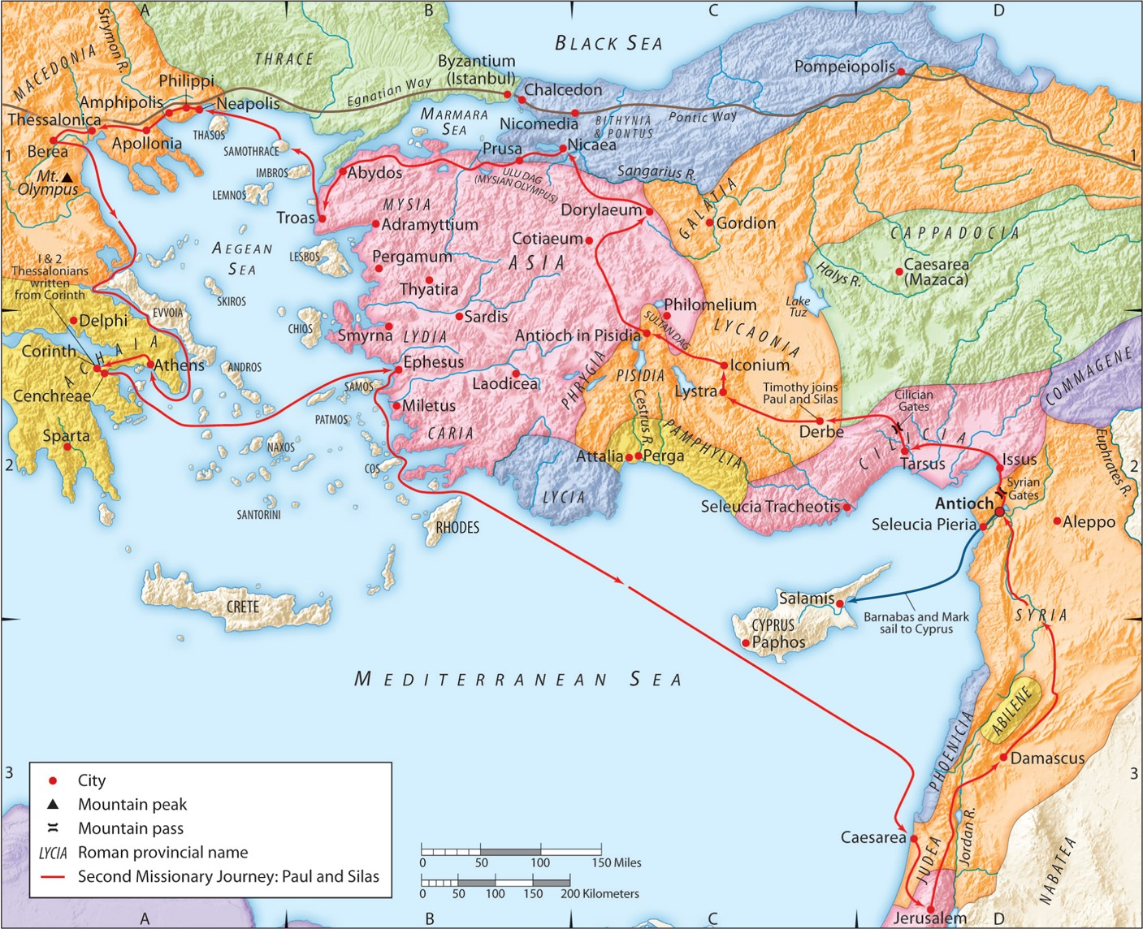
The Second Missionary Journey:
“Gospel Freedom for All”
(Part 1)
Acts 6:11-15
“Be my witnesses in Jerusalem and in all Judea and Samaria, and to the ends of the earth”
– Acts 1:8 (ESV)

Slide 2
Romans 6:16-22 (ESV)
Do you not know that if you present yourselves to anyone as obedient slaves, you are slaves of the one whom you obey, either of sin, which leads to death, or of obedience, which leads to righteousness? But thanks be to God, that you who were once slaves of sin have become obedient from the heart to the standard of teaching to which you were committed, and, having been set free from sin, have become slaves of righteousness. I am speaking in human terms, because of your natural limitations. For just as you once presented your members as slaves to impurity and to lawlessness leading to more lawlessness, so now present your members as slaves to righteousness leading to sanctification. For when you were slaves of sin, you were free in regard to righteousness. But what fruit were you getting at that time from the things of which you are now ashamed? For the end of those things is death. But now that you have been set free from sin and have become slaves of God, the fruit you get leads to sanctification and its end, eternal life.
Romans 6:23 (ESV)
For the wages of sin is death, but the free gift of God is eternal life in Christ Jesus our Lord.

Slide 3
John 8:32-36 (ESV)
and you will know the truth, and the truth will set you free.” They answered him, “We are offspring of Abraham and have never been enslaved to anyone. How is it that you say, ‘You will become free’?” Jesus answered them, “Truly, truly, I say to you, everyone who practices sin is a slave to sin. The slave does not remain in the house forever; the son remains forever. So if the Son sets you free, you will be free indeed.
John 8:37-38 (ESV)
I know that you are offspring of Abraham; yet you seek to kill me because my word finds no place in you. I speak of what I have seen with my Father, and you do what you have heard from your father.”

Slide 4
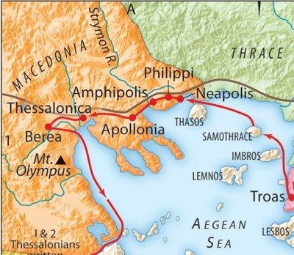

Slide 5
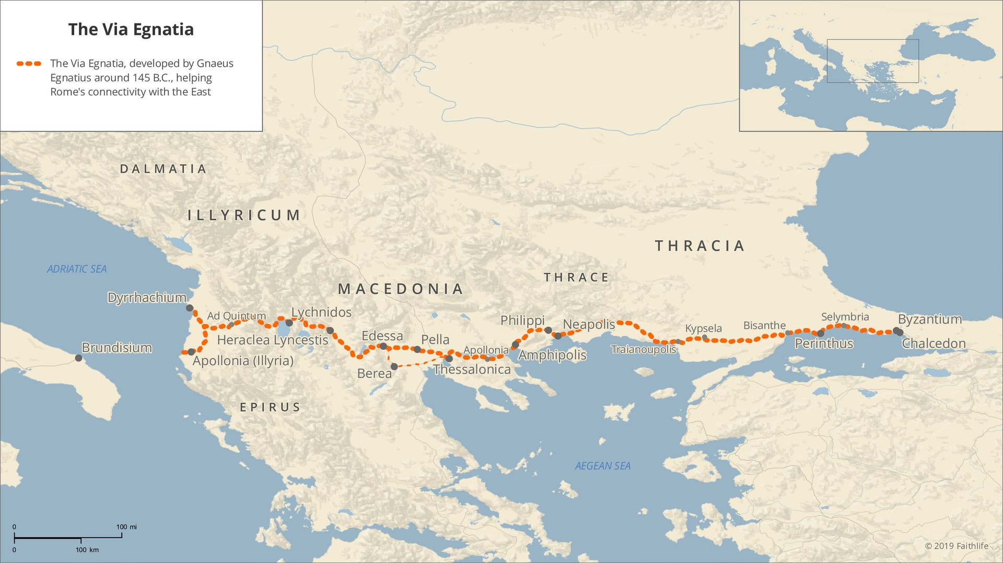

Slide 6
Colossians 4:14 (ESV)
Luke the beloved physician greets you, as does Demas.
Philippians 4:2-3 (ESV)
I entreat Euodia and I entreat Syntyche to agree in the Lord. Yes, I ask you also, true companion, help these women, who have labored side by side with me in the gospel together with Clement and the rest of my fellow workers, whose names are in the book of life.

Slide 7
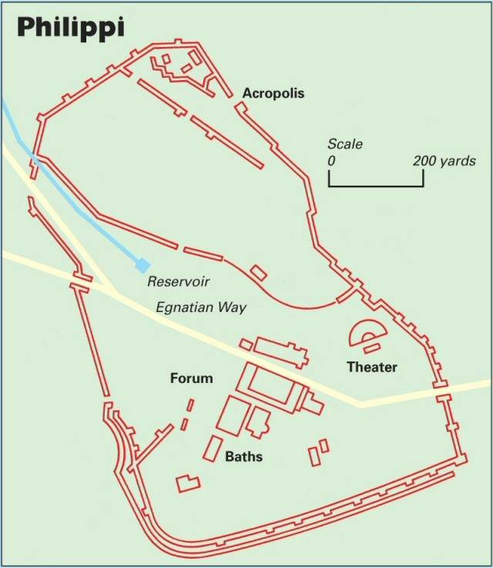

Slide 8
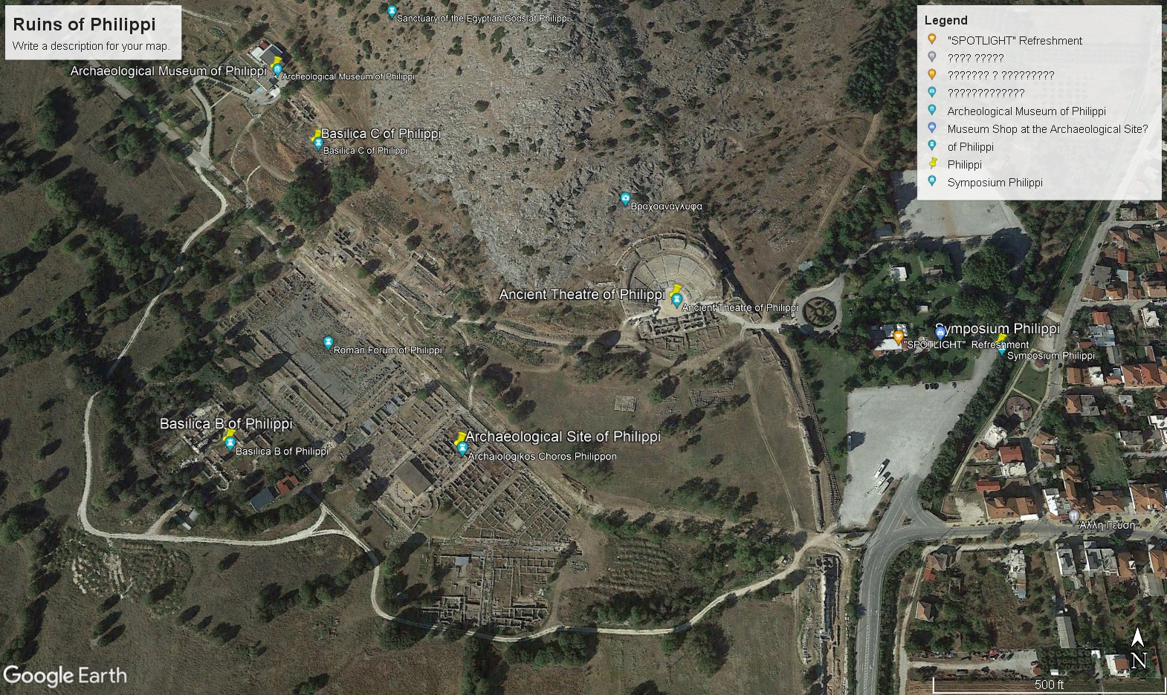

Slide 9
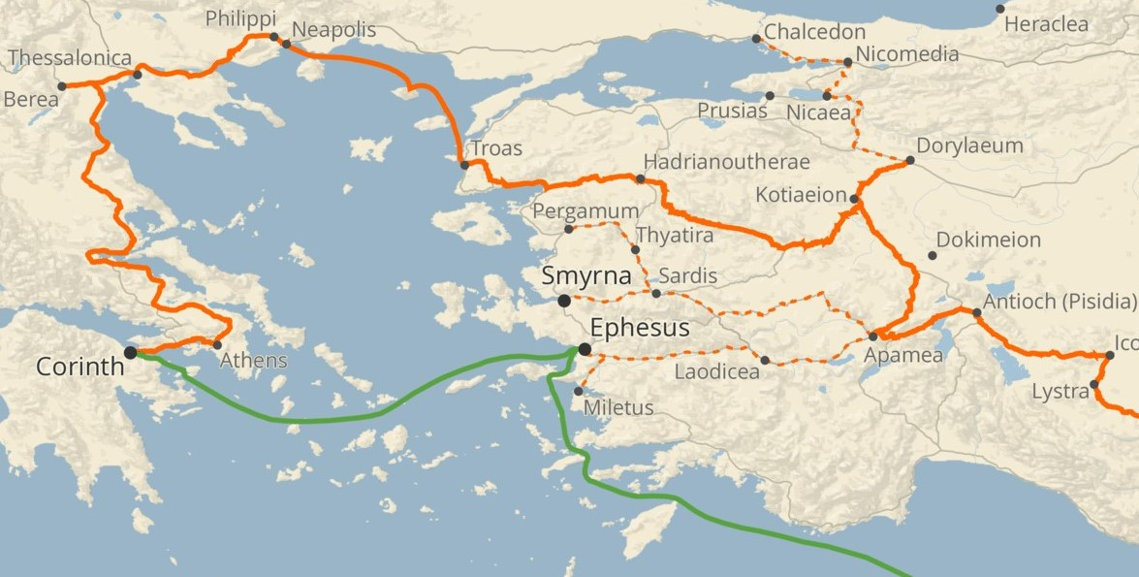
I. It doesn’t matter where you’re from, where you’re at, or where you’ve been.
A. Lydia was from Thyatira and was worshipping God at a riverside.

Slide 10
II. It doesn’t matter who you’ve been or who you are.
A. Lydia was a wealthy Gentile businesswoman seeking God.
Philippians 4:14-20 (ESV)
Yet it was kind of you to share my trouble. And you Philippians yourselves know that in the beginning of the gospel, when I left Macedonia, no church entered into partnership with me in giving and receiving, except you only. Even in Thessalonica you sent me help for my needs once and again. Not that I seek the gift, but I seek the fruit that increases to your credit. I have received full payment, and more. I am well supplied, having received from Epaphroditus the gifts you sent, a fragrant offering, a sacrifice acceptable and pleasing to God. And my God will supply every need of yours according to his riches in glory in Christ Jesus. To our God and Father be glory forever and ever. Amen.

Slide 11
II. It doesn’t matter who you’ve been or who you are.
A. Lydia was a wealthy Gentile businesswoman seeking God.
Galatians 3:27-28 (ESV)
For as many of you as were baptized into Christ have put on Christ. There is neither Jew nor Greek, there is neither slave nor free, there is no male and female, for you are all one in Christ Jesus.

Slide 12
III. It doesn’t matter what your circumstances have been or now are
A. Lydia was (probably) husband-less and a widow. She was free in many ways but enslaved to the Mosaic Law. She is wanted for her goods but likely shunned for her worship of Yahweh.
2 Corinthians 3:6 (ESV)
Not that we are sufficient in ourselves to claim anything as coming from us, but our sufficiency is from God, who has made us sufficient to be ministers of a new covenant, not of the letter but of the Spirit. For the letter kills, but the Spirit gives life.
Romans 7:9-10 (ESV)
I was once alive apart from the law, but when the commandment came, sin came alive and I died. The very commandment that promised life proved to be death to me.
Galatians 3:10 (ESV)
For all who rely on works of the law are under a curse; for it is written, “Cursed be everyone who does not abide by all things written in the Book of the Law, and do them.”

Slide 13
IV. It matters how you respond to Jesus and His Gospel.
A. Lydia responds positively.
1. She was seeking, listening to, and heeding the message.
a) She wasn’t saved by her own works or by Paul’s power.
b) Jesus opened her heart to heed the message.
Acts 8:6 (ESV)
And the crowds with one accord paid attention to what was being said by Philip, when they heard him and saw the signs that he did.
Acts 20:28 (ESV)
Pay careful attention to yourselves and to all the flock, in which the Holy Spirit has made you overseers, to care for the church of God, which he obtained with his own blood.

Slide 14
IV. It matters how you will respond to Jesus and His Gospel.
A. Lydia responds positively.
2. Her salvation was evidenced by three things:
a) Her willingness to be baptized.
b) Her household witness.
c) Her heart of hospitality.
Luke 24:44-47 (ESV)
Then he said to them, “These are my words that I spoke to you while I was still with you, that everything written about me in the Law of Moses and the Prophets and the Psalms must be fulfilled.” Then he opened their minds to understand the Scriptures, and said to them, “Thus it is written, that the Christ should suffer and on the third day rise from the dead, and that repentance for the forgiveness of sins should be proclaimed in his name to all nations, beginning from Jerusalem.

Slide 15
IV. It matters how you will respond to Jesus and His Gospel.
A. Lydia responds positively.
2. Her salvation was evidenced by three things:
a) Her willingness to be baptized.
b) Her household witness.
Rom 12:13 (ESV)
For an overseer, as God’s steward, must be above reproach. He must not be arrogant or quick-tempered or a drunkard or violent or greedy for gain, but hospitable, a lover of good, self-controlled, upright, holy, and disciplined.
c) Her heart of hospitality.
Rom 12:13 (ESV)
Contribute to the needs of the saints and seek to show hospitality.
1 Peter 4:9 (ESV)
Show hospitality to one another without grumbling.
Hebrews 13:2 (ESV)
Do not neglect to show hospitality to strangers, for thereby some have entertained angels unawares.
1 Timothy 5:9-10 (ESV)
Let a widow be enrolled if she … has shown hospitality,

