Slide 1
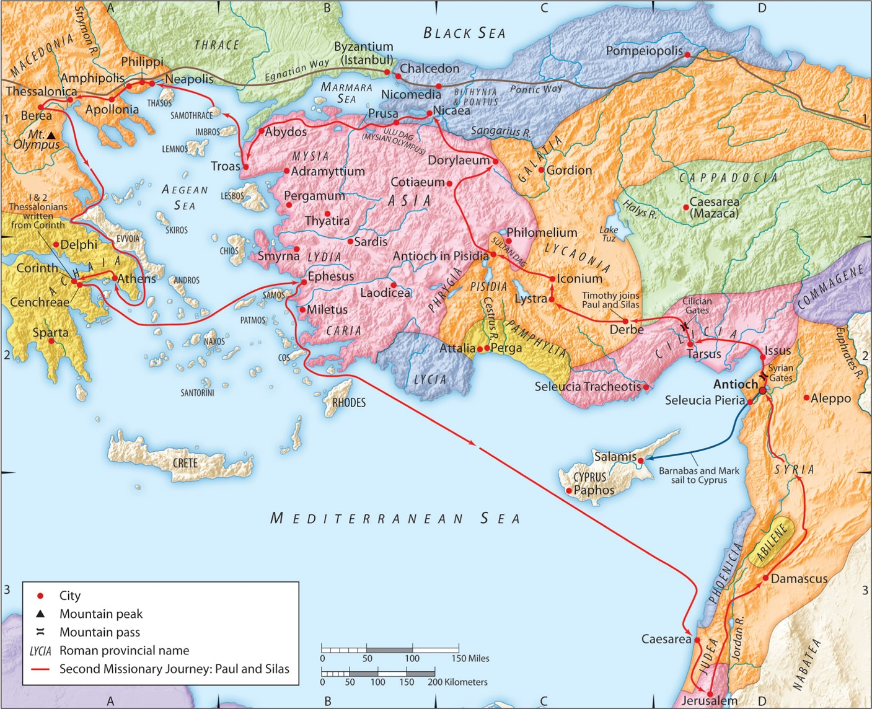
The Second Missionary Journey:
“God Directs His People”
Acts 6:6-12
“Be my witnesses in Jerusalem and in all Judea and Samaria, and to the ends of the earth”
– Acts 1:8 (ESV)

Slide 2
A. Defining God’s Will
1. God’s will of decree is His unthwartable sovereign will.
Ephesians 1:11 (ESV)
In him we have obtained an inheritance, having been predestined according to the purpose of him who works all things according to the counsel of his will,

Slide 3
A. Defining God’s Will
2. God’s will of desire are things He wants that ought to be true but depend on each person’s response.
1 Timothy 2:3-4 (ESV)
This is good, and it is pleasing in the sight of God our Savior, who desires all people to be saved and to come to the knowledge of the truth.
2 Peter 3:9 (ESV)
The Lord is not slow to fulfill his promise as some count slowness, but is patient toward you, not wishing that any should perish, but that all should reach repentance.
1 John 2:17 (ESV)
And the world is passing away along with its desires, but whoever does the will of God abides forever.
Matthew 7:21 (ESV)
“Not everyone who says to me, ‘Lord, Lord,’ will enter the kingdom of heaven, but the one who does the will of my Father who is in heaven.

Slide 4
A. Defining God’s Will
3. God’s will of direction is His specific & personal will for your life.
Ephesians 1:11 (ESV)
In him we have obtained an inheritance, having been predestined according to the purpose of him who works all things according to the counsel of his will,
Romans 8:28 (NASB95)
And we know that God causes all things to work together for good to those who love God, to those who are called according to His purpose.
Romans 8:29 (NASB95)
For those whom He foreknew, He also predestined to become conformed to the image of His Son…

Slide 5
A. Defining God’s Will
4. God’s will is for you to be conformed to the image of Christ.
Ephesians 1:11 (ESV)
In him we have obtained an inheritance, having been predestined according to the purpose of him who works all things according to the counsel of his will,
Romans 8:29 (NASB95)
And we know that God causes all things to work together for good to those who love God, to those who are called according to His purpose.
Romans 8:29 (NASB95)
For those whom He foreknew, He also predestined to become conformed to the image of His Son…

Slide 6
A. Defining God’s Will
5. Jesus said to seek God’s Kingdom first and then all will be added.
Matthew 6:28-31 (ESV)
“And why are you worried about clothing? Observe how the lilies of the field grow; they do not toil nor do they spin, yet I say to you that not even Solomon in all his glory clothed himself like one of these. “But if God so clothes the grass of the field, which is alive today and tomorrow is thrown into the furnace, will He not much more clothe you? You of little faith! “Do not worry then, saying, ‘What will we eat?’ or ‘What will we drink?’ or ‘What will we wear for clothing?’
Matthew 6:32 (ESV)
For the Gentiles eagerly seek all these things; for your heavenly Father knows that you need all these things.
Matthew 6:33-34 (ESV)
But seek first His kingdom and His righteousness, and all these things will be added to you. “So do not worry about tomorrow; for tomorrow will care for itself. Each day has enough trouble of its own.

Slide 7
A. Defining God’s Will
5. Jesus said to seek God’s Kingdom first and then all will be added.
2 Peter 1:2-3 (ESV)
Grace and peace be multiplied to you in the knowledge of God and of Jesus our Lord; seeing that His divine power has granted to us everything pertaining to life and godliness, through the true knowledge of Him who called us by His own glory and excellence.

Slide 8
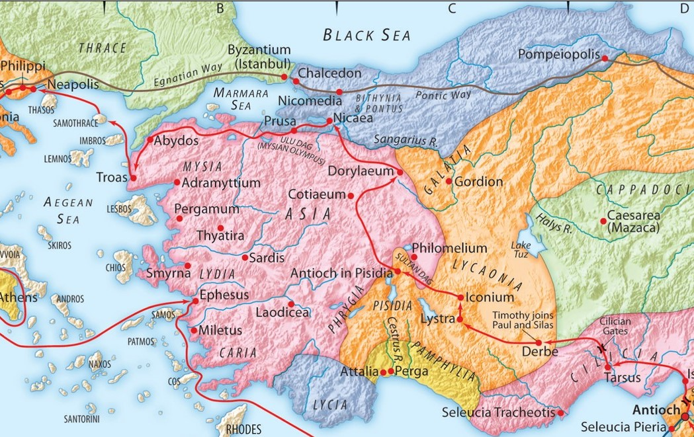
B. How God Directs His People
1. By closing some paths.

Slide 9
B. How God Directs His People
1. By closing some paths.

Slide 10
B. How God Directs His People
1. By closing some paths.
1 Peter 1:1 (ESV)
Peter, an apostle of Jesus Christ, To those who are elect exiles of the Dispersion in Pontus, Galatia, Cappadocia, Asia, and Bithynia,

Slide 11
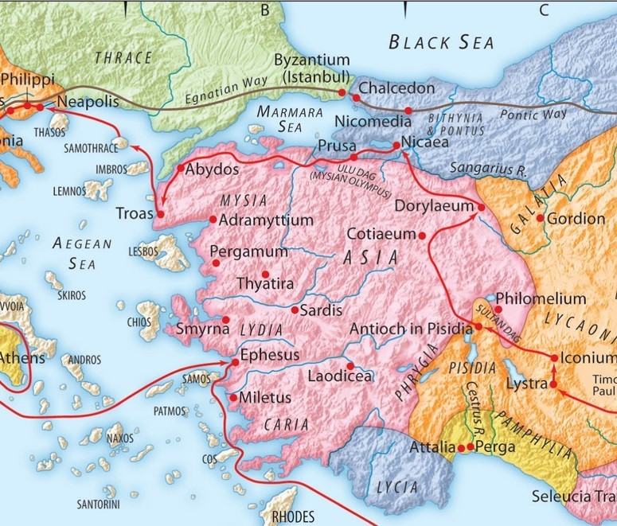
B. How God Directs His People
2. By opening other paths.

Slide 12
B. How God Directs His People
3. By the power of His Spirit and Word.

Slide 13
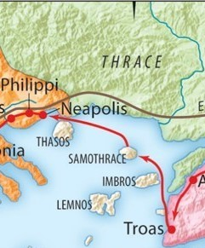
B. How God Directs His People
4. By His provision.

Slide 14
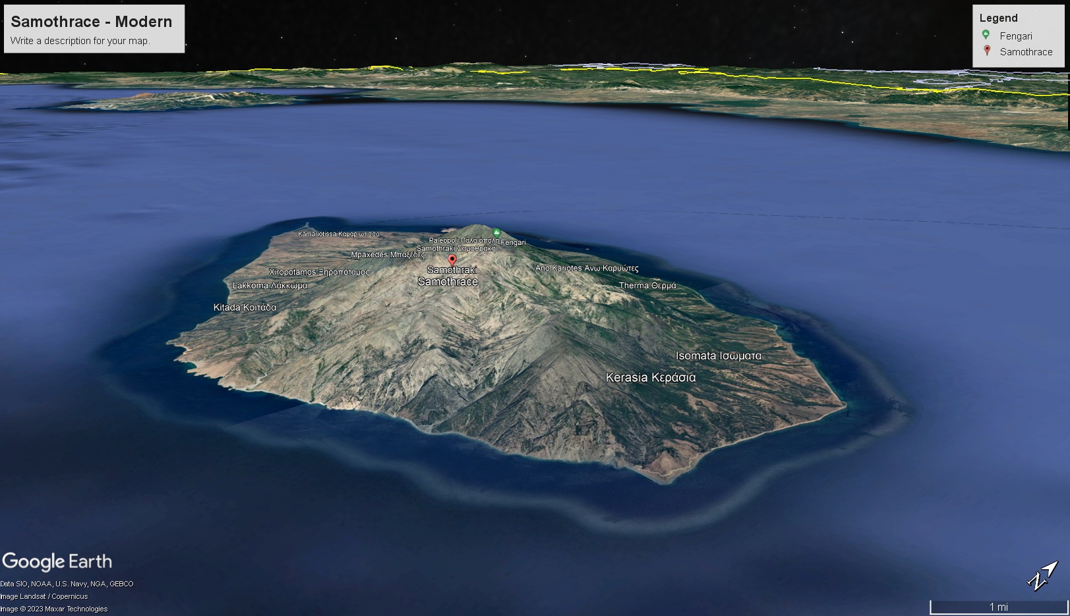

Slide 15
B. How God Directs His People
4. By His provision.

Slide 16
C. Five Clear Commands on God’s Will
1. His will is your salvation.
1 Timothy 2:3-4 (ESV)
This is good, and it is pleasing in the sight of God our Savior, who desires all people to be saved and to come to the knowledge of the truth.
2 Peter 3:9 (ESV)
The Lord is not slow to fulfill his promise as some count slowness, but is patient toward you, not wishing that any should perish, but that all should reach repentance.

Slide 17
C. Five Clear Commands on God’s Will
1. His will is your salvation.
2. His will for you to be Spirit-filled.
Ephesians 5:17-20 (ESV)
Therefore do not be foolish, but understand what the will of the Lord is. And do not get drunk with wine, for that is debauchery, but be filled with the Spirit, addressing one another in psalms and hymns and spiritual songs, singing and making melody to the Lord with your heart, giving thanks always and for everything to God the Father in the name of our Lord Jesus Christ
Colossians 3:16-17 (ESV)
Let the word of Christ dwell in you richly, teaching and admonishing one another in all wisdom, singing psalms and hymns and spiritual songs, with thankfulness in your hearts to God. And whatever you do, in word or deed, do everything in the name of the Lord Jesus, giving thanks to God the Father through him.

Slide 18
C. Five Clear Commands on God’s Will
1. His will is your salvation.
2. His will for you to be Spirit-filled.
3. His will is your sanctificaton.
1 Thessalonians 5:3-7 (ESV)
For this is the will of God, your sanctification: that you abstain from sexual immorality; that each one of you know how to control his own body in holiness and honor, not in the passion of lust like the Gentiles who do not know God; that no one transgress and wrong his brother in this matter, because the Lord is an avenger in all these things, as we told you beforehand and solemnly warned you. For God has not called us for impurity, but in holiness.

Slide 19
C. Five Clear Commands on God’s Will
1. His will is your salvation.
2. His will for you to be Spirit-filled.
3. His will is your sanctificaton.
4. His will is for you to be above reproach in the world.
1 Peter 2:13-16 (ESV)
Be subject for the Lord’s sake to every human institution, whether it be to the emperor as supreme, or to governors as sent by him to punish those who do evil and to praise those who do good. For this is the will of God, that by doing good you should put to silence the ignorance of foolish people. Live as people who are free, not using your freedom as a cover-up for evil, but living as servants of God.

Slide 20
C. Five Clear Commands on God’s Will
1. His will is your salvation.
2. His will for you to be Spirit-filled.
3. His will is your sanctificaton.
4. His will is for you to be above reproach in the world.
5. His will is that you are ready to suffer for Christ.
Philippians 1:27-30 (ESV)
Only let your manner of life be worthy of the gospel of Christ, so that whether I come and see you or am absent, I may hear of you that you are standing firm in one spirit, with one mind striving side by side for the faith of the gospel, and not frightened in anything by your opponents. This is a clear sign to them of their destruction, but of your salvation, and that from God. For it has been granted to you that for the sake of Christ you should not only believe in him but also suffer for his sake, engaged in the same conflict that you saw I had and now hear that I still have.

