Slide 1
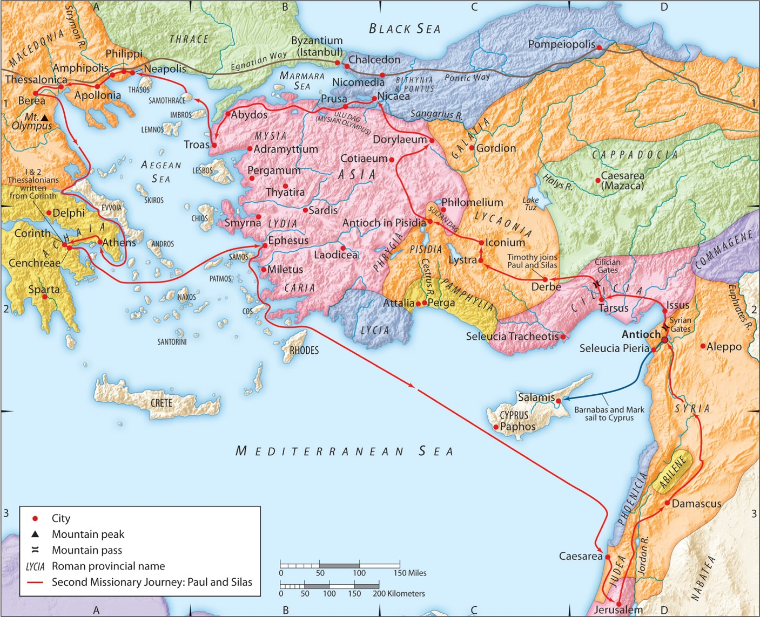
The Second Missionary Journey:
“Gospel Freedom for All”
(Part 2)
Acts 16:16-18
“Be my witnesses in Jerusalem and in all Judea and Samaria, and to the ends of the earth”
– Acts 1:8 (ESV)

Slide 2
Romans 7:7-12 (ESV)
What then shall we say? That the law is sin? By no means! Yet if it had not been for the law, I would not have known sin. For I would not have known what it is to covet if the law had not said, “You shall not covet.” But sin, seizing an opportunity through the commandment, produced in me all kinds of covetousness. For apart from the law, sin lies dead. I was once alive apart from the law, but when the commandment came, sin came alive and I died. The very commandment that promised life proved to be death to me. For sin, seizing an opportunity through the commandment, deceived me and through it killed me. So the law is holy, and the commandment is holy and righteous and good.
Colossians 2:16-17 (ESV)
Therefore let no one pass judgment on you in questions of food and drink, or with regard to a festival or a new moon or a Sabbath. These are a shadow of the things to come, but the substance belongs to Christ.

Slide 3
I. The missionary team encounters a slave girl.
A. She is a slave to a demon.
1. “Spirit of divination” = Gr. pneuma pythona = “spirit of Python”
1 John 4:1 (ESV)
Beloved, do not believe every spirit, but test the spirits to see whether they are from God, for many false prophets have gone out into the world.

Slide 4
I. The missionary team encounters a slave girl.
A. She is a slave to a demon.
2. She could accurately tell and/or predict things about people that she had not investigated, observed, or was told of by others.
Ezekiel 13:6(ESV)
They have seen false visions and lying divinations. They say, ‘Declares the LORD,’ when the LORD has not sent them, and yet they expect him to fulfill their word.
Leviticus 20:6 (ESV)
“If a person turns to mediums and necromancers, whoring after them, I will set my face against that person and will cut him off from among his people.
Ezekiel 13:9 (ESV)
My hand will be against the prophets who see false visions and who give lying divinations. They shall not be in the council of my people, nor be enrolled in the register of the house of Israel, nor shall they enter the land of Israel. And you shall know that I am the Lord GOD.

Slide 5
I. The missionary team encounters a slave girl.
A. She is a slave to a demon.
3. Application: There are still those today who claim to be medium or psychics and you should stay clear!

Slide 6
I. The missionary team encounters a slave girl.
A. She is a slave to a demon.
4. Application: Satan and the demons are very much active today and you must test the spirits!
1 John 5:19 (ESV)
We know that we are from God, and the whole world lies in the power of the evil one.
Ephesians 6:10-11 (ESV)
Finally, be strong in the Lord and in the strength of his might. Put on the whole armor of God, that you may be able to stand against the schemes of the devil.
Ephesians 2:1-2 (ESV)
And you were dead in the trespasses and sins in which you once walked, following the course of this world, following the prince of the power of the air, the spirit that is now at work in the sons of disobedience—
James 4:7 (ESV)
Submit yourselves therefore to God. Resist the devil, and he will flee from you.

Slide 7
I. The missionary team encounters a slave girl.
B. She is also a slave to man.
1. Application: Be careful of the world’s influence and things (that money can buy).
1 John 2:15-16 (ESV)
Do not love the world or the things in the world. If anyone loves the world, the love of the Father is not in him. For all that is in the world—the desires of the flesh and the desires of the eyes and pride of life—is not from the Father but is from the world.
Matthew 19:23-24 (ESV)
And Jesus said to his disciples, “Truly, I say to you, only with difficulty will a rich person enter the kingdom of heaven. Again I tell you, it is easier for a camel to go through the eye of a needle than for a rich person to enter the kingdom of God.”
1 Timothy 6:10 (ESV)
For the love of money is a root of all kinds of evils. It is through this craving that some have wandered away from the faith and pierced themselves with many pangs.

Slide 8
I. The missionary team encounters a slave girl.
B. She is also a slave to man.
1. Application: Be an ambassador of Jesus Christ and His message of reconciliation.
2 Corinthians 5:19-20 (ESV)
…in Christ God was reconciling the world to himself, not counting their trespasses against them, and entrusting to us the message of reconciliation. Therefore, we are ambassadors for Christ, God making his appeal through us…
2 Corinthians 4:4 (ESV)
In their case the god of this world has blinded the minds of the unbelievers, to keep them from seeing the light of the gospel of the glory of Christ, who is the image of God.

Slide 9
II. The slave girl attempts to partner with them but is stopped.
A. She spoke the truth, but it was relative truth.
1. She speaks of the ‘Most High God,’ but that could be a false god.
Numbers 24:16 (ESV)
the oracle of him who hears the words of God, and knows the knowledge of the Most High….
Daniel 3:26 (ESV)
…“Shadrach, Meshach, and Abednego, servants of the Most High God…
Luke 1:32 (ESV)
He will be great and will be called the Son of the Most High…
Luke 8:27-28 (ESV)
When Jesus had stepped out on land, there met him a man from the city who had demons … he cried out and fell down before him and said with a loud voice, “What have you to do with me, Jesus, Son of the Most High God?...”

Slide 10
II. The slave girl attempts to partner with them but is stopped.
A. She spoke the truth, but it was relative truth.
1. She speaks of the ‘Most High God,’ but that could be a false god.
Isaiah 14:12-15 (ESV)
“How you are fallen from heaven, O Day Star, son of Dawn! How you are cut down to the ground, you who laid the nations low! You said in your heart, ‘I will ascend to heaven; above the stars of God I will set my throne on high; I will sit on the mount of assembly in the far reaches of the north; I will ascend above the heights of the clouds; I will make myself like the Most High.’ But you are brought down to Sheol, to the far reaches of the pit.

Slide 11
II. The slave girl attempts to partner with them but is stopped.
A. She spoke the truth, but it was relative truth.
2. She speaks of “a” way of salvation, not “the” way of salvation.

Slide 12
II. The slave girl attempts to partner with them but is stopped.
A. She spoke the truth, but it was relative truth.
3. She speaks of salvation, but that could be physical rescue or a different way of salvation.

Slide 13
II. The slave girl attempts to partner with them but is stopped.
A. She spoke the truth, but it was relative truth.
4. Application: Expect Satan to come as an angel of light and speak some truth.
2 Corinthians 11:13-14 (ESV)
For such men are false apostles, deceitful workmen, disguising themselves as apostles of Christ. And no wonder, for even Satan disguises himself as an angel of light.

Slide 14
II. The slave girl attempts to partner with them but is stopped.
A. She spoke the truth, but it was relative truth.
5. Application: Avoid false prophets who speak some truth.
2 Timothy 3:1-5 (ESV)
But understand this, that in the last days there will come times of difficulty. For people will be lovers of self, lovers of money, proud, arrogant, abusive, disobedient to their parents, ungrateful, unholy, heartless, unappeasable, slanderous, without self-control, brutal, not loving good, treacherous, reckless, swollen with conceit, lovers of pleasure rather than lovers of God, having the appearance of godliness, but denying its power. Avoid such people.

Slide 15
II. The slave girl attempts to partner with them but is stopped.
A. She spoke the truth, but it was relative truth.
6. Application: Speak truth clearly (and especially the Gospel).
1 Peter 3:15 (ESV)
but in your hearts honor Christ the Lord as holy, always being prepared to make a defense to anyone who asks you for a reason for the hope that is in you; yet do it with gentleness and respect,

Slide 16
II. The slave girl attempts to partner with them but is stopped.
B. Paul will not partner with a demon and casts it out by the power of Jesus.
1. Application: Be careful who you partner with.
2 Corinthians 6:14-16 (ESV)
Do not be unequally yoked with unbelievers. For what partnership has righteousness with lawlessness? Or what fellowship has light with darkness? What accord has Christ with Belial? Or what portion does a believer share with an unbeliever? What agreement has the temple of God with idols? For we are the temple of the living God; as God said, “I will make my dwelling among them and walk among them, and I will be their God, and they shall be my people.

