Slide 1
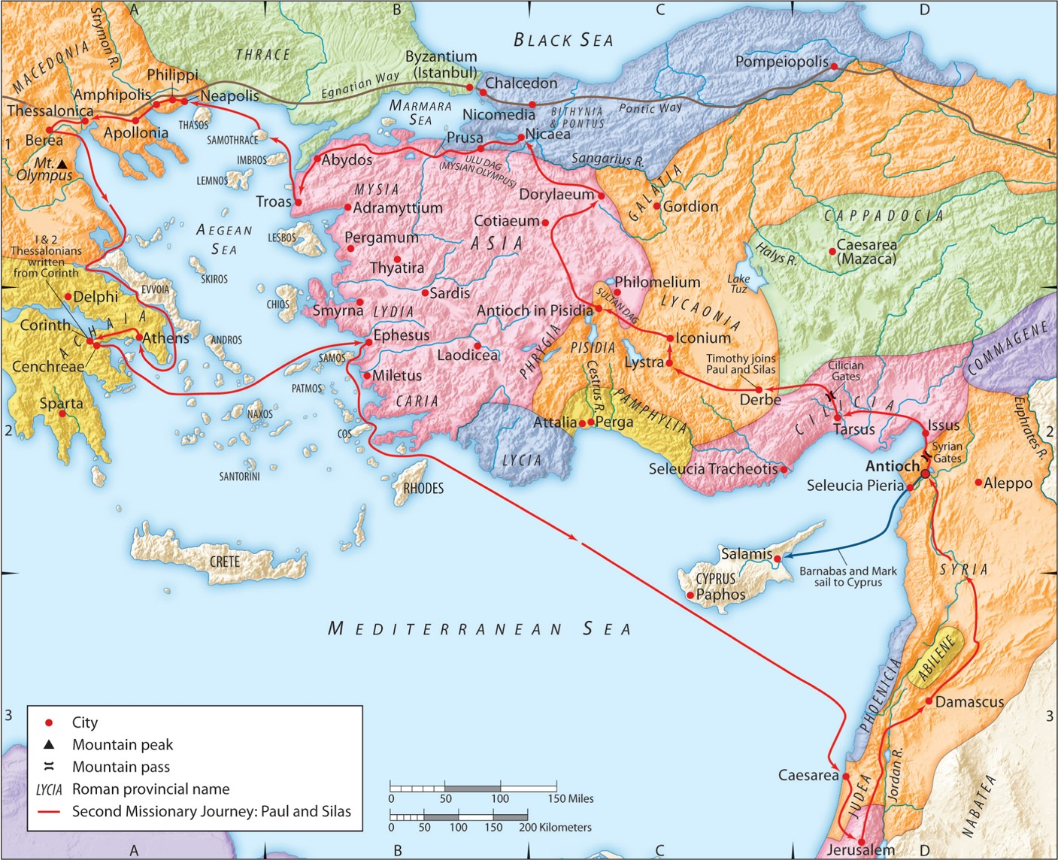
The Second Missionary Journey:
“Gospel Freedom for All”
(Part 4)
Acts 16:26-34
“Be my witnesses in Jerusalem and in all Judea and Samaria, and to the ends of the earth”
– Acts 1:8 (ESV)

Slide 2
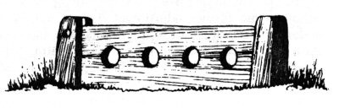
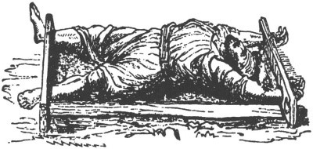

Slide 3
III. God’s powerful response to the imprisonment.
Psalm 103:19 (NASB95)
The LORD has established His throne in the heavens, And His sovereignty rules over all.
Colossians 1:19 (ESV)
And he is before all things, and in him all things hold together.
Hebrews 1:19a (ESV)
He is the radiance of the glory of God and the exact imprint of his nature, and he upholds the universe by the word of his power.

Slide 4

III. God’s powerful response to the imprisonment.
(Eng.) “great earthquake”
=
(Gr.) “megas seismos”
God’s Plan Provides:
Messengers
Recipients
Opportunity

Slide 5
IV. The jailer’s broken response in the earthquake.
A. God broke the jailer’s pride.
Acts 12:18-19 (ESV)
Now when day came, there was no little disturbance among the soldiers over what had become of Peter. And after Herod searched for him and did not find him, he examined the sentries and ordered that they should be put to death. Then he went down from Judea to Caesarea and spent time there.
John 8:44a (ESV)
You are of your father the devil, and your will is to do your father’s desires. He was a murderer from the beginning, and does not stand in the truth…
1 Peter 5:8 (ESV)
Be sober-minded; be watchful. Your adversary the devil prowls around like a roaring lion, seeking someone to devour.

Slide 6
IV. The jailer’s broken response in the earthquake.
A. God broke the jailer’s pride.
B. God broke the jailer’s heart.
Exodus 21:23-24 (ESV)
But if there is harm, then you shall pay life for life, eye for eye, tooth for tooth, hand for hand, foot for foot, burn for burn, wound for wound, stripe for stripe.
Matthew 5:38-39 (ESV)
“You have heard that it was said, ‘An eye for an eye and a tooth for a tooth.’ But I say to you, Do not resist the one who is evil. But if anyone slaps you on the right cheek, turn to him the other also.
Matthew 5:43-45a (ESV)
“You have heard that it was said, ‘You shall love your neighbor and hate your enemy.’ But I say to you, Love your enemies and pray for those who persecute you, so that you may be sons of your Father who is in heaven…

Slide 7
IV. The jailer’s broken response in the earthquake.
A. God broke the jailer’s pride.
B. God broke the jailer’s heart.
C. The jailer and his household believed in the Lord Jesus.
Romans 10:9-10 (ESV)
because, if you confess with your mouth that Jesus is Lord and believe in your heart that God raised him from the dead, you will be saved. For with the heart one believes and is justified, and with the mouth one confesses and is saved.
Romans 10:17 (ESV)
So faith comes from hearing, and hearing through the word of Christ.
Romans 3:23-24 (ESV)
for all have sinned and fall short of the glory of God, and are justified by his grace as a gift, through the redemption that is in Christ Jesus

Slide 8
IV. The jailer’s true response of faith in the Lord Jesus.
James 2:19 (ESV)
You believe that God is one; you do well. Even the demons believe—and shudder!
James 2:18 (ESV)
But someone will say, “You have faith and I have works.” Show me your faith apart from your works, and I will show you my faith by my works.

Slide 9
IV. The jailer’s true response of faith in the Lord Jesus.
A. He outwardly practiced an inward, Spirit-given love for his new brothers.
James 2:14-16 (ESV)
What good is it, my brothers, if someone says he has faith but does not have works? Can that faith save him? If a brother or sister is poorly clothed and lacking in daily food, and one of you says to them, “Go in peace, be warmed and filled,” without giving them the things needed for the body, what good is that?
James 1:17 (ESV)
So also faith by itself, if it does not have works, is dead.

Slide 10
IV. The jailer’s true response of faith in the Lord Jesus.
A. He ouwardly practiced an inward, Spirit-given love for his new brothers.
John 13:34-35 (ESV)
A new commandment I give to you, that you love one another: just as I have loved you, you also are to love one another. By this all people will know that you are my disciples, if you have love for one another.”

Slide 11
IV. The jailer’s true response of faith in the Lord Jesus.
A. He outwardly practiced an inward, Spirit-given love for his new brothers.
B. He outwardly proclaimed his inward commitment to Jesus.

