Slide 1
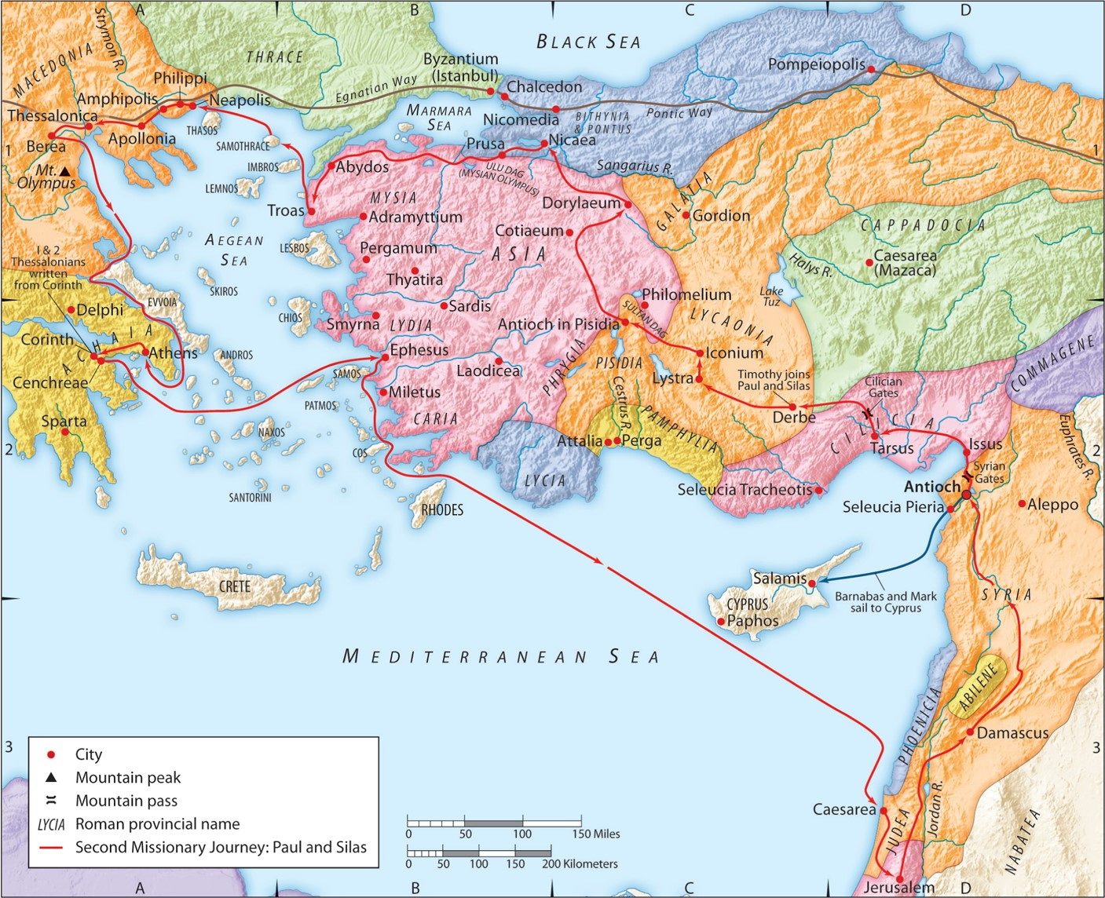
The Second Missionary Journey:
“When Faith and State Collide”
Acts 16:35-40
“Be my witnesses in Jerusalem and in all Judea and Samaria, and to the ends of the earth”
– Acts 1:8 (ESV)

Slide 5
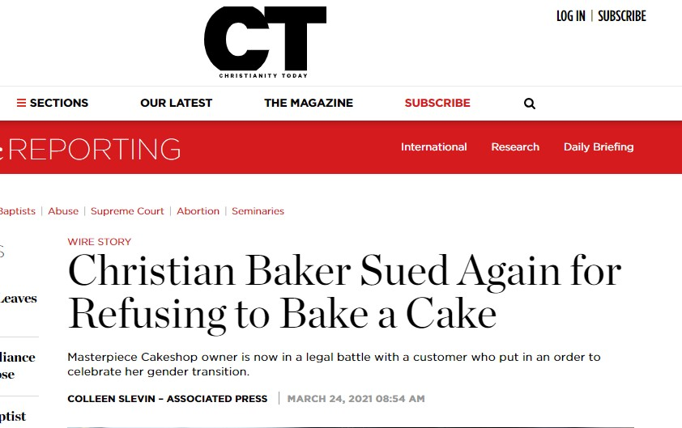

Slide 9
A. You must have a living and active faith in Jesus Christ.
1. It must be a living faith.
2. It must be an active faith.
1 Corinthians 3:1-3 (ESV)
But I, brothers, could not address you as spiritual people, but as people of the flesh, as infants in Christ. I fed you with milk, not solid food, for you were not ready for it. And even now you are not yet ready, for you are still of the flesh. For while there is jealousy and strife among you, are you not of the flesh and behaving only in a human way?

Slide 10
B. You must trust completely in the sovereignty of God.
Psalm 115:3 (ESV)
Our God is in the heavens; he does all that he pleases.
Matthew 19:26 (ESV)
But Jesus looked at them and said, “With man this is impossible, but with God all things are possible.”
Lamentations 3:37-38 (ESV)
Who has spoken and it came to pass, unless the Lord has commanded it? Is it not from the mouth of the Most High that good and bad come?
Jeremiah 32:17 (ESV)
‘Ah, Lord GOD! It is you who have made the heavens and the earth by your great power and by your outstretched arm! Nothing is too hard for you.

Slide 11
C. You must submit to authorities when it doesn’t compromise your faith.
Romans 13:1-7 (ESV)
Let every person be subject to the governing authorities. For there is no authority except from God, and those that exist have been instituted by God. Therefore whoever resists the authorities resists what God has appointed, and those who resist will incur judgment. For rulers are not a terror to good conduct, but to bad. Would you have no fear of the one who is in authority? Then do what is good, and you will receive his approval, for he is God’s servant for your good. But if you do wrong, be afraid, for he does not bear the sword in vain. For he is the servant of God, an avenger who carries out God’s wrath on the wrongdoer. Therefore one must be in subjection, not only to avoid God’s wrath but also for the sake of conscience. For because of this you also pay taxes, for the authorities are ministers of God, attending to this very thing. Pay to all what is owed to them: taxes to whom taxes are owed, revenue to whom revenue is owed, respect to whom respect is owed, honor to whom honor is owed.

Slide 12
C. You must submit to authorities when it doesn’t compromise your faith.
Acts 4:19-20 (ESV)
But Peter and John answered them, “Whether it is right in the sight of God to listen to you rather than to God, you must judge, for we cannot but speak of what we have seen and heard.”
Acts 5:28-29 (ESV)
“We strictly charged you not to teach in this name, yet here you have filled Jerusalem with your teaching, and you intend to bring this man’s blood upon us.” But Peter and the apostles answered, “We must obey God rather than men.

Slide 13
D. There are right reasons, times, and ways to stand up to authority if the above 3 things are true.
Romans 12:17-19 (ESV)
Repay no one evil for evil, but give thought to do what is honorable in the sight of all. If possible, so far as it depends on you, live peaceably with all. Beloved, never avenge yourselves, but leave it to the wrath of God, for it is written, “Vengeance is mine, I will repay, says the Lord.”

Slide 14
D. There are right reasons, times, and ways to stand up to authority if the above 3 things are true.
1 Timothy 3:2, 7 (ESV)
Therefore an overseer must be above reproach … he must be well thought of by outsiders …
Acts 20:29 (ESV)
Pay careful attention to yourselves and to all the flock, in which the Holy Spirit has made you overseers, to care for the church of God, which he obtained with his own blood.
1 Peter 5:1-2 (ESV)
So I exhort the elders among you, as a fellow elder and a witness of the sufferings of Christ, as well as a partaker in the glory that is going to be revealed: shepherd the flock of God that is among you, exercising oversight, not under compulsion, but willingly, as God would have you;

Slide 15
D. There are right reasons, times, and ways to stand up to authority if the above 3 things are true.
1. There are times to stand up when your reputation as Christ’s ambassador or the reputation of Jesus Christ Himself is on the line.
2. There are times to stand up in order to protect Jesus’s church.
Romans 12:17-19 (ESV)
Repay no one evil for evil, but give thought to do what is honorable in the sight of all. If possible, so far as it depends on you, live peaceably with all. Beloved, never avenge yourselves, but leave it to the wrath of God, for it is written, “Vengeance is mine, I will repay, says the Lord.”

Slide 16
A. Have a living and active faith in Jesus Christ
B. Trust in God’s sovereignty
C. Submit to authorities when it doesn’t compromise your faith
D. There are right reasons, times, and ways to stand up to authority if the above 3
things are true.

