Slide 1
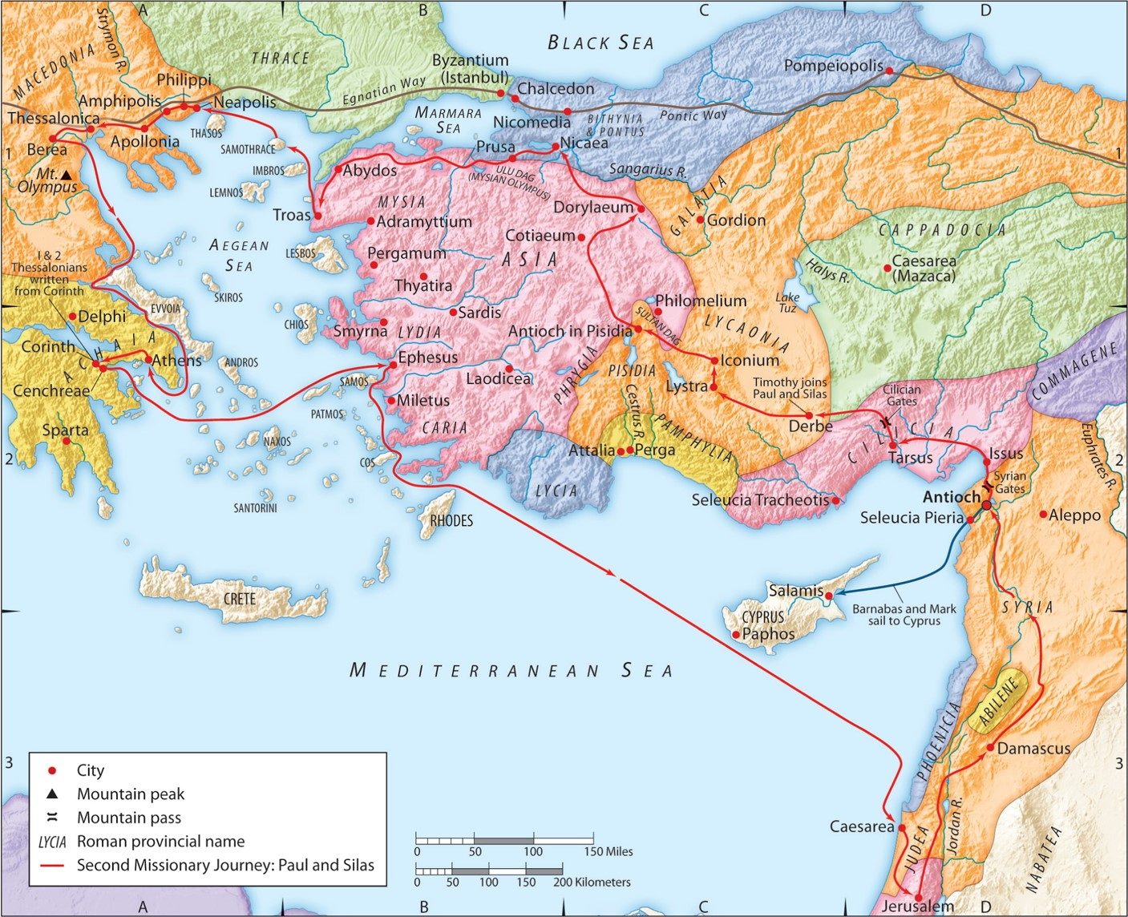
The Second Missionary Journey:
“Fully Equipped by God”
Acts 17:10-15
“Be my witnesses in Jerusalem and in all Judea and Samaria, and to the ends of the earth”
– Acts 1:8 (ESV)

Slide 2
A. God gives you the right convictions.
1 Thessalonians 1:9 (ESV)
For they themselves report concerning us the kind of reception we had among you, and how you turned to God from idols to serve the living and true God,
Philippians 4:15-16 (ESV)
And you Philippians yourselves know that in the beginning of the gospel, when I left Macedonia, no church entered into partnership with me in giving and receiving, except you only. Even in Thessalonica you sent me help for my needs once and again.
1 Thessalonians 2:8 (ESV)
So, being affectionately desirous of you, we were ready to share with you not only the gospel of God but also our own selves, because you had become very dear to us.

Slide 3
A. God’s give you the right convictions.
1 Thessalonians 2:17-18 (ESV)
But since we were torn away from you, brothers, for a short time, in person not in heart, we endeavored the more eagerly and with great desire to see you face to face, because we wanted to come to you—I, Paul, again and again—but Satan hindered us.

Slide 4
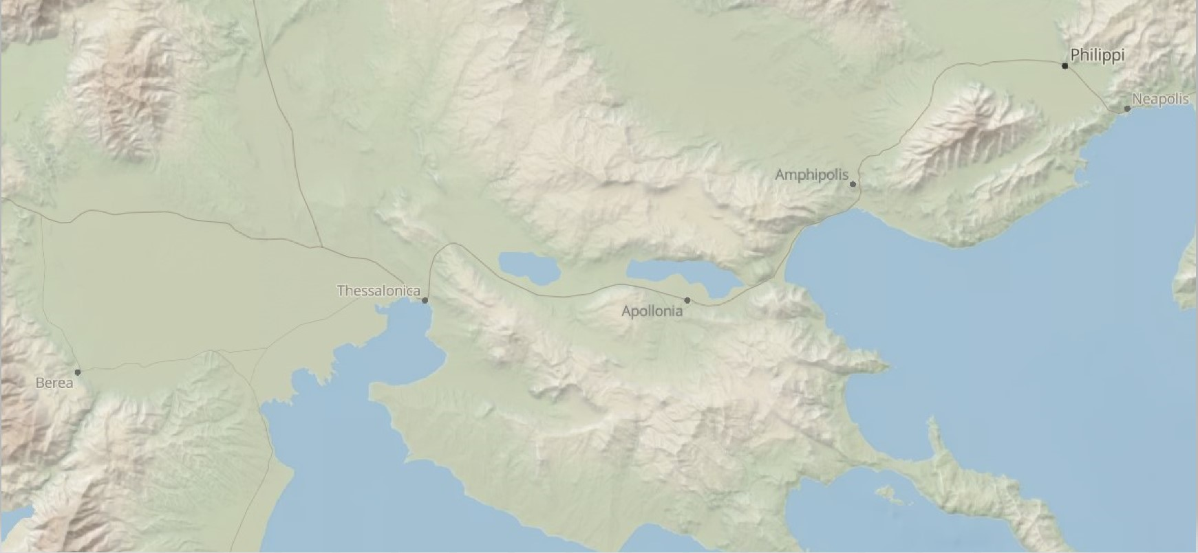

Slide 5
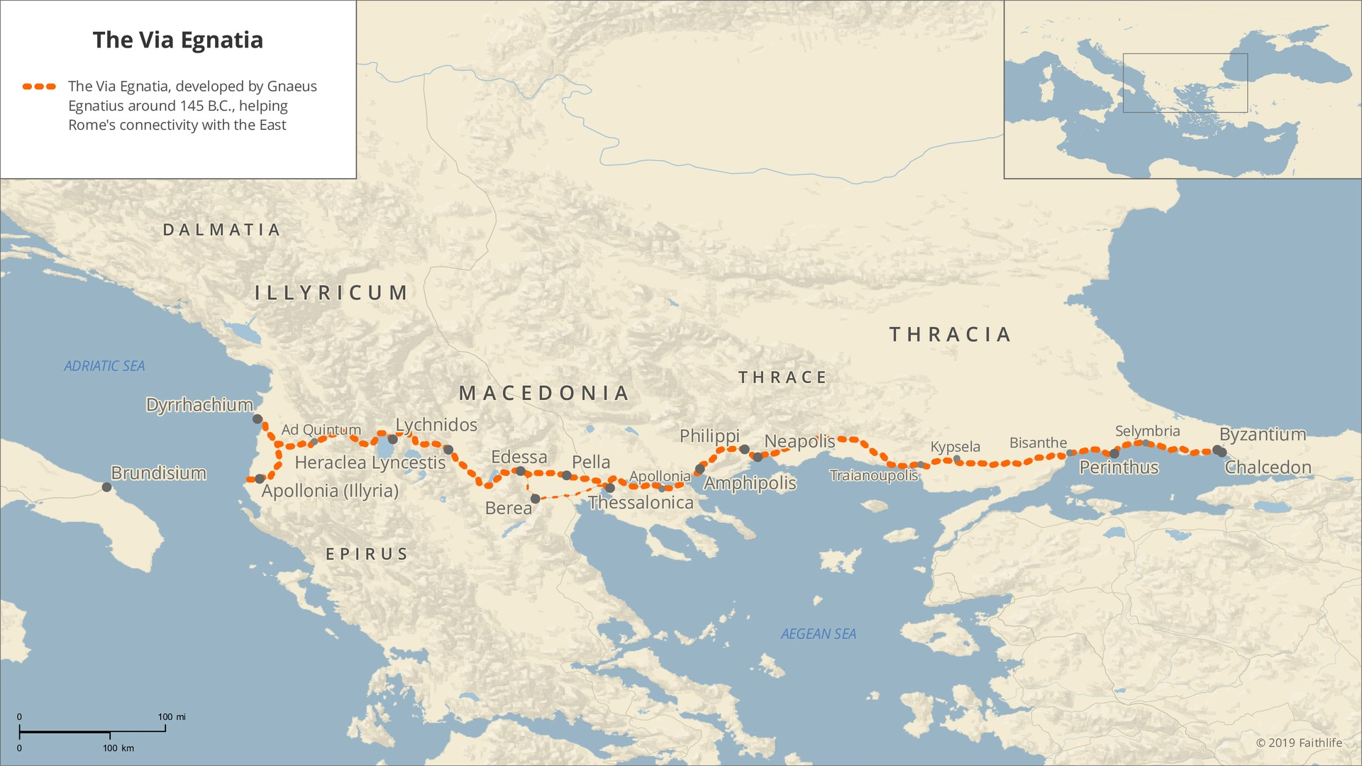

Slide 6
A. God gives you the right convictions.
Romans 16:21 (ESV)
Timothy, my fellow worker, greets you; so do Lucius and Jason and Sosipater, my kinsmen.
Acts 20:4 (ESV)
There he spent three months, and when a plot was made against him by the Jews as he was about to set sail for Syria, he decided to return through Macedonia. Sopater the Berean, son of Pyrrhus, accompanied him; and of the Thessalonians, Aristarchus and Secundus; and Gaius of Derbe, and Timothy; and the Asians, Tychicus and Trophimus. These went on ahead and were waiting for us at Troas,

Slide 7
B. God gives you the right truth.
1. God’s word can be received eagerly.
1 John 4:1 (ESV)
Beloved, do not believe every spirit, but test the spirits to see whether they are from God, for many false prophets have gone out into the world.
Ephesians 4:13-14 (ESV)
until we all attain to the unity of the faith and of the knowledge of the Son of God, to mature manhood, to the measure of the stature of the fullness of Christ, so that we may no longer be children, tossed to and fro by the waves and carried about by every wind of doctrine, by human cunning, by craftiness in deceitful schemes.

Slide 8
B. God gives you the right truth.
2. God’s word can be examined openly.
1 Timothy 5:17 (ESV)
Let the elders who rule well be considered worthy of double honor, especially those who labor in preaching and teaching.
1 Thessalonians 5:12-13 (ESV)
We ask you, brothers, to respect those who labor among you and are over you in the Lord and admonish you, and to esteem them very highly in love because of their work. Be at peace among yourselves.
James 3:1 (ESV)
Not many of you should become teachers, my brothers, for you know that we who teach will be judged with greater strictness.

Slide 9
B. God gives you the right truth.
3. God’s word can be sought daily.
Psalm 68:19 (ESV)
Blessed be the Lord, who daily bears us up; God is our salvation. Selah.
Matthew 6:34 (ESV)
“Therefore do not be anxious about tomorrow, for tomorrow will be anxious for itself. Sufficient for the day is its own trouble.

Slide 10
B. God gives you the right truth.
4. God’s word can be trusted completely.
Romans 8:3-4 (ESV)
For God has done what the law, weakened by the flesh, could not do. By sending his own Son in the likeness of sinful flesh and for sin, he condemned sin in the flesh, in order that the righteous requirement of the law might be fulfilled in us, who walk not according to the flesh but according to the Spirit.
Romans 8:1 (ESV)
There is therefore now no condemnation for those who are in Christ Jesus.
Romans 6:23 (ESV)
For the wages of sin is death, but the free gift of God is eternal life in Christ Jesus our Lord.

Slide 11
C. God gives you the right family.
1. God works through the church to care for you.

Slide 12
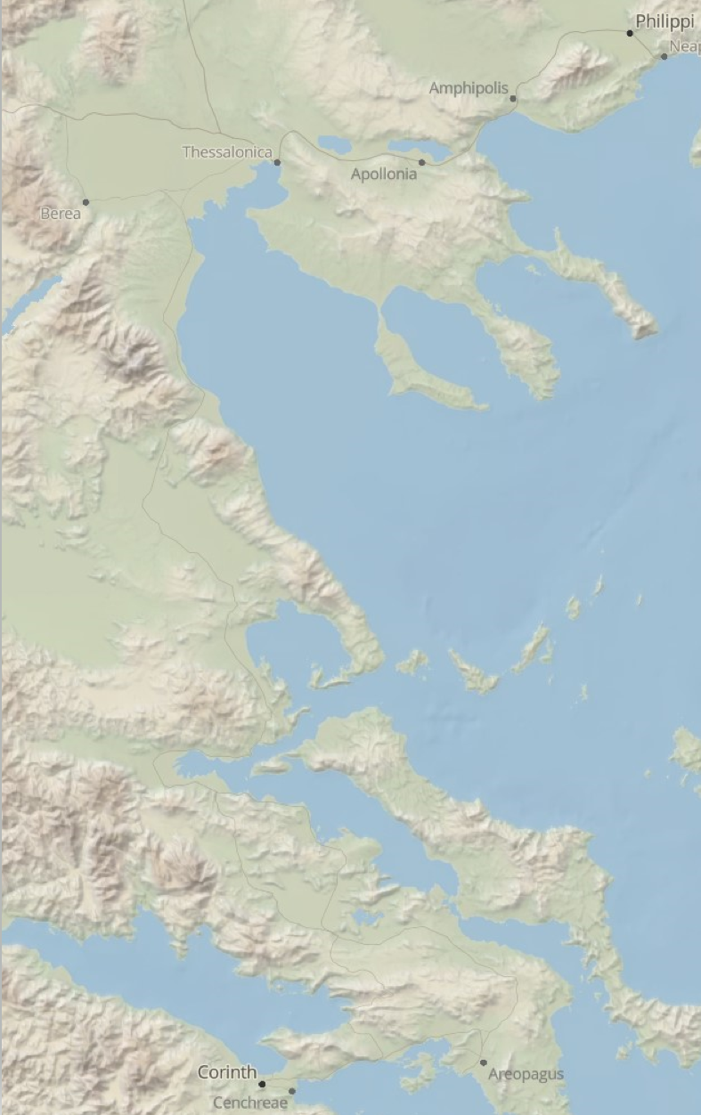
C. God gives you the right family.
1. God works through the church to care for you.
(Athens)

Slide 13
C. God gives you the right family.
2. God works through the church to strengthen and encourage you.
Acts 14:19 (ESV)
But Jews came from Antioch and Iconium, and having persuaded the crowds, they stoned Paul and dragged him out of the city, supposing that he was dead.
Acts 14:21b-22 (ESV)
…they returned to Lystra and to Iconium and to Antioch, strengthening the souls of the disciples, encouraging them to continue in the faith, and saying that through many tribulations we must enter the kingdom of God.
Acts 15:41 (ESV)
And he went through Syria and Cilicia, strengthening the churches.
Acts 16:40 (ESV)
So they went out of the prison and visited Lydia. And when they had seen the brothers, they encouraged them and departed.
Acts 15:32 (ESV)
And Judas and Silas, who were themselves prophets, encouraged and strengthened the brothers with many words.

Slide 14
C. God gives you the right family.
2. God works through the church to strengthen and encourage you.
Ephesians 4:11-12 (ESV)
And he gave the apostles, the prophets, the evangelists, the shepherds and teachers, to equip the saints for the work of ministry, for building up the body of Christ,
Matthew 28:19-20 (ESV)
Go therefore and make disciples of all nations, baptizing them in the name of the Father and of the Son and of the Holy Spirit, teaching them to observe all that I have commanded you. And behold, I am with you always, to the end of the age.”
Hebrews 10:24-25 (ESV)
And let us consider how to stir up one another to love and good works, not neglecting to meet together, as is the habit of some, but encouraging one another, and all the more as you see the Day drawing near.

