Slide 1
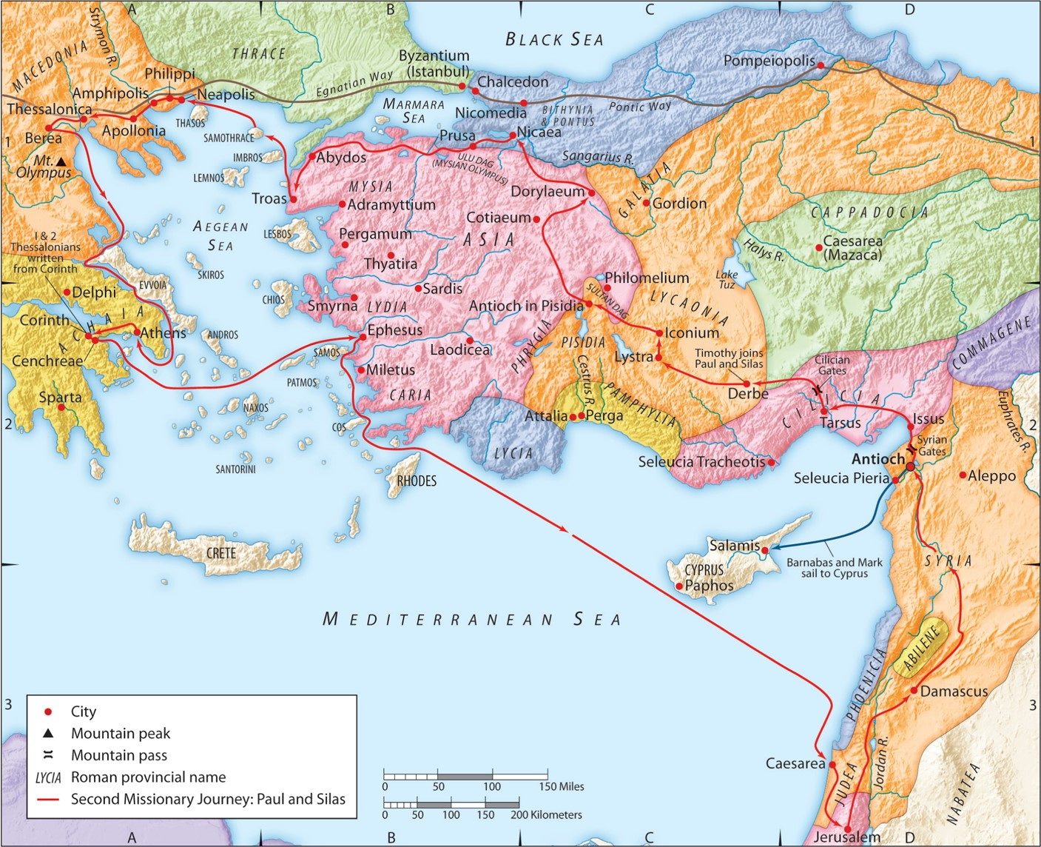
The Second Missionary Journey:
“Knowing the Unknown God”
Part 1
Acts 17:16-21
“Be my witnesses in Jerusalem and in all Judea and Samaria, and to the ends of the earth”
– Acts 1:8 (ESV)

Slide 2
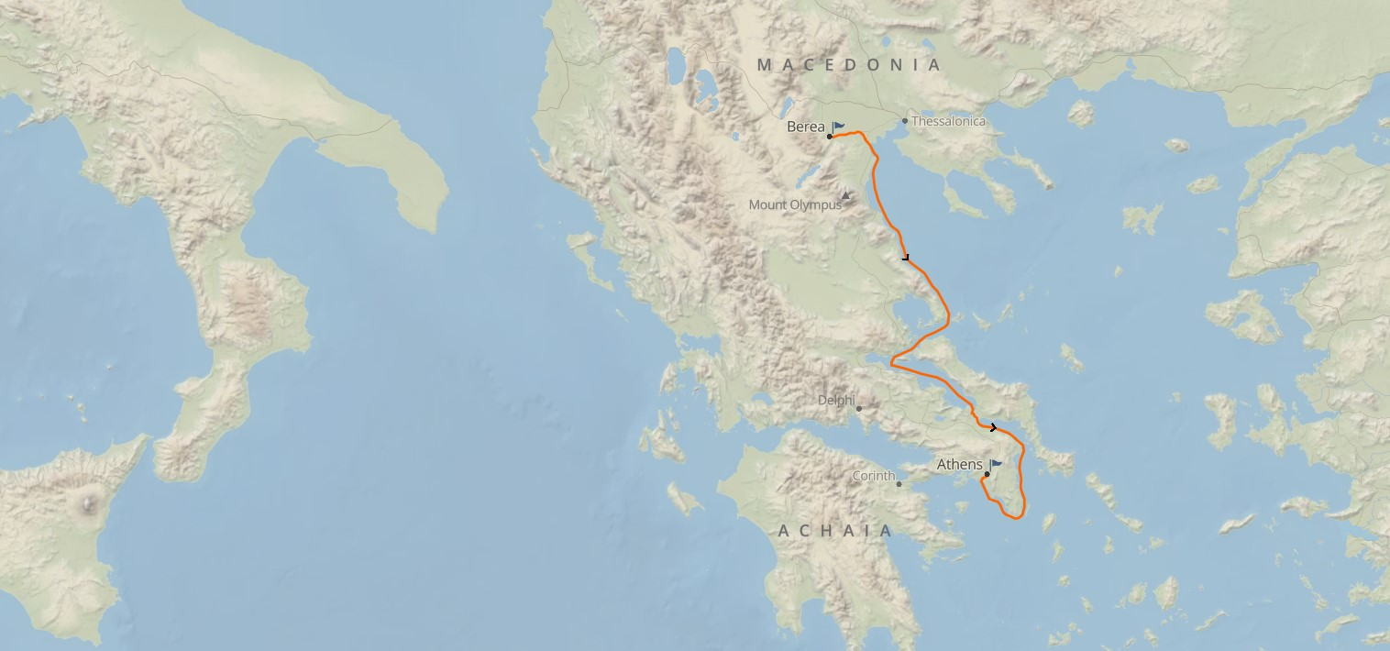

Slide 3
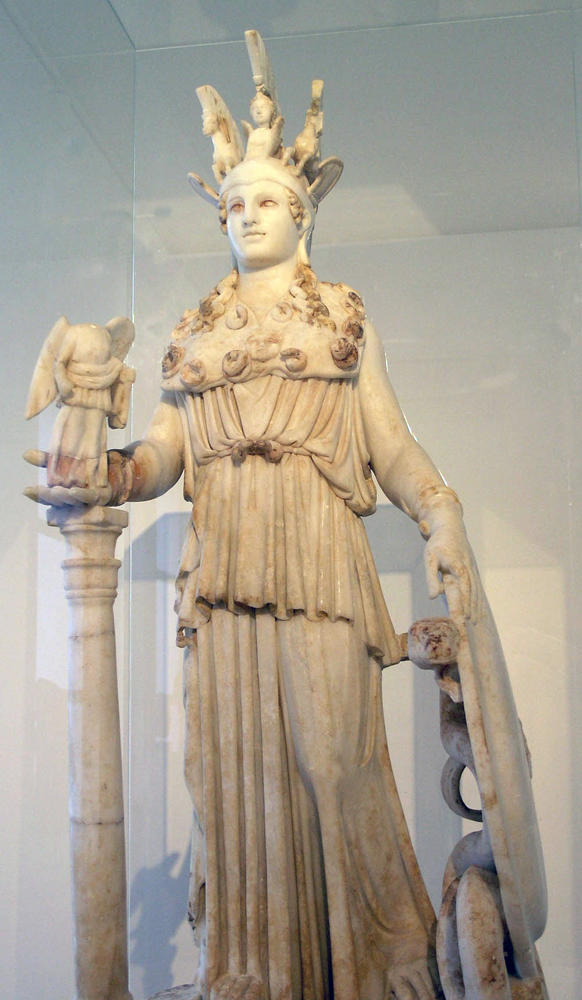
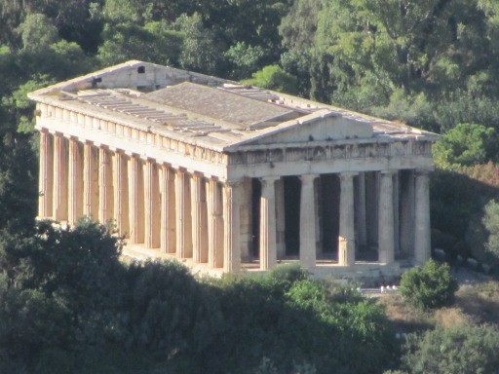
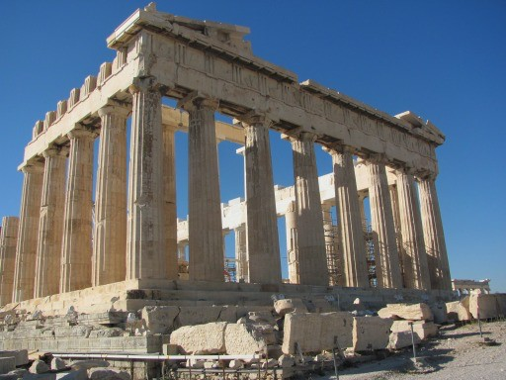
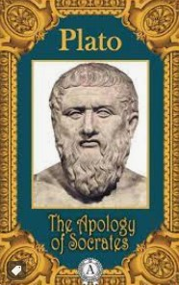
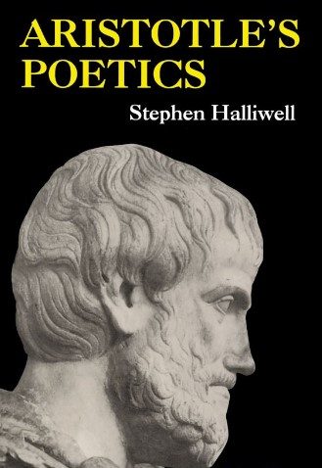
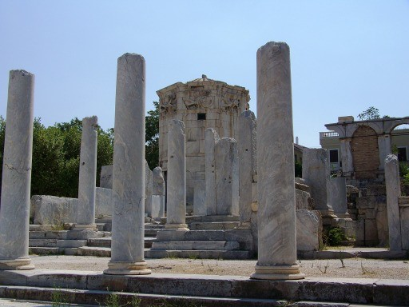
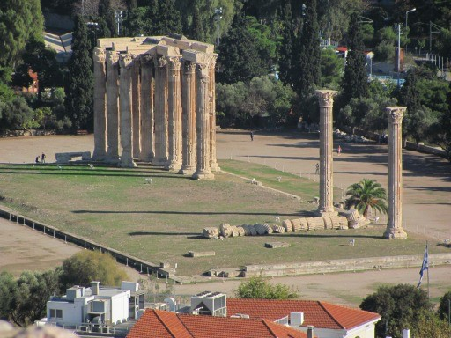

Slide 4
1. You must know who God is.
a. He is singularly worthy of all glory.

Slide 6
Deuteronomy 9:7 (ESV)
Remember and do not forget how you provoked the LORD your God to wrath in the wilderness. From the day you came out of the land of Egypt until you came to this place, you have been rebellious against the LORD.
Deuteronomy 9:18 (ESV)
So I took hold of the two tablets and threw them out of my two hands and broke them before your eyes. Then I lay prostrate before the LORD as before, forty days and forty nights. I neither ate bread nor drank water, because of all the sin that you had committed, in doing what was evil in the sight of the LORD to provoke him to anger.
Psalm 106:28-29 (ESV)
Then they yoked themselves to the Baal of Peor, and ate sacrifices offered to the dead; they provoked the LORD to anger with their deeds, and a plague broke out among them.

Slide 7
Exodus 20:2-5 (ESV)
“I am the LORD your God, who brought you out of the land of Egypt, out of the house of slavery. “You shall have no other gods before me. “You shall not make for yourself a carved image, or any likeness of anything that is in heaven above, or that is in the earth beneath, or that is in the water under the earth. You shall not bow down to them or serve them, for I the LORD your God am a jealous God, visiting the iniquity of the fathers on the children to the third and the fourth generation of those who hate me,

Slide 8
1 Corinthians 10:14 (ESV)
Therefore, my beloved, flee from idolatry.
1 Corinthians 10:22 (ESV)
Shall we provoke the Lord to jealousy? Are we stronger than he?
1 Corinthians 10:31 (ESV)
So, whether you eat or drink, or whatever you do, do all to the glory of God.

Slide 9
Ephesians 4:26-27 (ESV)
Be angry and do not sin; do not let the sun go down on your anger, and give no opportunity to the devil.
Matthew 5:21-22 (ESV)
“You have heard that it was said to those of old, ‘You shall not murder; and whoever murders will be liable to judgment.’ But I say to you that everyone who is angry with his brother will be liable to judgment; whoever insults his brother will be liable to the council; and whoever says, ‘You fool!’ will be liable to the hell of fire.

Slide 10
Matthew 5:29-30 (ESV)
If your right eye causes you to sin, tear it out and throw it away. For it is better that you lose one of your members than that your whole body be thrown into hell. And if your right hand causes you to sin, cut it off and throw it away. For it is better that you lose one of your members than that your whole body go into hell.

Slide 11
Amos 5:21-24 (ESV)
“I hate, I despise your feasts, and I take no delight in your solemn assemblies. Even though you offer me your burnt offerings and grain offerings, I will not accept them; and the peace offerings of your fattened animals, I will not look upon them. Take away from me the noise of your songs; to the melody of your harps I will not listen.
But let justice roll down like waters, and righteousness like an ever-flowing stream.
Psalm 51:16-17 (ESV)
For you will not delight in sacrifice, or I would give it; you will not be pleased with a burnt offering.
The sacrifices of God are a broken spirit; a broken and contrite heart, O God, you will not despise.

Slide 12
1 Corinthians 1:22-24 (ESV)
For Jews demand signs and Greeks seek wisdom, but we preach Christ crucified, a stumbling block to Jews and folly to Gentiles, but to those who are called, both Jews and Greeks, Christ the power of God and the wisdom of God.
Romans 1:16 (ESV)
For I am not ashamed of the gospel, for it is the power of God for salvation to everyone who believes, to the Jew first and also to the Greek.

Slide 13
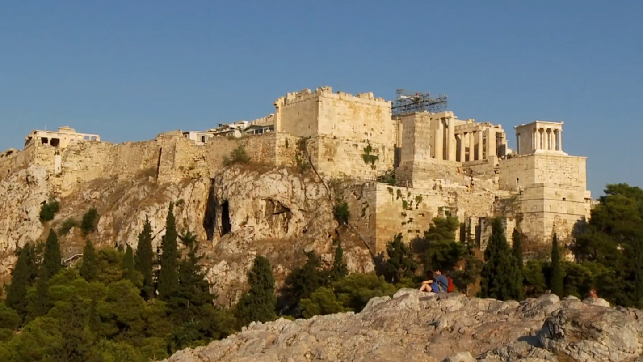

Slide 14
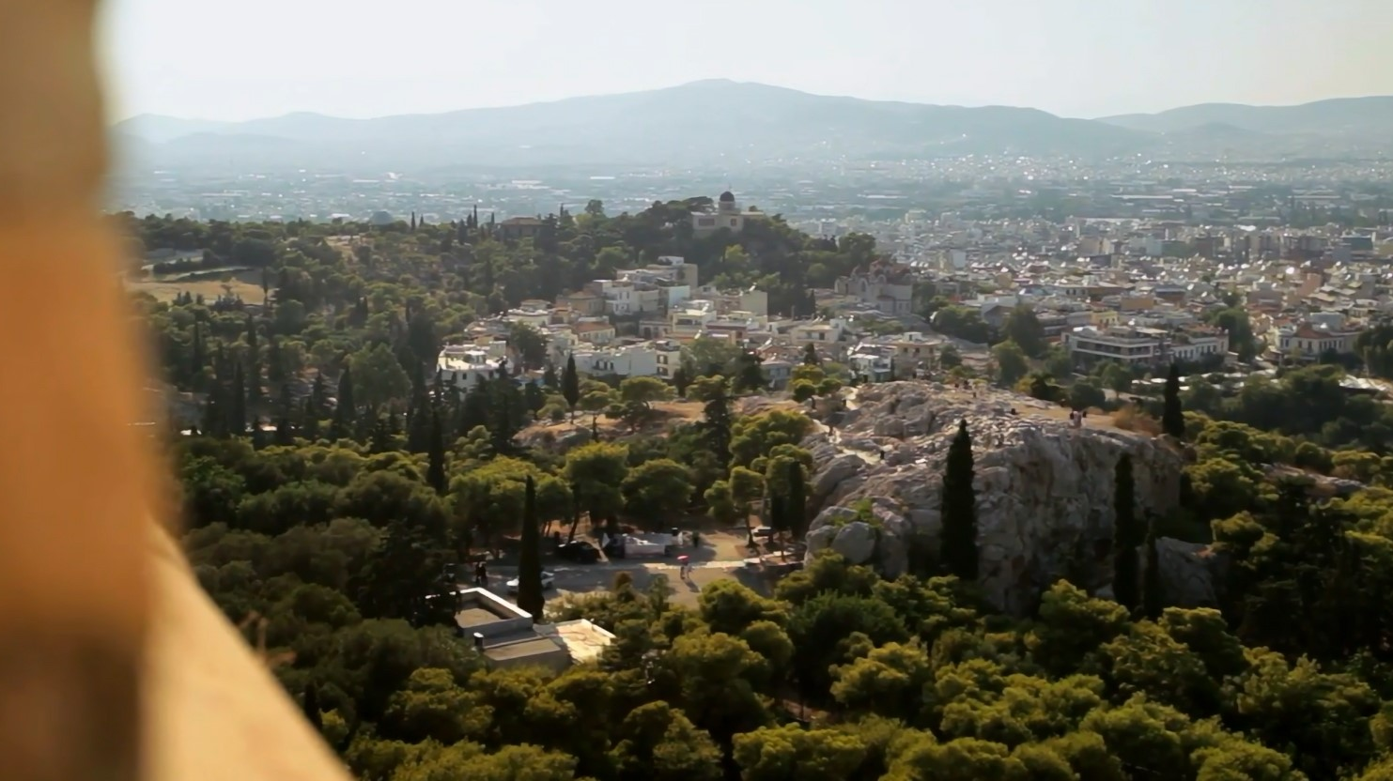

Slide 15
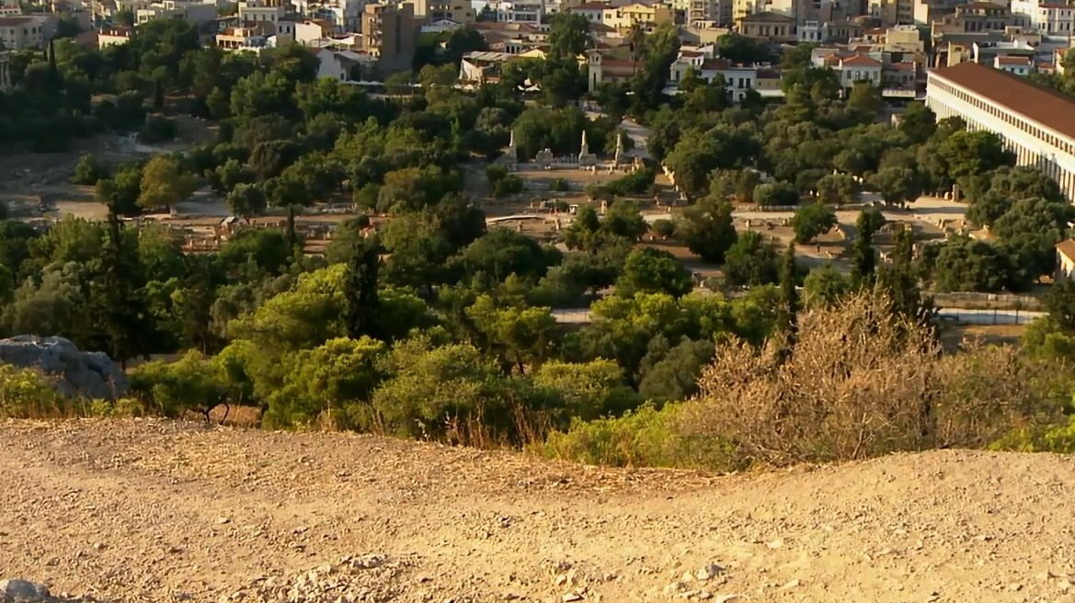

Slide 16
Hebrew 2:17-18 (ESV)
Therefore he had to be made like his brothers in every respect, so that he might become a merciful and faithful high priest in the service of God, to make propitiation for the sins of the people. For because he himself has suffered when tempted, he is able to help those who are being tempted.
Hebrews 4:14-15 (ESV)
Since then we have a great high priest who has passed through the heavens, Jesus, the Son of God, let us hold fast our confession. For we do not have a high priest who is unable to sympathize with our weaknesses, but one who in every respect has been tempted as we are, yet without sin.

