Slide 1
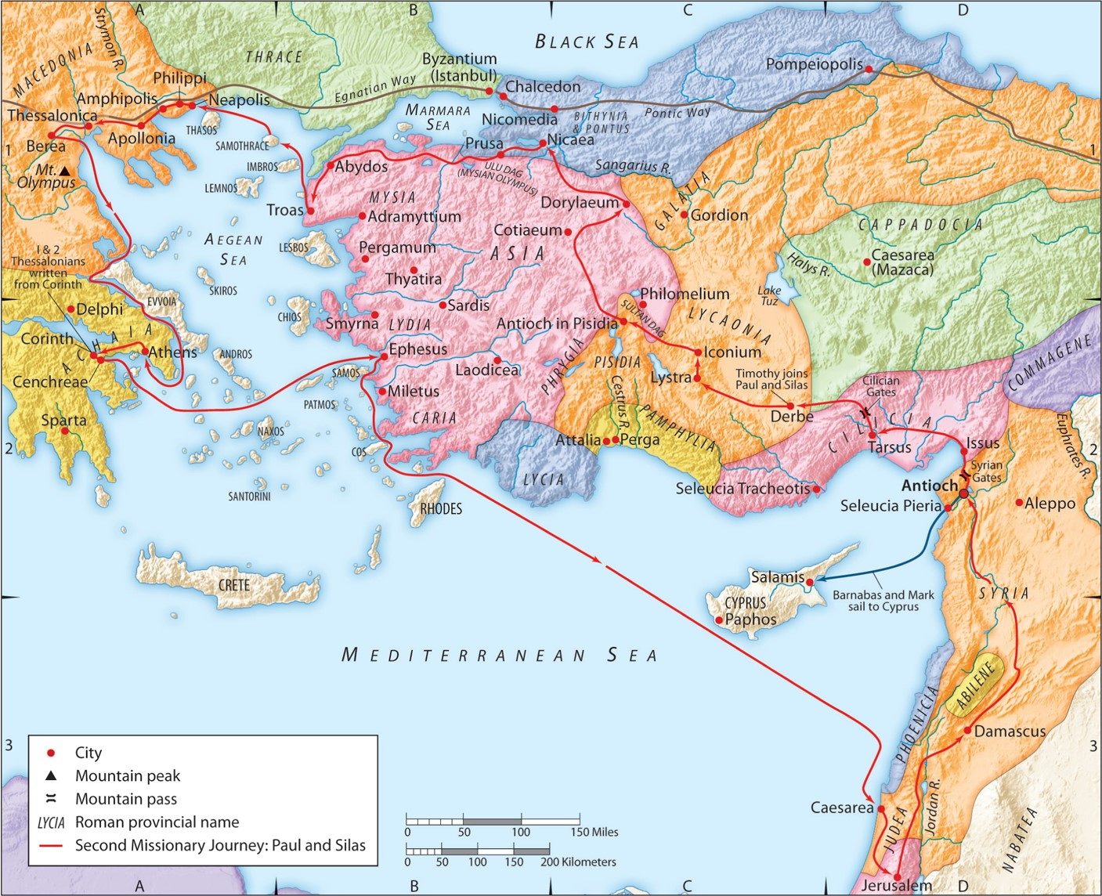
The Second Missionary Journey:
“Knowing the Unknown God”
Part 2
Acts 17:22-27a
“Be my witnesses in Jerusalem and in all Judea and Samaria, and to the ends of the earth”
– Acts 1:8 (ESV)

Slide 2
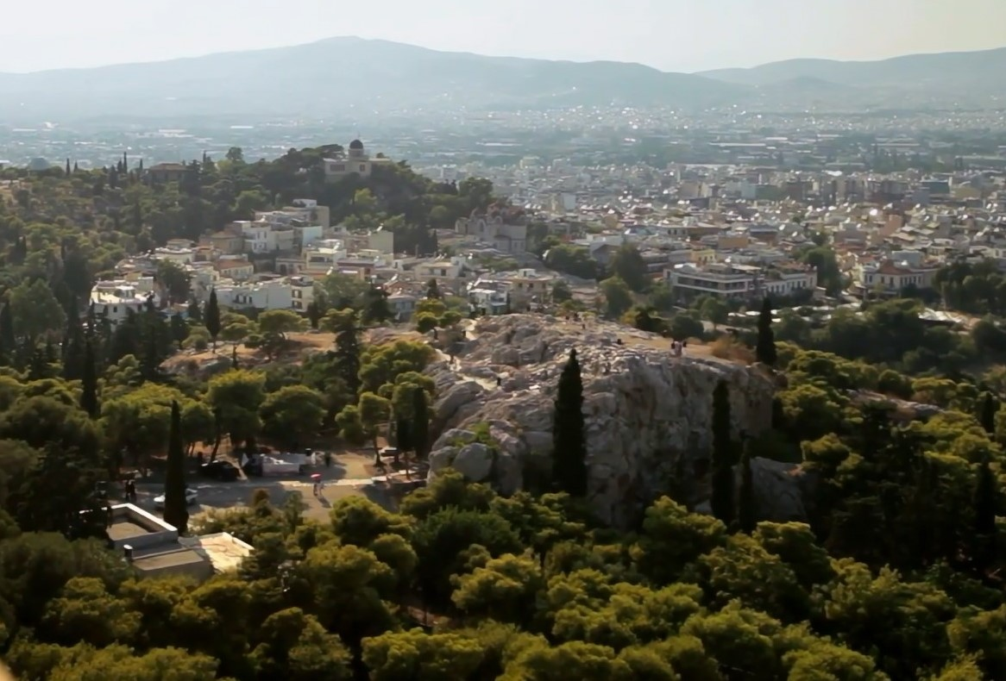
1. God is singularly worthy of all glory.

Slide 3
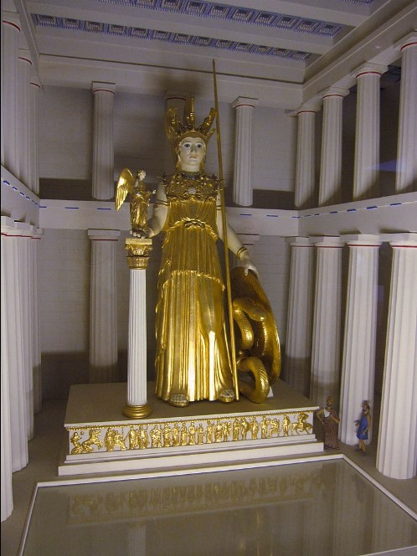
1. God is singularly worthy of all glory.
Psalm 115:4-7 (ESV)
Their idols are silver and gold, the work of human hands. They have mouths, but do not speak; eyes, but do not see. They have ears, but do not hear; noses, but do not smell. They have hands, but do not feel; feet, but do not walk; and they do not make a sound in their throat. Those who make them become like them; so do all who trust in them.
Statue of Athena Parthenos
as it would have appeared in Paul’s day in Athens

Slide 4
2. God is the one and only Creator of all.
John 1:1-4 (ESV)
In the beginning was the Word, and the Word was with God, and the Word was God. He was in the beginning with God. All things were made through him, and without him was not any thing made that was made. In him was life, and the life was the light of men.
Genesis 1:1 (ESV)
In the beginning, God created the heavens and the earth.
Psalm 33:6 (ESV)
By the word of the LORD the heavens were made, and by the breath of his mouth all their host.
Colossians 1:16 (ESV)
For by him all things were created, in heaven and on earth, visible and invisible, whether thrones or dominions or rulers or authorities—all things were created through him and for him.
Isaiah 45:12 (ESV)
I made the earth and created man on it; it was my hands that stretched out the heavens, and I commanded all their host.
Revelation 4:11 (ESV)
“Worthy are you, our Lord and God, to receive glory and honor and power, for you created all things, and by your will they existed and were created.”

Slide 5
3. God is the one and only Lord of all.
Colossians 1:16-17 (ESV)
For by him all things were created, in heaven and on earth, visible and invisible, whether thrones or dominions or rulers or authorities—all things were created through him and for him. And he is before all things, and in him all things hold together.
Isaiah 45:5-8 (ESV)
I am the LORD, and there is no other, besides me there is no God; I equip you, though you do not know me, that people may know, from the rising of the sun and from the west, that there is none besides me; I am the LORD, and there is no other. I form light and create darkness; I make well-being and create calamity; I am the LORD, who does all these things. “Shower, O heavens, from above, and let the clouds rain down righteousness; let the earth open, that salvation and righteousness may bear fruit; let the earth cause them both to sprout; I the LORD have created it.
Deuteronomy 10:17 (ESV)
For the LORD your God is God of gods and Lord of lords, the great, the mighty, and the awesome God…
Psalm 50:10-12 (ESV)
For every beast of the forest is mine, the cattle on a thousand hills. I know all the birds of the hills, and all that moves in the field is mine. “If I were hungry, I would not tell you, for the world and its fullness are mine.

Slide 6
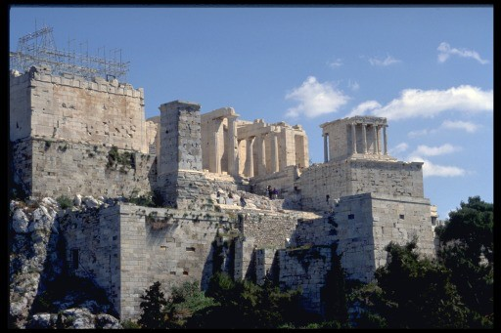
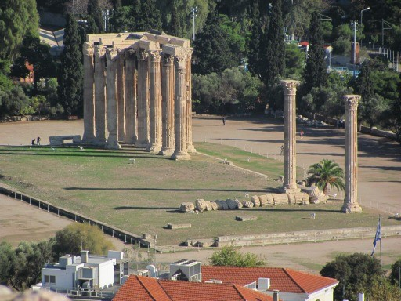
4. God is awesomely infinite.

Slide 7
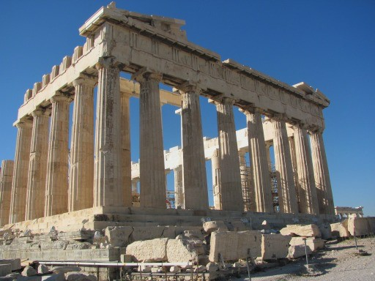
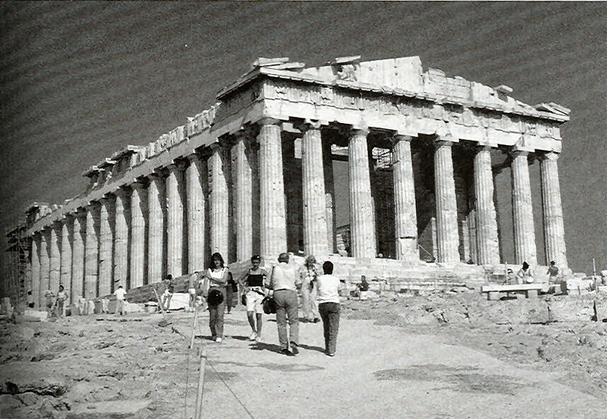
4. God is awesomely infinite.

Slide 8
4. God is awesomely infinite.
1 Kings 8:27 (ESV)
“But will God indeed dwell on the earth? Behold, heaven and the highest heaven cannot contain you; how much less this house that I have built!
Isaiah 66:1 (ESV)
Thus says the LORD: “Heaven is my throne, and the earth is my footstool; what is the house that you would build for me, and what is the place of my rest?”
1 Corinthians 3:16 (ESV)
Do you not know that you (plural) are God’s temple and that God’s Spirit dwells in you?
1 Corinthians 6:19 (ESV)
Or do you not know that your body (singular) is a temple of the Holy Spirit within you, whom you have from God? You are not your own,

Slide 9
5. God is entirely independent.
Job 41:11 (ESV)
Who has first given to me, that I should repay him? Whatever is under the whole heaven is mine.
Rom 11:36 (ESV)
For from him and through him and to him are all things. To him be glory forever. Amen.
Psalm 8:4-5 (ESV)
what is man that you are mindful of him, and the son of man that you care for him? Yet you have made him a little lower than the heavenly beings and crowned him with glory and honor.

Slide 10
6. God is the Giver of all good things.
Psalm 139:13-14 (ESV)
For you formed my inward parts; you knitted me together in my mother’s womb. I praise you, for I am fearfully and wonderfully made. Wonderful are your works; my soul knows it very well.
Jeremiah 1:5 (ESV)
“Before I formed you in the womb I knew you, and before you were born I consecrated you; I appointed you a prophet to the nations.”
Isaiah 45: 9-12 (ESV)
“Woe to him who strives with him who formed him, a pot among earthen pots! Does the clay say to him who forms it, ‘What are you making?’ or ‘Your work has no handles’? Woe to him who says to a father, ‘What are you begetting?’ or to a woman, ‘With what are you in labor?’ ” Thus says the LORD, the Holy One of Israel, and the one who formed him: “Ask me of things to come; will you command me concerning my children and the work of my hands? I made the earth and created man on it; it was my hands that stretched out the heavens, and I commanded all their host.

Slide 11
6. God is the Giver of all good things.
Matthew 5:44-45 (ESV)
But I say to you, Love your enemies and pray for those who persecute you, so that you may be sons of your Father who is in heaven. For he makes his sun rise on the evil and on the good, and sends rain on the just and on the unjust.
James 1:17 (ESV)
Every good gift and every perfect gift is from above, coming down from the Father of lights, with whom there is no variation or shadow due to change.

Slide 12
7. God is Sovereign over all of history.
Genesis 12:3 (ESV)
I will bless those who bless you, and him who dishonors you I will curse, and in you all the families of the earth shall be blessed.”
Deuteronomy 10:17-18 (ESV)
For the LORD your God is God of gods and Lord of lords, the great, the mighty, and the awesome God, who is not partial and takes no bribe. He executes justice for the fatherless and the widow, and loves the sojourner, giving him food and clothing.

Slide 13
7. God is Sovereign over all of history.
Job 12:23 (ESV)
He makes nations great, and he destroys them; he enlarges nations, and leads them away.
Deuteronomy 32:8 (ESV)
When the Most High gave to the nations their inheritance, when he divided mankind, he fixed the borders of the peoples according to the number of the sons of God. But the LORD’s portion is his people, Jacob his allotted heritage.

Slide 14
7. God is Sovereign over all of history.
Genesis 15:13-16 (ESV)
Then the LORD said to Abram, “Know for certain that your offspring will be sojourners in a land that is not theirs and will be servants there, and they will be afflicted for four hundred years. But I will bring judgment on the nation that they serve, and afterward they shall come out with great possessions. As for you, you shall go to your fathers in peace; you shall be buried in a good old age. And they shall come back here in the fourth generation, for the iniquity of the Amorites is not yet complete.”
Jeremiah 18:7-8 (ESV)
If at any time I declare concerning a nation or a kingdom, that I will pluck up and break down and destroy it, and if that nation, concerning which I have spoken, turns from its evil, I will relent of the disaster that I intended to do to it.

Slide 15
7. God is Sovereign over all of history.
Psalm 103:19 (ESV)
The LORD has established his throne in the heavens, and his kingdom (sovereignty, NASB95) rules over all.

Slide 16
7. God is Sovereign over all of history.
Psalm 14:2-3 (ESV)
The LORD looks down from heaven on the children of man, to see if there are any who understand, who seek after God. They have all turned aside; together they have become corrupt; there is none who does good, not even one.
Romans 3:11-12 (ESV)
no one understands; no one seeks for God. All have turned aside; together they have become worthless; no one does good, not even one.”

Slide 17
7. God is Sovereign over all of history.
Acts 2:23-24 (ESV)
this Jesus, delivered up according to the definite (NASB95: predetermined) plan and foreknowledge of God, you crucified and killed by the hands of lawless men. God raised him up, loosing the pangs of death, because it was not possible for him to be held by it.
Acts 3:19-20 (ESV)
Repent therefore, and turn back, that your sins may be blotted out, that times of refreshing may come from the presence of the Lord, and that he may send the Christ appointed for you, Jesus,
1 Peter 1:19-20 (ESV)
knowing that you were ransomed from the futile ways inherited from your forefathers, not with perishable things such as silver or gold, but with the precious blood of Christ, like that of a lamb without blemish or spot. He was foreknown before the foundation of the world but was made manifest in the last times for the sake of you

Slide 18
7. God is Sovereign over all of history.
Romans 5:16-17 (ESV)
And the free gift is not like the result of that one man’s sin. For the judgment following one trespass brought condemnation, but the free gift following many trespasses brought justification. For if, because of one man’s trespass, death reigned through that one man, much more will those who receive the abundance of grace and the free gift of righteousness reign in life through the one man Jesus Christ.
Romans 5:18-19 (ESV)
Therefore, as one trespass led to condemnation for all men, so one act of righteousness leads to justification and life for all men. For as by the one man’s disobedience the many were made sinners, so by the one man’s obedience the many will be made righteous.
Romans 5:21 (ESV)
so that, as sin reigned in death, grace also might reign through righteousness leading to eternal life through Jesus Christ our Lord.

Slide 19
7. God is Sovereign over all of history.
Hebrews 9:27 (ESV)
And just as it is appointed for man to die once, and after that comes judgment, so Christ, having been offered once to bear the sins of many, will appear a second time, not to deal with sin but to save those who are eagerly waiting for him.
Acts 10:42 (ESV)
And he commanded us to preach to the people and to testify that he is the one appointed by God to be judge of the living and the dead.
Hebrews 4:6-7 (ESV)
Since therefore it remains for some to enter it, and those who formerly received the good news failed to enter because of disobedience, again he appoints a certain day, “Today,” saying through David so long afterward, in the words already quoted, “Today, if you hear his voice, do not harden your hearts.”
.

