Slide 1
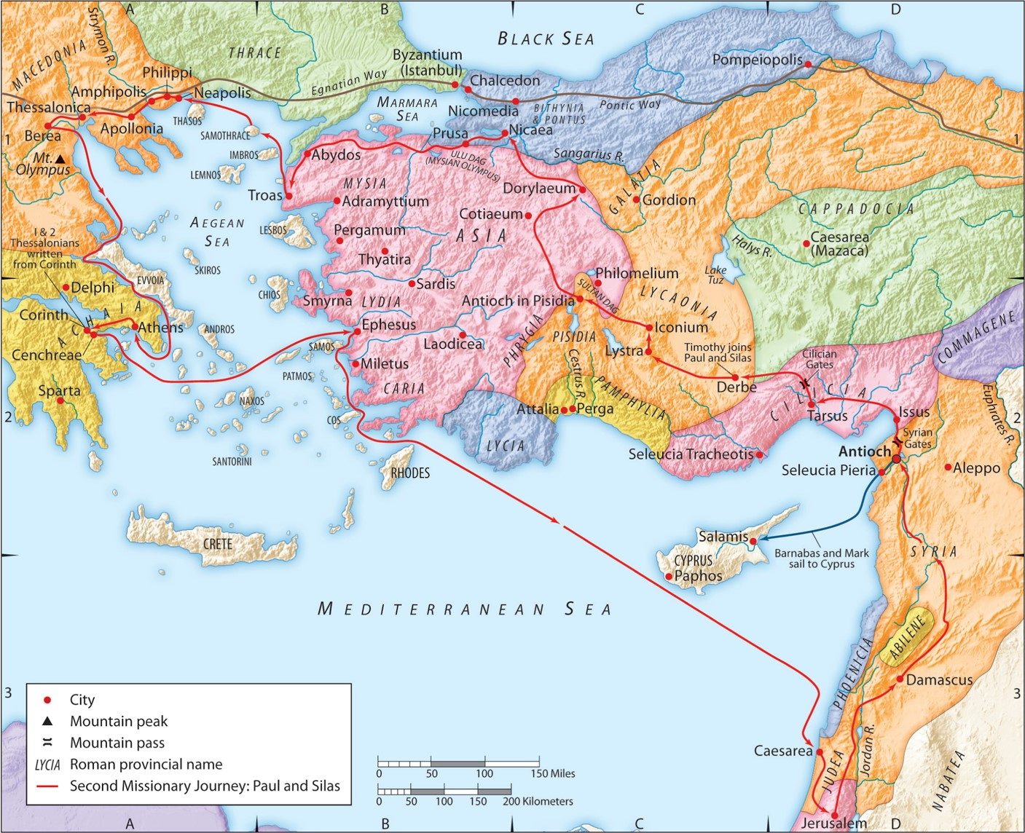
The Second Missionary Journey:
“Knowing the Unknown God”
Part 3
Acts 17:10-15
“Be my witnesses in Jerusalem and in all Judea and Samaria, and to the ends of the earth”
– Acts 1:8 (ESV)

Slide 2
8. God can be sought and found because He is near to us.
Acts 17:27 (ESV)
so that they should seek the Lord, in the hope that they might grope for Him and find Him, though He is not far from each one of us;
Greek Optative Mood: The verb carries the sentence in a mood of “wishful thinking” or “wishing upon an uncertain outcome.”
Psalm 145:18 (ESV)
The LORD is near to all who call upon Him, To all who call upon Him in truth.

Slide 3
8. God can be sought and found because He is near to us.
Titus 1:12-13a (ESV)
One of them, a prophet of their own, said, “Cretans are always liars, evil beasts, lazy gluttons.” This testimony is true.
“They fashioned a tomb for thee, O holy and high one— The Cretans, always liars, evil beasts, idle bellies! But thou art not dead; thou livest and abidest for ever, For in thee we live and move and have our being”
- Cretica by Epimenides,
In Horae Semiticae X, page 40
translated by M.D. Gibson

Slide 4
9. God makes you in His Image and is not to worshiped in yours.
Genesis 1:27-28a (ESV)
So God created man in his own image, in the image of God he created him; male and female he created them. And God blessed them. And God said to them, “Be fruitful and multiply and fill the earth …”
Chronicles 16:26 (ESV)
For all the gods of the peoples are worthless idols, but the LORD made the heavens.
Jeremiah 10:5-9 (ESV)
Their idols are like scarecrows in a cucumber field, and they cannot speak; they have to be carried, for they cannot walk. Do not be afraid of them, for they cannot do evil, neither is it in them to do good.” There is none like you, O LORD; you are great, and your name is great in might. Who would not fear you, O King of the nations? For this is your due; for among all the wise ones of the nations and in all their kingdoms there is none like you. They are both stupid and foolish; the instruction of idols is but wood! Beaten silver is brought from Tarshish, and gold from Uphaz. They are the work of the craftsman and of the hands of the goldsmith; their clothing is violet and purple; they are all the work of skilled men.
Jeremiah 10:10-12 (ESV)
But the LORD is the true God; he is the living God and the everlasting King. At his wrath the earth quakes, and the nations cannot endure his indignation. Thus shall you say to them: “The gods who did not make the heavens and the earth shall perish from the earth and from under the heavens.” It is he who made the earth by his power, who established the world by his wisdom, and by his understanding stretched out the heavens.

Slide 5
10. God is patient and merciful.
2 Peter 3:9-10 (ESV)
The Lord is not slow to fulfill his promise as some count slowness, but is patient toward you, not wishing that any should perish, but that all should reach repentance. But the day of the Lord will come like a thief, and then the heavens will pass away with a roar, and the heavenly bodies will be burned up and dissolved, and the earth and the works that are done on it will be exposed.

Slide 6
11. God is the Holy and Righteous Judge or all.
Psalm 9:8 (ESV)
and he judges the world with righteousness; he judges the peoples with uprightness.
John 5:22(ESV)
For the Father judges no one, but has given all judgment to the Son,
Acts 10:42 (ESV)
And he commanded us to preach to the people and to testify that he is the one appointed by God to be judge of the living and the dead.

Slide 7
12. God is the God of saving grace.
John 1:29 (ESV)
The next day he saw Jesus coming toward him, and said, “Behold, the Lamb of God, who takes away the sin of the world!
Romans 3:23-25 (ESV)
for all have sinned and fall short of the glory of God, and are justified by his grace as a gift, through the redemption that is in Christ Jesus, whom God put forward as a propitiation by his blood, to be received by faith. This was to show God’s righteousness, because in his divine forbearance he had passed over former sins.
Romans 3:26 (ESV)
It was to show his righteousness at the present time, so that he might be just and the justifier of the one who has faith in Jesus.
1 Corinthians 15:14 (ESV)
And if Christ has not been raised, then our preaching is in vain and your faith is in vain.

Slide 8
B. You must respond to who He is.
1. You can reject God and His truth. This leads to eternal hell separated from Him.
Galatians 6:7-8 (ESV)
Do not be deceived: God is not mocked, for whatever one sows, that will he also reap. For the one who sows to his own flesh will from the flesh reap corruption, but the one who sows to the Spirit will from the Spirit reap eternal life.

Slide 9
B. You must respond to who He is.
1. You can reject God and His truth. This leads to eternal hell separated from Him.
2. You can delay your response, but tomorrow may be too late.
Hebrews 9:27 (ESV)
And just as it is appointed for man to die once, and after that comes judgment,
Mark 13:32-33 (ESV)
“But concerning that day or that hour, no one knows, not even the angels in heaven, nor the Son, but only the Father. Be on guard, keep awake. For you do not know when the time will come.
Hebrews 4:7 (ESV)
again he appoints a certain day, “Today,” saying through David so long afterward, in the words already quoted, “Today, if you hear his voice, do not harden your hearts.”

Slide 10
B. You must respond to who He is.
1. You can reject God and His truth. This leads to eternal hell separated from Him.
2. You can delay your response, but tomorrow may be too late.
3. You can believe in God and His truth. This leads to eternal life with Him.
How will you respond?

