Slide 1
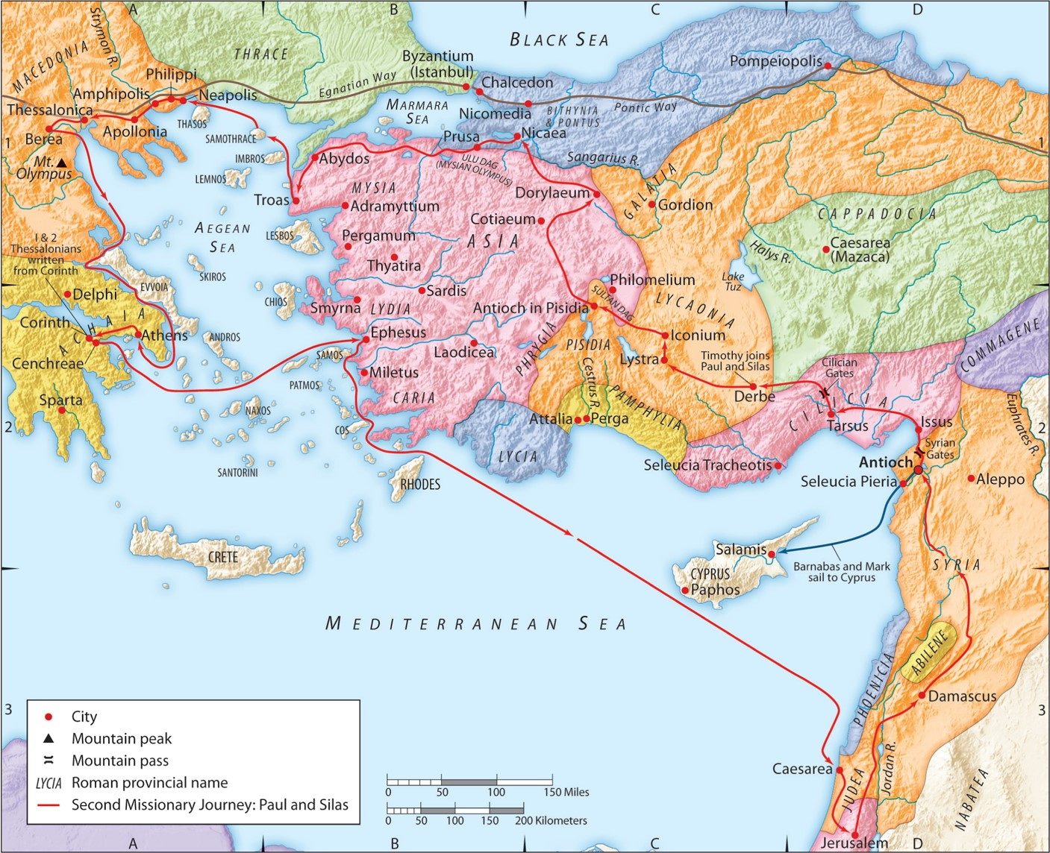
The Second Missionary Journey:
“God Encourages His Child”
Part 1
Acts 18:1-5
“Be my witnesses in Jerusalem and in all Judea and Samaria, and to the ends of the earth”
– Acts 1:8 (ESV)

Slide 2
A. God encourages you through the comfort of His people.
1. Paul comes to Corinth discouraged.
a. He comes in weakness, fear and trembling.
b. He comes alone.
1 Corinthians 2:1-5 (ESV)
And I, when I came to you, brothers, did not come proclaiming to you the testimony of God with lofty speech or wisdom. For I decided to know nothing among you except Jesus Christ and him crucified. And I was with you in weakness and in fear and much trembling, and my speech and my message were not in plausible words of wisdom, but in demonstration of the Spirit and of power, so that your faith might not rest in the wisdom of men but in the power of God.

Slide 3
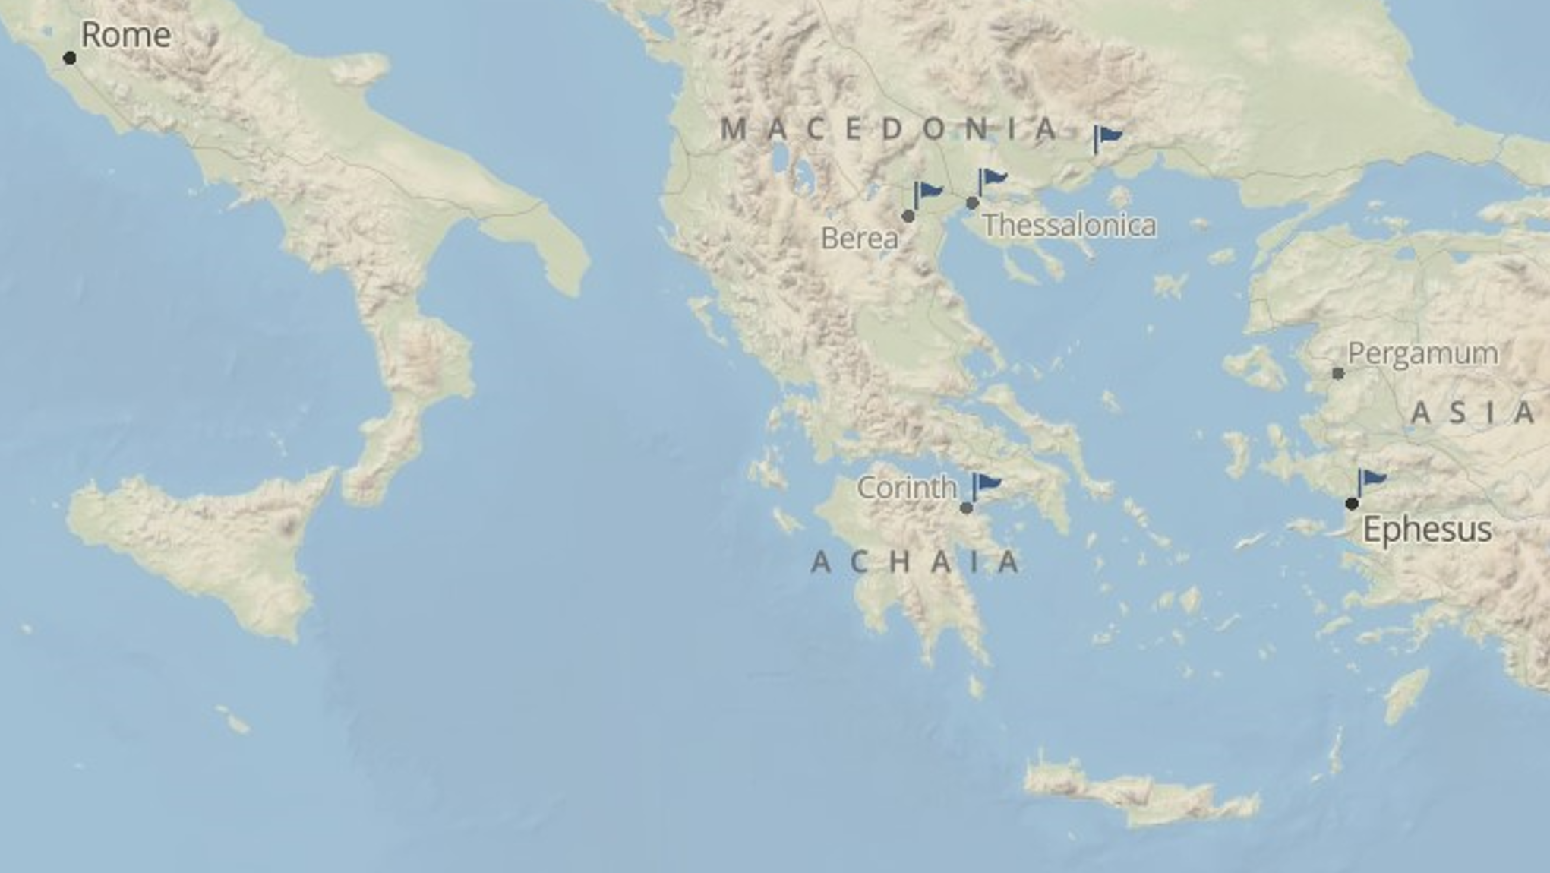

Slide 4
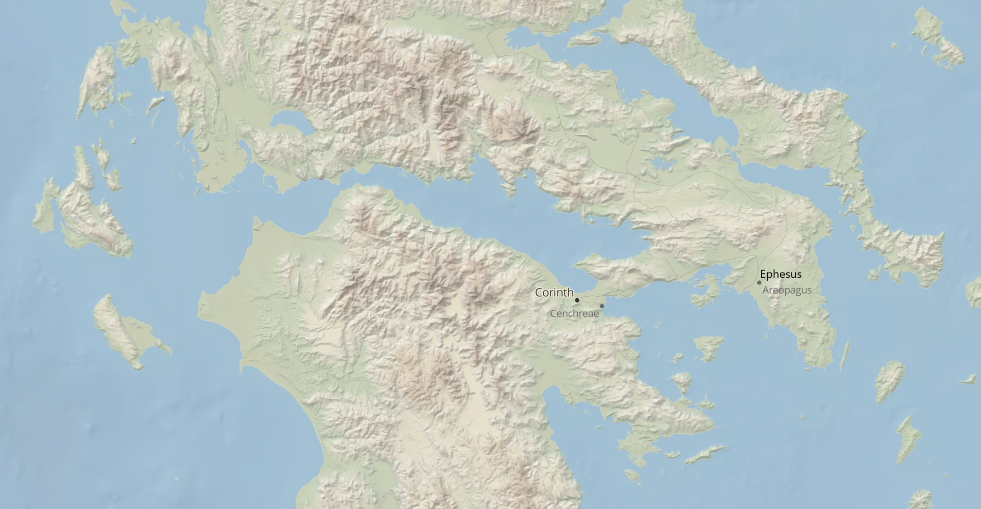

Slide 5
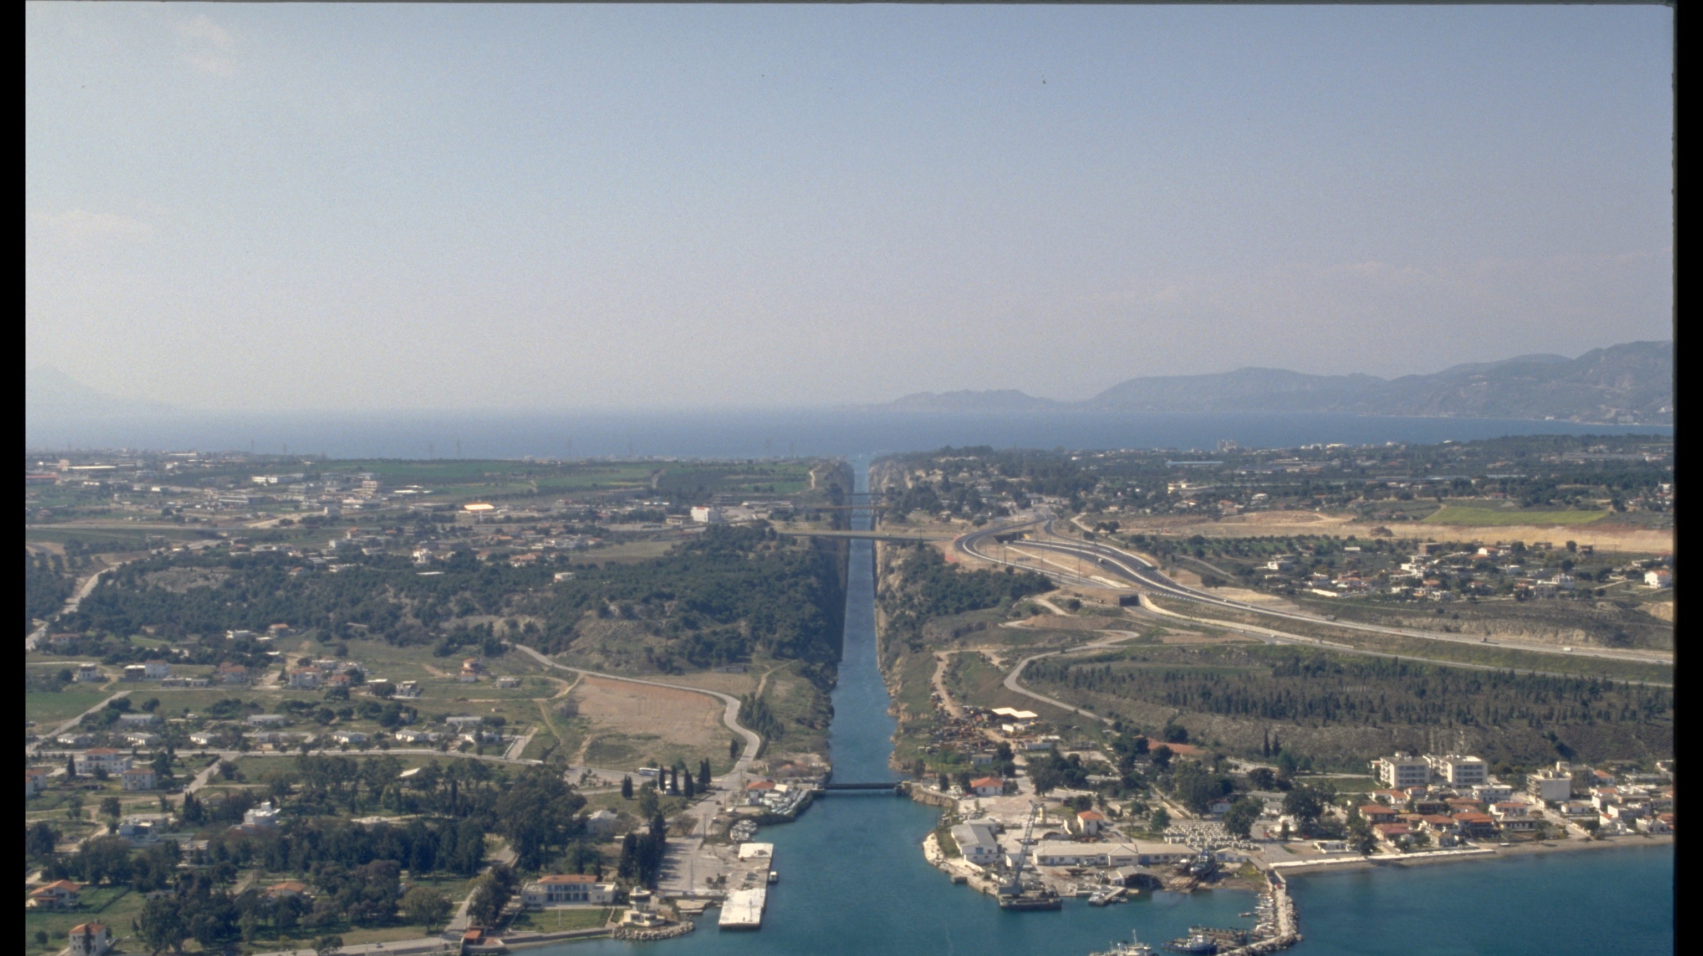

Slide 6
A. God encourages you through the comfort of His people.
1. Paul comes to Corinth discouraged.
a. He comes in weakness, fear and trembling.
b. He comes alone.
c. Corinth was:
(i). The capital of Achaia.
(ii) Commercial at its center.
(iii) Cosmopolitan in its makeup.
(iv) Corrupt in its nature.

Slide 7
2. God sends Paul two new friends, Aquila and Priscilla.
a. They will become two of Paul’s close companions.
Romans 16:3-4 (ESV)
Greet Prisca and Aquila, my fellow workers in Christ Jesus, who risked their necks for my life, to whom not only I give thanks but all the churches of the Gentiles give thanks as well.
;
2 Timothy 4:19(ESV)
Greet Prisca and Aquila, and the household of Onesiphorus.

Slide 8
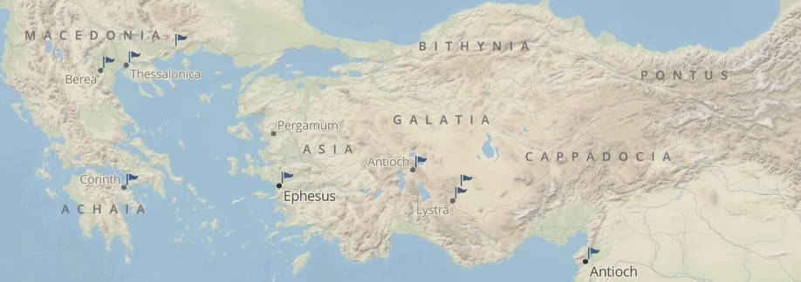
2. God sends Paul two new friends, Aquila and Priscilla.
a. They will become two of Paul’s close companions.
b. They are likely already believers.
(i) Aquila is from Pontus, where some at Pentecost were from.
Acts 2:8-9 (ESV)
And how is it that we hear, each of us in his own native language? Parthians and Medes and Elamites and residents of Mesopotamia, Judea and Cappadocia, Pontus and Asia,.

Slide 9
2. God sends Paul two new friends, Aquila and Priscilla.
a. They will become two of Paul’s close companions.
b. They are likely already believers.
(ii) They probably came from an established church in Rome.
Romans 15 (ESV)
²² This is the reason why I have so often been hindered from coming to you.
²³ But now, since I no longer have any room for work in these regions, and since I have longed for many years to come to you,
²⁴ I hope to see you in passing as I go to Spain, and to be helped on my journey there by you, once I have enjoyed your company for a while.
Romans 1:7-8 (ESV)
To all those in Rome who are loved by God and called to be saints: Grace to you and peace from God our Father and the Lord Jesus Christ. First, I thank my God through Jesus Christ for all of you, because your faith is proclaimed in all the world.
.

Slide 10
2. God sends Paul two new friends, Aquila and Priscilla.
a. They will become two of Paul’s close companions.
b. They are likely already believers.
(iii) Jews were kicked out of Rome b/c of Chrestus (Christos).
(iv) The context suggests an immediate friendship
(v) There is no mention of their conversion in Scripture.

Slide 11
3. God sends Paul two old friends, Timothy and Silas.
a. Where have they been?
(i) Paul sent for them from Berea to come to Athens.
Acts 17:15 (ESV)
Those who conducted Paul brought him as far as Athens, and after receiving a command for Silas and Timothy to come to him as soon as possible, they departed.

Slide 12
3. God sends Paul two old friends, Timothy and Silas.
a. Where have they been?
(i) Paul sent for them from Berea to come to Athens.
(ii) Paul sent Timothy from Athens back to Thessalonica.
1 Thessalonians 3:6-7 (ESV)
But now that Timothy has come to us from you, and has brought us the good news of your faith and love and reported that you always remember us kindly and long to see us, as we long to see you— for this reason, brothers, in all our distress and affliction
we have been comforted about you through your faith.
1 Thessalonians 3:1-2 (ESV)
Therefore when we could bear it no longer, we were willing to be left behind at Athens alone, and we sent Timothy, our brother and God’s coworker in the gospel of Christ, to establish and exhort you in your faith,

Slide 13
3. God sends Paul two old friends, Timothy and Silas.
a. Where have they been?
(i) Paul sent for them from Berea to come to Athens.
(ii) Paul sent Timothy from Athens back to Thessalonica.
(iii) Monetary relief came from Macedonia to Achaia.
(iv) The Philippian church sent monetary relief after Paul left Macedonia.
2 Corinthians 11:9-10 (ESV)
And when I was with you and was in need, I did not burden anyone, for the brothers who came from Macedonia supplied my need. So I refrained and will refrain from burdening you in any way. As the truth of Christ is in me, this boasting of mine will not be silenced in the regions of Achaia.
Philippians 4:15-16 (ESV)
And you Philippians yourselves know that in the beginning of the gospel, when I left Macedonia, no church entered into partnership with me in giving and receiving, except you only. Even in Thessalonica you sent me help for my needs once and again.

Slide 14
3. God sends Paul two old friends, Timothy and Silas.
a. Where have they been?
(i) Paul sent for them from Berea to come to Athens.
(ii) Paul sent Timothy from Athens back to Thessalonica.
(iii) Monetary relief came from Macedonia to Achaia.
(iv) The Philippian church sent monetary relief after Paul left Macedonia.
(v) Silas and Timothy rejoin Paul here in Corinth.
(vi) It seems, then, Silas came from Philippi with the relief.

Slide 15
3. God sends Paul two old friends, Timothy and Silas.
b. Their arrival means Paul is freed from being discouraged about those he previously ministered to, and from financial worry, and could now be completely devoted to the preaching of the Word.
Romans 10:9 (ESV)
because, if you confess with your mouth that Jesus is Lord and believe in your heart that God raised him from the dead, you will be saved.

Slide 16
3. God sends Paul two old friends, Timothy and Silas.
b. Their arrival means Paul is freed from being discouraged about those he previously ministered to, and from financial worry, and could now be completely devoted to the preaching of the Word.
2 Corinthians 1:3-7 (ESV)
Blessed be the God and Father of our Lord Jesus Christ, the Father of mercies and God of all comfort, who comforts us in all our affliction, so that we may be able to comfort those who are in any affliction, with the comfort with which we ourselves are comforted by God. For as we share abundantly in Christ’s sufferings, so through Christ we share abundantly in comfort too. If we are afflicted, it is for your comfort and salvation; and if we are comforted, it is for your comfort, which you experience when you patiently endure the same sufferings that we suffer. Our hope for you is unshaken, for we know that as you share in our sufferings, you will also share in our comfort.

Slide 17
A. God encourages you through the comfort of His people.
1. Paul comes to Corinth discouraged.
2. God sends Paul two new friends, Aquila and Priscilla.
3. God sends Paul two old friends, Timothy and Silas.
Hebrews 10:24-25 (ESV)
And let us consider how to stir up one another to love and good works, not neglecting to meet together, as is the habit of some, but encouraging one another, and all the more as you see the Day drawing near.

