Slide 1
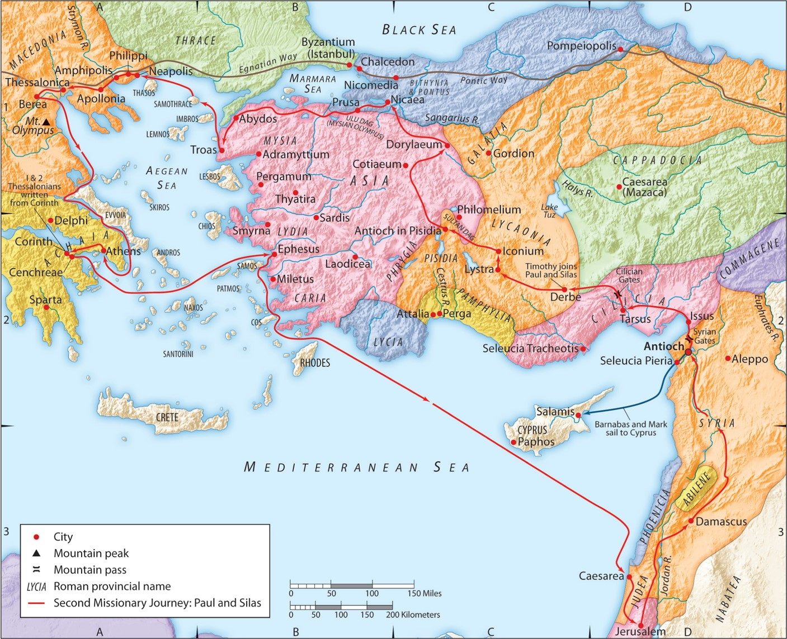
The Second Missionary Journey:
“Promises Made, Promises Kept”
Part 1 of 2
Acts 18:10-18a
“Be my witnesses in Jerusalem and in all Judea and Samaria, and to the ends of the earth”
– Acts 1:8 (ESV)

Slide 2
I. The Lord made and kept His promises to Paul.
A. Three promises the Lord made:
1. He would be with him.
2. He would ensure his protection.
3. He would save more people through Paul’s ministry.

Slide 3
I. The Lord made and kept His promises to Paul.
B. Three ways the Lord kept His promises:
1. Paul was able to teach God’s word 1.5 years in Corinth.

Slide 4
I. The Lord made and kept His promises to Paul.
B. Three ways the Lord kept His promises:
2. Many WERE saved through Paul’s ministry.
Roman 16:1 (ESV)
I commend to you our sister Phoebe, a servant of the church at Cenchreae,
Roman 16:22-23 (ESV)
I Tertius, who wrote this letter, greet you in the Lord. Gaius,
who is host to me and to the whole church (in Corinth) greets you.
Erastus, the city treasurer, and our brother Quartus, greet you.
1 Corinthians 1:11,14 (ESV)
11: For it has been reported to me by Chloe’s people that there is quarreling among you, my brothers.
14: I thank God that I baptized none of you except Crispus and Gaius,
1 Corinthians 16:15-17 (ESV)
you know that the household of Stephanas were the first converts in Achaia,
and that they have devoted themselves to the service of the saints—
be subject to such as these, and to every fellow worker and laborer.
I rejoice at the coming of Stephanas and Fortunatus and Achaicus,
because they have made up for your absence,

Slide 5
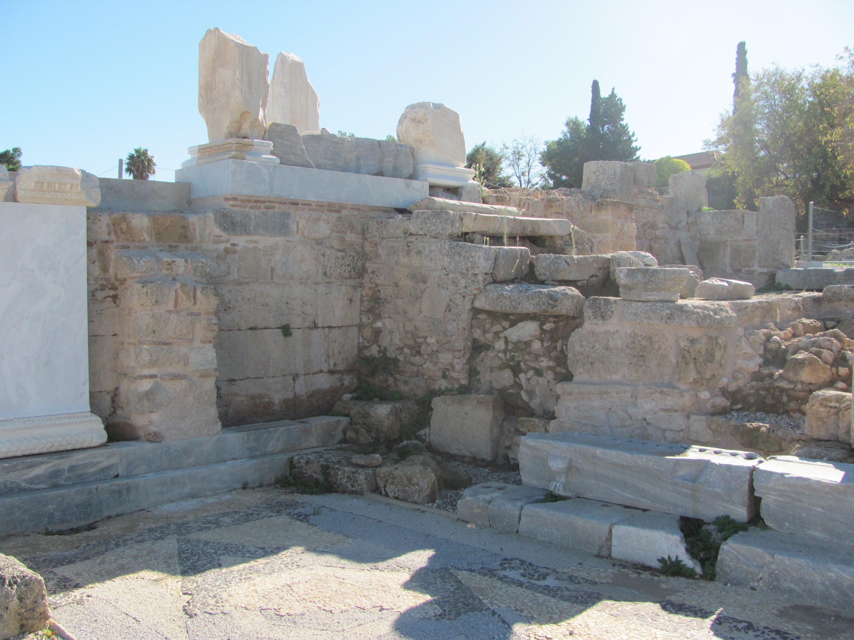
I. The Lord made and kept His promises to Paul.
B. Three ways the Lord kept His promises:
3. Paul was protected from the proconsul’s judgment.

Slide 6
I. The Lord made and kept His promises to Paul.
B. Three ways the Lord kept His promises:
4. BONUS: Those saved were protected from Rome.
1 Corinthians 1:1-2 (ESV)
Paul, called by the will of God to be an apostle of Christ Jesus, and our brother Sosthenes,
To the church of God that is in Corinth,
to those sanctified in Christ Jesus,
called to be saints together with all those who in every place call upon the name of our Lord Jesus Christ,
both their Lord and ours:

Slide 7
II. Application
A. Jesus keeps all his promises to you.
2 Corinthians 1:18-21 (ESV)
As surely as God is faithful, our word to you has not been Yes and No.
For the Son of God, Jesus Christ,
whom we proclaimed among you, Silvanus and Timothy and I,
was not Yes and No,
but in him it is always Yes.
For all the promises of God find their Yes in him.
That is why it is through him that we utter our Amen to God for his glory.
And it is God who establishes us with you in Christ, and has anointed us,

Slide 8
II. Application
A. Jesus keeps all his promises to you.
Hebrews 13:7-9a (ESV)
⁷ Remember your leaders, those who spoke to you the word of God.
Consider the outcome of their way of life, and imitate their faith.
⁸ Jesus Christ is the same yesterday and today and forever.
⁹ Do not be led away by diverse and strange teachings…

Slide 9
II. Application
A. Jesus keeps all his promises to you.
Hebrews 13:7-9a (ESV)
⁷ Remember your leaders, those who spoke to you the word of God.
Consider the outcome of their way of life, and imitate their faith.
⁸ Jesus Christ is the same yesterday and today and forever.
⁹ Do not be led away by diverse and strange teachings…

Slide 10
II. Application
B. Jesus will build His church.
Matthew 16:18 (ESV)
And I tell you, you are Peter, and on this rock
I will build my church, and the gates of hell shall not prevail against it.

Slide 11
II. Application
A. Jesus keeps all his promises to you.
B. Jesus will build His church.
Will you trust Jesus’s promises to you completely and be the church He will build?

