Slide 1
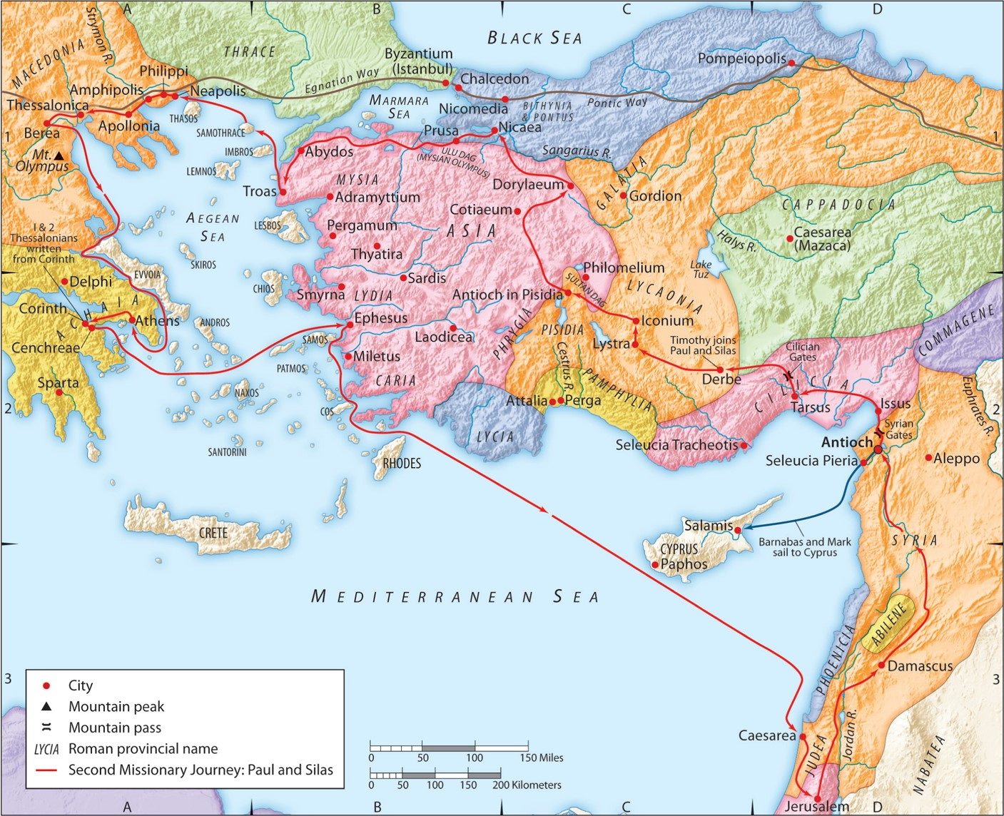
The Second Missionary Journey:
“God Encourages His Child”
Part 2
Acts 18:6-8
“Be my witnesses in Jerusalem and in all Judea and Samaria, and to the ends of the earth”
– Acts 1:8 (ESV)

Slide 2
2 Corinthians 7:5 (ESV)
For even when we came into Macedonia,
our bodies had no rest,
but we were afflicted at every turn —
fighting without
and fear within.
1 Corinthians 2:3 (ESV)
And I was with you
in weakness and
in fear and
much trembling
2 Corinthians 1:3-4a (ESV)
Blessed be the God and Father of our Lord Jesus Christ, the Father of mercies and
God of all comfort,
who comforts us in all our affliction…

Slide 3
Review:
A. God encourages you through the comfort of His people.
1 Thessalonians 3:7 (ESV)
for this reason, brothers, in all our distress and affliction we have been comforted about you through your faith.
2 Corinthians 1:4-5 (ESV)
God … who comforts us in all our affliction, so that we may be able to comfort those who are in any affliction, with the comfort with which we ourselves are comforted by God. For as we share abundantly in Christ’s sufferings, so through Christ we share abundantly in comfort too.
Hebrews 10:24-25 (ESV)
And let us consider how to stir up one another to love and good works,
not neglecting to meet together,
as is the habit of some,
but encouraging one another,
and all the more as you see the Day drawing near.

Slide 4
A. God encourages you through the comfort of His people.
B. God encourages you when you are opposed.
1. He frees you from any guilt.
Ephesians 6:12 (ESV)
For we do not wrestle against flesh and blood, but against the rulers, against the authorities, against the cosmic powers over this present darkness, against the spiritual forces of evil in the heavenly places.
Ephesians 6:13 (ESV)
Therefore take up the whole armor of God, that you may be able to withstand in the evil day, and having done all, to stand firm.

Slide 5
A. God encourages you through the comfort of His people.
B. God encourages you when you are opposed.
1. He frees you from any guilt.
Ezekiel 33:8 (ESV)
If I say to the wicked, O wicked one, you shall surely die, and you do not speak to warn the wicked to turn from his way, that wicked person shall die in his iniquity, but his blood I will require at your hand.
Matthew 7:6 (ESV)
“Do not give dogs what is holy, and do not throw your pearls before pigs, lest they trample them underfoot and turn to attack you.
.
Matthew 7:6-7 (ESV)
And if anyone will not receive you or listen to your words, shake off the dust from your feet when you leave that house or town. Truly, I say to you, it will be more bearable on the day of judgment for the land of Sodom and Gomorrah than for that town.
.

Slide 6
A. God encourages you through the comfort of His people.
B. God encourages you when you are opposed.
1. He frees you from any guilt.
Romans 9:1-6a (ESV)
I am speaking the truth in Christ—I am not lying; my conscience bears me witness in the Holy Spirit— that
I have great sorrow and unceasing anguish in my heart. For I could wish that I myself were accursed and cut off from Christ for the sake of my brothers, my kinsmen according to the flesh. They are Israelites, and to them belong the adoption, the glory, the covenants, the giving of the law, the worship, and the promises. To them belong the patriarchs, and from their race, according to the flesh, is the Christ, who is God over all, blessed forever. Amen. But it is not as though the word of God has failed.

Slide 7
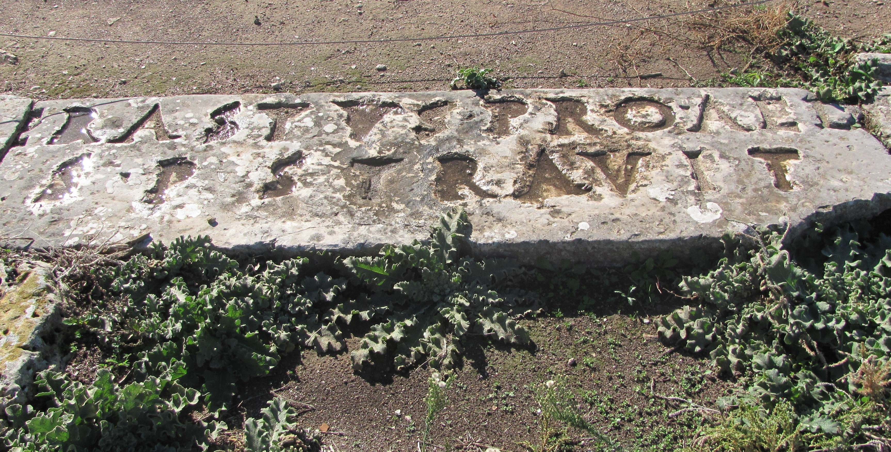
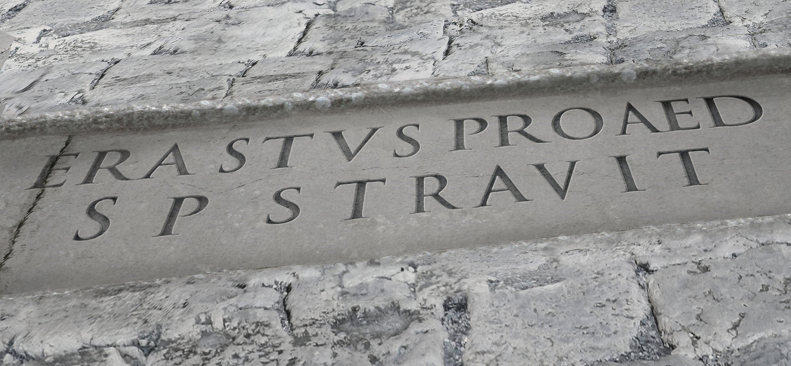
A. God encourages you through the comfort of His people.
B. God encourages you when you are opposed.
2. He opens just the right doors at just the right time.
Romans 16:22-23 (ESV)
I Tertius, who wrote this letter, greet you in the Lord. Gaius, who is host to me and to the whole church, greets you.
Erastus, the city treasurer, and our brother Quartus, greet you.
2 Timothy 4:20 (ESV)
Erastus remained at Corinth, and I left Trophimus, who was ill, at Miletus.
1 Corinthians 1:14 (ESV)
I thank God that I baptized none of you except Crispus and Gaius,

Slide 8
A. God encourages you through the comfort of His people.
B. God encourages you when you are opposed.
3. He mightily saves by His never-failing, all-reaching grace.

Slide 9
Communion

