Slide 1
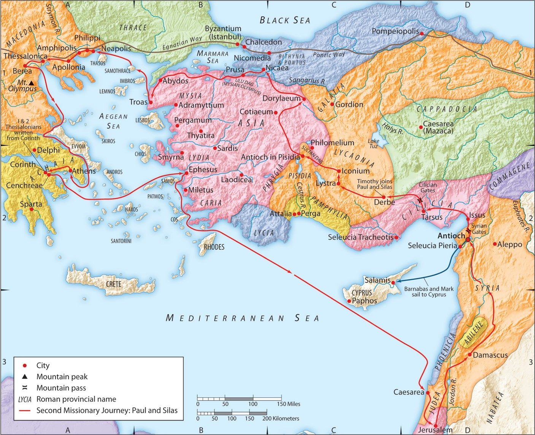
The Second Missionary Journey:
“God Encourages His Child”
Part 3
Acts 18:9-11
“Be my witnesses in Jerusalem and in all Judea and Samaria, and to the ends of the earth”
– Acts 1:8 (ESV)

Slide 2
C. God encourages you by speaking to you by His Word through the Spirit.
Ephesians 2:19-20 (ESV)
So then you are no longer strangers and aliens, but you are fellow citizens with the saints and members of the household of God,
built on the foundation of the apostles and prophets,
Christ Jesus himself being the cornerstone,
1 Corinthians 3:11 (ESV)
For no one can lay a foundation other than that which is laid, which is Jesus Christ.

Slide 3
C. God encourages you by speaking to you by His Word through the Spirit.
2 Timothy 2:14-16 (ESV)
Remind them of these things, and charge them before God not to quarrel about words, which does no good, but only ruins the hearers. Do your best to present yourself to God as one approved, a worker who has no need to be ashamed,
rightly handling the word of truth.
2 Timothy 3:14-17 (ESV)
But as for you, continue in what you have learned and have firmly believed, knowing from whom you learned it and how from childhood you have been acquainted with the sacred writings, which are able to make you wise for salvation through faith in Christ Jesus. All Scripture is breathed out by God…
2 Timothy 4:2 (ESV)
preach the word; be ready in season and out of season; reprove, rebuke, and exhort, with complete patience and teaching.

Slide 4
C. God encourages you by speaking to you by His Word through the Spirit.
2 Peter 1:19-21 (ESV)
And we have
the prophetic word more fully confirmed, to which you will do well to pay attention
as to a lamp shining in a dark place, until the day dawns and the morning star rises in your hearts, knowing this first of all, that
no prophecy of Scripture comes from someone’s own interpretation.
For no prophecy was ever produced by the will of man,
but men spoke from God
as they were carried along
by the Holy Spirit.

Slide 5
C. God encourages you by speaking to you by His Word through the Spirit.
1. He tells you to stop fearing.
1 Corinthians 2:3 (ESV)
And I was with you in weakness and in fear and much trembling,

Slide 6
C. God encourages you by speaking to you by His Word through the Spirit.
1. He tells you to stop fearing.
Joshua 1:6-9 (ESV)
Be strong and courageous,
for you shall cause this people to inherit the land that I swore to their fathers to give them.
Only be strong and very courageous,
being careful to do according to all the law that Moses my servant commanded you. Do not turn from it to the right hand or to the left, that you may have good success wherever you go. This Book of the Law shall not depart from your mouth, but you shall meditate on it day and night, so that you may be careful to do according to all that is written in it. For then you will make your way prosperous, and then you will have good success. Have I not commanded you?
Be strong and courageous.
Do not be frightened,
and do not be dismayed, for the LORD your God is with you wherever you go.”
1 Samuel 17:32 (ESV)
And David said to Saul, “Let no man’s heart fail because of him. Your servant will go and fight with this Philistine.”

Slide 7
C. God encourages you by speaking to you by His Word through the Spirit.
1. He tells you to stop fearing.
Matthew 10:29-31 (ESV)
Are not two sparrows sold for a penny? And not one of them will fall to the ground apart from your Father. But even the hairs of your head are all numbered.
Fear not, therefore;
you are of more value than many sparrows.
Romans 8:15-17 (ESV)
For you did not receive the spirit of slavery to fall back into fear,
but you have received the Spirit of adoption as sons,
by whom we cry, “Abba! Father!” The Spirit himself bears witness with our spirit that we are children of God, and if children, then heirs—heirs of God and fellow heirs with Christ, provided we suffer with him in order that we may also be glorified with him.
1 John 4:18-19 (ESV)
There is no fear in love, but perfect love casts out fear. For fear has to do with punishment, and whoever fears has not been perfected in love. We love because he first loved us.

Slide 8
C. God encourages you by speaking to you by His Word through the Spirit.
2. He tells you to keep going.
2 Timothy 1:7(ESV)
for God gave us a spirit not of fear but of power and love and self-control.
2 Timothy 1:8 (ESV)
Therefore do not be ashamed of the testimony about our Lord, nor of me his prisoner, but share in suffering for the gospel by the power of God,
2 Timothy 2:1-3a (ESV)
You then, my child, be strengthened by the grace that is in Christ Jesus, and what you have heard from me in the presence of many witnesses entrust to faithful men, who will be able to teach others also. Share in suffering as a good soldier of Christ Jesus.

Slide 9
C. God encourages you by speaking to you by His Word through the Spirit.
3. He tells you He is with you.
Genesis 26:3 (ESV)
Sojourn in this land, and I will be with you and will bless you, for to you and to your offspring I will give all these lands, and I will establish the oath that I swore to Abraham your father..
Exodus 3:11-12 (ESV)
But Moses said to God, “Who am I that I should go to Pharaoh and bring the children of Israel out of Egypt?” He (God) said, “But I will be with you, and this shall be the sign for you, that I have sent you: when you have brought the people out of Egypt, you shall serve God on this mountain.”

Slide 10
C. God encourages you by speaking to you by His Word through the Spirit.
3. He tells you He is with you.
Joshua 1:5 (ESV)
No man shall be able to stand before you all the days of your life.
Just as I was with Moses, so I will be with you. I will not leave you or forsake you.
Joshua 1:9 (ESV)
Have I not commanded you? Be strong and courageous. Do not be frightened, and do not be dismayed,
for the LORD your God is with you wherever you go.”

Slide 11
C. God encourages you by speaking to you by His Word through the Spirit.
3. He tells you He is with you.
Matthew 28:18-20 (ESV)
And Jesus came and said to them, “All authority in heaven and on earth has been given to me.
Go therefore and make disciples of all nations, baptizing them in the name of the Father and of the Son and of the Holy Spirit, teaching them to observe all that I have commanded you.
And behold, I am with you always, to the end of the age.”

Slide 12
C. God encourages you by speaking to you by His Word through the Spirit.
3. He tells you He is with you.
Hebrews 12:1-2 (ESV)
Therefore, since we are surrounded by so great a cloud of witnesses, let us also lay aside every weight, and sin which clings so closely, and let us run with endurance the race that is set before us, looking to Jesus, the founder and perfecter of our faith, who for the joy that was set before him endured the cross, despising the shame, and is seated at the right hand of the throne of God.

Slide 13
C. God encourages you by speaking to you by His Word through the Spirit.
4. He tells you there is purpose for your life, and He will help you see it through.
2 Timothy 4:7-8a (ESV)
I have fought the good fight, I have finished the race, I have kept the faith. Henceforth there is laid up for me the crown of righteousness, which the Lord, the righteous judge, will award to me on that day, and not only to me but also to all who have loved his appearing.

