Slide 1
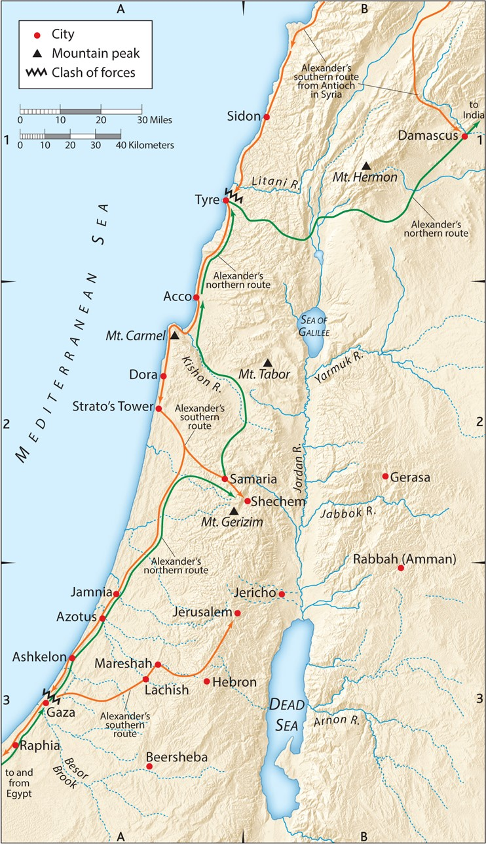
Campaign routes of Alexander “the Great”
332-331 B.C.
“Prophecy, Israel, & Gaza, Oh My!”
Various Passages

Slide 2
A. Why study Biblical Prophecy?
1. It is a large part of God’s profitable word and should not be ignored.
2 Timothy 3:16-17 (ESV)
All Scripture is breathed out by God
and profitable
for teaching,
for reproof,
for correction,
and for training in righteousness,
that the man of God may be complete,
equipped for every good work.

Slide 3
A. Why study Biblical Prophecy?
2. The coming of Jesus is your blessed hope that you should be preparing for.
Titus 2:11-15 (ESV)
For the grace of God has appeared, bringing salvation for all people, training us to renounce ungodliness and worldly passions, and to live self-controlled, upright, and godly lives in the present age, waiting for our blessed hope, the appearing of the glory of our great God and Savior Jesus Christ, who gave himself for us to redeem us from all lawlessness and to purify for himself a people for his own possession who are zealous for good works.
Declare these things; exhort and rebuke with all authority. Let no one disregard you.
Luke 12:40 (ESV)
“You also must be ready, for the Son of Man is coming at an hour you do not expect.”
Revelation 22:20 (ESV)
He who testifies to these things says, “Surely I am coming soon.” Amen. Come, Lord Jesus!

Slide 4
A. Why study Biblical Prophecy?
3. Being ignorant of prophecy can actually be harmful to yourself and others.
Turn in Your Bibles to 2 Peter 3

Slide 5
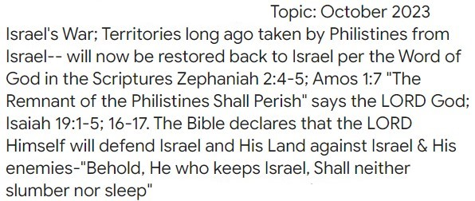
A. Why study Biblical Prophecy?
3. Being ignorant of prophecy can actually be harmful to yourself and others.

Slide 6
B. What are the 3 major ways Christians approach eschatology?
Revelation 20:1-6 (ESV)
Then I saw an angel coming down from heaven, holding in his hand the key to the bottomless pit and a great chain. And he seized the dragon, that ancient serpent, who is the devil and Satan, and bound him for a thousand years, and threw him into the pit, and shut it and sealed it over him, so that he might not deceive the nations any longer, until the thousand years were ended. After that he must be released for a little while. Then I saw thrones, and seated on them were those to whom the authority to judge was committed. Also I saw the souls of those who had been beheaded for the testimony of Jesus and for the word of God, and those who had not worshiped the beast or its image and had not received its mark on their foreheads or their hands. They came to life and reigned with Christ for a thousand years. The rest of the dead did not come to life until the thousand years were ended. This is the first resurrection. Blessed and holy is the one who shares in the first resurrection! Over such the second death has no power, but they will be priests of God and of Christ, and they will reign with him for a thousand years.

Slide 7
B. What are the 3 major ways Christians approach eschatology?
1. Post-millennial: Jesus will return after a non-literal 1000 years.
Matthew 24:21-22 (ESV)
For then there will be great tribulation, such as has not been from the beginning of the world until now, no, and never will be. And if those days had not been cut short, no human being would be saved. But for the sake of the elect those days will be cut short.

Slide 8
B. What are the 3 major ways Christians approach eschatology?
2. A-millennial: Jesus is reigning now, spiritually, through the church on earth and/or
spiritually in heaven, either way in a non-literal 1000-year reign.
Luke 4:17-21 (ESV)
And the scroll of the prophet Isaiah was given to him. He unrolled the scroll and found the place where it was written, “The Spirit of the Lord is upon me, because he has anointed me to proclaim good news to the poor. He has sent me to proclaim liberty to the captives and recovering of sight to the blind, to set at liberty those who are oppressed, to proclaim the year of the Lord’s favor.” And he rolled up the scroll and gave it back to the attendant and sat down. And the eyes of all in the synagogue were fixed on him. And he began to say to them, “Today this Scripture has been fulfilled in your hearing.”
Isaiah 61:1-3 (ESV)
(Jesus fulfilled above, 1st coming) The Spirit of the Lord GOD is upon me, because the LORD has anointed me to bring good news to the poor; he has sent me to bind up the brokenhearted, to proclaim liberty to the captives, and the opening of the prison to those who are bound; to proclaim the year of the LORD’s favor, (Jesus stopped here because this will still fulfilled at His 2nd coming) and the day of vengeance of our God; to comfort all who mourn; to grant to those who mourn in Zion— to give them a beautiful headdress instead of ashes, the oil of gladness instead of mourning, the garment of praise instead of a faint spirit; that they may be called oaks of righteousness, the planting of the LORD, that he may be glorified.

Slide 9
B. What are the 3 major ways Christians approach eschatology?
3. Pre-millennial: Jesus returns before (or really, at the start of) the
literal 1000 years, and literally reigns as King for those 1000 years.

Slide 10
C. How does the church fit into prophecy?
1. There is no mention of the church in the Old Testament.
2. Although God knew Israel would reject Jesus, He gave a real choice to repent
for the very real offer of the Kingdom to come.
Matthew 4:17 (ESV)
From that time Jesus began to preach, saying, “Repent, for the kingdom of heaven is at hand.”
Acts 1:6-7 (ESV)
So when they had come together, they asked him, “Lord, will you at this time restore the kingdom to Israel?” He said to them, “It is not for you to know times or seasons that the Father has fixed by his own authority.”

Slide 11
C. How does the church fit into prophecy?
3. God reveals a mystery previously unknown: His plan for Israel is delayed while He builds His church.
Ephesians 3:4-6 (ESV)
When you read this, you can perceive my insight into the mystery of Christ, which
was not made known to the sons of men in other generations
as it has now been revealed to his holy apostles and prophets by the Spirit.
This mystery is that the Gentiles are fellow heirs,
members of the same body,
and partakers of the promise in Christ Jesus through the gospel.
Romans 11:25-26 (ESV)
Lest you be wise in your own sight, I do not want you to be unaware of this mystery, brothers:
a partial hardening has come upon Israel,
until the fullness of the Gentiles has come in.
And in this way all Israel will be saved…

Slide 12
C. How does the church fit into prophecy?
1. There is no mention of the church in the Old Testament.
2. Although God knew Israel would reject Jesus, He gave a real choice to repent
for the very real offer of the Kingdom to come.
3. God reveals a mystery previously unknown: His plan for Israel is delayed
while He builds His church.
Revelation 7:4 (ESV)
And I heard the number of the sealed, 144,000, sealed from every tribe of the sons of Israel
Revelation 7:9-10 (ESV)
…and behold, a great multitude that no one could number, from every nation, from all tribes and peoples and languages, standing before the throne and before the Lamb, clothed in white robes, with palm branches in their hands, and crying out with a loud voice, “Salvation belongs to our God who sits on the throne, and to the Lamb!”

Slide 13
D. What about the Rapture?
Three views
1. Post-tribulation: The rapture happens after the tribulation.
2. Mid-tribulation: The rapture happens in the middle of the tribulation.
3. Pre-tribulation: The rapture happens before the tribulation.

Slide 14
D. What about the Rapture?
Why a Pre-tribulational Rapture?
a. Once the Lord raptures you, you will be with Him forever.
1 Thessalonians 4:17 (ESV)
Then we who are alive, who are left, will be caught up together with them in the clouds to meet the Lord in the air,
and so we will always be with the Lord.

Slide 15
D. What about the Rapture?
Why a Pre-tribulational Rapture?
a. Once the Lord raptures you, you will be with Him forever.
b. Jesus promise He will keep His church from the tribulation.
Revelation 3:10 (ESV)
Because you have kept my word about patient endurance,
I will keep you from the hour of trial
that is coming on the whole world,
to try those who dwell on the earth.

Slide 16
D. What about the Rapture?
Why a Pre-tribulational Rapture?
a. Once the Lord raptures you, you will be with Him forever.
b. Jesus promise He will keep His church from the tribulation.
c. The church is nowhere to be found during the tribulation period
described in Revelation 6-19.

Slide 17
E. How should the church respond to the current events in Israel and Gaza?
Jeremiah 25:15-22 (ESV)
Thus the LORD, the God of Israel, said to me: “Take from my hand this cup of the wine of wrath, and make all the nations to whom I send you drink it. They shall drink and stagger and be crazed because of the sword that I am sending among them.” So I took the cup from the Lord’s hand, and made all the nations to whom the Lord sent me drink it: Jerusalem and the cities of Judah, its kings and officials, to make them a desolation and a waste, a hissing and a curse, as at this day; Pharaoh king of Egypt, his servants, his officials, all his people, and all the mixed tribes among them; all the kings of the land of Uz and all the kings of the land of the Philistines (Ashkelon, Gaza, Ekron, and the remnant of Ashdod); Edom, Moab, and the sons of Ammon; all the kings of Tyre, all the kings of Sidon, and the kings of the coastland across the sea;
Amos 1:6-7 (ESV)
Thus says the LORD: “For three transgressions of Gaza, and for four, I will not revoke the punishment, because they carried into exile a whole people to deliver them up to Edom. So I will send a fire upon the wall of Gaza, and it shall devour her strongholds.
Zechariah 9:5 (ESV)
Ashkelon shall see it, and be afraid; Gaza too, and shall writhe in anguish; Ekron also, because its hopes are confounded. The king shall perish from Gaza; Ashkelon shall be uninhabited;

Slide 18
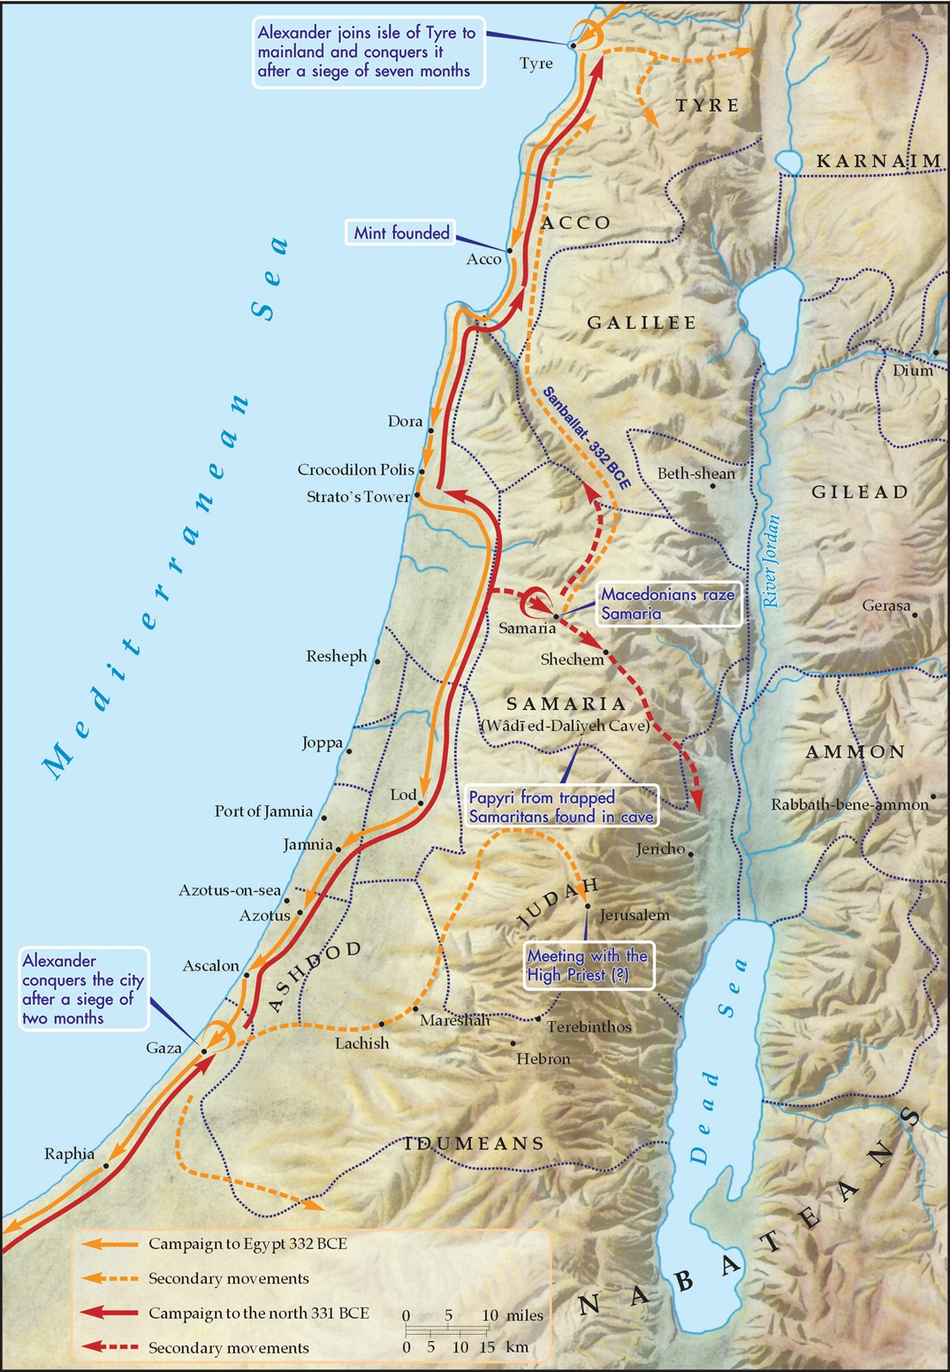
E. How should the church respond to the current events in Israel and Gaza?
The Gaza prophecy has already been literally fulfilled by Alexander, called “the Great.”

Slide 19
E. How should the church respond to the current events in Israel and Gaza?
1. When you hear of wars and rumors of wars, do not fear because that’s not the end.
Luke 21:24b (ESV)
and Jerusalem will be trampled underfoot by the Gentiles, until the times of the Gentiles are fulfilled.

Slide 20
E. How should the church respond to the current events in Israel and Gaza?
1. When you hear of wars and rumors of wars, do not fear because that’s not the end.
2. Rather than fearing, look up to Jesus and dwell on your security in salvation.
Luke 21:28 (ESV)
Now when these things begin to take place,
straighten up and raise your heads,
because your redemption is drawing near.”

Slide 21
E. How should the church respond to the current events in Israel and Gaza?
1. When you hear of wars and rumors of wars, do not fear because that’s not the end.
2. Rather than fearing, look up to Jesus and dwell on your security in salvation.
3. Pray for Jerusalem.
Psalm 122:6 (ESV)
Pray for the peace of Jerusalem! “May they be secure who love you!

Slide 22
E. How should the church respond to the current events in Israel and Gaza?
1. When you hear of wars and rumors of wars, do not fear because that’s not the end.
2. Rather than fearing, look up to Jesus and dwell on your security in salvation.
3. Pray for Jerusalem.
4. If you don’t know Jesus, pray for your own salvation.

Slide 23
E. How should the church respond to the current events in Israel and Gaza?
1. When you hear of wars and rumors of wars, do not fear because that’s not the end.
2. Rather than fearing, look up to Jesus and dwell on your security in salvation.
3. Pray for Jerusalem.
4. If you don’t know Jesus, pray for your own salvation.
5. If you do know Jesus, live as if He’s coming back today, because He just might!

