Slide 1
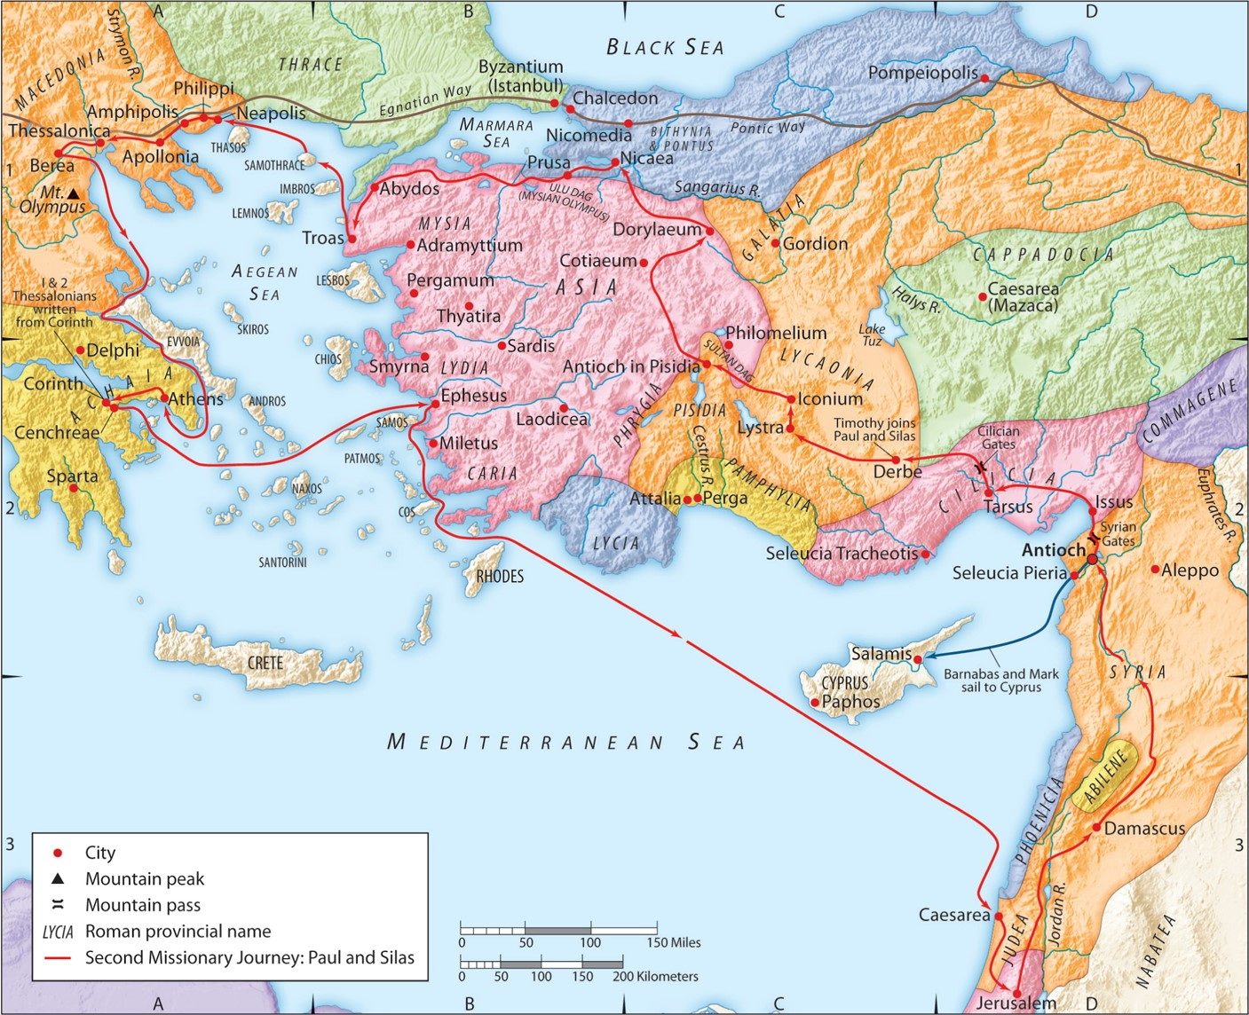
The Second Missionary Journey:
“Promises Made, Promises Kept”
Part II: Acts 18:18-23
“Be my witnesses in Jerusalem and in all Judea and Samaria, and to the ends of the earth”
– Acts 1:8 (ESV)

Slide 2
2. Paul made and kept a promises to the Lord.

Slide 3
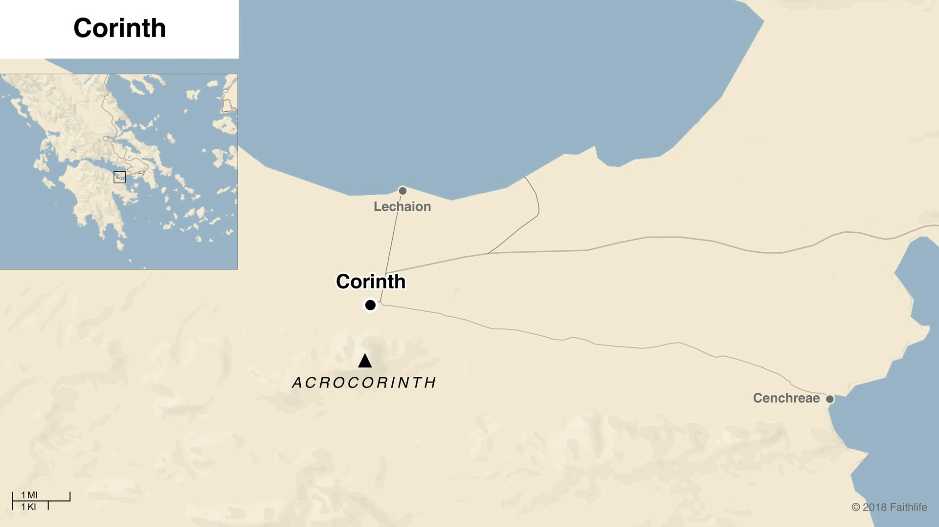
2. Paul made and kept a promises to the Lord.
Romans 16:1-2 (ESV)
¹ I commend to you our sister Phoebe,
a servant of the church at Cenchreae,
² that you may welcome her in the Lord
in a way worthy of the saints,
and help her in whatever she may need from you,
for she has been a patron of many and of myself as well.

Slide 4
A. Paul made a promise to the Lord:
1. This is a Nazarite vow.
a. This vow was optional even in the Old Testament.
b. This vow was made to separate (consecrate) oneself to the Lord.
c. This vow involved growing one’s hair out as a public sign for the people.
d. This vow was made as a petition for sin and as thanksgiving for God’s blessings.

Slide 5
A. Paul made a promise to the Lord:
1. This is a Nazarite vow.
Leviticus 7:11-16 (ESV)
¹¹ “And this is the law of the sacrifice of peace offerings that one may offer to the Lord.
¹² If he offers it for a thanksgiving, then he shall offer with the thanksgiving sacrifice unleavened loaves mixed with oil, unleavened wafers smeared with oil, and loaves of fine flour well mixed with oil.
¹³ With the sacrifice of his peace offerings for thanksgiving he shall bring his offering with loaves of leavened bread.
¹⁴ And from it he shall offer one loaf from each offering, as a gift to the Lord. It shall belong to the priest who throws the blood of the peace offerings.
¹⁵ And the flesh of the sacrifice of his peace offerings for thanksgiving shall be eaten on the day of his offering. He shall not leave any of it until the morning.
¹⁶ But if the sacrifice of his offering is a vow offering or a freewill offering, it shall be eaten on the day that he offers his sacrifice, and on the next day what remains of it shall be eaten.

Slide 6
A. Paul made a promise to the Lord:
1. This is a Nazarite vow.
a. This vow was optional even in the Old Testament.
b. This vow was made to separate (consecrate) oneself to the Lord.
c. This vow involved growing one’s hair out as a public sign for the people.
d. This vow was made as a petition for sin and as thanksgiving for God’s blessings.
e. This vow involved cutting one’s hair at the end of the vow.
f. The offering of hair was to be made at the tent of meetings, and later, the temple.

Slide 7
A. Paul made a promise to the Lord:
2. This vow was made to honor the Lord in Paul’s cultural setting, NOT out of need, nor for salvation.
1 Corinthians 9:20 (ESV)
To the Jews I became as a Jew, in order to win Jews.
To those under the law I became as one under the law
(though not being myself under the law)
that I might win those under the law.
Romans 6:15 (ESV)
What then? Are we to sin because we are not under law
but under grace? By no means!
Colossians 2:16-17 (ESV)
Therefore let no one pass judgment on you in questions of food and drink,
or with regard to a festival or a new moon or a Sabbath.
These are a shadow of the things to come,
but the substance belongs to Christ.

Slide 8
B. Paul kept his promise to the Lord:
1. Paul is devoted to God’s will in all things.
James 4:13-15 (ESV)
Come now, you who say, “Today or tomorrow we will go into such and such a town and spend a year there and trade and make a profit”— yet you do not know what tomorrow will bring. What is your life? For you are a mist that appears for a little time and then vanishes. Instead, you ought to say,
“If the Lord wills, we will live and do this or that.”
Proverbs 16:9 (ESV)
The heart of man plans his way, but the Lord establishes his steps.

Slide 9
B. Paul kept his promise to the Lord:
2. God’s will was for Paul to keep his promise and that meant an offering in Jerusalem.
“for it is usual with those that had been either afflicted with a distemper, or with any other distresses to make vows; and for 30 days before they are to offer their sacrifices, to
abstain from wine, and to shave the hair of their head.”
- Flavius Josephus, Wars, 2.15.1
(translated by William Whiston
in The Works of Josephus:
Complete and Unabridged)

Slide 10
B. Paul kept his promise to the Lord:
2. God’s will was for Paul to keep his promise and that meant an offering in Jerusalem.
Acts 18:21a (NKJV)
Paul bade them farewell, saying,
“I must by all means keep this coming feast
in Jersusalem.

Slide 11
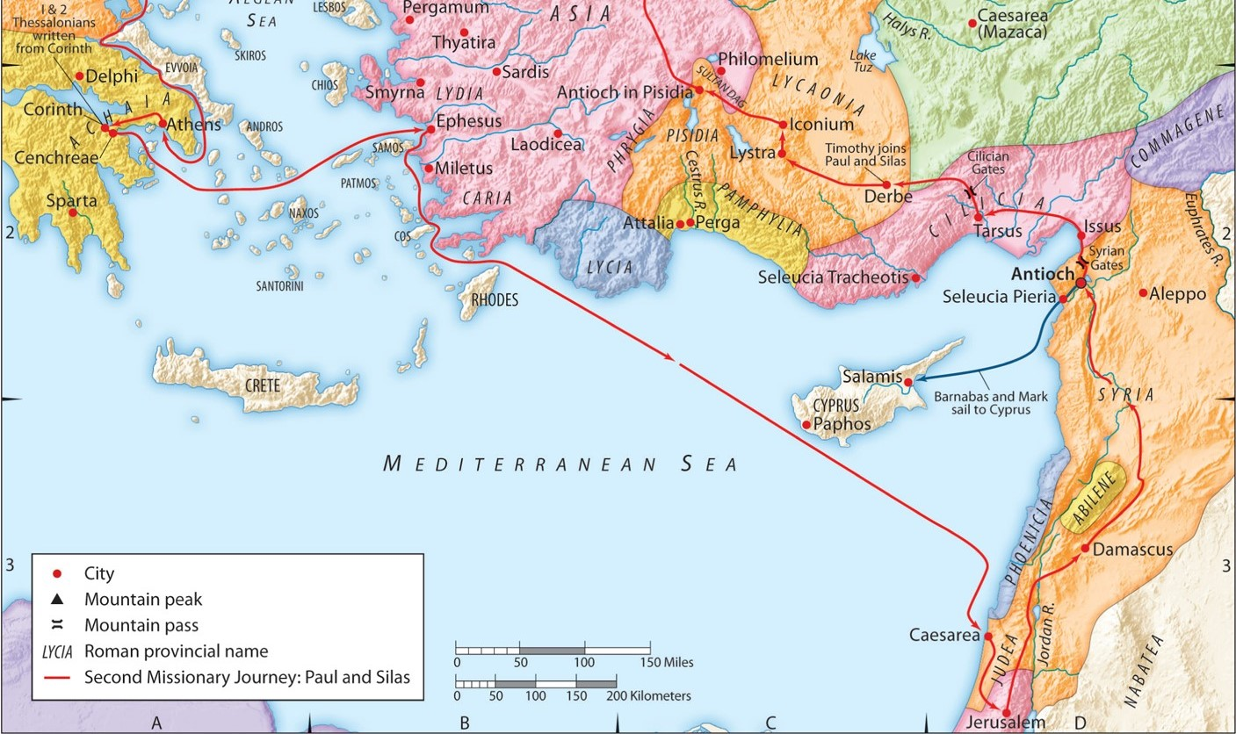

Slide 12
3. Application
C. Should Christian’s make vows today?
Short Answer: Carefully, be sure it honors God, and keep it!
Matthew 5:33-37 (ESV)
³³ “Again you have heard that it was said to those of old, ‘You shall not swear falsely,
but shall perform to the Lord what you have sworn.’
³⁴ But I say to you, Do not take an oath at all,
either by heaven, for it is the throne of God,
³⁵ or by the earth, for it is his footstool,
or by Jerusalem, for it is the city of the great King.
³⁶ And do not take an oath by your head, for you cannot make one hair white or black.
³⁷ Let what you say be simply ‘Yes’ or ‘No’;
anything more than this comes from evil.

Slide 13
3. Application
D. Will you follow God’s will no matter what?
John 14:15 (ESV)
“If you love me, you will keep my commandments.”
John 14:21 (ESV)
Whoever has my commandments and keeps them, he it is who loves me. And he who loves me will be loved by my Father, and I will love him and manifest myself to him.”

Slide 14
Communion

