Slide 1
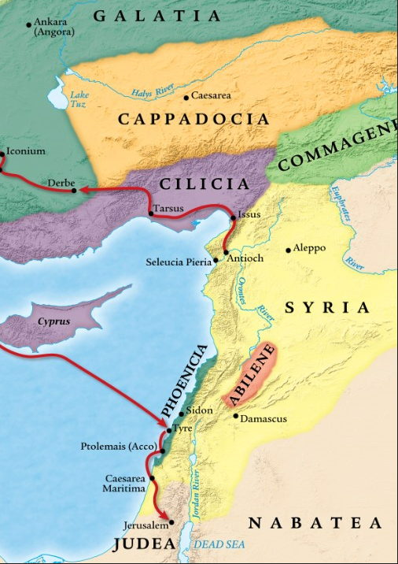
When it Doesn’t Seem Like God Is in Control
Acts 12:1-5a
“Be my witnesses in Jerusalem and in all Judea and Samaria, and to the ends of the earth” – Acts 1:8 (ESV)

Slide 2
1. The enemy seems to be in control and winning.
a. A new enemy rises up against the church.

Slide 3
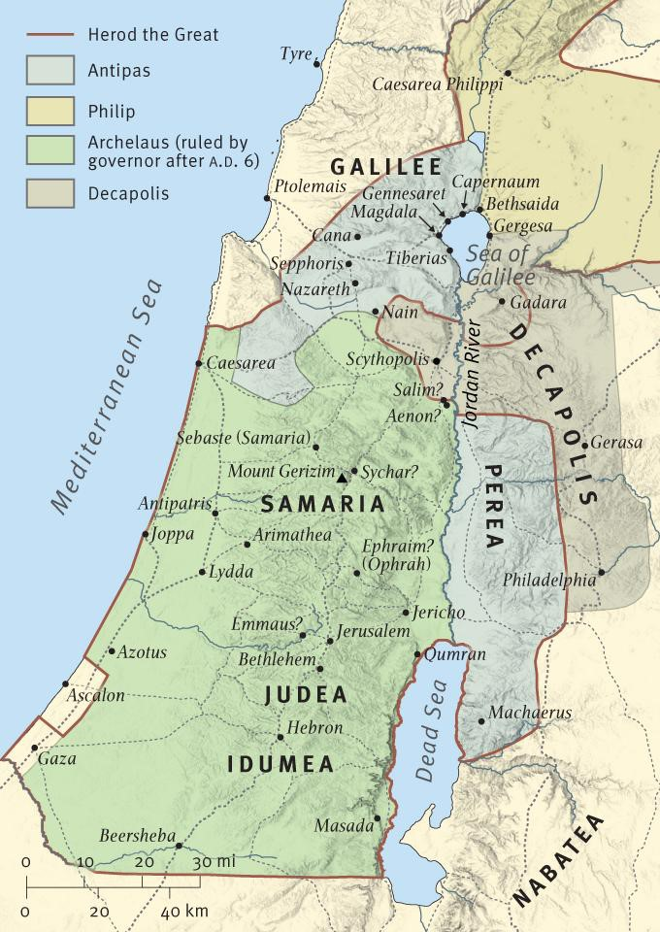
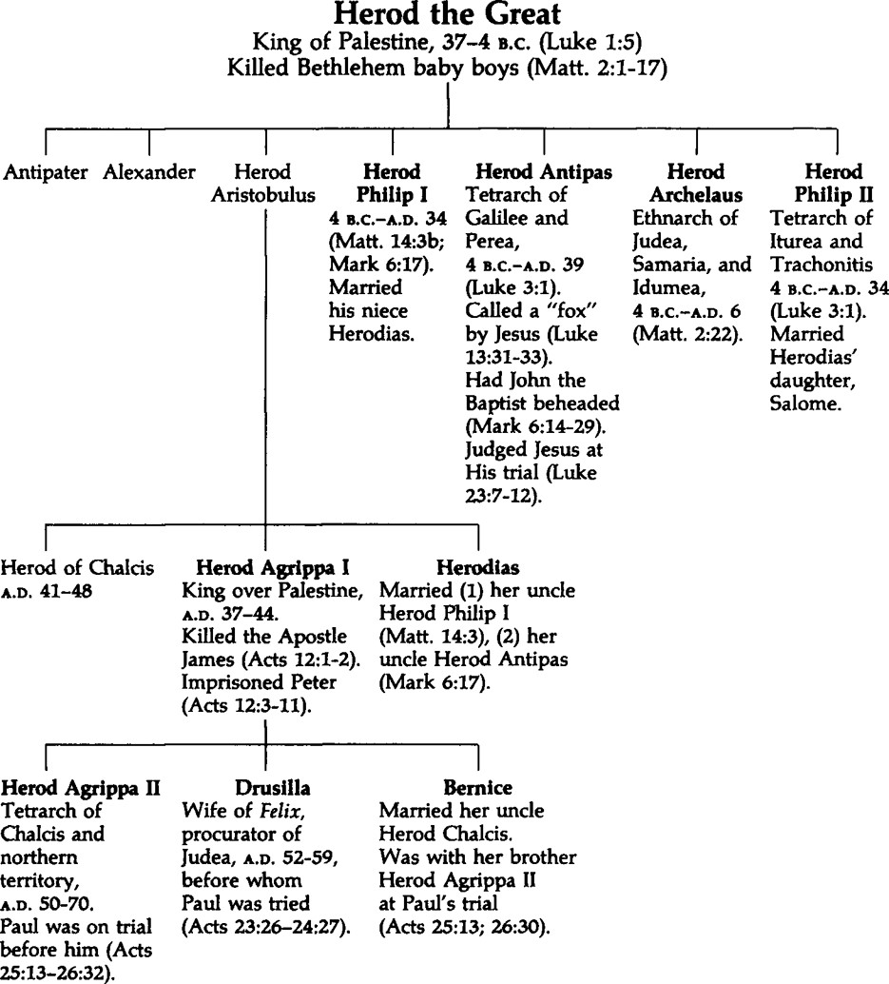
1. The enemy seems to be in control and winning.
a. A new enemy rises up against the church.

Slide 4
1. The enemy seems to be in control and winning.
a. A new enemy rises up against the church.

Slide 5
1. The enemy seems to be in control and winning.
a. A new enemy rises up against the church.

Slide 6
1. The enemy seems to be in control and winning.
a. A new enemy rises up against the church.

Slide 7
1. The enemy seems to be in control and winning.
a. A new enemy rises up against the church.

Slide 8
1. The enemy seems to be in control and winning.
a. A new enemy rises up against the church.
Application #1
Parents, you have a powerful influence on your children.

Slide 9
1. The enemy seems to be in control and winning.
a. A new enemy rises up against the church.
Application #2
Be watchful. The enemy never sleeps and is always looking to harm.
John 16:33 (ESV)
I have said these things to you, that in me you may have peace. In the world you will have tribulation. But take heart; I have overcome the world.”
1 Peter 5:8 (ESV)
Be sober-minded; be watchful. Your adversary the devil prowls around like a roaring lion, seeking someone to devour.
1 John 5:19 (ESV)
We know that we are from God, and the whole world lies in the power of the evil one.

Slide 10
1. The enemy seems to be in control and winning.
a. A new enemy rises up against the church.
Application #2
Be watchful. The enemy never sleeps and is always looking to harm.
John 16:33 (ESV)
I have said these things to you, that in me you may have peace. In the world you will have tribulation. But take heart; I have overcome the world.”

Slide 11
1. The enemy seems to be in control and winning.
b. One of Jesus’s 12 Apostles is murdered by the enemy.
Luke 8:51 (ESV)
And when he came to the house, he allowed no one to enter with him, except Peter and John and James, and the father and mother of the child.
Mark 9:2 (ESV)
And after six days Jesus took with him Peter and James and John, and led them up a high mountain by themselves. And he was transfigured before them,
Mark 9:2 (ESV)
Then Jesus went with them to a place called Gethsemane, and he said to his disciples, “Sit here, while I go over there and pray.” And taking with him Peter and the two sons of Zebedee, he began to be sorrowful and troubled.

Slide 12
1. The enemy seems to be in control and winning.
b. One of Jesus’s 12 Apostles is murdered by the enemy.
Mark 10:39-40 (ESV)
And Jesus said to them, “The cup that I drink you will drink, and with the baptism with which I am baptized, you will be baptized, but to sit at my right hand or at my left is not mine to grant, but it is for those for whom it has been prepared.”
Mark 14:35-36 (ESV)
And going a little farther, he fell on the ground and prayed that, if it were possible, the hour might pass from him. And he said, “Abba, Father, all things are possible for you. Remove this cup from me. Yet not what I will, but what you will.”
Luke 12:50 (ESV)
I have a baptism to be baptized with, and how great is my distress until it is accomplished!

Slide 13
1. The enemy seems to be in control and winning.
b. One of Jesus’s 12 Apostles is murdered by the enemy.
Application #3
God is in control in both your suffering and death.
Matthew 24:9 (ESV)
“Then they will deliver you up to tribulation and put you to death, and you will be hated by all nations for my name’s sake.
Acts 9:16 (ESV)
“For I will show him how much he must suffer for the sake of my name.”
Romans 6:3 (ESV)
Do you not know that all of us who have been baptized into Christ Jesus were baptized into his death?
Romans 8:17 (ESV)
and if children, then heirs—heirs of God and fellow heirs with Christ, provided we suffer with him in order that we may also be glorified with him.
Philippians 3:10 (ESV)
that I may know him and the power of his resurrection, and may share his sufferings, becoming like him in his death,

Slide 14
1. The enemy seems to be in control and winning.
b. One of Jesus’s 12 Apostles is murdered by the enemy.
Application #3
God is in control in both your suffering and death.
Deuteronomy 13:12-15 (ESV)
“If you hear in one of your cities, which the LORD your God is giving you to dwell there, that certain worthless fellows have gone out among you and have drawn away the inhabitants of their city, saying, ‘Let us go and serve other gods,’ which you have not known, then you shall inquire and make search and ask diligently. And behold, if it be true and certain that such an abomination has been done among you, you shall surely put the inhabitants of that city to the sword, devoting it to destruction, all who are in it and its cattle, with the edge of the sword.

Slide 15
1. The enemy seems to be in control and winning.
b. One of Jesus’s 12 Apostles is murdered by the enemy.
Application #3
God is in control in both your suffering and death.
Psalm 116:15 (ESV)
“Precious in the sight of the Lord is the death of his saints.”

Slide 16
1. The enemy seems to be in control and winning.
c. One of Jesus’s 12 Apostles is imprisoned and set to face the same fate.
Application #4
God is sovereign over all authorities.
Acts 5:38-39 (ESV)
So in the present case I tell you, keep away from these men and let them alone, for if this plan or this undertaking is of man, it will fail; but if it is of God, you will not be able to overthrow them. You might even be found opposing God!”

Slide 17
1. The enemy seems to be in control and winning.
c. One of Jesus’s 12 Apostles is imprisoned and set to face the same fate.
Application #4
God is sovereign over all authorities.
Romans 13:1 (ESV)
Let every person be subject to the governing authorities. For there is no authority except from God, and those that exist have been instituted by God.
1 Peter 2:13-14a (ESV)
Be subject for the Lord’s sake to every human institution, whether it be to the emperor as supreme, or to governors as sent by him…

Slide 18
2. Jesus is the answer to suffering and death.
Romans 5:17-21 (ESV)
For if, because of one man’s trespass, death reigned through that one man, much more will those who receive the abundance of grace and the free gift of righteousness reign in life through the one man Jesus Christ. Therefore, as one trespass led to condemnation for all men, so one act of righteousness leads to justification and life for all men. For as by the one man’s disobedience the many were made sinners, so by the one man’s obedience the many will be made righteous. Now the law came in to increase the trespass, but where sin increased, grace abounded all the more, so that, as sin reigned in death, grace also might reign through righteousness leading to eternal life through Jesus Christ our Lord.

Slide 19
2. Jesus is the answer to suffering and death.
1 Corinthians 15:25-26 (ESV)
For he must reign until he has put all his enemies under his feet. The last enemy to be destroyed is death.
1 Corinthians 15:54-57 (ESV)
When the perishable puts on the imperishable, and the mortal puts on immortality, then shall come to pass the saying that is written: “Death is swallowed up in victory.” “O death, where is your victory? O death, where is your sting?” The sting of death is sin, and the power of sin is the law. But thanks be to God, who gives us the victory through our Lord Jesus Christ.

